Slide 1

Map to Mental Wellness: Youth Mental Health and Cyber bullying
Presented by Ashley Jellema
Notes:
AI-generated content may be incorrect. --- Understanding youth mental health is critical in fostering a supportive environment for young people. This presentation will cover key aspects of youth mental health, the importance of awareness, strategies for promoting wellness, available support systems, and effective strategies for addressing mental health challenges.

Slide 2
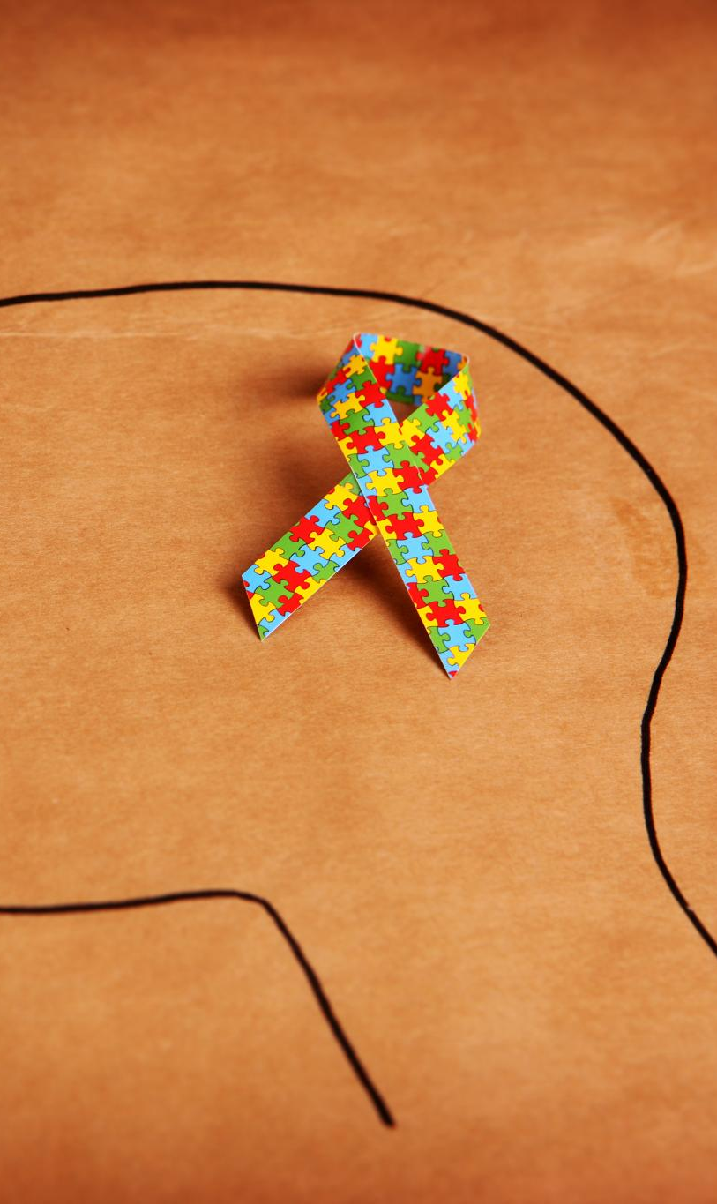
Agenda for Today's Discussion
Understanding Youth Mental Health and the Impact of Cyber Bullying
The Importance of Mental Health Awareness
Promoting Mental Wellness
Notes:
In today's presentation, we will first explore the fundamentals of youth mental health, including common issues and their symptoms. Next, we will discuss the significance of mental health awareness and strategies to reduce stigma. Then, we will delve into ways to promote mental wellness, support systems available, and strategies to effectively address mental health challenges faced by youth.

Slide 3
Understanding Youth Mental Health
Notes:
Youth mental health is a crucial area of focus, as mental health challenges can significantly impact young people's lives. Understanding the common issues, symptoms, and influencing factors is essential for effective support.

Slide 4

Mental wellness is a balance of the mental, physical, spiritual, and emotional. This balance is enriched as people have:
HOPE for their future and those of their families that is grounded in a sense of identity, unique Indigenous values, and having a belief in spirit
a sense of BELONGING and connectedness within their families, to community, and to culture
MEANING and an understanding of how their lives and those of their families and communities are part of creation and a rich history
a sense of PURPOSE in their daily lives whether it is through education, employment, care-giving activities, or cultural ways of being and doing

Slide 5
Indigenous Social Determinants of Health
Cultural identity, family and kinship, country, and caring for country
Knowledge and beliefs, language, and participation in cultural activities
Access to traditional lands
Racism
Early childhood development, education, and youth
Employment and income
Housing, environment, and infrastructure
Interaction with government systems and services
Law and justice
Health Choices
history, political climate, economics, and social contexts

Slide 6

Factors Affecting Youth Mental Health
Family Dynamics
Family dynamics play a crucial role in shaping a youth's mental health, influencing emotional well-being and coping mechanisms.
Peer Relationships
Healthy peer relationships can enhance youth mental health, while negative interactions may lead to stress and anxiety.
Bullying and Social Media
Societal Expectations
Societal expectations can create additional stress for youth, affecting their self-esteem and mental well-being.
Notes:
Several factors can affect youth mental health, including family dynamics, peer relationships, academic pressure, and societal expectations. Understanding these factors can help in developing effective support strategies.

Slide 7

Notes:
Discuss with the possible ill-effects of parents and caregivers spending too much time using technology rather than engaging their kids.

Slide 8
Elder
Deficit
Disorder
Notes:
“Another challenge facing young people is something Dr. Brendtro calls, ‘Elder Deficit Disorder’. Young people are spending less time with caring adults than they once did and this has resulted in a critical shortage of role models and learning of tradition, respect, social skills, communication, etc.”

Slide 9
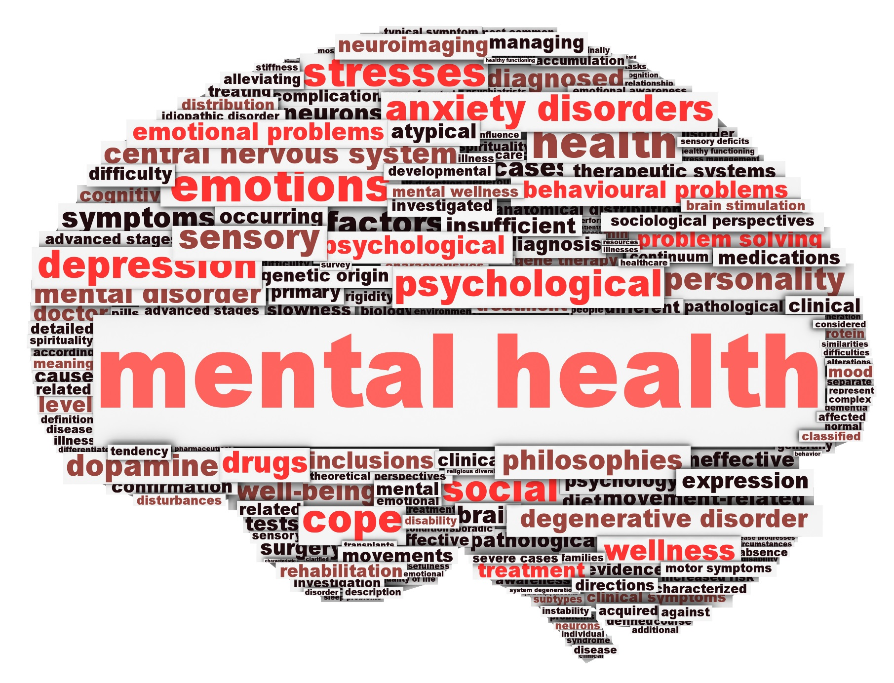
Common Mental Health Issues Among Youth
Anxiety Disorders
Anxiety disorders are among the most common mental health issues in youth, affecting their daily functioning and well-being.
Mood Related Disorders
Depression in youth can significantly impact their mood, behavior, and overall health, requiring attention and support.
Eating Disorders
Eating disorders are serious mental health conditions that can affect youth's physical and emotional health, requiring early intervention.
Self Harm
Youth may engage in cutting, burning, piercing or other forms of self harm.
Suicide
Youth may feel a sense of hopelessness and no escape which could lead to suicidal ideation or suicide.
Notes:
Common mental health issues among youth include anxiety disorders, depression, attention-deficit/hyperactivity disorder (ADHD), and eating disorders. Awareness of these conditions is vital for early detection and intervention.

Slide 10

What is CyberBullying?
Flaming: broadcasting offensive messages about a person in the hopes of getting a reaction
Outing: sharing personal or embarrassing information about someone on the Internet
Trolling: Trolling refers to posting content or comments with the goal of causing divide
Name Calling: using offensive language to refer to other people
Spreading False Rumors: making up stories about individuals and posting them online
Sending Explicit Images or Messages: sharing explicit images or messages without the consent of the victim
Cyber Stalking/Harassing/Physical Threats: repeated comments of threats towards an individual

Slide 11
Why do people cyberbully?
To gain popularity
Lack of consequences
Less chance of getting caught
It has become accepted
Access
No feedback from victim
To increase sense of power or worth
Lack of role models

Slide 12
Characteristics of CyberBullying
Youth who are bullied
Youth who Bully others
Teens and young adults are the most at risk.
Girls are more likely to be victims.
People who are gay, lesbian, bisexual, or transgender may be victims more often.
Those who are shy, socially awkward, or don't fit in
People who use the Internet constantly are more likely to be victims of online bullies.
Impulsivity, aggression, substance use
Youth who have been bullied themselves
Boredom
Loneliness and isolation
Peer group
Experiencing or witnessing violence
Lack of consequences
Notes:
Caution of victim blaming

Slide 13
Signs and Symptoms
Feelings of distress and anxiety about the bullying
Increased feelings of depression
Problems falling asleep or staying asleep (e.g., insomnia)
Increased feelings of fearfulness
Feelings of low self-esteem or self-worth
Social isolation, withdrawing from friend groups, or spending a lot of time alone
Avoiding doing things that they used to enjoy
Increased feelings of anger, irritability, mood swings
Poor academic performance
Problems in relationships with family members and friends
Self-harm
suicide
Substance abuse

Slide 14
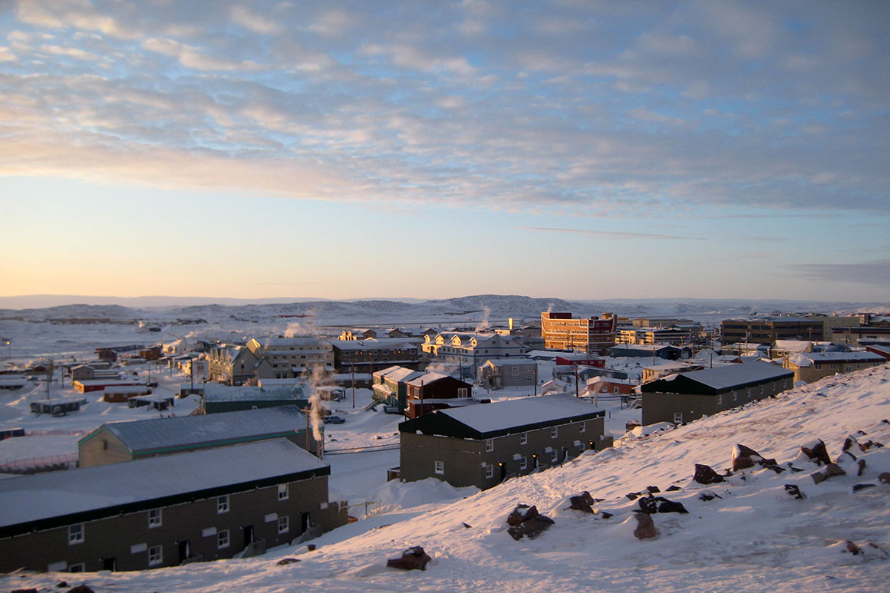


Nunavut Parents Speak out about social media

Slide 15

The Importance of Mental Health Awareness
Notes:
Raising awareness about mental health is essential for fostering understanding and support within communities. Increased awareness can lead to better mental health outcomes for youth.

Slide 16
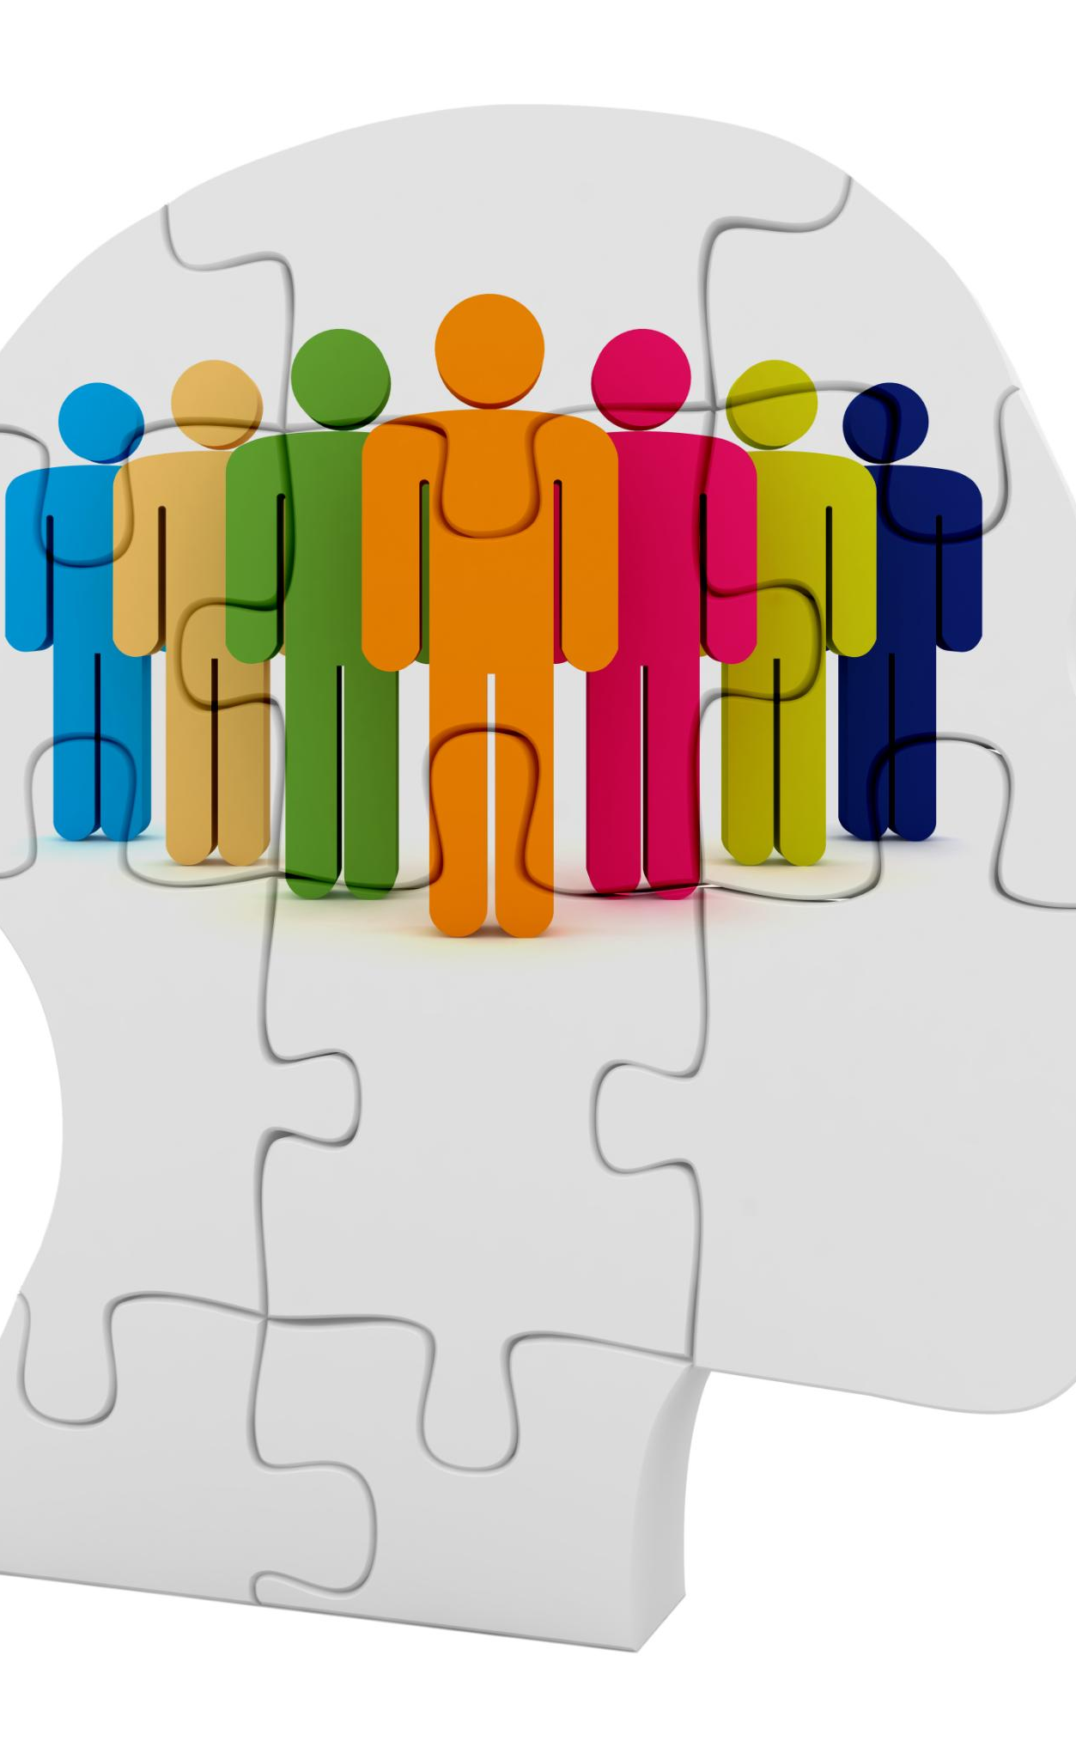
Raising Awareness in Schools and Communities
Mental Health Education Programs
Mental health education programs are essential in schools to promote understanding and awareness of mental health issues among students.
Normalizing Discussions
Normalizing discussions about mental health helps reduce stigma and encourages individuals to seek help when needed.
Support for Struggling Individuals
Creating a supportive environment in schools and communities aids those struggling with mental health issues to feel understood and accepted.
Notes:
Implementing mental health education programs in schools and communities can help normalize discussions about mental health. This initiative encourages understanding and support for those struggling with mental health issues.

Slide 17
Promoting Mental Wellness
Notes:
Promoting mental wellness involves encouraging healthy lifestyle choices and building resilience. These strategies can significantly enhance overall well-being and support positive mental health.

Slide 18


Using Technology and Social Media in a Good Way
Access to Support
Digital tools provide enhanced access to mental health support, especially for youth who may feel uncomfortable in traditional settings.
Mental Health Apps
Mental health apps are valuable resources that offer self-help tools and coping strategies for managing mental health issues.
Increasing our Digital Literacy
There are resources to help us increase awareness about online information and help teach youth to do the same.
Notes:
Leveraging technology and digital tools, such as mental health apps and online therapy, can enhance access to support for youth. These resources can be effective, especially for those who may be hesitant to seek in-person help.

Slide 19
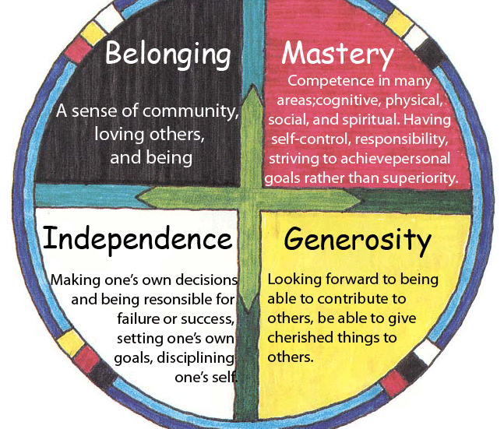
The Circle of Courage

Slide 20










Broken Circles
generosity
independence
belonging
mastery
Notes:
20
“Central to the Circle of Courage model is the understanding that when any of the four universal needs go unmet, one’s Circle can become broken. And when one’s Circle is broken they seek ways to cope. Often times these attempts to cope surface as problematic behavior.”

Slide 21
Building Resilience and Coping Skills
Importance of Resilience
Building resilience helps youth cope with challenges and bounce back from setbacks, fostering emotional strength.
Coping Strategies
Effective coping strategies equip young people with the tools they need to manage stress and anxiety.
Empowerment Through Skills
Empowering youth with coping skills enhances their confidence and ability to navigate life's uncertainties.
Notes:
Building resilience and developing coping skills are essential for youth to navigate life's challenges. Providing tools and strategies for effective coping can empower young people.

Slide 22

Collective Care: School and Community Programs
Mental Health Resources
Access to mental health resources is crucial for youth, promoting awareness and providing training for communities. Mental health supports available for victims and those who bully.
Inclusive Schools
Schools and staff that include mental health and wellness activities support positive outcomes for children and youth.
Community Based Wellness
Whole community approaches that include culture, Elders and gatherings, sending clear messages that bullying is unacceptable, bullying prevention activities and role modeling from adults
Notes:
Schools and community organizations offer valuable support programs for youth. These programs often include counseling services, peer support groups, and mental health resources.

Slide 23

The Role of Physical Activity in Mental Wellness
Mental Well-Being
Regular physical activity is linked to significant improvements in mental wellness and emotional well-being.
Endorphin Release
Exercise promotes the release of endorphins, which are natural mood lifters that help reduce feelings of stress.
Stress Reduction
Regular exercise helps to reduce stress levels, allowing individuals to better manage their daily challenges.
Notes:
Engaging in regular physical activity can significantly improve mental wellness. Exercise promotes the release of endorphins, reduces stress, and enhances overall mood.

Slide 24

Youth Resilience Toolkit

Slide 25
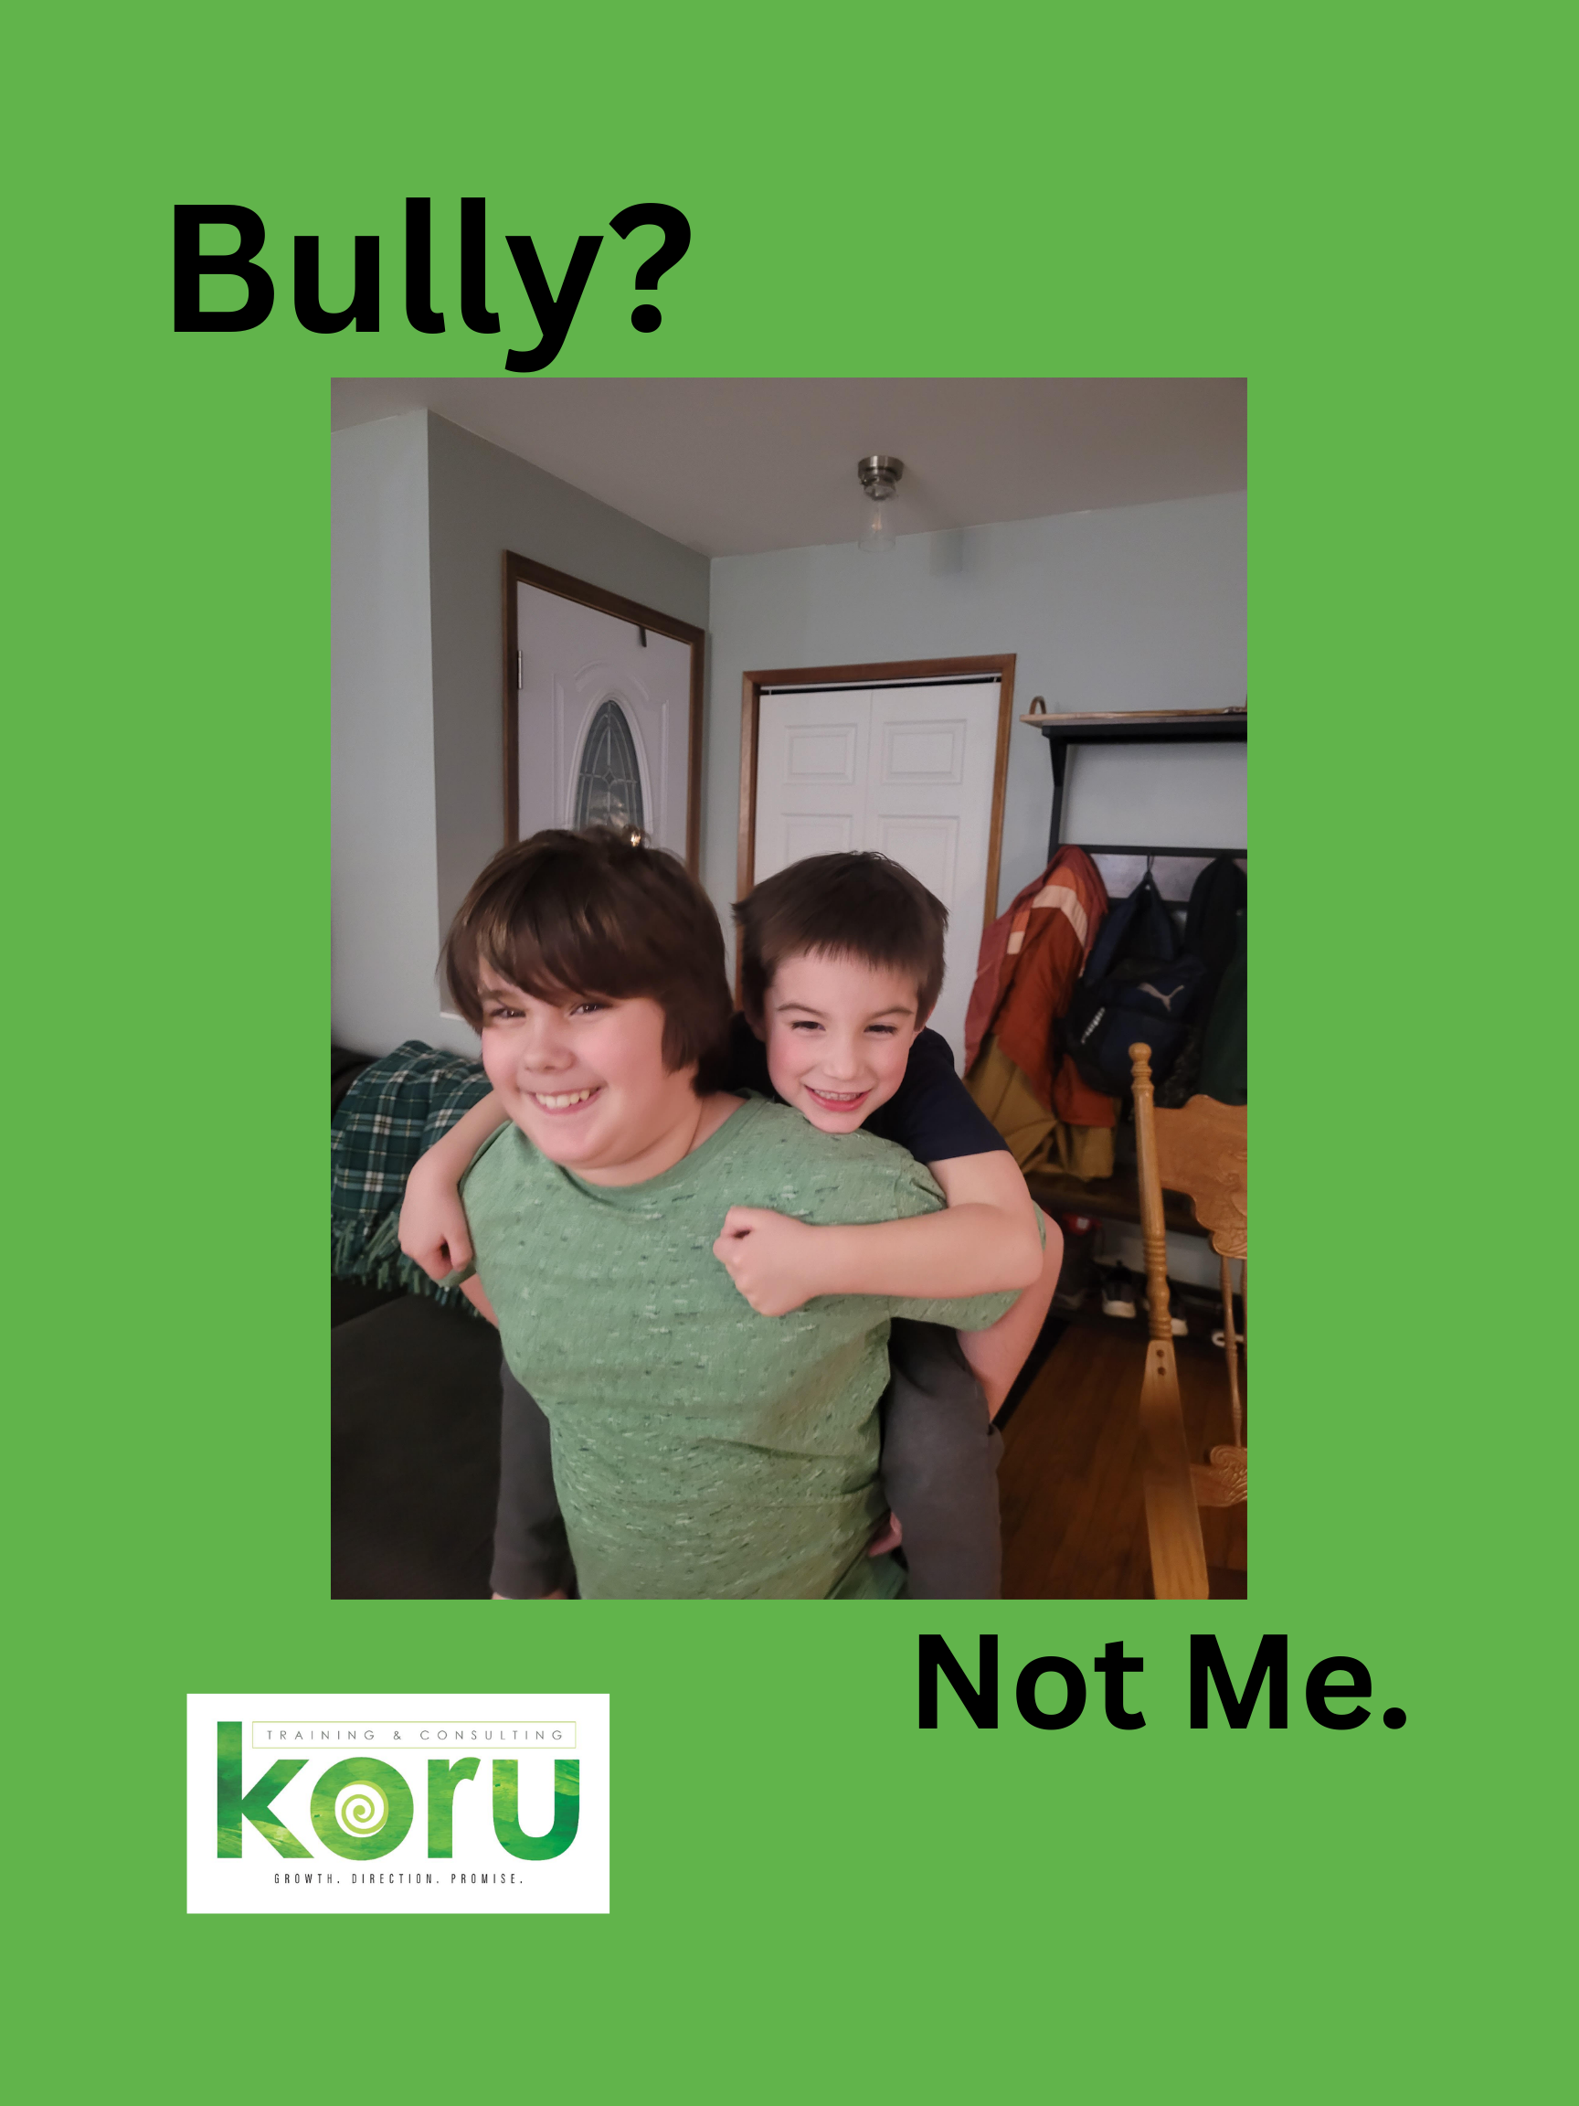
The Kindness Campaign

Slide 26
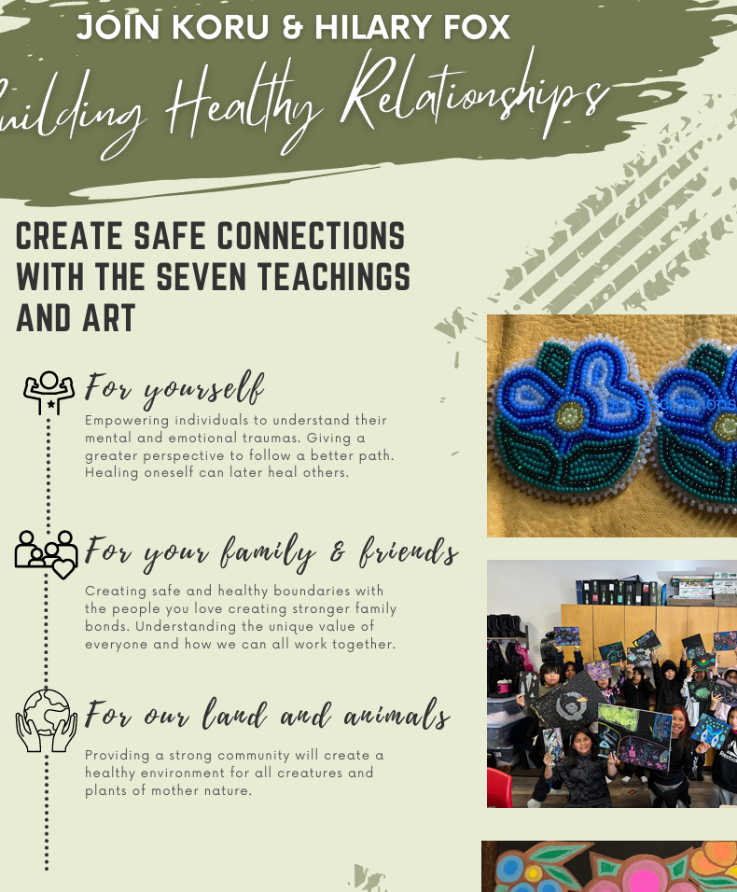
Healthy Relationships

Slide 27
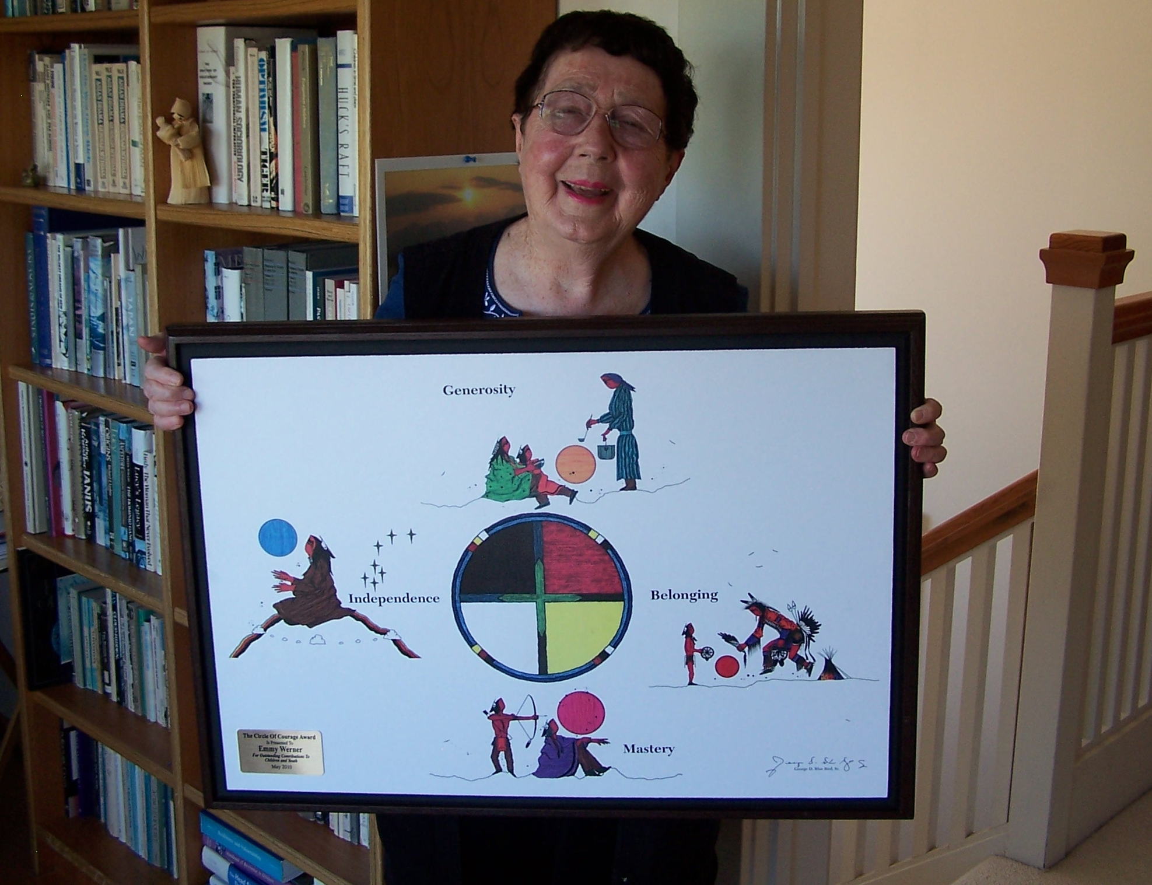
EMMY WERNER
American developmental psychologist
40-year old study of all 698 children born on the island of Kauai in 1955
Risk factors & “protective factors”
Notes:
“What was Urie Bronfenbrenner’s famous quote three slides back? (Allow participants to respond) He said, ‘every child needs at least one adult that is irrationally crazy about him or her’. His statement is backed up by the incredible research conducted by this woman. Emmy Werner is an American developmental psychologist known for her 40-year study of all 698 children born on the island of Kauai in 1955. Her study revealed risk factors for problems later in life, much like the ACE study does. But her research also indicated that there are ‘protective factors’ that improve a person’s chances of overcoming adversity and being successful. Chief among these factors is having at least one carding adult in their life that they are bonded to and can rely on; someone who loves them unconditionally. Sounds a bit like Bronfenbrenner doesn’t it? How should knowing this influence the way we go about our jobs in the care of young people?” Discuss responses. It is important to note a few things during this discussion: 1.) you may be the only person in a child’s life is going to be that caring adult who they can rely on, and you may not even know it, 2.) we cannot be this person to every child, it would be emotionally and physically exhausting, and 3.) because of this, teams and strategy are important so that every child in our settings has someone looking out for them.

Slide 28

Mental Health in the North Collective Safe Keeping - Debriefing Collective Care – Healing Informed Self Care Indigenous Harm Reduction Healthy Relationships Youth Voice Case Management Circle of Courage Sharing Spaces Community Wellness Planning Team Building with a Purpose
www.korudirection.com
korudirection@gmail.com
Follow on Facebook.

