Slide 1
Oshki-Pimache-O-Win: The Wenjack Education Institute’s Progress Towards Developing Culturally-Centred Programs for Classroom Assistant and Anishinaabemowin Language
Siigwan 2025 NAN Education Directors Forum
May 13, 2025
Raven Linklater
Samantha Servi
Emily Drake
Notes:
2:00 -2:!5 break Use this time to put buckets of supplies on the tables
2:15 -3:15 Presentation
60 Minutes
5 minutes Slides 1-7
9 Minutes Slide 8 (46 minutes left)
5 Minutes Slide 11 (41 minutes left)
Buckets for table talk
-pens, pencils, markers, note pads, flip chart, Post IT notes

Slide 2
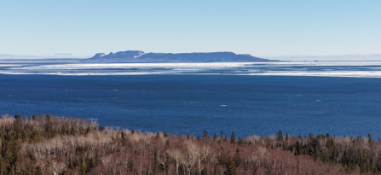
Land Acknowledgement
Oshki-Wenjack respectfully acknowledges its campus is located on the traditional lands of the Anishinaabe peoples of Fort William First Nation, Signatory to the Robinson Superior Treaty of 1850. We also recognize the contributions made to our community by the Inuit and Métis people.
2
Notes:
Photo: View of “Sleeping Giant” peninsula in Lake Superior taken from Fort William First Nation.

Slide 3
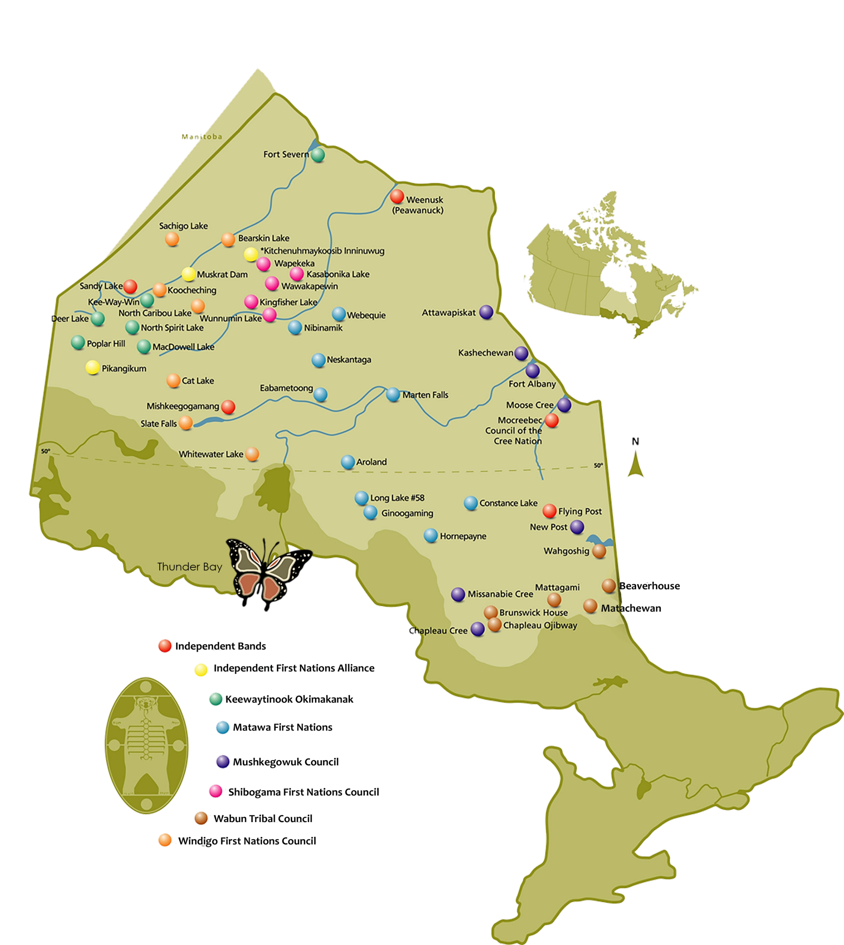

Nishnawbe Aski Nation
Hudson’s Bay
Manitoba
James Bay
49 communities, 45K+ members on- and off-reserve
Quebec
Oshki
Ontario, Canada
540,000 sqkm
www.nan.on.ca
3
Notes:
Oshki-Pimache-O-Win: The Wenjack Education Institute ("Oshki-Wenjack") is situated in Thunder Bay, Ontario, however our mandate is to provide post-secondary education and training to the 49 First Nation communities of Nishnawbe Aski Nation (NAN), in the far north of the province. NAN encompasses James Bay Treaty 9 territory and Ontario's portion of Treaty 5. NAN has a total land mass covering two-thirds of Ontario spanning an area of over 540,000 square kilometers across 2 time zones, bounding Manitoba, Hudson’s and James Bays, and Quebec.
Our people traditionally speak Cree and Algonquin in the east, OjiCree in the west, and Ojibwe in the central south area, with a total population (on and off-reserve) of approximately 45,000 people grouped by Tribal Council. Six of our member Nations are not affiliated with a specific Tribal Council (they are Independent).
Thirty-two communities within NAN are remote and isolated, accessible only by air and winter season roads, many with inadequate employment opportunities, housing, safe drinking water, community services, health services, education, coupled with low incomes, plus a high number of short-term workers coming into communities from the elsewhere.

Slide 4
A New Beginning
Oshki-Pimache-O-Win “A New Beginning” was established in 1996 ‘to provide culturally appropriate education and training programs that meet the needs of the people and communities’ by Nishnawbe Aski Nation Chiefs’ Resolution 96/64, “Nishnawbe-Aski Nation Post-Secondary Education System” and incorporated in 2001.
20th
Anniversary
20
21
4
Notes:
The name was selected by the founding Governing Council members (GC represents the 8 Tribal Councils, plus Elder and Youth representatives and one NAN Deputy Grand Chief).
At the core of Oshki-Wenjack’s mission is the pursuit of self-determination in Indigenous Education. The conventional Canadian education models have proven inadequate for meeting the unique needs of the NAN territory residents, particularly due to the barriers of no all-season road access to most communities and inadequate community infrastructure and services available. Recognizing this gap, the NAN Chiefs established Oshki-Wenjack in 1996 with a shared vision of revolutionizing education. Our mandate outlines our commitment to addressing the holistic educational requirements of the Nishnawbe Aski Nation and other learners within an environment that prioritizes safety, inclusivity, support, and cultural enrichment. We are “Building and Empowering First Nations Futures.”

Slide 5

Our Vision Strengthening Nations through First Nations Education Our Mission Building and Empowering First Nations Futures
Notes:
Newest Strategic Plan 2024-2028
Our Vision Strengthening Nations through First Nations Education Our Mission Building and Empowering First Nations Futures

Slide 6
Mandate
1. To develop, design & deliver post secondary education programs & services to meet the education & cultural needs of the members & communities of NAN & other learners.
2. To enhance, organize & coordinate the delivery of post secondary education & training programs and services which promote and support NAN culture, traditions, teachings, beliefs, language, values & lifestyles.
3. To establish protocols & partnerships with post secondary education institutions & NAN communities at the local, regional, national and international arenas.
6
Notes:
Mandate was developed by NAN Chiefs at the inception of the institution.

Slide 7



Do not edit How to change the design
Audience Q&A
The Slido app must be installed on every computer you’re presenting from

Slide 8
Indigenous Post-Secondary Education under Development
Phase 1
Indigenous College Access Certificate
Phase 2
First Nation Classroom Assistant Diploma
Anishinaabe Language Certificate and Diploma
Notes:
In Phase 1 – We are beginning development of the program
In Phase 2 – working with community and Program Advisory Circles to design program/curriculum
Need the voices of NAN Education Directors to help shape the program to meet the needs of your communities

Slide 9
Can you describe the role of a First Nation Classroom Assistant?
HAVE A TABLE TALK and then record on flipchart/notepad/Post IT. Please describe duties and activities the Classroom Assistant engages in your communities. Write your community on page.
Administrative tasks
Instructional support
Supervising students
Managing classroom behaviour
Supporting Individual learning needs
Other responsibilities
Notes:
7-9 minutes
Ensure they Identify Community on the pages.
Perhaps this is a worksheet with sub headers for the respondents to get inspiration from.

Slide 10
How many individuals are in the Classroom Assistant role in your community?
Please use the worksheet provided at your table to indicate:
Your community
How many individuals are in the Classroom Assistant role in your community
Notes:
I feel this slide is better using interactive app.
Open text. They can write community and number of Classroom Assistants are in their Community.
Or we can add this to the feedback form

Slide 11
We want to hear from you: Anishinaabe Language Certificate and Diploma

Slide 12
Language Survey
We conducted a language survey to gain a better understanding of individual community needs across NAN. We reached out to each Chief and Education Director from NAN communities to share the survey, along with doing online and in-person advertisement at events.
We received 122 responses, with 61 people requesting a follow-up interview.
We received survey responses from 20 different NAN communities. Sandy Lake had the highest response rate, making up 36.8% of the total. This may skew the results. Many Cree communities were unrepresented.
Notes:
5 Minutes

Slide 13
Survey Results
Oji-Cree and Ojibwe had the greatest percentage of speakers and those who wish to learn the language.
Syllabics and roman orthography were both selected as the most desired writing system to learn.
Fluency rates are low, but the desire to learn is high.
Youth and Elder engagement is crucial to sharing the language.
There needs to be accessible language learning opportunities for all ages, both in community and in urban centers.
There is a need for more language teachers, specifically those who work in their community. Additionally, people are looking for resources to learn the language, then become a language teacher.

Slide 14

Do not edit How to change the design
Please share any questions or feedback you have regarding the survey.
The Slido app must be installed on every computer you’re presenting from

Slide 15
Do not edit How to change the design
What is your community? What are your communities’ language goals?
The Slido app must be installed on every computer you’re presenting from

Slide 16

Do not edit How to change the design
What resources would help you meet your community language goals?
The Slido app must be installed on every computer you’re presenting from

Slide 17
More Community Feedback
Requests will be sent to each community’s Chief and Council requesting permission to conduct a survey in their community so that those with feedback on these, and other, new programs under development have an opportunity to share feedback to shape our program to meet NAN community needs.
We wish to copy you on this correspondence: Please leave your contact info (name, email, Community) with us to be included.
Notes:
Introduce feedback form

Slide 18
Miigwetch/Thank you for your time and participation.
Feedback is always welcome and appreciated.
Please reach out any time
(contact information on following slide)

Slide 19
Academic Director Susan Sinclair,
Email: ssinclair@oshki.ca
Campus: 106 Centennial Square, 2nd Floor,
Thunder Bay, ON Canada P7E 1H3
Head Office: 14-656 City Road,
Fort William First Nation, ON Canada P7J 1K3
www.oshki-wenjack.ca
807-626-1880
19

