Slide 1


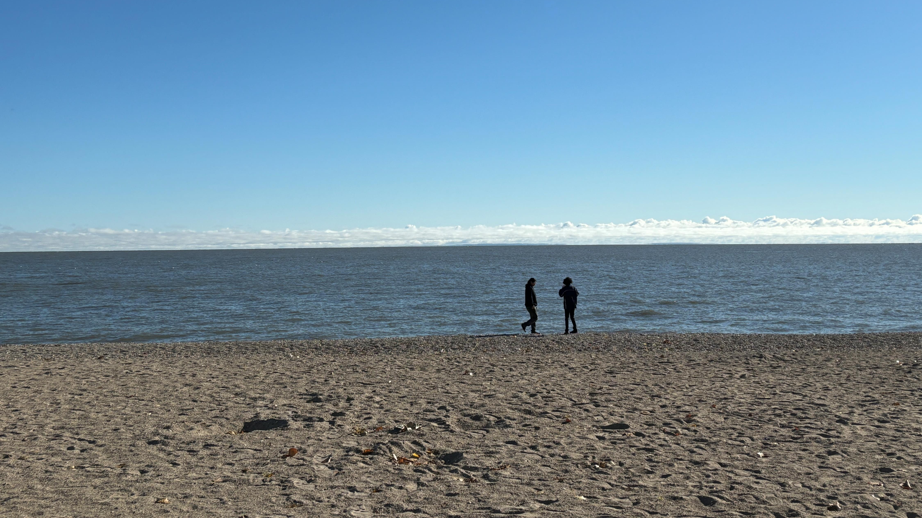

z
Project Based Learning with Indigenous Knowledge
Michelle Arnaud
Wednesday May 22, 2025
Notes:
Boozhoo. Tansi. Aniin everyone. (Introduce yourself). I would like to thank Nishnawbe Aski Nation for inviting me here today to talk about our journey in helping our students becoming land defenders, by tapping into their ancestral knowledge, that their ancestors once did. I want to put it out there that I am not an expert. I am sharing the things that we am doing in our advisory with you. I hope that this gives you some ideas on how to teach and learn projects and sustainability through an Indigenous lens.

Slide 2
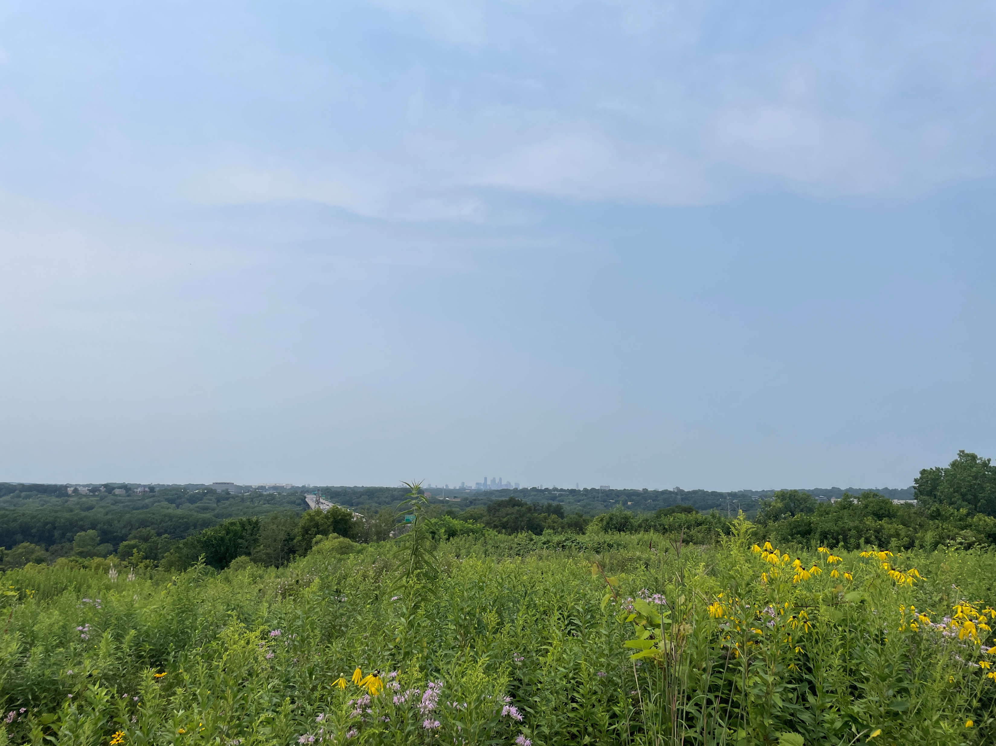
Everything starts with the land
Notes:
Before we start today, I would like everyone in this room to close their eyes for a moment. I want you to think of a place on land that truly makes you happy. A place where everything disappears, where the background noise goes away – it is just you and the land. What does it look like? What does it smell like? What does it feel like? What do you hear? Is there a taste recollection with this land? Are you roasting hot dogs, or eating a sandwich? Can you feel the land between your toes? Is it snow underneath your boots? [Short pause] Open your eyes.
This is my happy place. This is Oheyawahi – Dakota for A Hill Well Visited. Its geographical location is in Mendota Heights, MN – the land of the Dakota people. My ancestors. My 6x great grandmother walked on this land. She lived on this land with her father Chief Great Buffalo who negotiated treaty with President Filmore, and requested that annuity payment be restored to his people. Oheyawahi is a traditional sacred burial ground for the Dakota people, being documented in books kept by historians. It is the most serene and loving place I have been to so far. When you are on top of that hill, you can see the cities of Minneapolis and St Paul; the airport is to your left, Fort Snelling is just down below and up the river a bit. B’dote – where the Dakota people say is the centre of the earth, is just downstream at the confluences of the Minnesota and Mississippi Rivers. The roaring traffic is heard below on Highways 55 and 62. But when I am there and I offer tobacco – the sounds of the highways go away. I hear the birds. I hear the sweetgrass rustling around me. I can smell the wild bergamot and Vervain. You can even hear the wild turkeys if you listen carefully. My feet feel as if they are firmly planted in that land and that I am one with it and the connection to my ancestors. They know I am there the minute my feet touch the ground and I am thankful for them wrapping their loving arms around me and welcoming my spirit back home.
When we say everything begins with the land, we mean it. This also goes for our lessons. Tyler is going to pass around a document. You are going to get 10 minutes to work in your table groups to discuss three things: what do you notice? What do you wonder? And what questions do you have? You can write notes on this copy. We’ll have a brief share at the end.
Everything starts with the land.

Slide 3
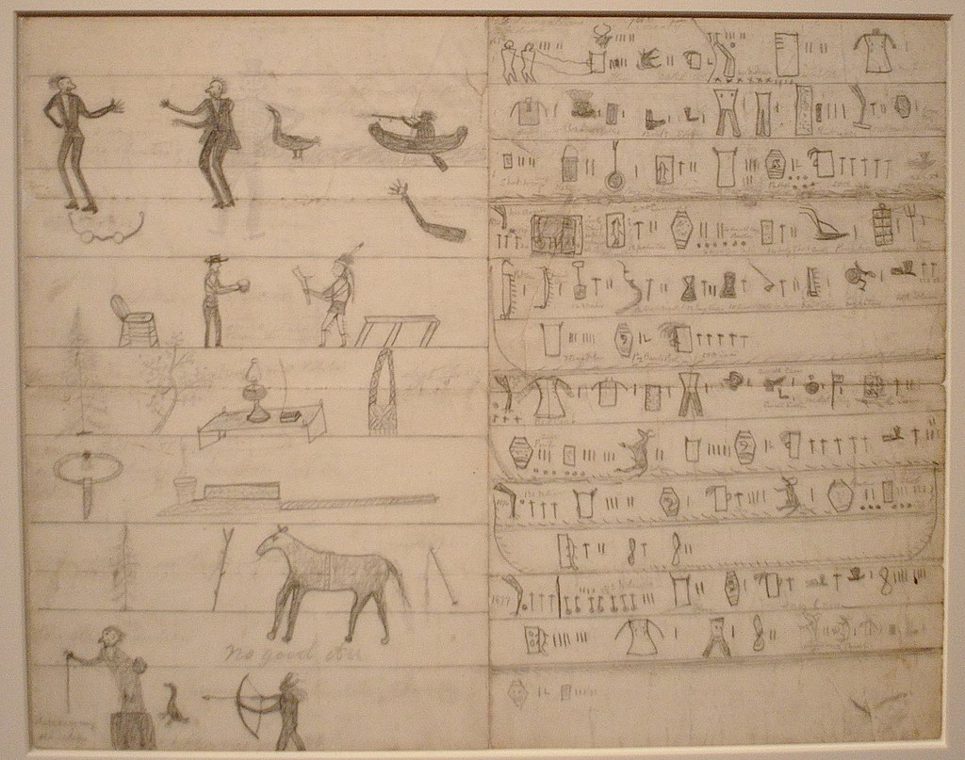
What do you see/notice.
What do you wonder
What questions do you have?
Group Activity – Think, Pair, Share
Notes:
To understand how we introduce content from the curriculum, we are going to lead an activity that we have completed with our students. It was very successful and one of the most engaging activities to date for us. In your table groups you will be given this document here. We hope that you have paper and something to write with. Feel free to write on the document itself, or jot notes on the back. You will individually answer the three questions you see here. Talk amongst your group everyone and these three questions, as we all see things differently. (Time allotment?) Be prepared to share with everyone and select a representative that will share your findings.

Slide 4
Treaty 4 Process
Chief Paskwa
Notes:
The document that you studied is the only Indigenous pictorial representation of a treaty in Canada. It was drawn by Chief Paskwa, who drew the entire Treaty 4 process of the treaty negotiations. The original document was intended for Queen Victoria but was sealed away somewhere in the UK. The Paskwa Nation purchased it back in 2007 and loaned it to the Treaty Exhibit at the Royal Saskatchewan Museum. A descendant of Chief Paskwa has been working on the transcribing since and it has not been an easy progress. He mentioned in an article that Elders and Knowledge Keepers had to be involved. Ceremonies had to be held. Pipes Smoked. He shared that it discussed the issues that needed to be addressed and the ones that weren’t being addressed. We’ve used this document and the map of the Treaty of Selkirk to introduce the Grade 10 Geography unit of Natural Resources. Students need to understand that the reason we extract natural resources is because of treaties.

Slide 5
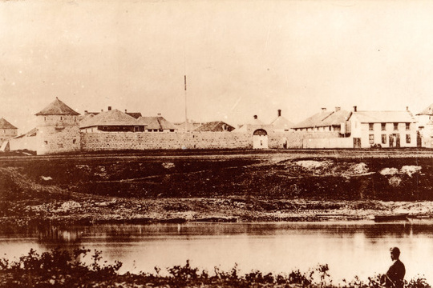
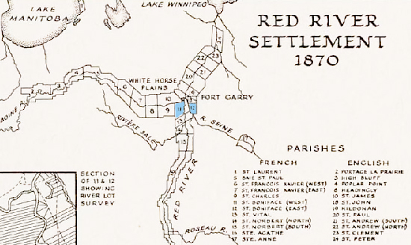
I recognize that I am on the stolen lands of the Anishinaabe, Anisininew, Dakota Oyate, Denesuline, Ininiwak, and Nehethowuk; and the homelands of my people, the Red River Metis. I recognize that Manitoba is also the ancestral lands of the Inuit.
I would also like to recognize the land where all of you are gathering today, on the land that is the Robinson-Superior Treaty; and your Nation located in the James Bay Treaty 9 and the Ontario part of Treaty 5, home of the Anishinaabe Nation, traditional lands of the Anishnaabe, Anisininew and Algonquin People.
Ekosani for allowing me to present today.

Slide 6

Located in the heart of Winnipeg’s North End
Opened in 1991 as “Aboriginal High School”
Children of the Earth was submitted by a student, and adopted
Focus on cultural practices
Daily smudging
Pipe Ceremonies
Teachings
Feasts
Sage Picking in September
Language instruction in Cree and Ojibwe
Notes:
A little about where I teach before I get started on the sustainability focus of this presentation.

Slide 7

The Big Picture model emphasizes students at the center of learning which engages and challenges the student including making learning authentic. Students experience learning through varied methods including workshops, projects, real-world internships, field trips (Leaving to Learn), and community service.
http://www.bigpicture.org
Notes:
Regular teaching – November told we’re changing

Slide 8
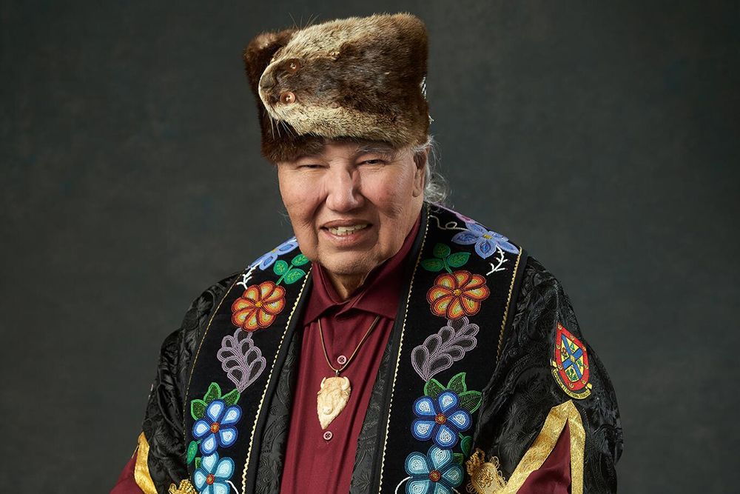
“In order for Indigenous societies to function properly, they must raise and educate children so that they can answer what Elders from all walks and cultures in the world call “the great questions of life.”
Children need to know their personal story. We all need to know the stories of our parents and our grandparents, our direct and indirect ancestors, and our real and mythological villains and heroes.”
Who We Are: The Four Questions for a Life and a Nation”
Mazina Giizhik-iban

Slide 9
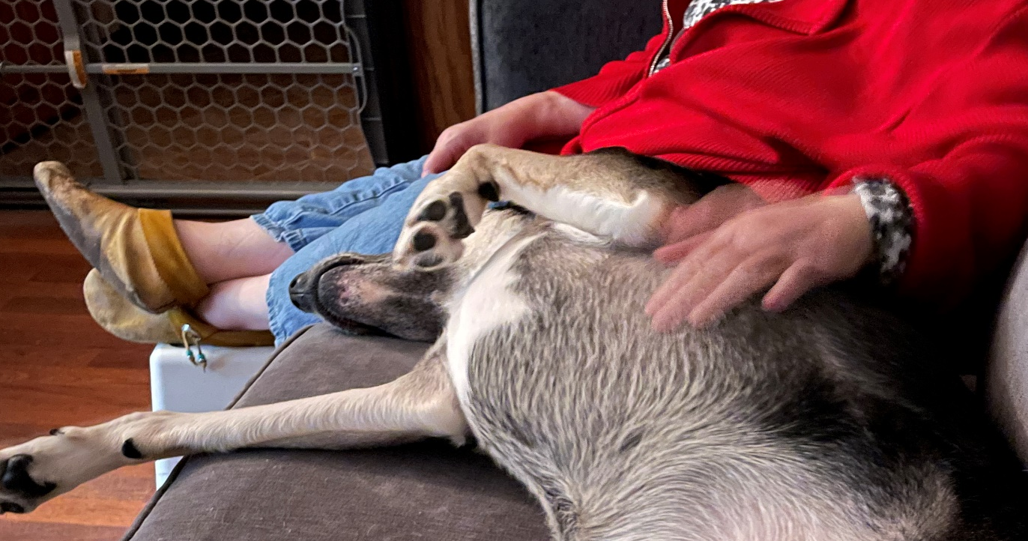
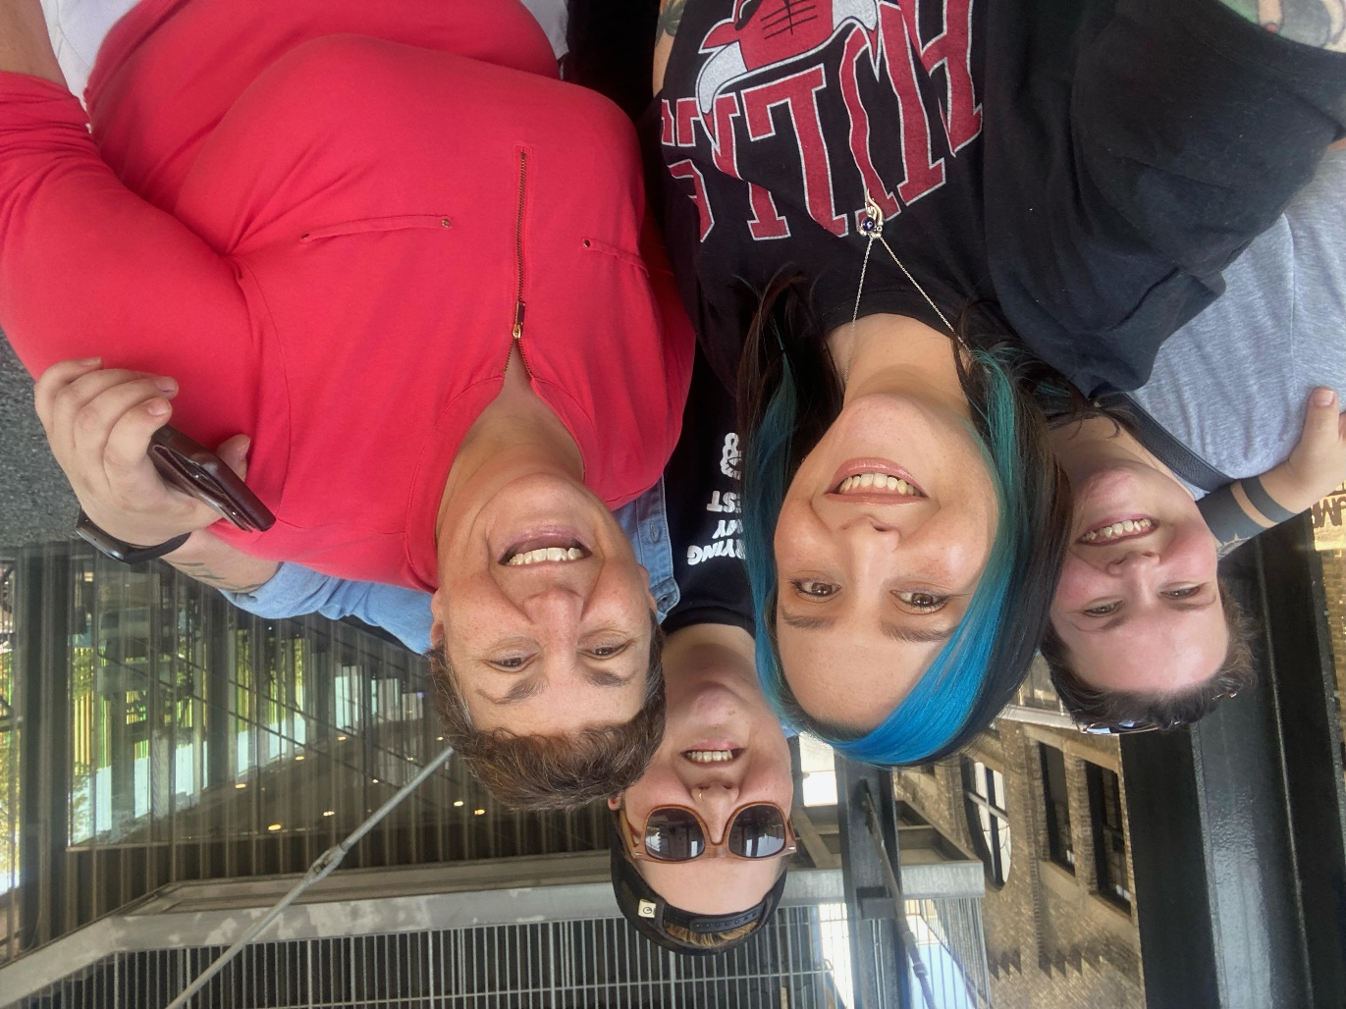
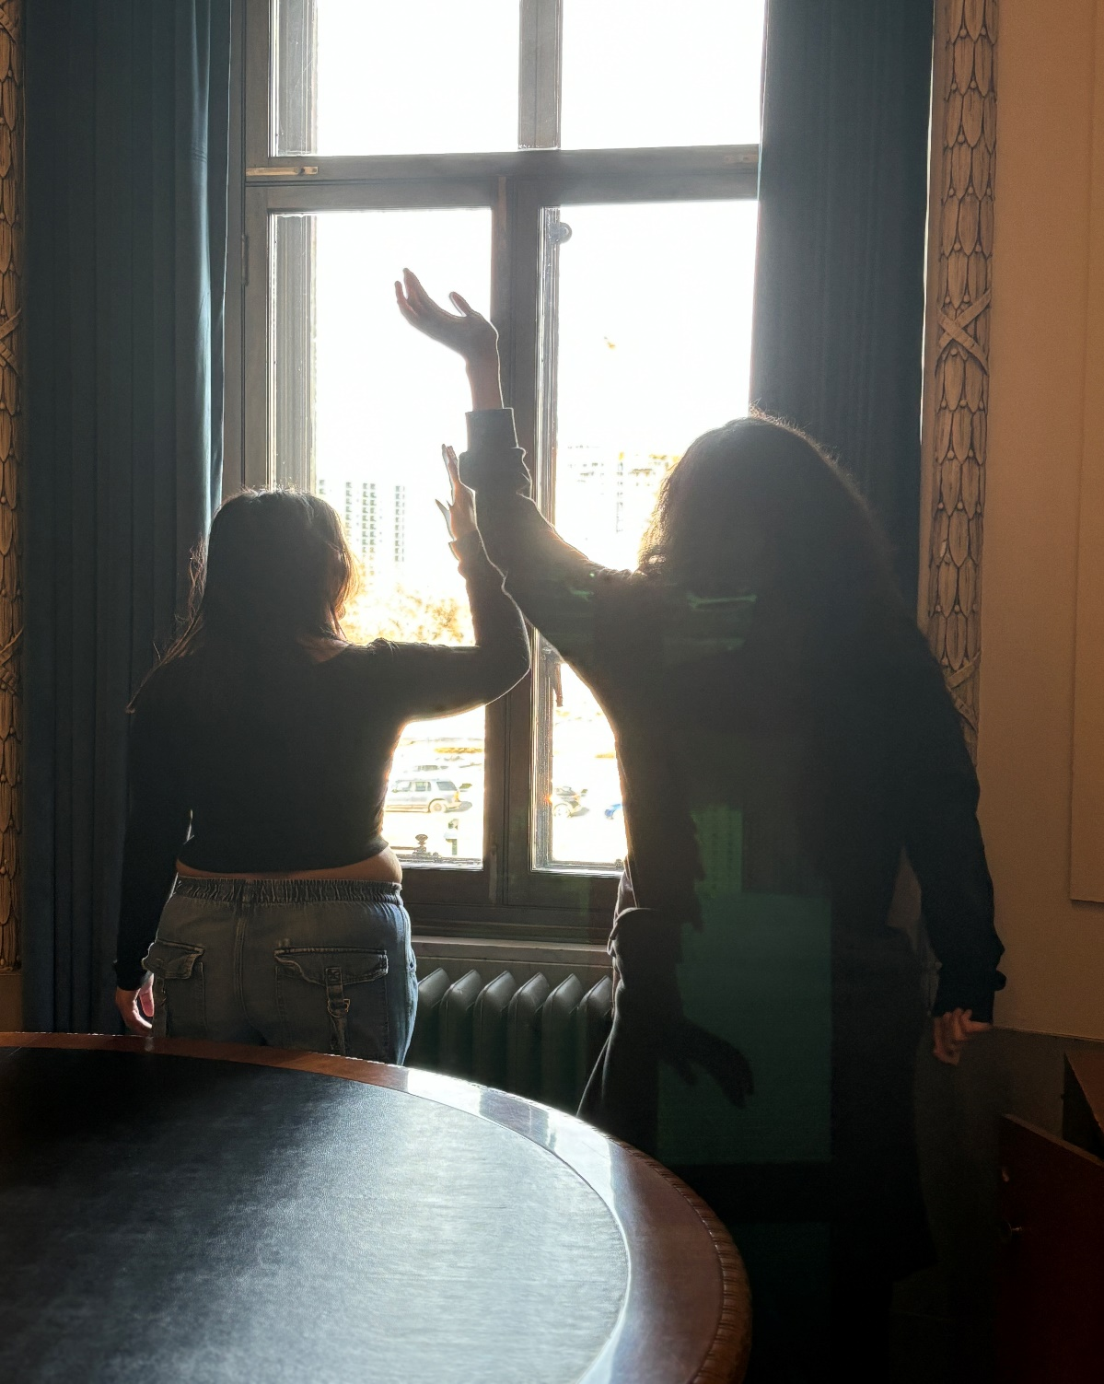
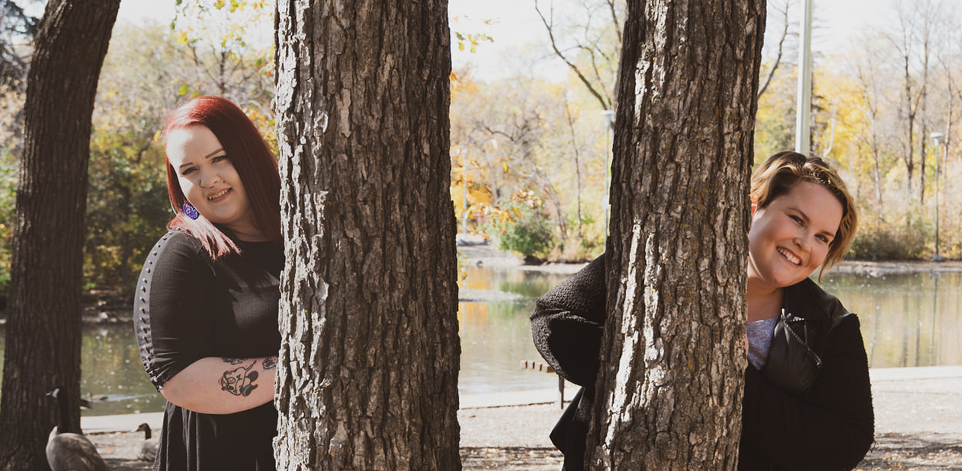
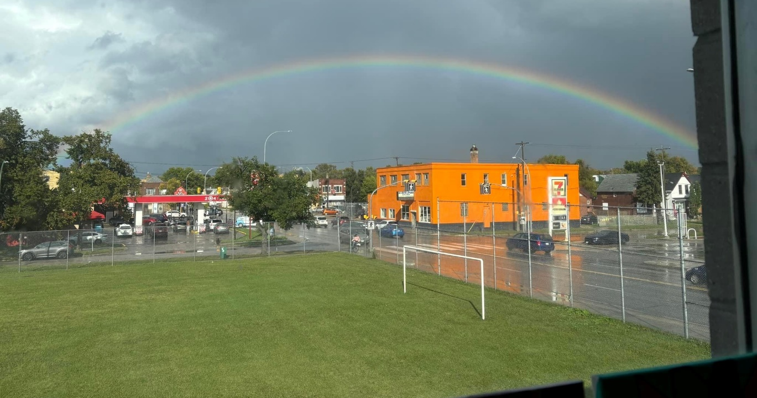
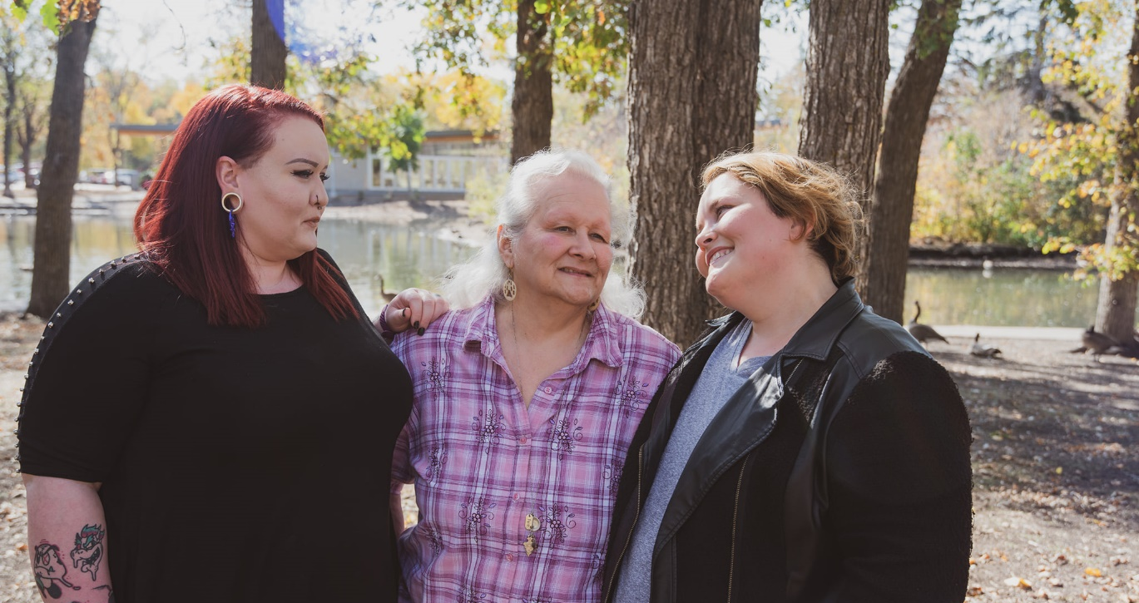
Who Am I?
Notes:
I am going to share with you my responses for each of those four questions. Who Am I? I am a Teacher, Daughter, Sister, Dog Aunty, Friend, North Ender, an Ally, Education Rebel, Lifelong Learner. I am Metis, Cree, Anishinaabe, Dakota, Dene. I grew up knowing I am Indigenous, but I didn’t know what that meant. My great grandmother, a Residential School survivor, did not pass down her culture to my grandpa and his siblings. They did learn it every time they went to visit their mooshum and kookum (whom you will see in the next slide). They were traditional and lived off the land. His kookum was a traditional indigenous medicine woman, using the medicines she grew. As a kid my grandpa would tell me stories, stories which I brushed off because I was a typical kid. It wasn’t until recently that I pieced together, the stories were Indigenous teachings. Sometimes you need that time to figure it all out. I am on an incredible journey of discovering who I am.

Slide 10
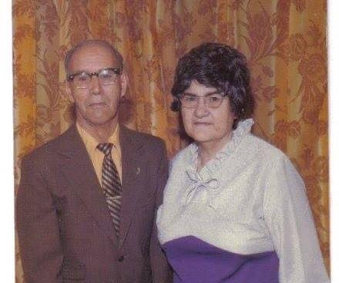
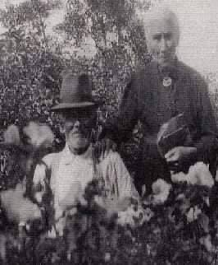
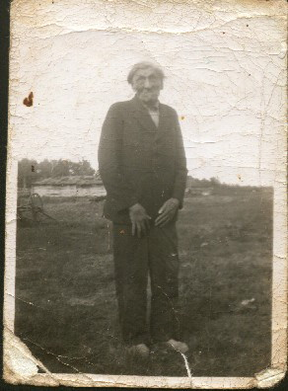
Where Am I from?
I am an Indigenous Ikwe from Treaty 1 territory; ancestral connection to Sandy Bay FN, and the Metis communities of Ste. Rose du Lac, St. Francois Xavier, and St. Andrews. I also have ancestral connections to the Dakota People of Mini Sota; Kiowa, and the Cherokee and Choctaw Peoples of the south.

Slide 11
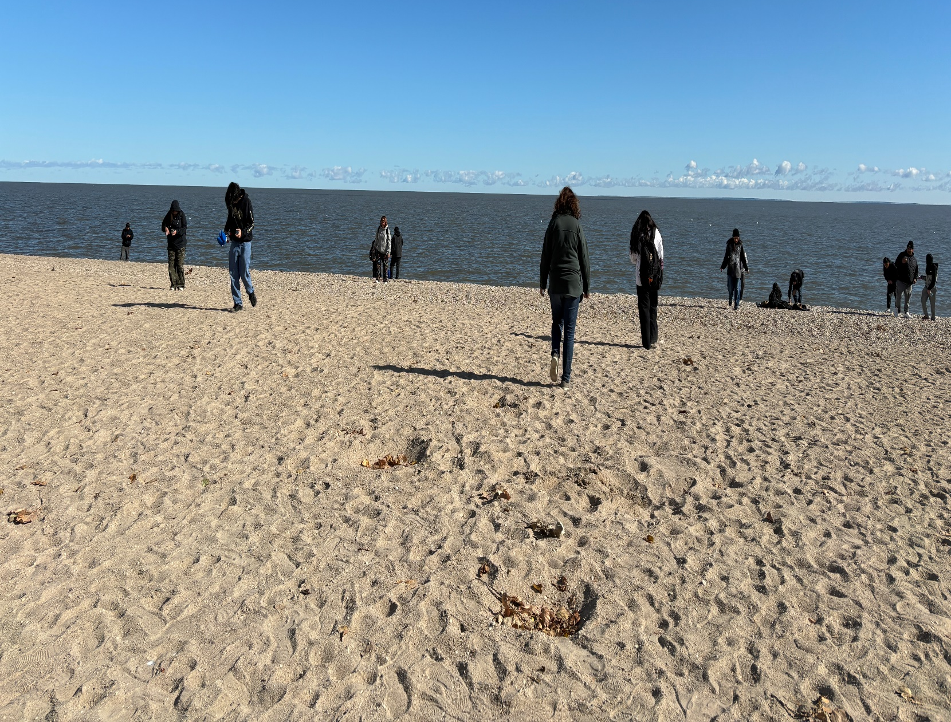
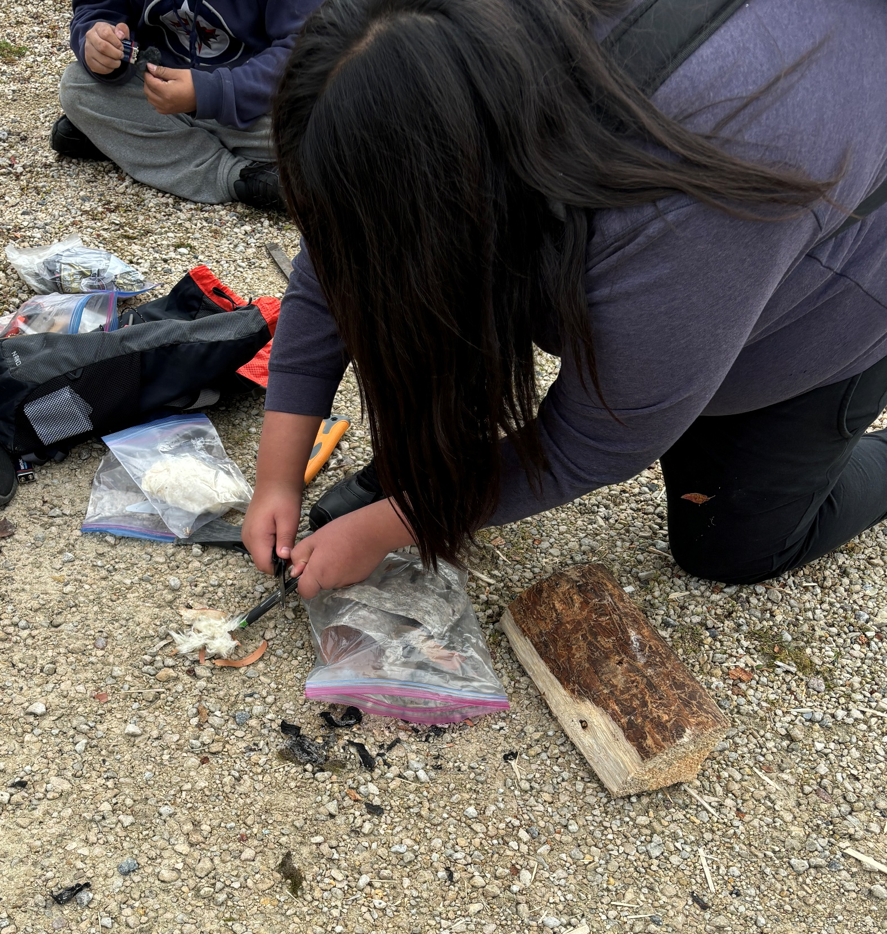
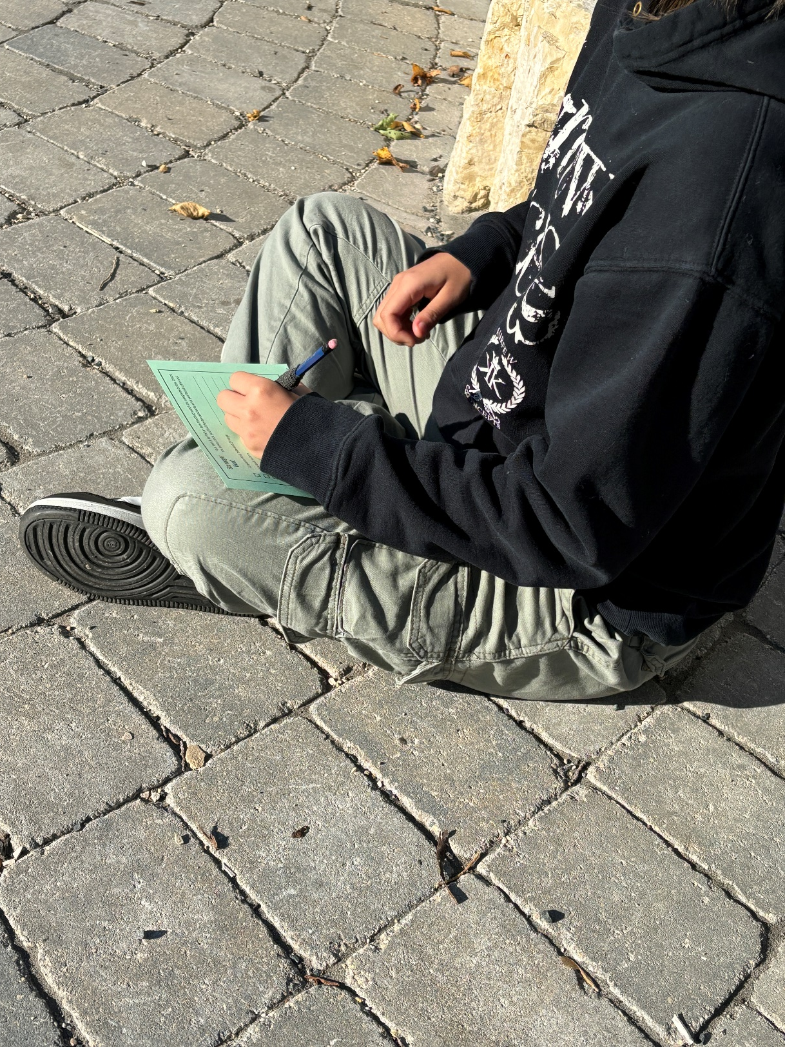

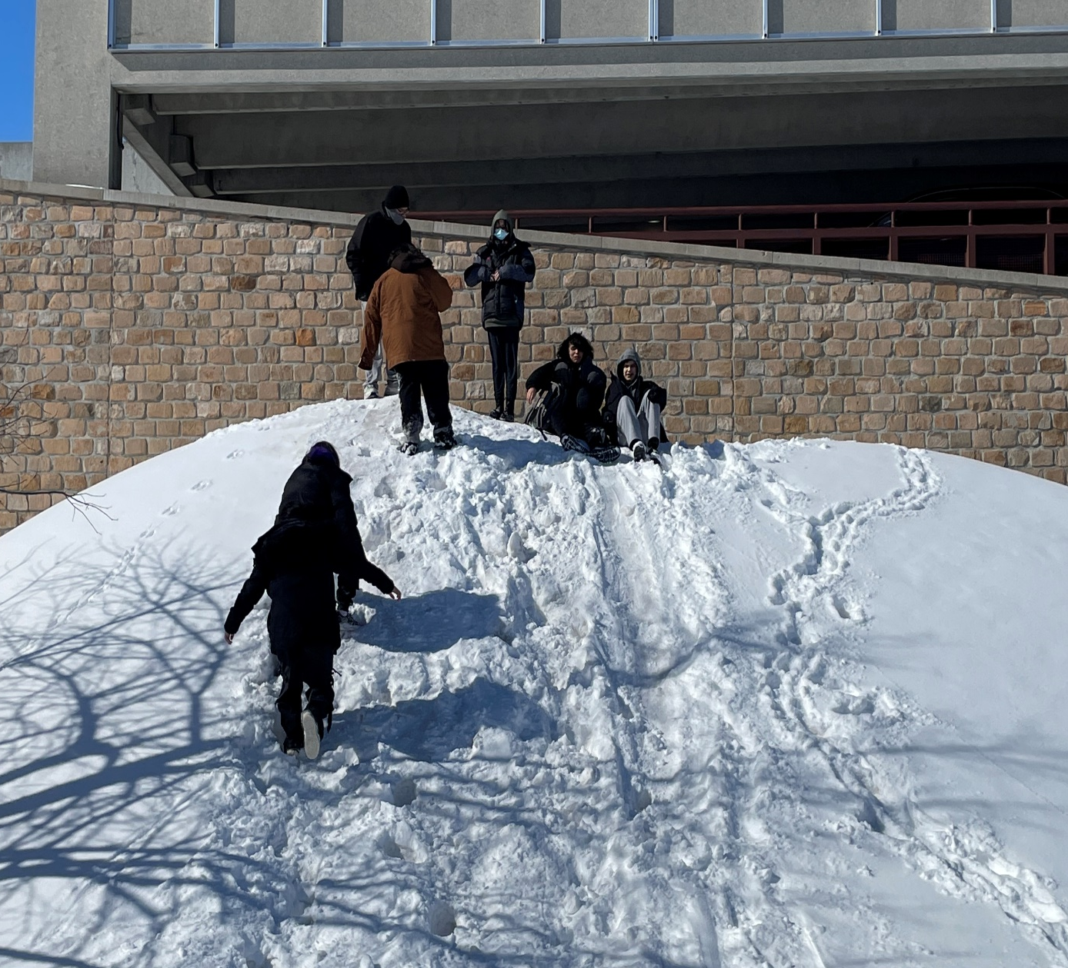
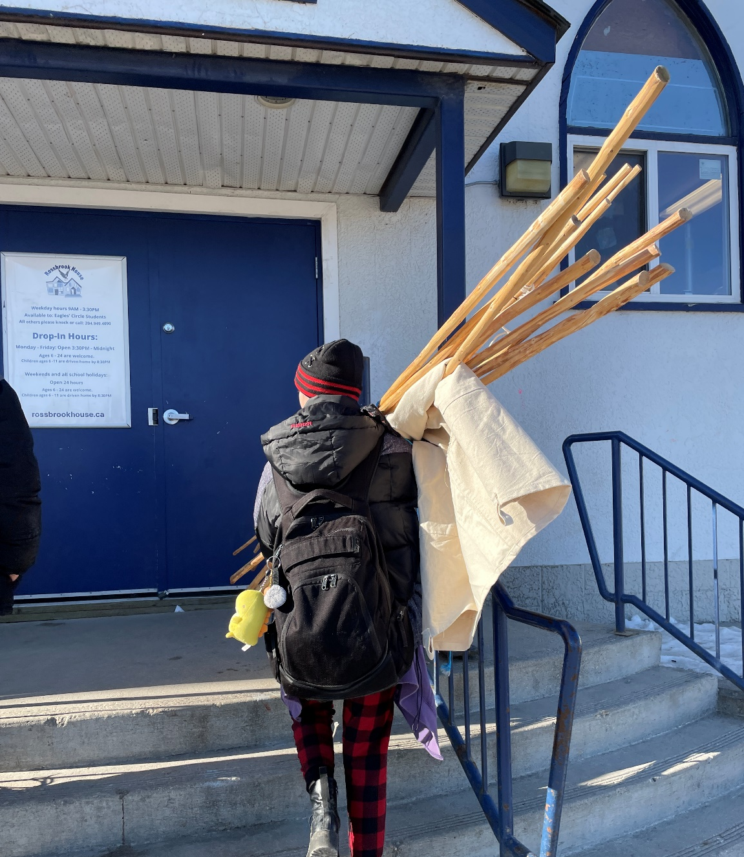
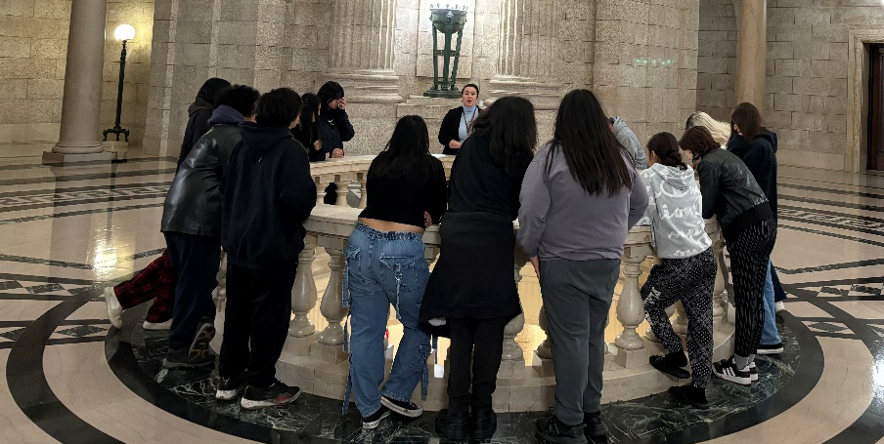
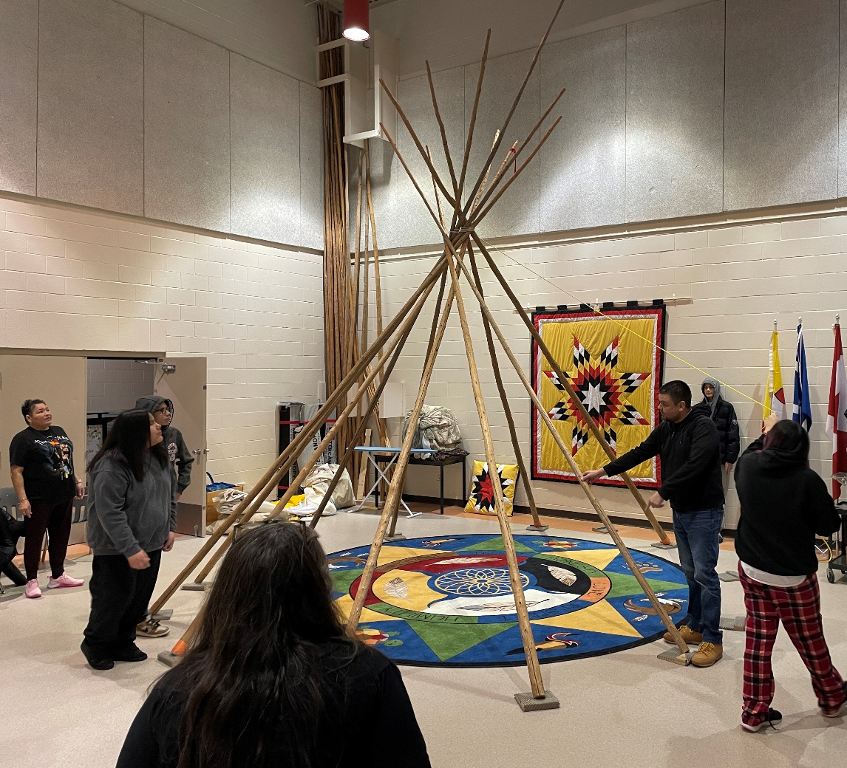
Why Am I Here?

Slide 12
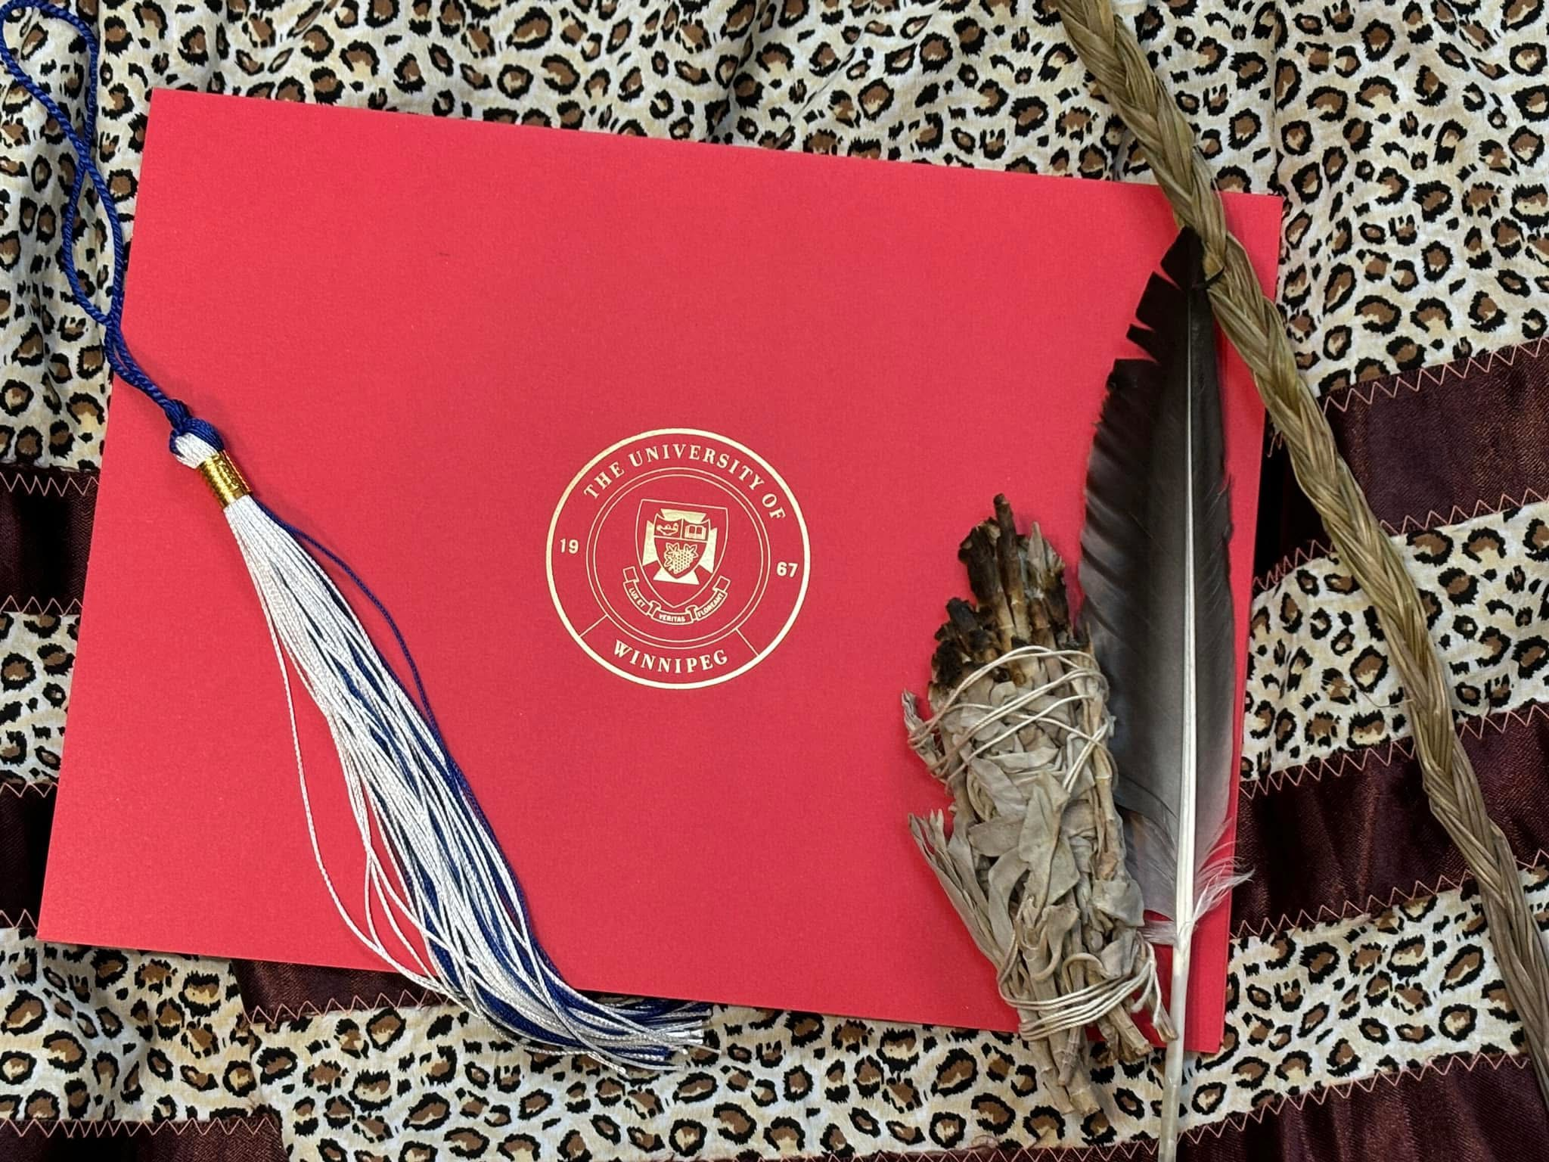
Where Am I Going?

Slide 13
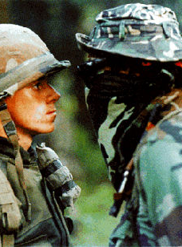
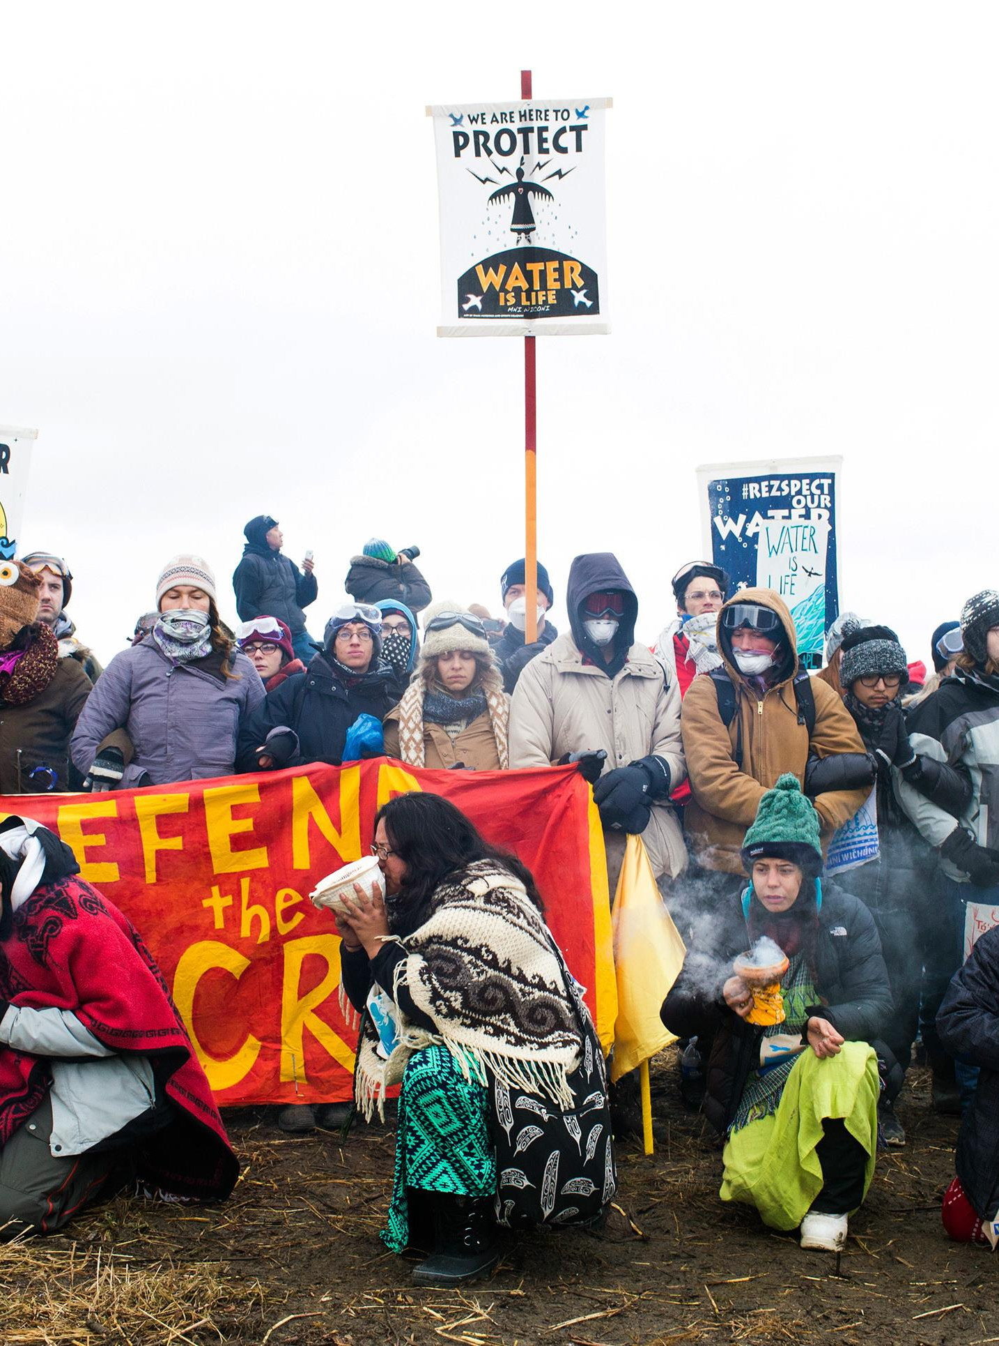
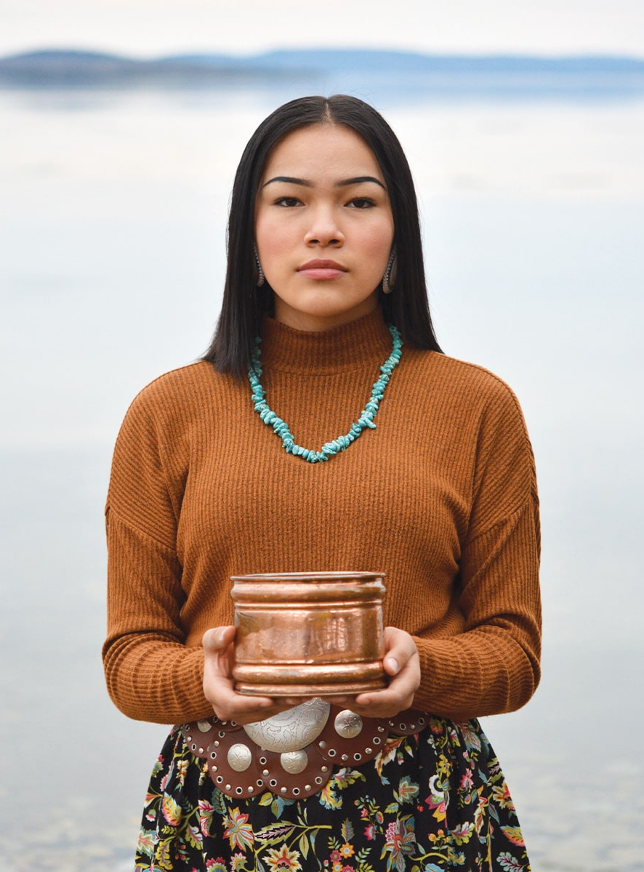
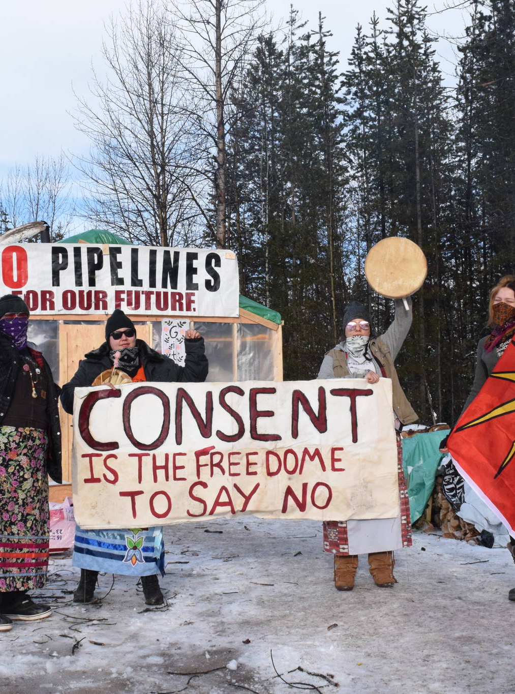
Land Defenders
z
Notes:
When I think of sustainability and land defenders, I think of The Kanesatake Resistance in 1990 (I was 8 but understood), Autumn Peltier; our relatives in Standing Rock, and the grandmothers, mothers, aunties, uncles, and grandfathers of wet'suwet’en. (wet-so-ih-ten). These people are land defenders, with ancestral knowledge to help them be land defenders. But governments have seen them as troublemakers. Problematic.
I never thought of myself as a land defender. I am merely a teacher, with some of the ancestral knowledge that I have been learning; how can I possibly tell a story about being a land defender? Especially about sustainability from an Indigenous perspective? I am only on the start of this journey. It was Dr. Myra Laramee that told me, “my girl… when you feel this way, that humbleness… that humility… That means you’ve reached that part of the teaching on humility where you know yourself.”
But when I was thinking about those very important land defenders, I remembered that I come from land defenders. So I’m going to tell you a little story about me, but a little piece of me.

Slide 14
“…troubled Indians, and troublemakers”
Notes:
I come from a long line of land defenders. Of Indigenous sustainability. The man in this picture is my 4x great-grandfather, Jean Baptiste Spence Sr. His spirit name is Aweypenais Wichewask. I asked our former Cree language teacher if he knew the translation. He said it was old Cree, and it took him a while to translate. He said it roughly means, “Man Who Walks Backwards into the Wind.” It’s funny that’s his name because I have been told by several Elders that I walk backwards into circles. I have always been a backwards person, I start with the end in mind and work my way back to the beginning.
Nichipan (my great-grandfather) was born about 1811 in Cumberland House, SK and died December 18, 1897 in Ste Rose du Lac, Manitoba. He was apparently a very tall man, as you can see by his photo – over 6ft. I have a picture of him with my 4x great-grandmother and she barely comes up to his shoulders in the picture. Do you know what I love most about this photo aside from his smile? His moccasins! Yes, he is wearing moccs! On July 21, 1884 he and his son (my 3x great-grandfather) were elected as councellors to the first chief of Sandy Bay First Nation, also my 4x great-grandfather, Francois Demarais. Their first task was to petition the Canadian government on moving Sandy Bay reserve inland a bit, because it would flood every spring. The original reserve was just a few kilometers south of where it is presently located. They tried three times. The first two times they were denied. The government told them, and I quote, “you stay where we put you.” They urged the government to move the reserve inland because they couldn’t sustain the community due to the annual flood waters – they couldn’t plant the necessary crops they needed to survive off the land. That’s the thing, it’s always about the land and the relationship we have with the land. My people KNEW how to live off the land and what they needed to be sustainable. They were called “troubled Indians, and trouble makers” by the Indian Agents for even trying. On the third time, they finally got a response that they could move. But there was an ulterior motive. They could move alright, but the papers they were tricked into signing were treaty dissolution papers. Jean, his children, grand children (which included my great-great grandmother) were removed from their land, their home, by lies. They were tricked into giving up their treaty status so they could “move inland.” They were also given scrips – which finally solved our question about how a first nation family suddenly became “Metis”. So my kin, along with other members of the reserve, moved to what is now known as Ste. Rose du Lac and were the original inhabitants of that town. During my research into my family history, I obtained a letter from a gentleman who came across Jean and asked about how he felt about losing his status. His response, “I am now a free man. I no longer live by the rules of the white man. I can come and go as I please. I can get back to living the way I once did. I am free.” That saddened me, but also humbled me. Here is a man, who defended the land, his home… lost the land he lived on and was ok with it. It set my trajectory for wanting to learn more about my own history, Indigenous Ways of Knowing/being/living, and Indigenous sustainability.
I have to say that I am okay with being a troublemaker. I am after all his chapan. I am his kin.

Slide 15
Everything starts with the land
Notes:
Before we start today, I would like everyone in this room to close their eyes for a moment. I want you to think of a place on land that truly makes you happy. A place where everything disappears, where the background noise goes away – it is just you and the land. What does it look like? What does it smell like? What does it feel like? What do you hear? Is there a taste recollection with this land? Are you roasting hot dogs, or eating a sandwich? Can you feel the land between your toes? Is it snow underneath your boots? [Short pause] Open your eyes.
When we say everything begins with the land, we mean it. This also goes for our lessons. Tyler is going to pass around a document. You are going to get 10 minutes to work in your table groups to discuss three things: what do you notice? What do you wonder? And what questions do you have? You can write notes on this copy. We’ll have a brief share at the end.
This is my happy place. This is Oheyawahi – Dakota for A Hill Well Visited. It’s geographical location is in Mendota Heights, MN – the land of the Dakota people. My ancestors. My 6x great grandmother walked on this land. She lived on this land with her father Chief Great Buffalo who negotiated treaty with President Filmore, and requested that annuity payment be restored to his people. Oheyawahi is a traditional sacred burial ground for the Dakota people, being documented in books kept by colonizers. It is the most serene and loving place I have been to so far. When you are on top of that hill, you can see the cities of Minneapolis and St Paul; the airport is to your left, Fort Snelling is just down below and up the river a bit. B’dote – where the Dakota people say is the centre of the earth, is just downstream at the confluences of the Minnesota and Mississippi Rivers. The roaring traffic is heard below on Highways 55 and 62. But when I am there and I offer tobacco – the sounds of the highways go away. I hear the birds. I hear the sweetgrass rustling around me. I can smell the wild bergamot and Vervain. You can even hear the wild turkeys if you listen carefully. My feet feel as if they are firmly planted in that land and that I am one with it and the connection to my ancestors. They know I am there the minute my feet touch the ground and I am thankful for them wrapping their loving arms around me and welcoming my spirit back home.
Everything starts with the land.

Slide 16
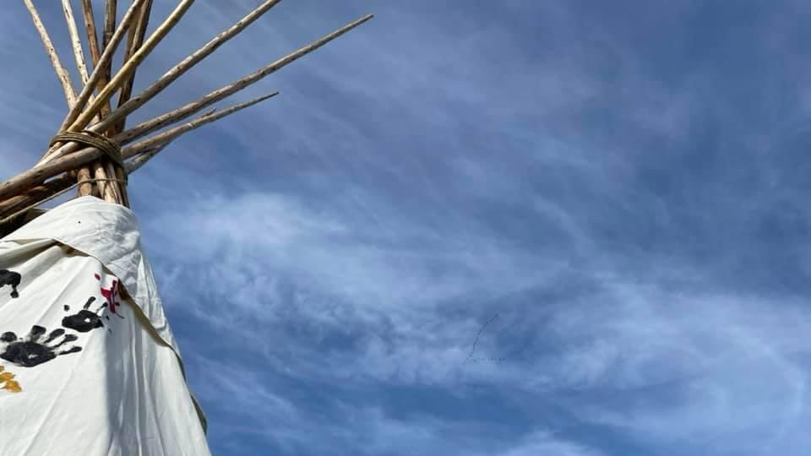
Ask yourself
How do you talk to the land?
If you could talk to the land, what would you say?
What do you think the land would say to me?
What would the land say to me?
Notes:
In his memoir, the Late Murray Sinclair talks about how Elders used to teach us about our relationship with all of creation, the animals, the land, and the sea and water. He talks about Elder Phillip Deere, a traditional Muskogee/Creek healer, and how the following questions were his favourite topic. You have been given a sheet of loose leaf and I would like you to pick one of these questions to answer. You will have two minutes to complete this task. When you’re done, if you have brought your phone with you, I would like you to take a picture and then share it on any of your social media platforms. We need to generate conversations about the relationship we have with the Earth, nimaamaa-aki. Your time starts now.

Slide 17
Treaty 4 Process
Chief Paskwa
Notes:
The document that you studied is the only Indigenous pictorial representation of a treaty in Canada. It was drawn by Chief Paskwa, who drew the entire Treaty 4 process of the treaty negotiations. The original document was intended for Queen Victoria but was sealed away somewhere in the UK. The Paskwa Nation purchased it back in 2007 and loaned it to the Treaty Exhibit at the Royal Saskatchewan Museum. A descendant of Chief Paskwa has been working on the transcribing since and it has not been an easy progress. He mentioned in an article that Elders and Knowledge Keepers had to be involved. Ceremonies had to be held. Pipes Smoked. He shared that it discussed the issues that needed to be addressed and the ones that weren’t being addressed. We’ve used this document and the map of the Treaty of Selkirk to introduce the Grade 10 Geography unit of Natural Resources. Students need to understand that the reason we extract natural resources is because of treaties.

Slide 18
Project Based Learning is Indigenous Education
Notes:
I want to share with you how we used inquiry for project based learning to spark stewardship – how our students could understand our ways of knowing, being, and living. I wanted to make it relevant to the land that we are located on – specifically our school, and then eventually move it out to the bigger picture.

Slide 19

Authentic Involvement
Promote Elder, knowledge keeper, and community involvement
Promote parent, grandparent, and extended family involvement
Putting students at the Centre
Respect and listen to students
Employ a holistic approach to supporting students
Understanding world views, values, identities, traditions, and contemporary lifestyles
Teach true history
Incorporate cultural teachings, experiences, and Indigenous languages
Inclusive and Culturally Safe Learning Environment
Demonstrate respect for world views, values, identities, and traditions
Value and celebrate differences
Individual
ff
Family
Community/Nation
Creation
"A Recognition of Being: Reconstructing Native Womanhood" - Kim Anderson
Mamàhtawisiwin: The Wonder We are Born With – An Indigenous Education Policy Framework; Government of Manitoba (2022)
Notes:
The diagram on the right is what Indigenous Education looked like prior to colonization and the oppressive policies. Children were the center of everything. They were surrounded by their family which included mom and dad, grandma and grandpa, siblings, aunties, uncles, cousins. I also want to point out that aunties and uncles were not just our blood relatives – we call anyone older than us auntie or uncle because we respect them, we seek their guidance and knowledge. Then children were surrounded by their community and nation. Finally, by creation. That is not just Creator, but everything around them – the trees, the land, the plants, the animals.
When we teach sustainability through an Indigenous lens, we are doing all of this. It’s important. So so important.

Slide 20
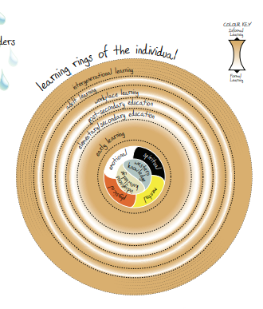
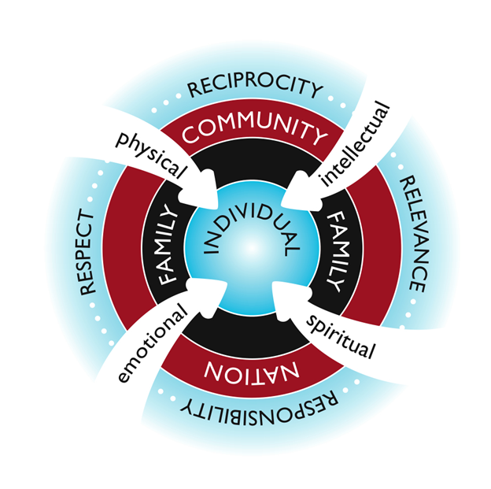
Four R’s of Indigenous Guiding Principles*:
Respect
Relationship
Reciprocity
Responsibility
Two additions:
Relevance
Representation
ff
The State of Aboriginal Learning in Canada: A Holistic Approach To Measuring Success. The Canadian Council on Learning, 2009
Indigenous wholistic framework, 2009
Verna Kirkness and Ray Barnhardt (1991)
Notes:
To take the previous slide further, here is additional learning that is integrated into our learning without even thinking about it: Indigenous wholistic framework, the Four R’s (more so 6 R’s) of Indigenous Guiding Principles, and the First Nation Learning Rings of the Individual continuum.
But for some reason, somewhere, we were made to think that Indigenous education is about just being on the land, putting up tipis, and making Bannock. We put up tipis, but we provide lessons. We allow students to struggle, to nearly bean another person on the head with a pole. This is heart work that we’re doing.

Slide 21
Indigenous Ways of Knowing/Being/Living
IS sustainability
Notes:
We knew the land. We had a beautiful relationship with it. We listened to it. We listened to the water. The air. The animals. The plants. The trees. The land talks to us. It tells us when it is sick. It tells us when the seasons are going to change. It tells us when it’s going to get hot, or cold. Speaking of getting hot, I have a little story to share with you. Have you ever been outside and it smells like horse poop? And you’re not around it? Well, my grandpa told me that was their way of knowing, when out in the bush, when it was going to get really hot. You see, that smell is the chemical change in the air when atmosphere starts to heat up. They knew that soon it would get really hot. So now, in the summer, if the nights get cool and it smells like horse poop – now you know! We were fire mitigators. We took care of the water. We never overconsumed. We used what we needed, and we used everything. Nothing was wasted.
With colonization, this was all taken from us. It was taken from us with oppressive policies that killed our inherent rights. Policies that told us what we could and couldn’t do – like taking care of the land. We were no longer caregivers of the land, but merely occupants, who were told where we could occupy. We were put on land that wasn’t sustainable for us, like I shared with my chapan’s story. Treaties were signed, in good faith, for the use of the natural resources we relied on. To produce electricity they flooded indigenous communities to build dams. They poisoned that water; making fish relocate. They cut down trees. Over fished. Killed off the bison to control our people. Nearly wiped out the beaver population to sent pelts back to England for hats. Forbade us from moving to hunt. We had to ASK permission to do this and were often denied.
Like Mr. Sinclair said, to make a positive change we must acknowledge the hard truth of this country. So in my journey to discover my culture I sat with Elders and Knowledge Keepers like Dr. Myra Laramee, the late Ted Fontaine, Wilfred Buck and his wife Connie (whom I have the esteemed pleasure of working with); Sharon Sky and Elaine Mayham, more colleagues. I recently graduated with my Post-Baccalaurate Diploma in Education, focusing on Indigenous Knowledge. As someone with no connection to community, I had to pay to get that knowledge. I am so appreciative of those who I have learned from like Jackie Connell, Lisa Whitecloud, Kevin Lamaroux, Dr. Laura Forsythe, Myra, and Nikki Ferland. I put down tobacco and prayed for guidance with this new information. I asked nimaamaa-aki (Mother Earth), Creator, and Creation to help me with this new information and use it in a way where others can learn.
With this knowledge, I wanted to share it with my students. So how did I teach it?

Slide 22
How It Started
Notes:
I want to share with you how we used inquiry for project based learning to spark stewardship – how our students could understand our ways of knowing, being, and living. I wanted to make it relevant to the land that we are located on – specifically our school, and then eventually move it out to the bigger picture.

Slide 23
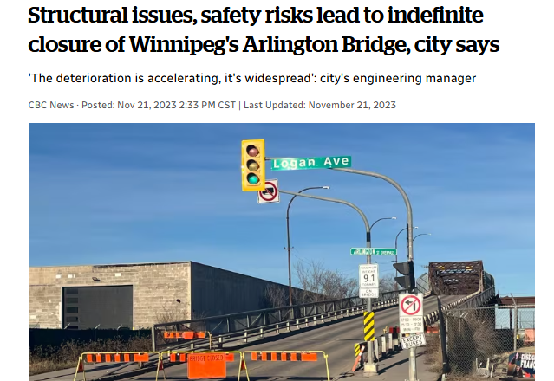
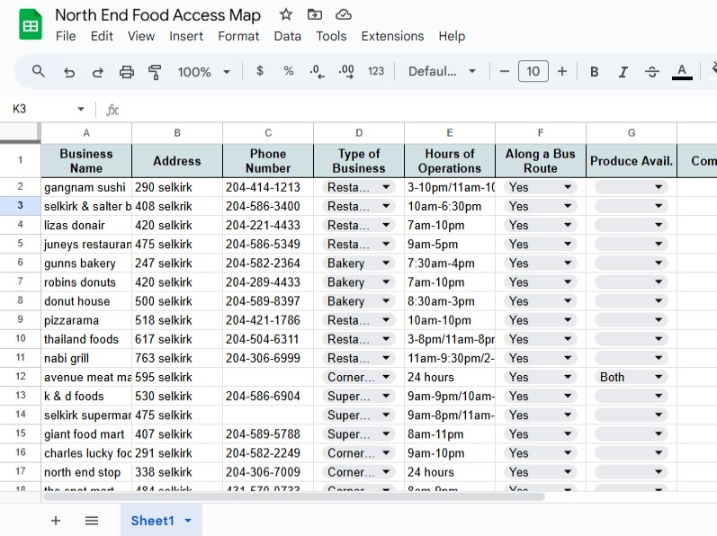
Food Insecurity (Grade 11 Topics in Science)
How is a bridge more than just a vessel to transport vehicles?
Notes:
There is a course here in Manitoba called Grade 11 Current Topics in Science. I wanted to make this completely Indigenous Ways of Knowing, so I did it. I spent a summer while in Minneapolis on vacation, crafting the course I was going to teach. I relied on the teachings I received, I also studied. I taught the students about the medicines and the protocols. We went out on the land around us and studied and listened. That November the Arlington Bridge was closed suddenly. It led to a student asking why the city hated the North End so bad, and by hated, he means the biggest population -Indigenous people. My student was able to see that bridge are more than just a transport vessel for vehicles. It was a means of getting to the other side to access groceries, food. Sure, we have Sobeys Cash & Carry on the north side of the bridge, but that’s about it, aside from Safeway on McGregor and Mountain. So, we took on a task to discover all of the food sources within 5km of the school. While there were only two grocery stores, we compiled a list of restaurants, cafes, bakeries, butchers, fisheries, and convenience stores. We came up with a comprehensive list and stuck it in a Google Sheet. We also had a big map on the wall so they could see the proximity of these places.

Slide 24
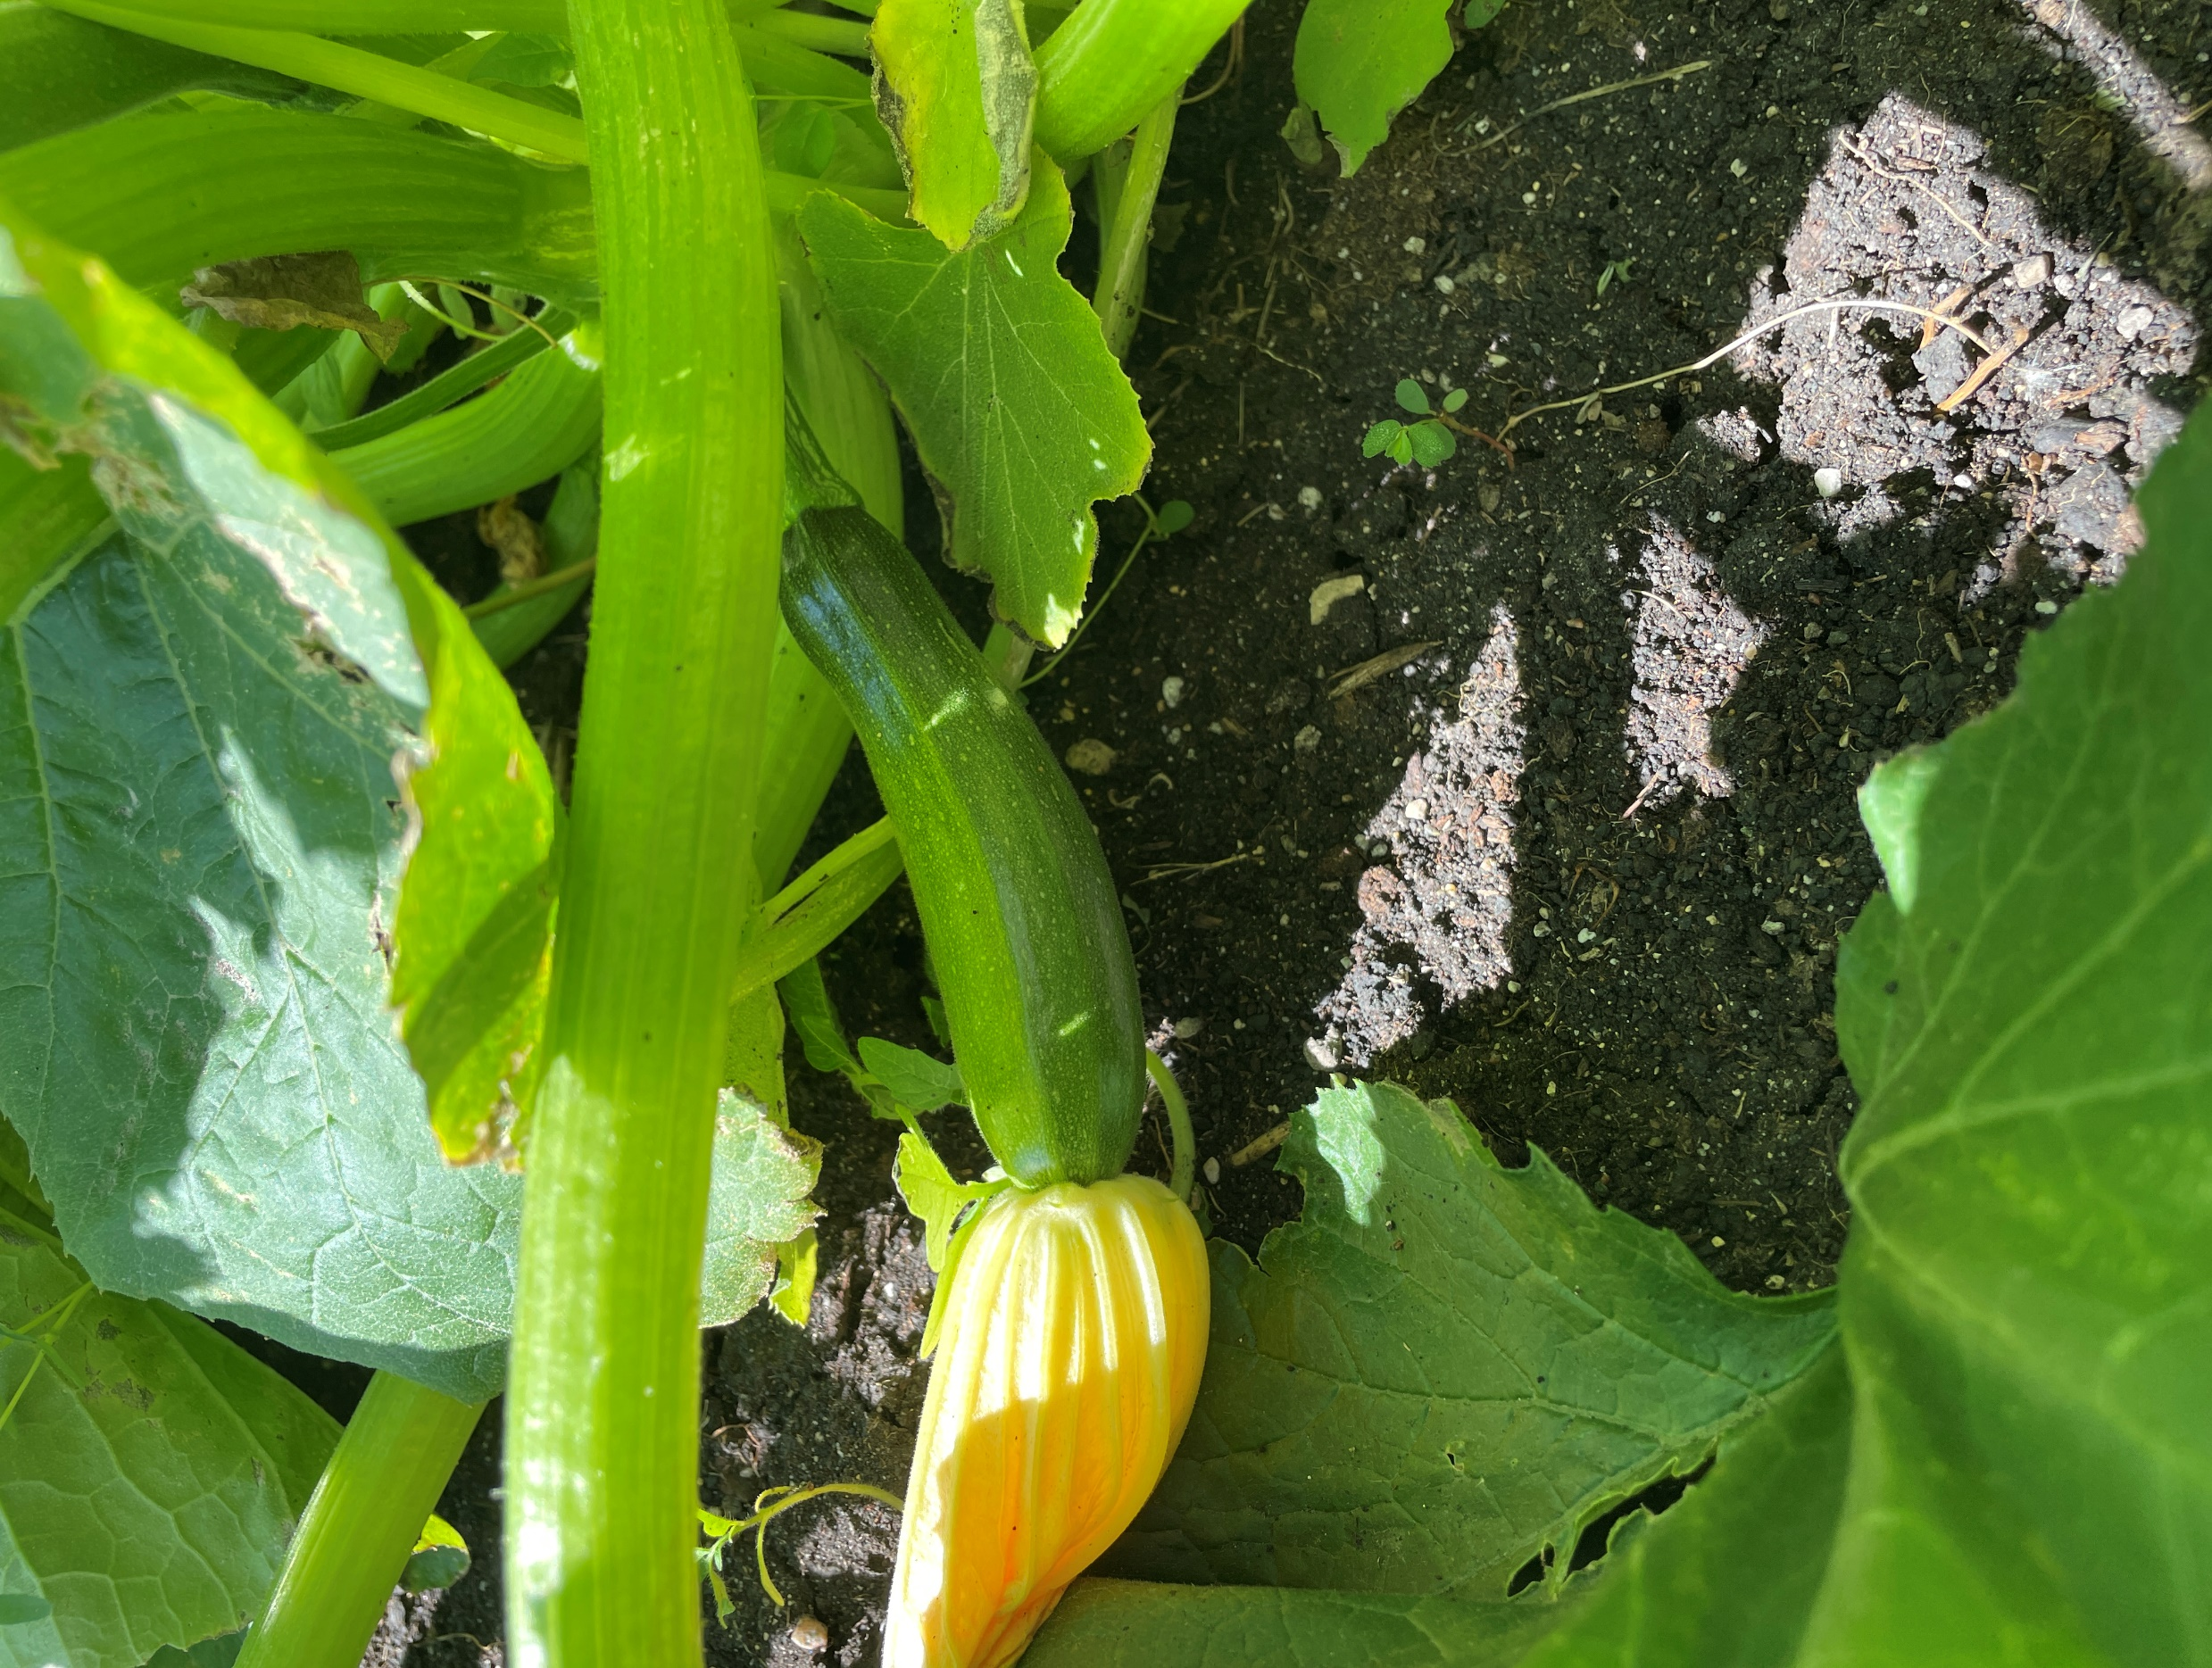
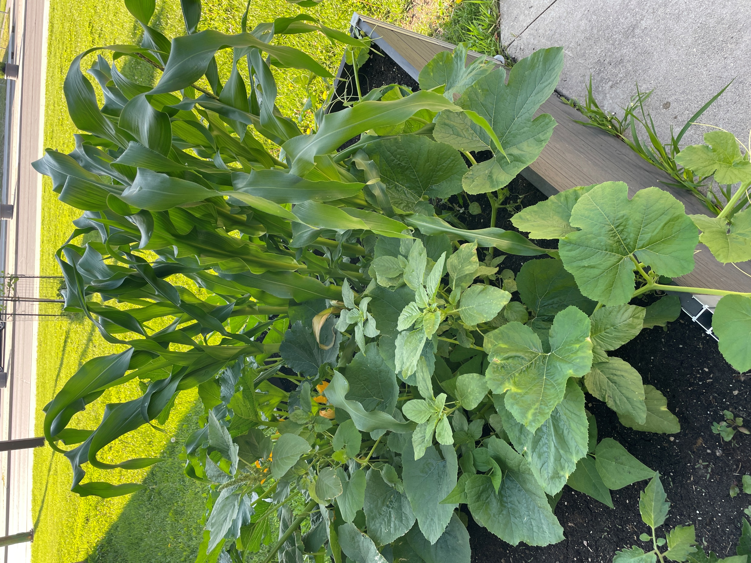
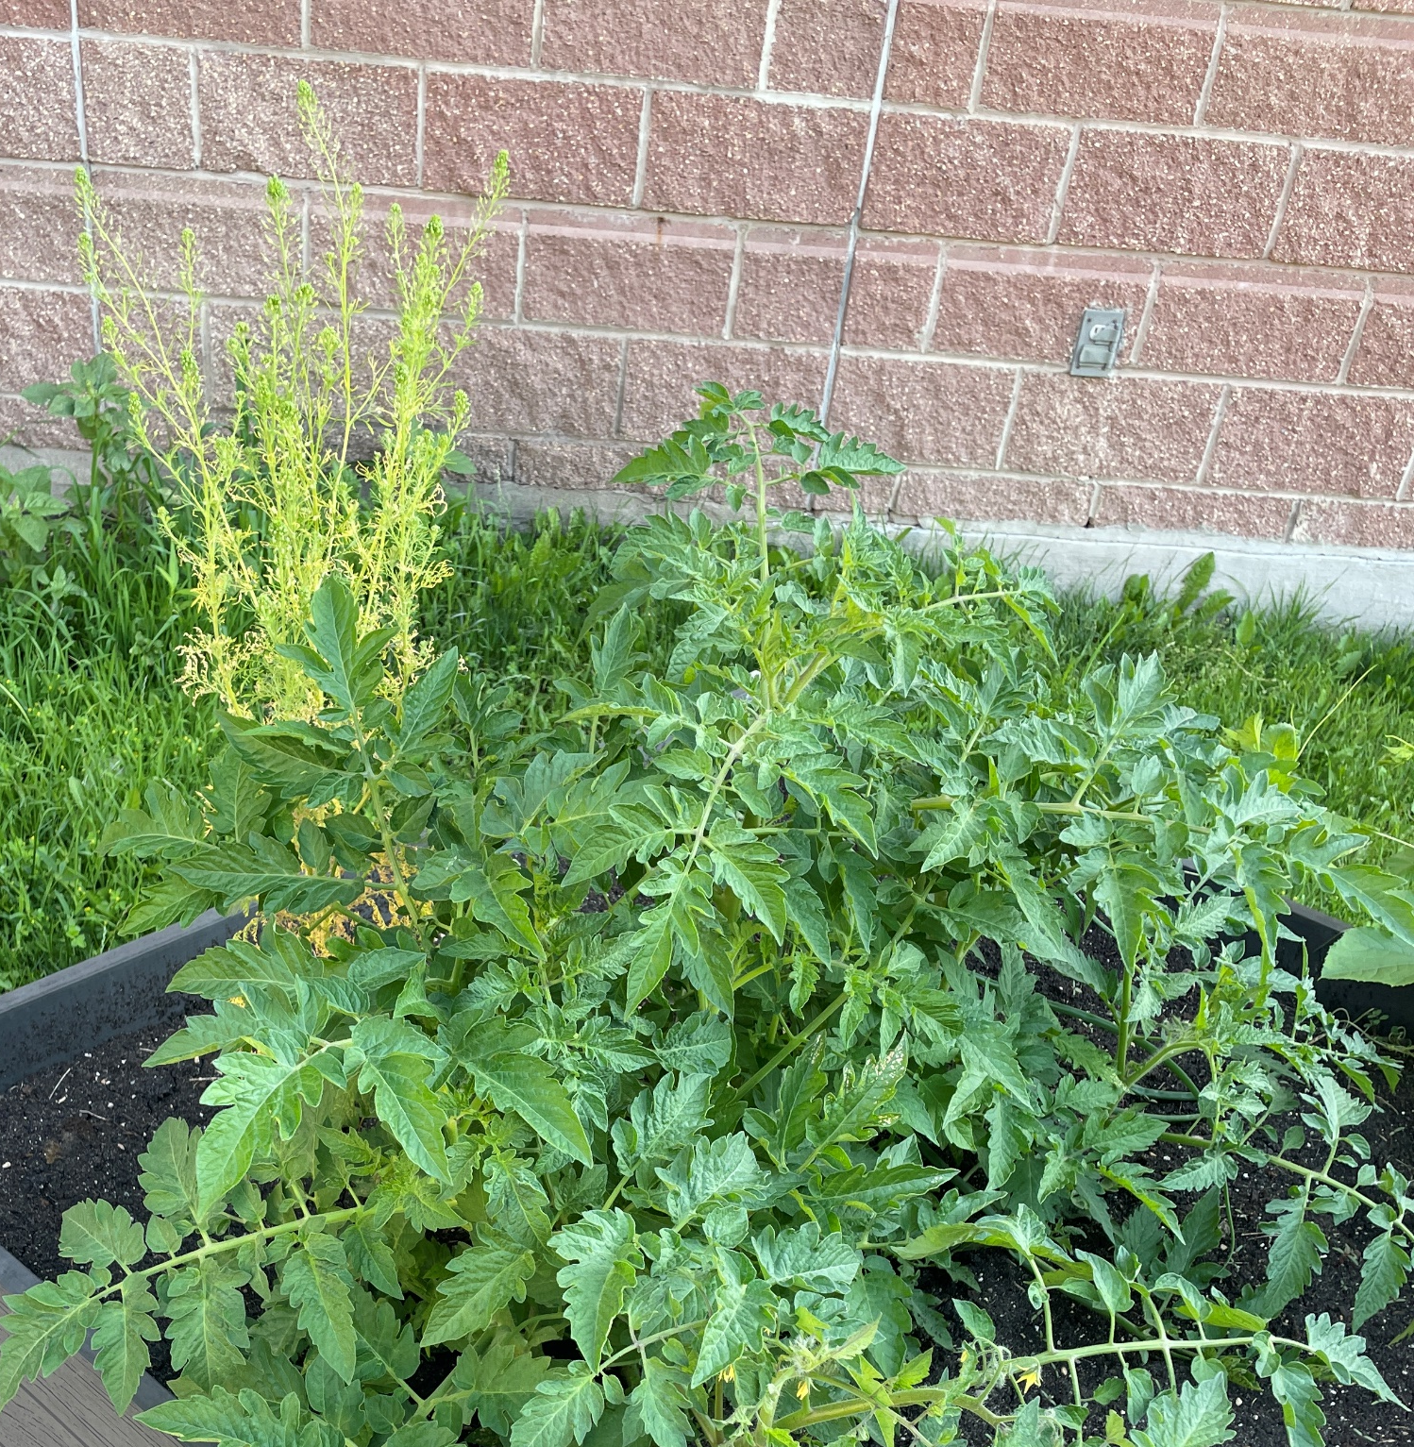
Food Insecurity (Grade 9 Science - Reproduction)
“How can we design and maintain a community garden that meets the diverse needs and interests of all participants while promoting sustainability, community engagement, and incorporating Indigenous Ways of Knowing?”
Notes:
When I was tasked with my new assignment with big Picture Learning for the Grade 9s, we took that information from the Topics in Science class and expanded. If food security is an issue in the North End, how can we at Children of the Earth help? So, we learned about the Three Sisters and started our own garden. It was a huge success. We plan on making our garden BIGGER for summer 2025.

Slide 25

Water is Life (Grade 10 Science & Geography)
How can we use both scientific and Indigenous knowledge to improve the ecological health of Lake Winnipeg? ​
Notes:
The grade 9s are now with us for grade 10 this year and we wanted to take what we did earlier this year, and make it bigger. We wanted to expand our curiosities and look at a bigger picture – How can we use both scientific and Indigenous Knowledge to do better? To help Mother Earth? To help sustain what we have. It was then when the Southern Chiefs organization announced that they were taking the Province and Manitoba Hydro to court over the status of Lake Winnipeg – water has a spirit and is a living entity. They want the government and Manitoba Hydro to be responsible for overuse of a natural resource and not taking care of it when they should have been. We watched videos of Autumn speaking. We watched videos of the late Elder Dave Courchene talking about Mother Earth having a spirit, and the need for us to take care of her more than ever. He called on the youth to take on this responsibility because our kin have left it for us to take care of, and it will be our job to pass it along to the next generation and so on. We will be combing Grade 10 Science with the Grade 10 Geography course because they blend so well. We will be looking at ecosystems, weather, chemistry; natural resources, food, trade and industry all from the lens of the land. Remember, it is about the land and our connection/relationship. Always.

Slide 26
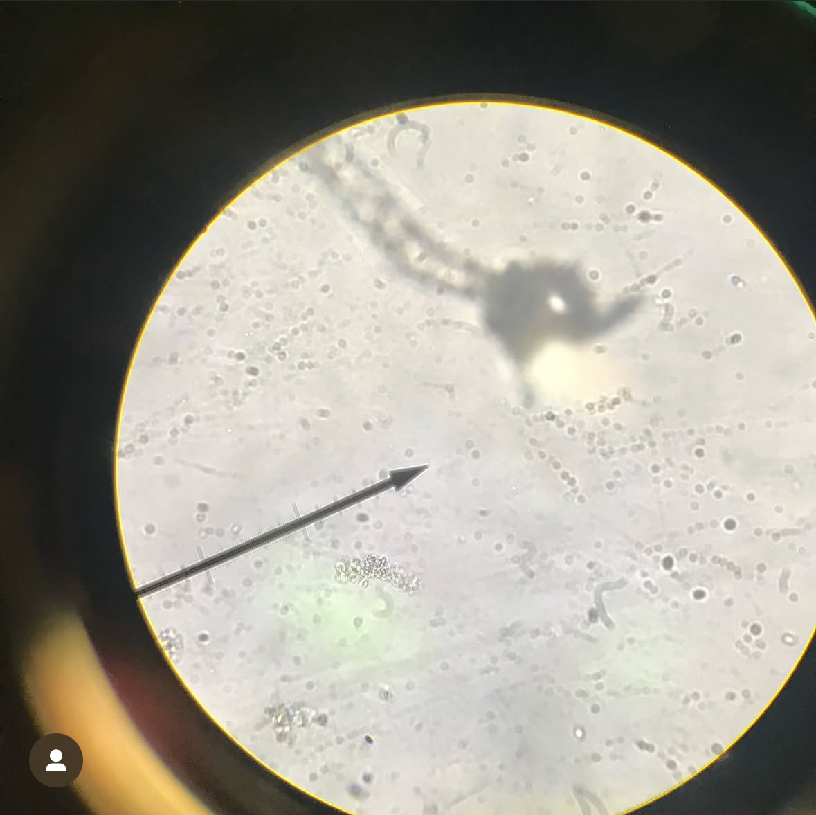
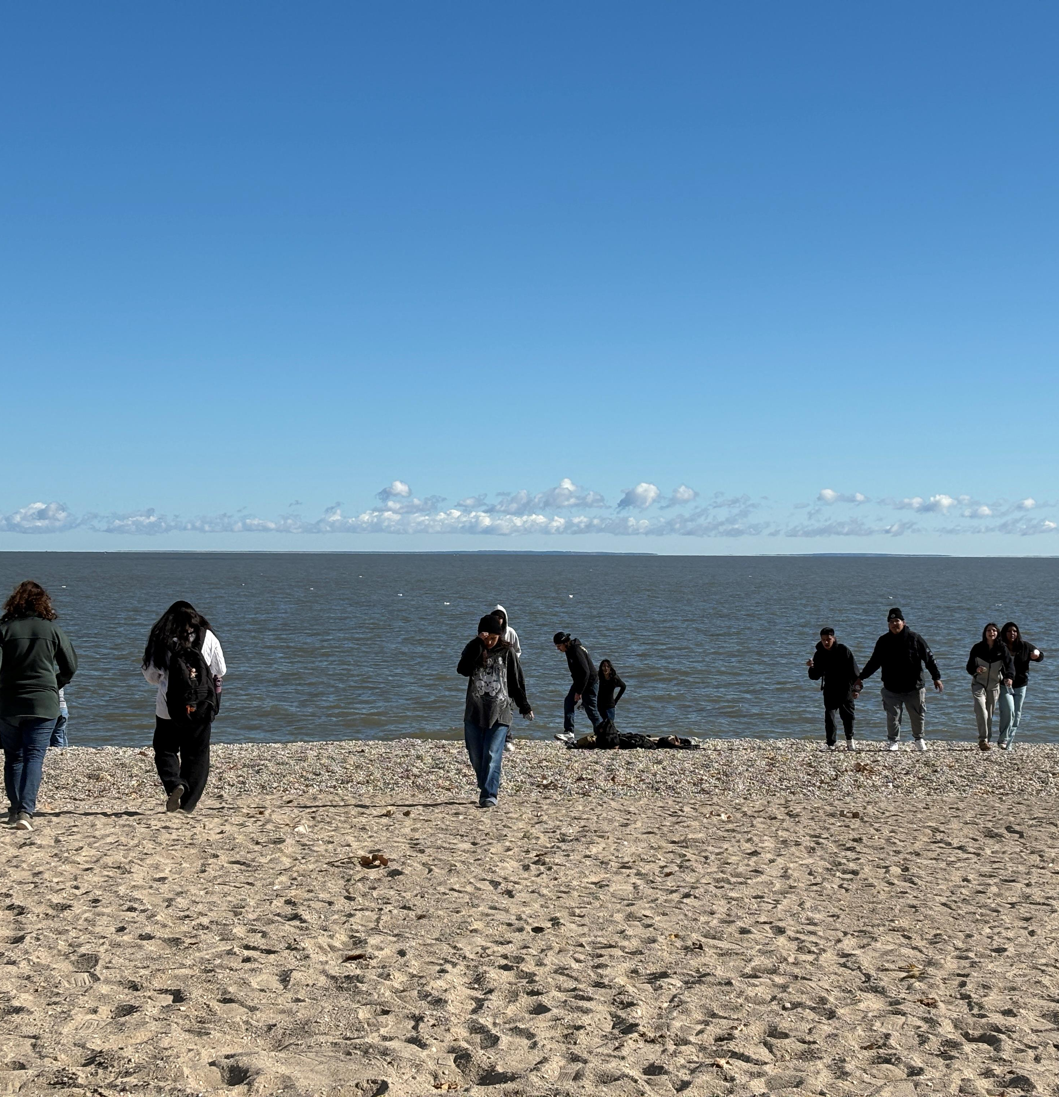
Notes:
What did we do? We decided to partner with the Grade 11 & 12 cohorts and work together to come up with ideas/solutions. On October 11 we got on a school bus and headed out to Lake Winnipeg at Gimli to take water samples. We spent a lovely day learning on the land. It started with a Pipe Ceremony with songs on the beach. We offered tobacco and told Mother Earth, the water, and Creator of our intentions for the day. After lunch, students collected samples that we would observe with a microscope later on. It was a fun day for everyone. It is always a great day to get be on the land. The grade 10s observed their samples in groups, taking a close look with each magnification, trying to see what they could find. We found micro organisms, blue algae and regular algae. We also think we found Zebra mussel larvae, and E.coli. Don’t worry, we were safe. The grade 11 & 12 took their samples to a science lab to see if they could grow E.coli from their samples.
We don’t know what the end result will be exactly, and that is still okay. We have ideas – student projects, letters to government officials, chatting with knowledge keepers, the people who need Lake Winnipeg to sustain their communities; and those who have conducted water research on Lake Winnipeg.

Slide 27
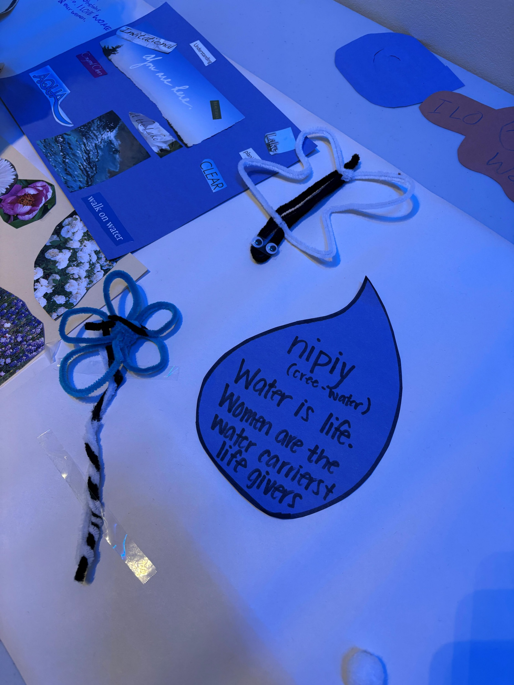
Evidence of Learning
“The fabric of our identity”

Slide 28
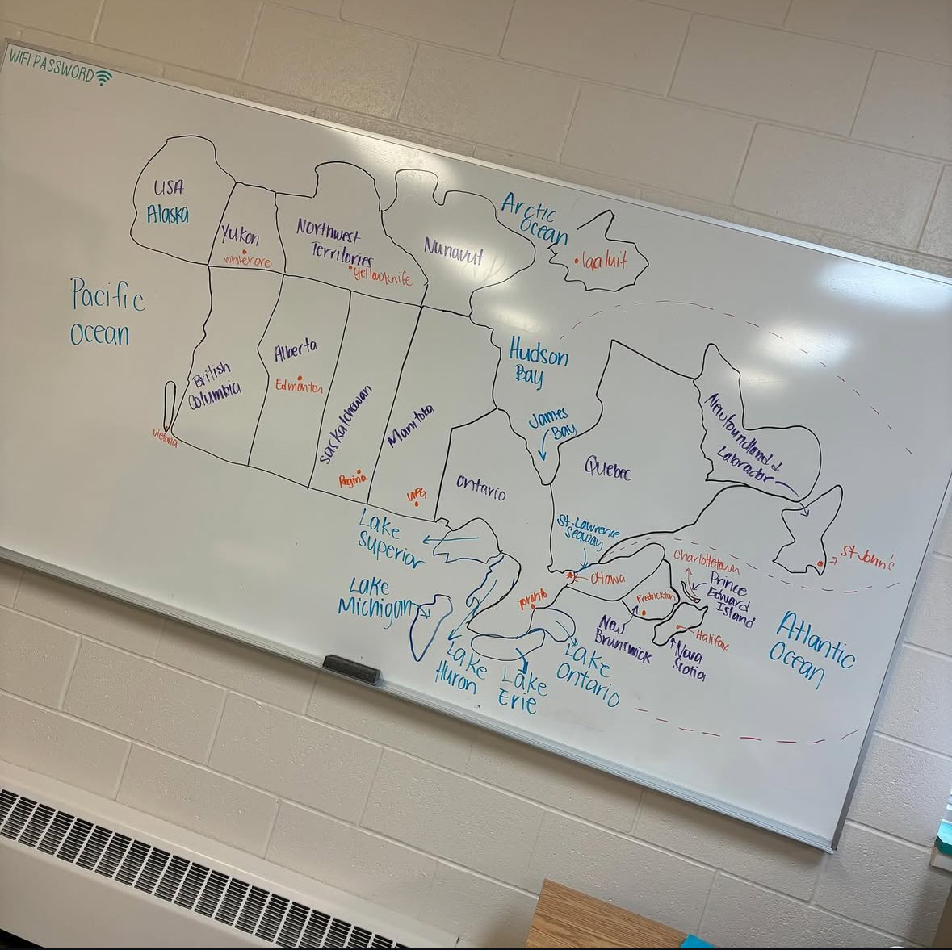
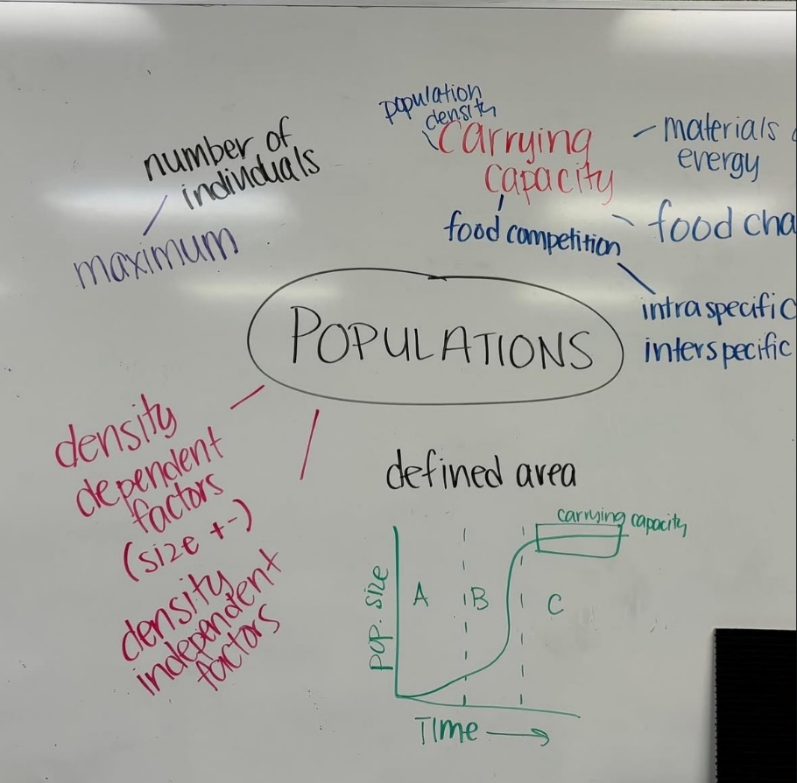
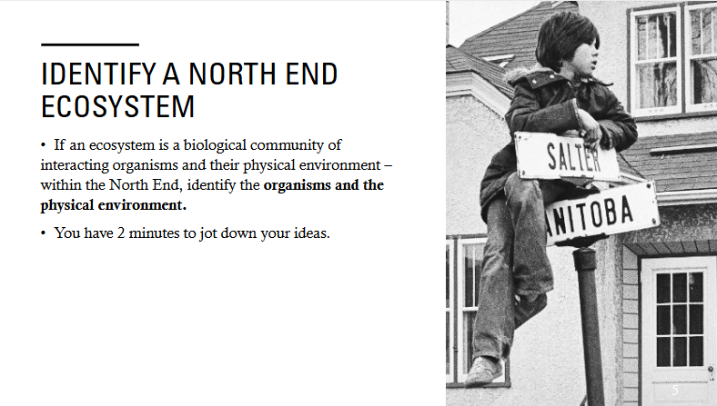
Notes:
So how are we teaching them the information they need to understand the conflict that is transpiring within the ecosystem that is Lake Winnipeg? Since our method of instruction has changed, we now have workshops. We use this class time for topics with in Science and Geography, that is still curricular, but shaped more towards what they need to understand about Lake Winnipeg. Hint: It’s all of it. It will get a little tricky with the Physics unit, but we’ll make it work. We have them working on their mapping skills. Last week we learned about political maps, and soon we’ll begin to map the geography of Manitoba that will include the communities that our students come from. We’ve studied ecosystems and made it relatable by thinking about the ecosystems that are in a school, the North End, and our favourite spot – Birds Hill. On Friday last week we looked at populations and studied how quickly house flies can populate; this week we took a look at carrying capacity by studying the jackpine trees in Northern Manitoba after a forest fire.
When we study the effects of climate change, human activity, and monocultures in Lake Winnipeg, we want them to understand the communities that surround Lake Winnipeg and how this affects their home communities – many of our students live off a tributary of Lake Winnipeg. We want them to know the populations of fish that live in Lake Winnipeg and how commercial fishing is presently being affected by these issues; and we want them to understand the unique and fragile ecosystem of a Lake that gives to much, yet we ignore the most important thing – taking care of that body of water.
Even ELA will have a theme with science an geography, so that they are enveloped by the importance of stewardship and sustainability.

Slide 29
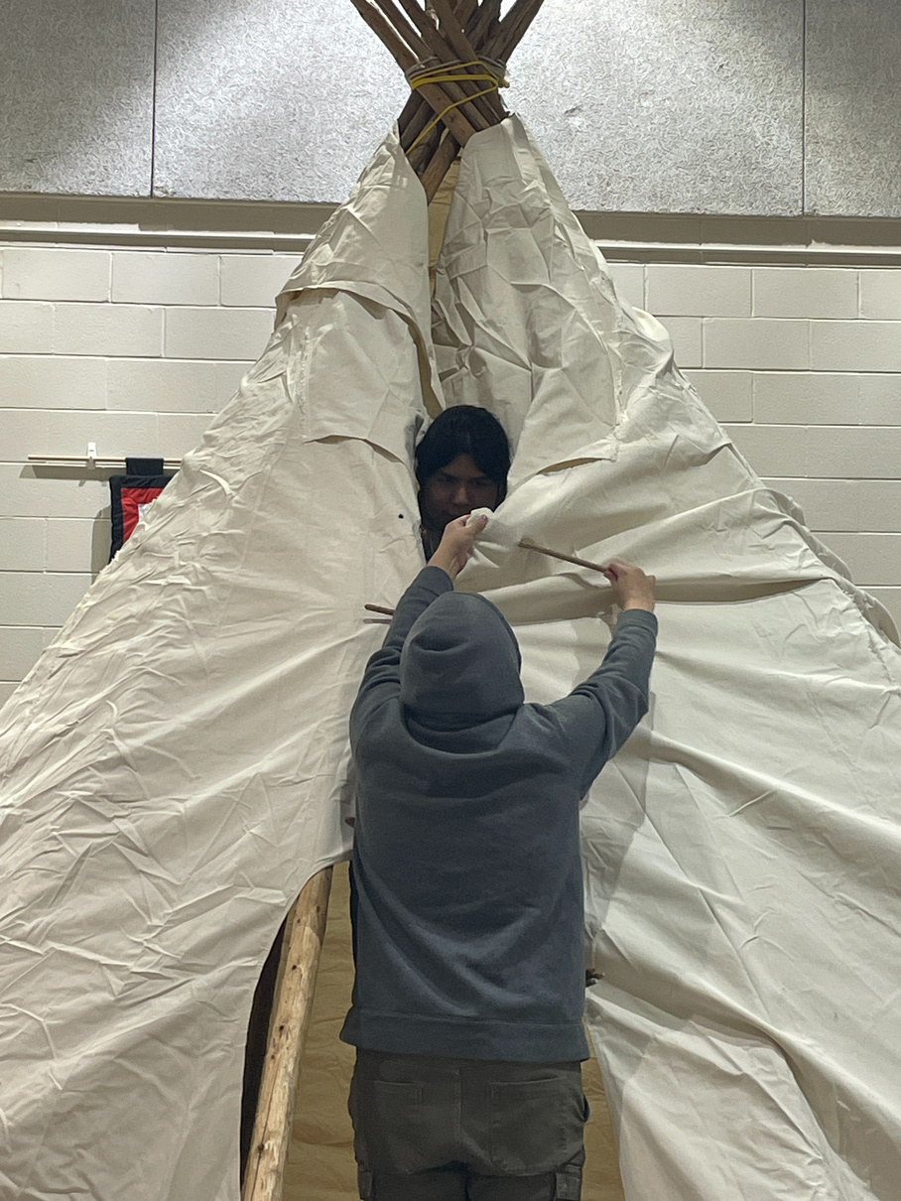
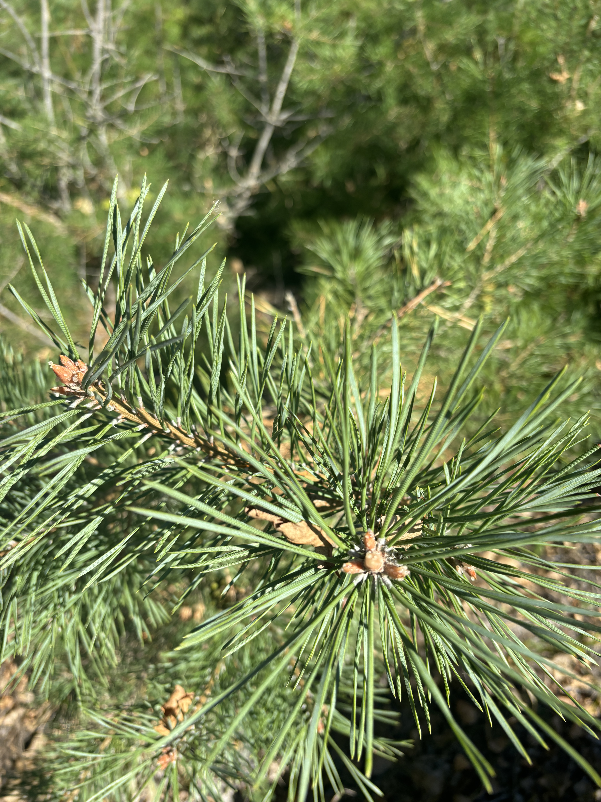
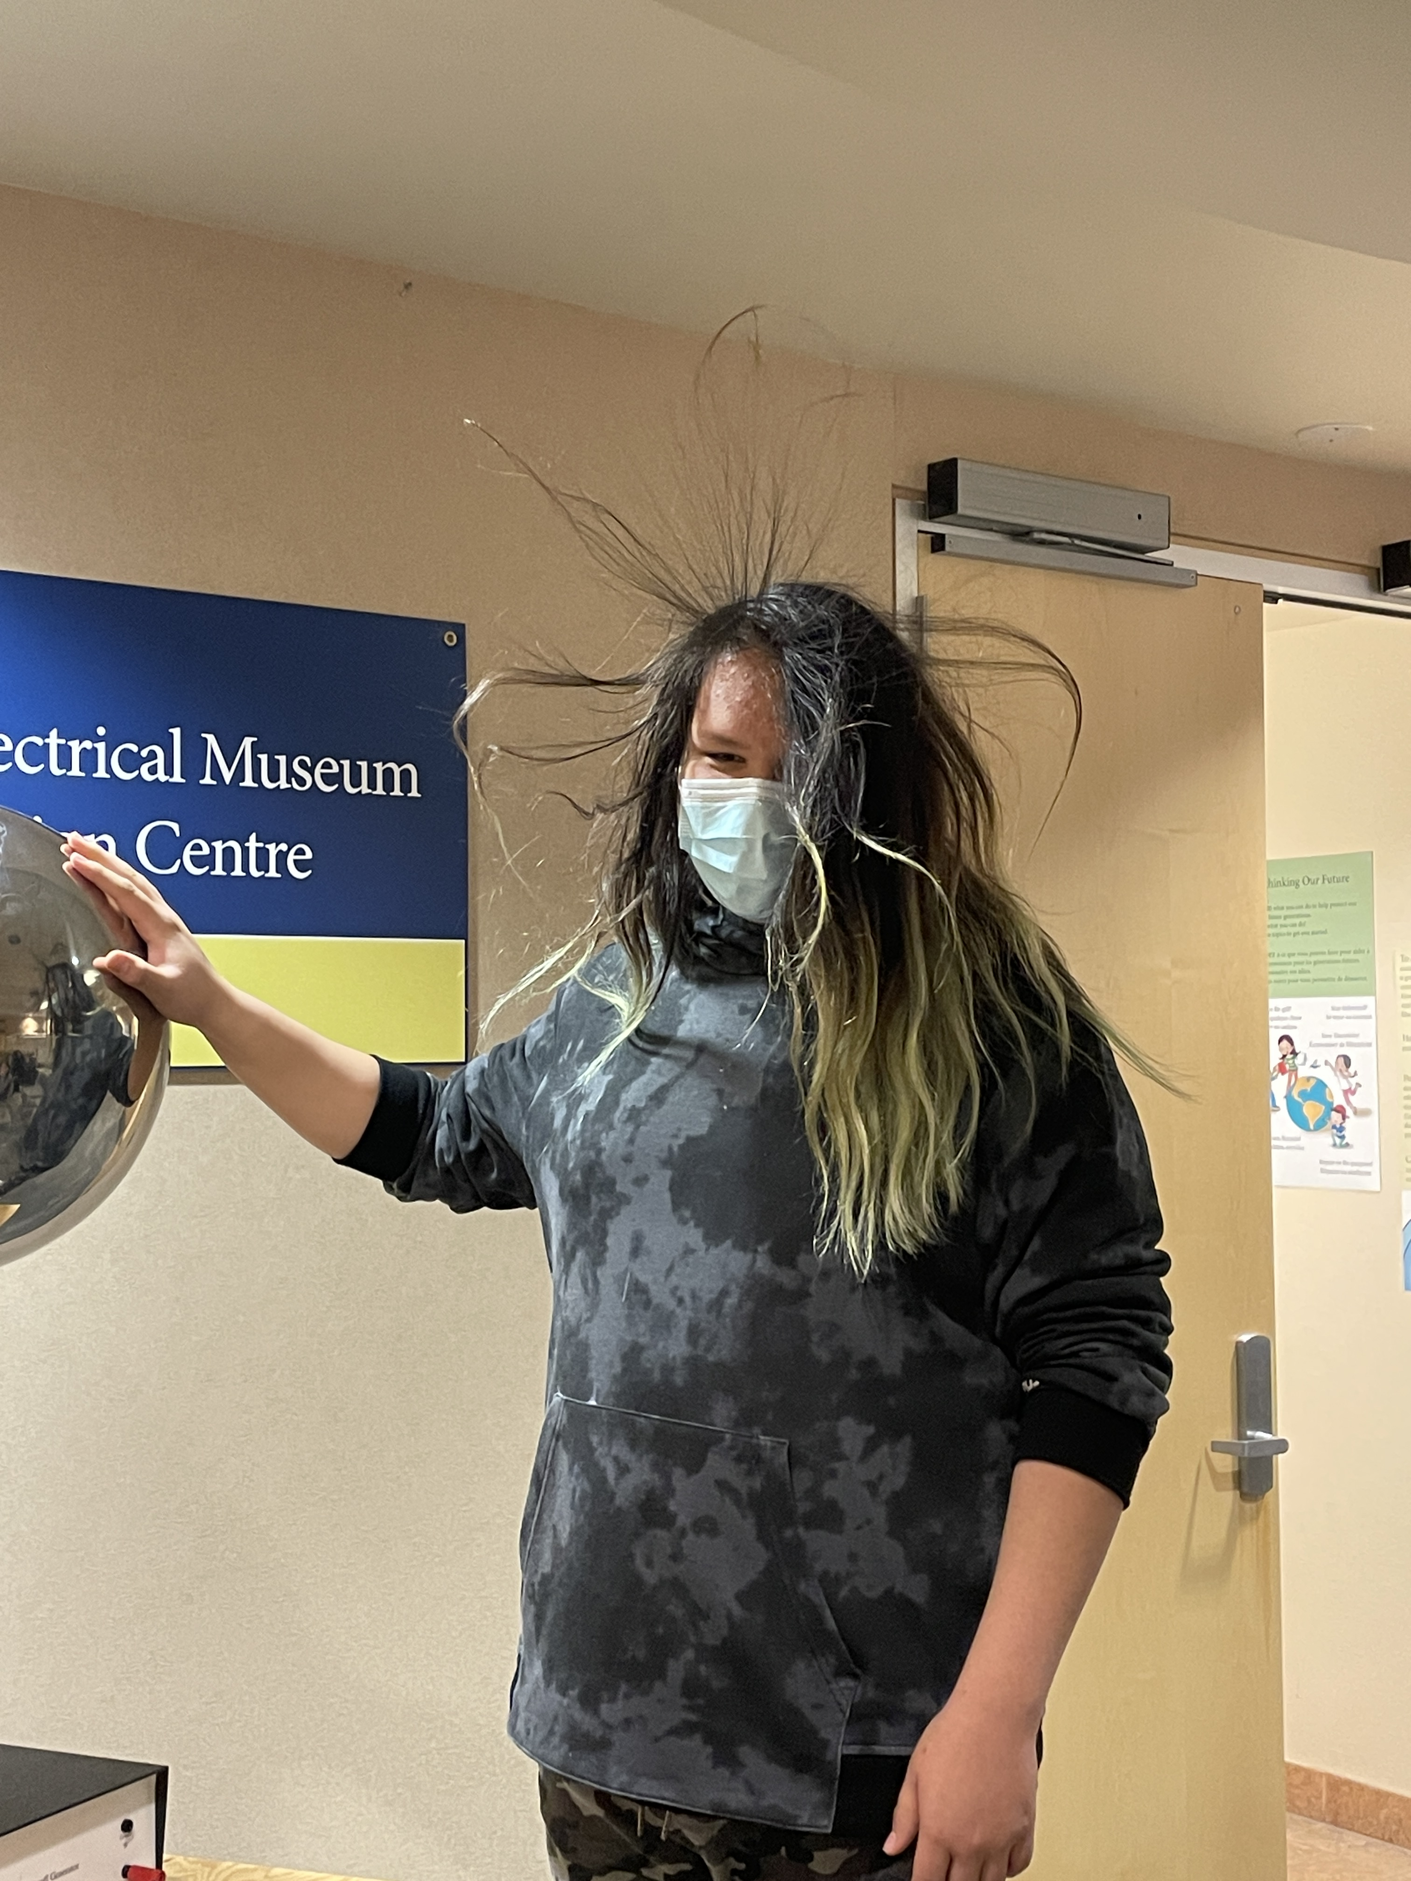
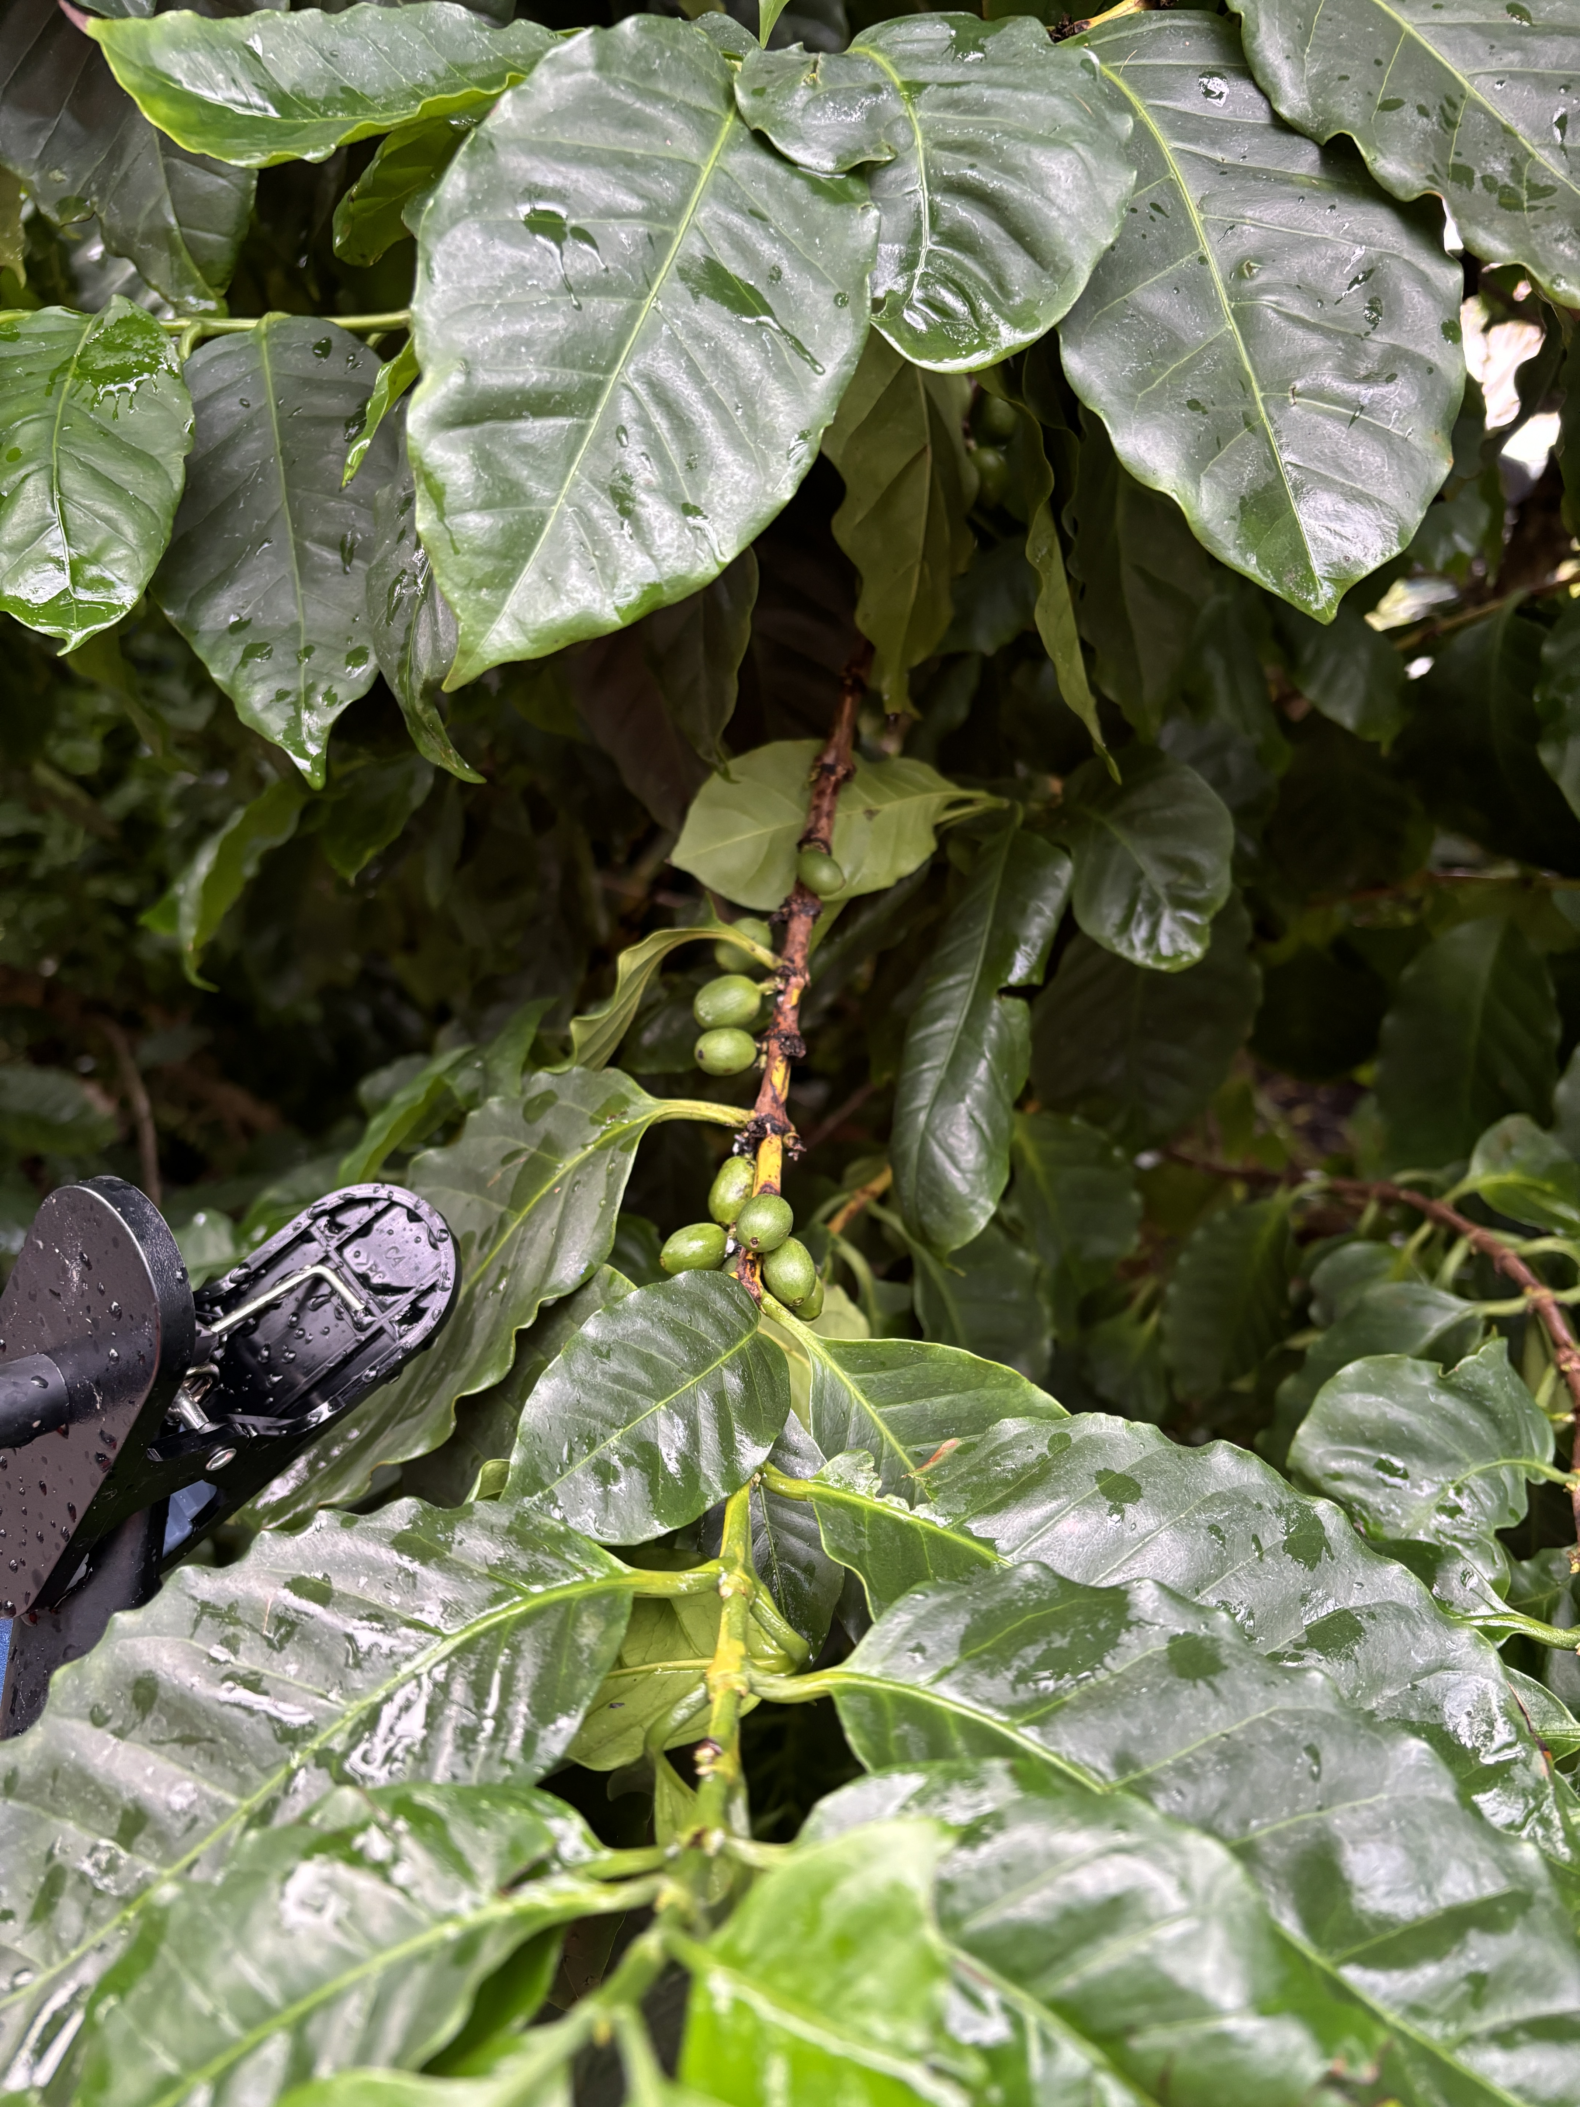
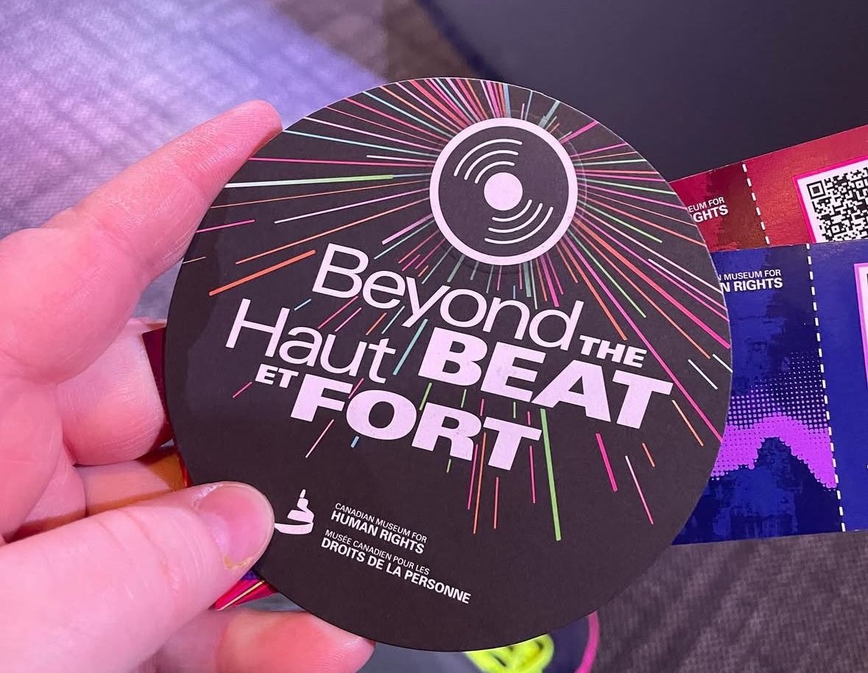
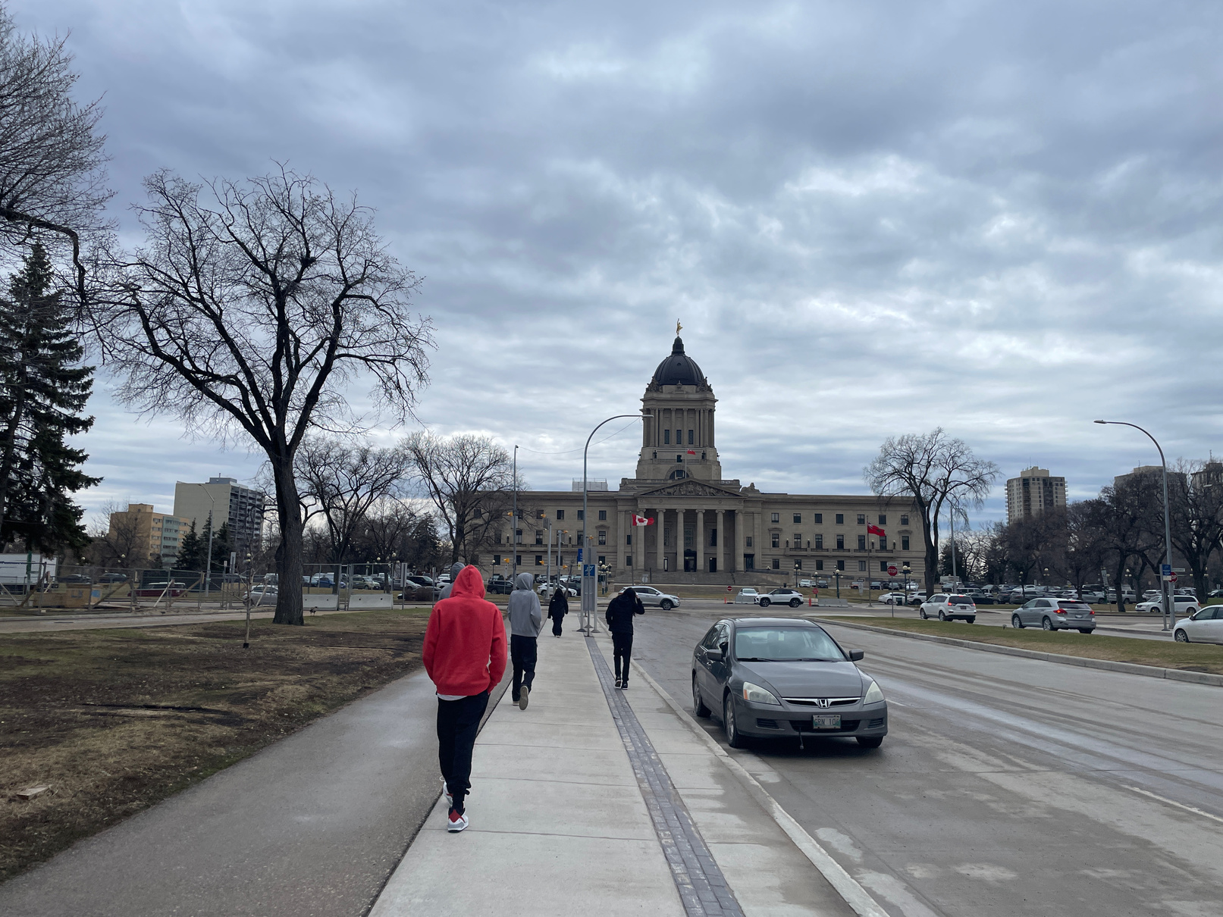

Slide 30

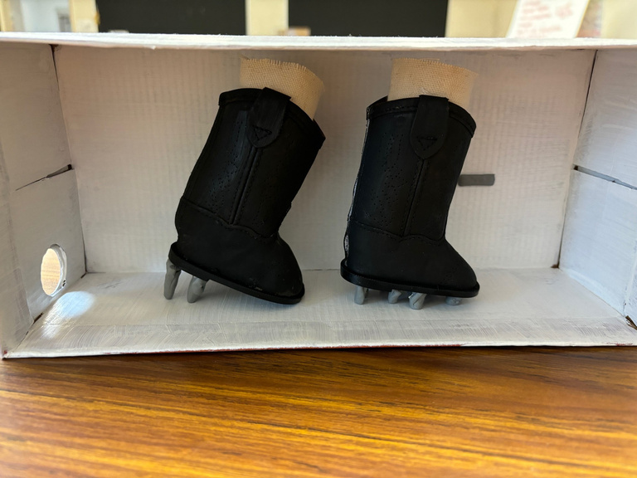
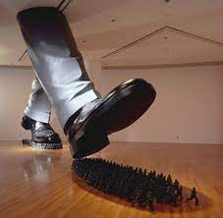
Do Ho Suh, South Korea
“Karma”
Student inquiry: “How can art help tell the story of human rights injustices?”
Notes:
This is a student project from last year. She was inspired by a leaving to learn trip to the Canadian Museum for Human Rights. This was her inquiry question, and through her process she created a mini version of the art by this artist. This year she is learning about Fast Fashion and all of the environmental and consumerism issues that come from it – she is repurposing clothing and will host a fashion show. She is including pieces of her Indigenous culture into the fashion pieces – we recently went to a local fur store and she purchased pieces to be incorporated into what she is making. For example a fur lined hoodie.
Some other examples of upcoming projects are: a student’s project on her favourite rapper Tyler the Creator, one student is researching clouds; we have another that is researching Space and will include the Cree perspectives of constellations. Another student is looking at graffiti art and how we can use it to cover up the bad graffiti in community spaces while providing an outlet for creativity.

Slide 31
Pedagogy over content

Slide 32
CURIOSITY

Slide 33
ENGAGEMENT

Slide 34
ONE STUDENT AT A TIME

Slide 35
MAKE MISTAKES!
LEARN FROM THEM!
TRY AGAIN!

Slide 36
Academic Journals & Books
“Land as pedagogy: Nishnaabeg intelligence and rebellious transformation” – Leanne Betasamosake Simpson (Decolonization: Indigeneity, Education & Society; Vol. 3, No. 3, 2014, pp.1-25)
“Land Education: Indigenous, post-colonial, and decolonizing perspectives on place and environmental education research” – Eve Tuck, Marcia McKenzie & Kate McCoy; Environmental Education Research, 20:1, 1-23
“Importance of Metis Ways of Knowing in Healing Communities” – Judy M. Iseke
“Literacies of Land: Decolonizing Narratives, Storying, and Literature” – Sandra Styres
“Working in Good Ways: Framework and resources for Indigenous community engagement” – Nicki Ferland, et. Al
“Wayi Wah! Indigenous Pedagogies” – Jo Chrona
“Teaching Each Other: Nehinuw Concepts and Indigenous Pedagogies” – Linda M. Goulet, Keith N. Goulet
“Indigenous Ingenuity: A Celebration of Traditional North American Knowledge” – Deidre Havrelock & Edward Kay

