Slide 1
Nishnawbe Aski Nation
NAN Early Years @ Siigwan Education Directors Forum
May 22, 2025
Presented by:
Kristy Hankila, Manager, Early Learning and Child Care, Nishnawbe Aski Nation

Slide 2

Indigenous Early Learning and Child Care Framework:
The Indigenous Early Learning and Child Care Framework (IELCC) was co-developed with Indigenous partners following a national engagement process in 2017. The Vision of this initiative is First Nation children and families supported by a comprehensive and coordinated system of ELCC policies, programs and services that are led by Indigenous peoples, rooted in Indigenous knowledges, cultures and languages, and supported by strong partnerships of holistic, accessible and flexible programming that is inclusive of the needs and aspirations of Indigenous children and families.
https://www.canada.ca/en/employment-social-development/programs/indigenous-early-learning/2018-framework.html

Slide 3
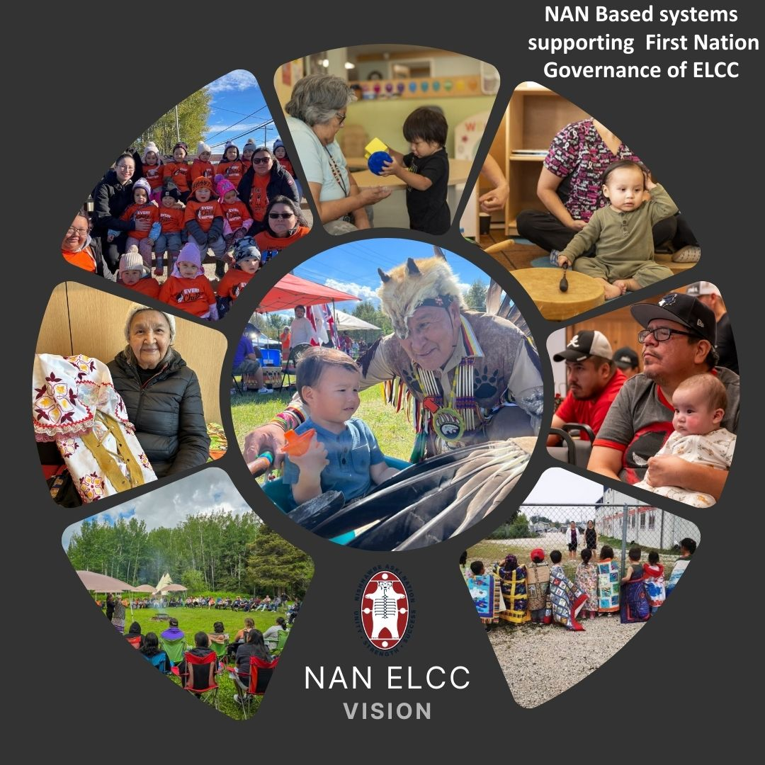
IELCC FUNDING All First Nations also receive funding for before and after care with Education agreements. 2024-2025 JUST received
$24,235,372.22 Programs and Services directly to NAN First Nations
$1,432,340.77 IELCC Partnership and Governance - NAN
$6,348,696.17 NAN Housing and Infrastructure for capital projects
Received between 2018-2024
Programs and Services$56,543,735
IELCC Partnership and Governance $1,967,048
Repairs and Renovations 2022-2023 $1,052,003
Notes:
IELCC Funding Highlights Notes:
IELCC Funding to communities is flowed through existing ISC agreements. IELCC community funding includes Programs and Services funding and Partnership and Governance funding.
NAN First Nations partnership and governance funding can be used for First Nations to provide their community the opportunity to discuss their goals and input into a NAN wide Child Care Strategy.
NAN Partnership and Governance funding is used to support the design and implementation of a comprehensive and coordinated system of Early Learning and Child Care policies, programs and services through the development of a NAN Early Learning and Child Care Strategy.
This includes:
NAN ELCC Technical Working Group
Comprehensive Work with FNESL, NAN wide ELCC capital needs assessment to determine on the ground needs
Repair and Renovation Funding:
NAN ELCC worked with centres, communities and Technical Service units of tribal councils to support all FNICCI funded centres to complete and submit their applications.

Slide 4
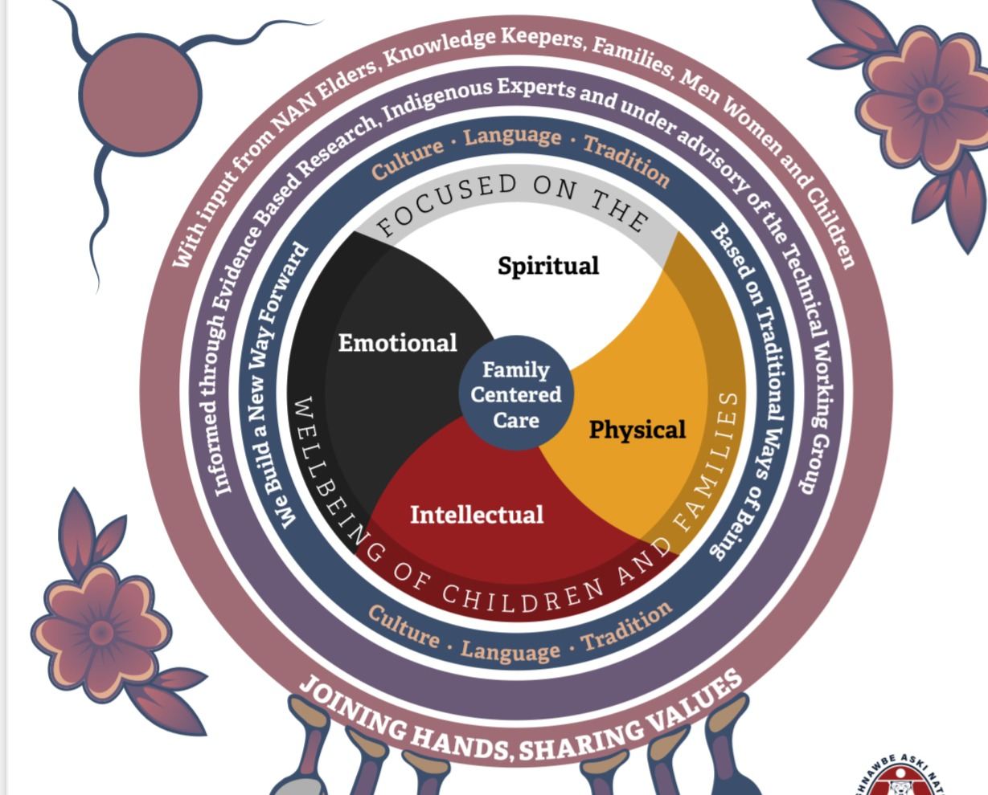
IELCC Support
@NAN
Transition to Kindergarten
Program planning and development for Early Learning and Child Care programs
Before and After School care support
Preschool programs and school readiness
Education and Training opportunities
On site support for those working with students 0-6
ielcc@nan.ca

Slide 5




Wise Practices in Early Learning and Child Care

Slide 6
Kristy Hankila
Early Learning and Child Care Manager
khankila@nan.ca
(807) 629-1512
ielcc@nan.ca

