Slide 1
FNIIP/AIIP: Capital Projects Priority List
Step-by-Step Guide
OFA Capital Planning Session January 13, 2026
Presented by: Mark Bellefleur, Senior Engineer, Indigenous Services Canada

Slide 2
Purpose
To provide step-by-step guidance to complete the First Nation Infrastructure Investment Plans (FNIIP) or the Agency Infrastructure Investment Plans (AIIP) under the Ontario Final Agreement (OFA)

Slide 3
OFA Capital Planning
First Nation Child and Family Services (FNCFS) capital requests in Ontario will follow an established planning process
FNCFS capital will be integrated into overall community infrastructure planning to ensure alignment with broader community goals
First Nations will identify their FNCFS capital needs in their FNIIPs and FNCFS Agencies will identify their FNCFS capital needs in their AIIPs (submitted 6 months after OFA effective date in the first year, and in the fall in subsequent years)
ISC will assess the eligibility of FNCFS capital proposals and prioritize projects for funding using the OFA FNCFS Priority Ranking Framework

Slide 4
FNIIP/AIIP
Part A:
Privacy Statement
First Nation Contact Information and Authorization (FNIIP)
Agency Contact Information and Authorization (AIIP)
Part B:
First Nation Capital Project Priority List (FNIIP)
FNCFS Agency Capital Project Priority List (AIIP)

Slide 5
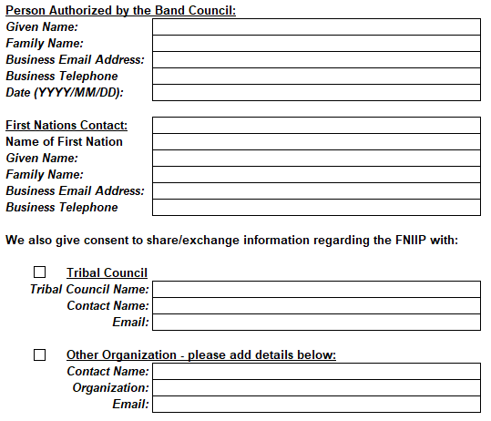
Privacy Act Tab – First Nations

Slide 6
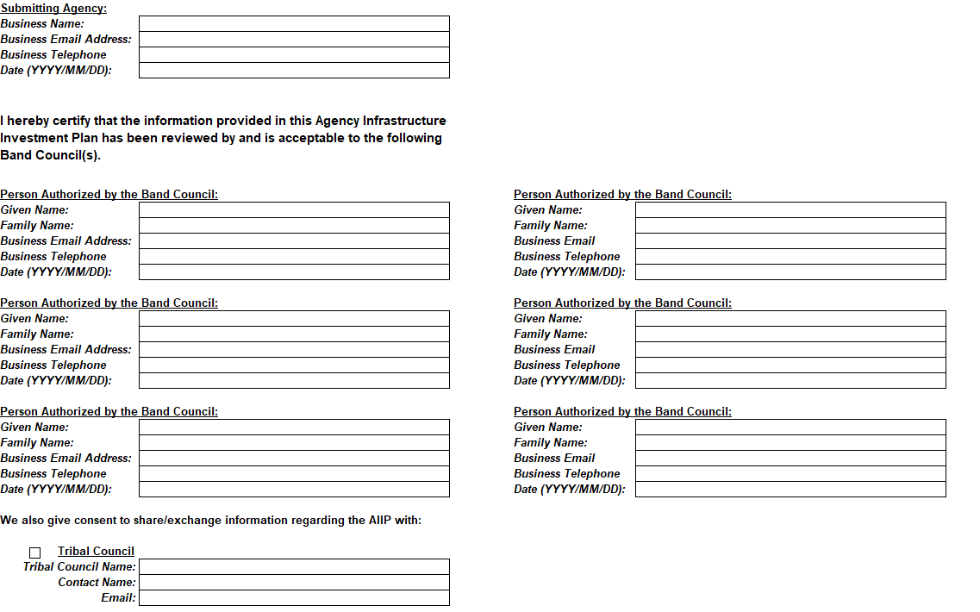
Privacy Act Tab - Agencies

Slide 7
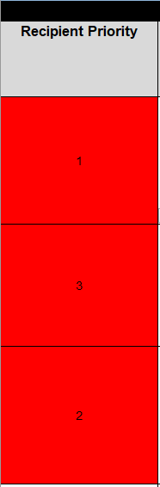

Part B – Capital Project Priority List

Slide 8
Recipient Priority
Use whole, unique numbers starting at 1
Rank multiple FNCFS projects in order
AGENCIES: Ensure alignment with Community Well-Being Plan

Slide 9
Project Name
Use short, descriptive titles
Include infrastructure type and phase
Ex: Healing Lodge – Feasibility Study

Slide 10
Project Description
Summarize scope, purpose, phase
1
Explain link to FNCFS service delivery
2
Note needs assessment or cultural supports
3

Slide 11
Project Description
A summary of the scope of work and intended outcomes of the project
It should capture the project's purpose, phase, and connection to FNCFS objectives
Required information/steps:
Identify whether the project is for feasibility, design, new build, or renovation
Clearly state how the project supports the delivery of FNCFS services
Include whether the project has completed a needs assessment or is being designed to support culturally appropriate services

Slide 12
Comments
Add contextual notes or status info
Indicate new/existing building and infrastructure availability
Ex: BCR submitted, needs assessment completed

Slide 13
Comments
A space for contextual notes, supporting information, or cross-references that provide clarity or important caveats
Required information/steps:
Include relevant status (e.g. “ready to proceed,” needs assessment underway, etc.)
New or Existing Building
Building Inspection Completed and condition (Closed, Poor, Fair Good, New)
If existing building, does it meet building codes?
If existing building, estimated percentage of building that can meet service delivery needs?
Are there any other assets in the community, within an hour, or over an hour away that deliver these services? Indicate time
How many FNCFS services will be delivered in this building? Indicate all services
Is the building shared or will be used entirely for FNCFS? If shared, indicate percentage used
Infrastructure present or not (Watermain, sewer main, storm if applicable, hydro/electrical)

Slide 14
Project Category
A classification that aligns with ISC infrastructure reporting categories for planning and funding purposes
This field allows requests to be easily sorted for application of the Priority Ranking Framework
Reflects current phase you are applying for
This is a dropdown list in the FNIIP/AIIP
For example:
FNCFS Facility – Feasibility
FNCFS Facility – Design
FNCFS Facility – Construction

Slide 15
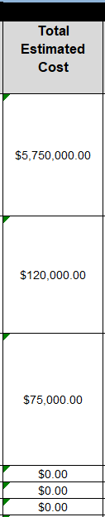
Total Estimated Cost
All-inclusive project cost
Auto-populated from fiscal year entries
Use whole-dollar Canadian amounts

Slide 16
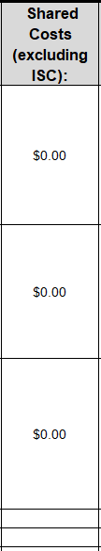
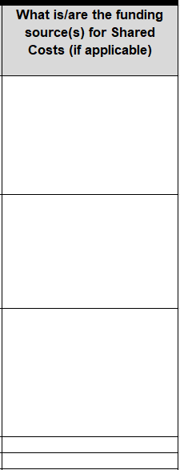
Shared Costs (Excluding ISC)
List external confirmed or anticipated funds
Include FN, CMHC, provincial, or philanthropic contributions
Enter $0 if none

Slide 17
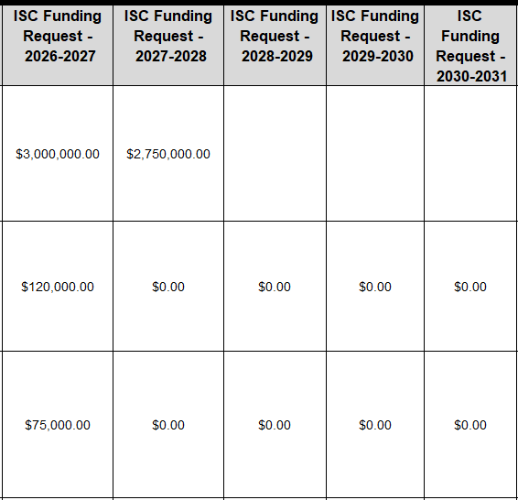
ISC Funding Request – FY
Enter requested ISC amount per fiscal year
Ensure totals equal full project cost
Smaller projects may require only one fiscal year

Slide 18
Examples / Sample FNIIP / AIIP
Sample Walkthrough of Templates:
2026-2027 FNIIP Sample Template - OFA
2026-2027 AIIP Sample Template - OFA

Slide 19
Contact Information
For more information about the implementation of the OFA’s FNCFS capital commitment or the OFA Capital Process, you can contact: immobilisation-edon-onfa-capital@sac-isc.gc.ca

Slide 20
Thank you! – Merci! – Miigwech!

