Slide 1
Sandy Lake First Nation (Band Representative) Working together Mamow Weechiwaywin program off reserve, Thunder Bay and the east.
Racheal Anishinabie/ Mary Martha Day / Leah Meekis

Slide 2
Bill C‑92, An Act respecting First Nations, Inuit and Métis children, youth and families, is a key part of reconciliation through child welfare reform. It affirms the inherent rights and jurisdiction of Indigenous peoples to care for their children and sets national principles that prioritize cultural continuity, substantive equality, and the best interests of Indigenous children
The Sandy Lake Mamow Weechiwaywin Thunder Bay Band Representative Program has been evolving since April 2022.

Slide 3
What is a (Band Representative) A Band Representative (Band Rep) also known as a Family & Child Advocate is a trained support worker who stands alongside our First Nation children, families, and caregivers when they become involved with any local Child Welfare Agencies. Their role is grounded in advocacy, cultural safety, and the protection of the family and community integrity. What our workers do.
Support and Advocate for Our People:
They provide guidance, information, and culturally grounded support to Sandy Lake First Nation members living in Thunder Bay and to any Sandy Lake Band member residing east of Thunder Bay.
Walk Alongside Families:
They work collaboratively with children, parents, extended family, and caregivers to ensure their voices are heard and respected throughout any child welfare process. (That could be a safety plan, a family service plan or a child in care plan)
Navigate Child Welfare Systems, we work along side with CFS intake and or on-going families’ files:
Band Reps help families understand why child welfare agencies may be involved, what their rights are, what the Agency obligations are and what steps need to be taken to close a file. They ensure families are not facing these systems alone. Band Rep workers attend emergency on-call calls from local CFS. Attend home visits with local CFS workers. Case reviews are done every four months with our members present at the case reviews, we always encourage families to attend.
Our workers need to have knowledge of Child Welfare documentation. Any in care documents, kinship, supervision, VYSA.
Promote Transparency and Trust:
Our workers are open and honest with families and community members about the reasons for involvement. They communicate clearly, respectfully, and without judgment. Community members are also advised if there are child welfare concerns seen and noted, that Band reps have a duty to report. We are not child welfare, and it is up to the local CFS to deem the children safe or unsafe. That is not Band reps’ positions. We support the families and children.
Uphold Integrity and Cultural Values:
Band Reps carry out their work with dignity, compassion, and grace, ensuring that cultural identity, family connections, and community values remain at the centre of every decision.

Slide 4
Why This Role Matters
Family & Child Advocate workers help protect the rights of our children and families, reduce harm, and ensure that child welfare involvement is handled in a way that honours our people, our culture, and our inherent right to care for our own.
Home visits
Referrals to community resources links, counselling, addictions, medical.
Band Reps participate in family planning, plan of care meetings and safety plan meetings. In theses spaces, our Band reps could recommend prevention programs and services available in the city.

Slide 5
Date | Tikinagan | Dilico | Ottawa CFS | NCFS
April 2022 | 38 | 2 | 3 | 2
Nov 2025 | 12 | 2 | 0 | 0
Date | Tikinagan | Dilico | Ottawa CFS | NCFS
April 2022 | 42 | 2 | 2 | 4
Nov 2025 | 12 | 2 | 0 | 0
Date | Tikinagan | Dilico | Ottawa CFS | NCFS
April | 10 | 0 | 1 | 2
Nov 2025 | 6 | 0 | 0 | 2

Slide 6
“This is generational work. And it deserves generational commitment”.

Slide 7
All My Relations Prevention
Support with Addictions, After care, and Family Services
Community empowered pathways for healing, resilience, and sustained support
Notes:
Image source: AI-generated

Slide 8
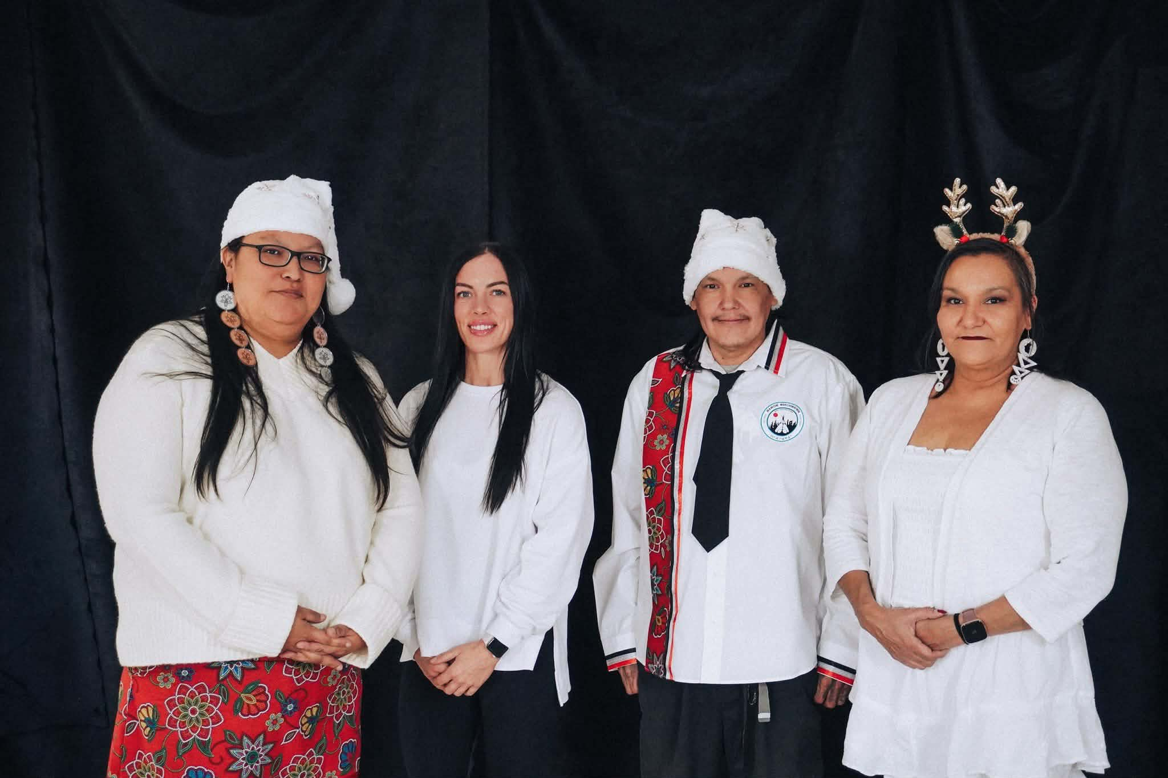
ALL MY RELATIONS
• Prevention Strategies for Addictions
• Effective Aftercare Approaches for Addiction Recovery
• Social Service Strategies to Support Family Dynamics
• Role of Prevention and Aftercare
All My Relations Staff Photo by Tyler Angeconeb
Notes:
Prevention Strategies for Addictions Effective Aftercare Approaches for Addiction Recovery Social Service Strategies to Support Family Dynamics Role of Child Protection Agencies in Prevention and Aftercare Image source: AI-generated

Slide 9
Prevention Strategies for Addictions

Slide 10
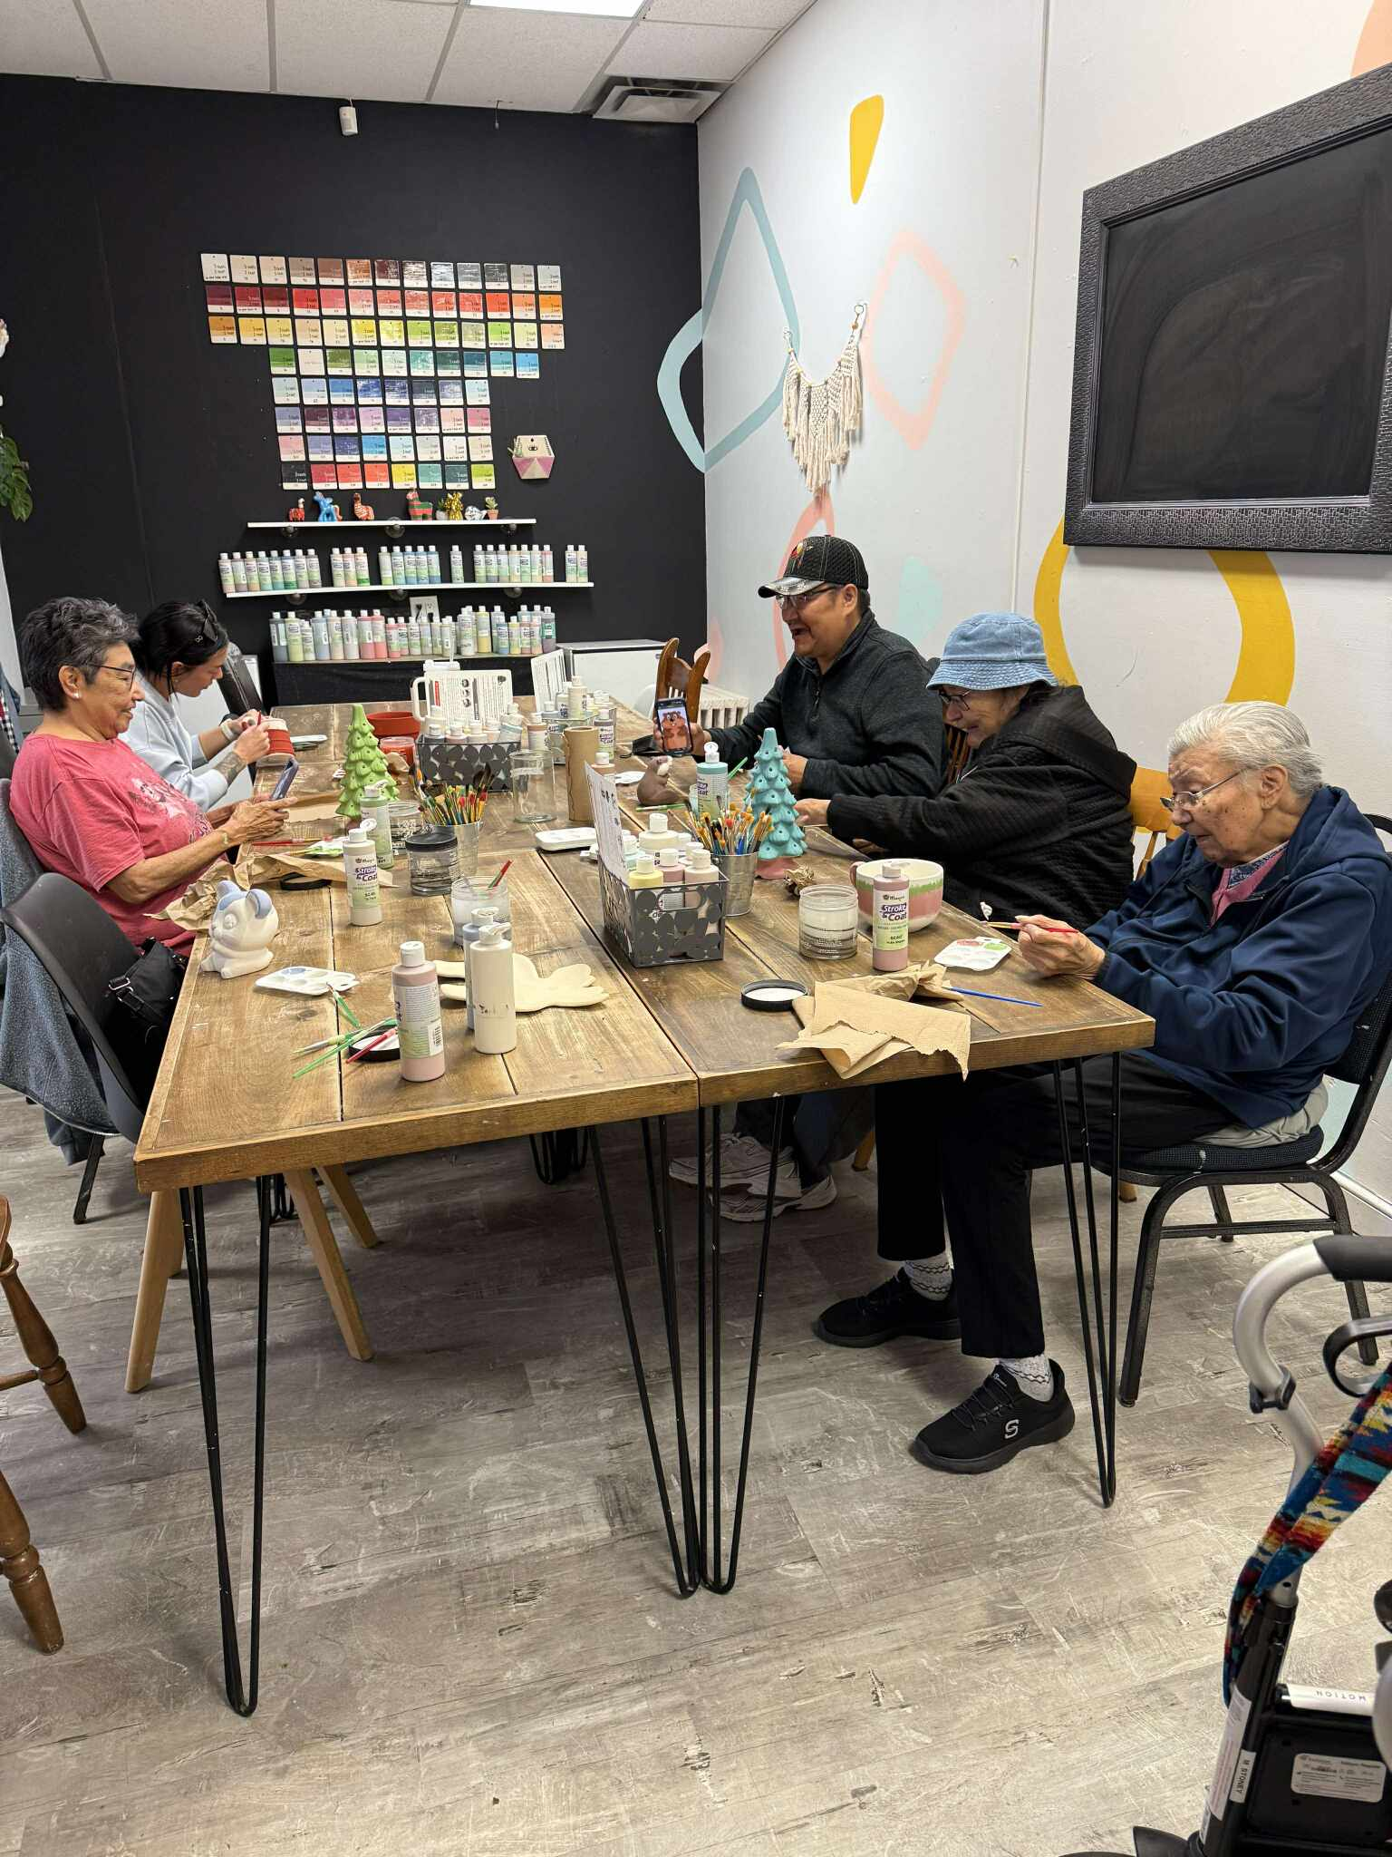
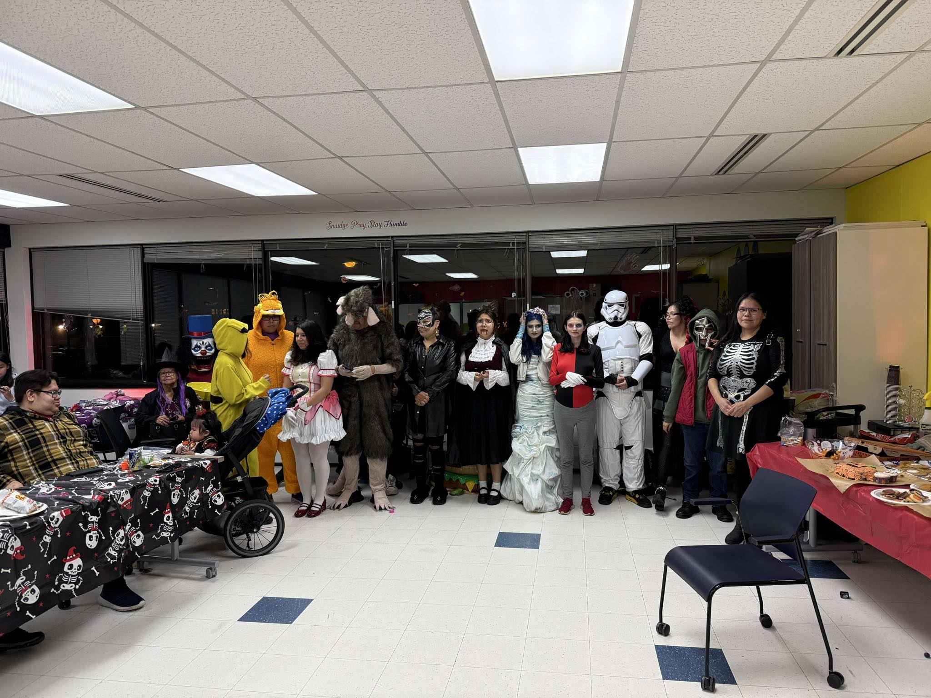
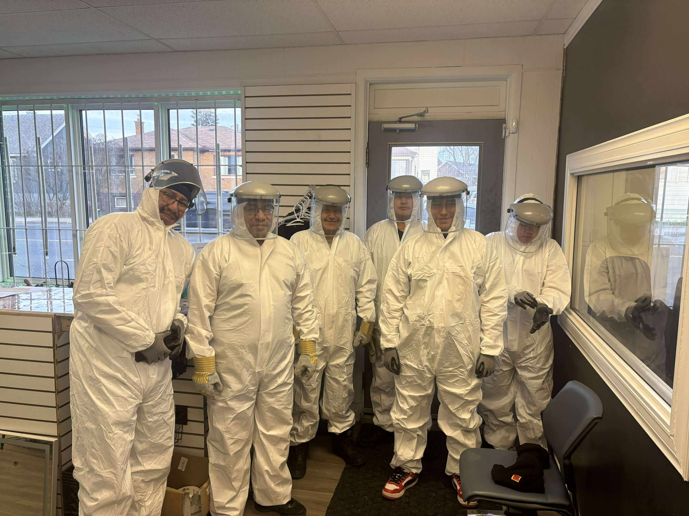
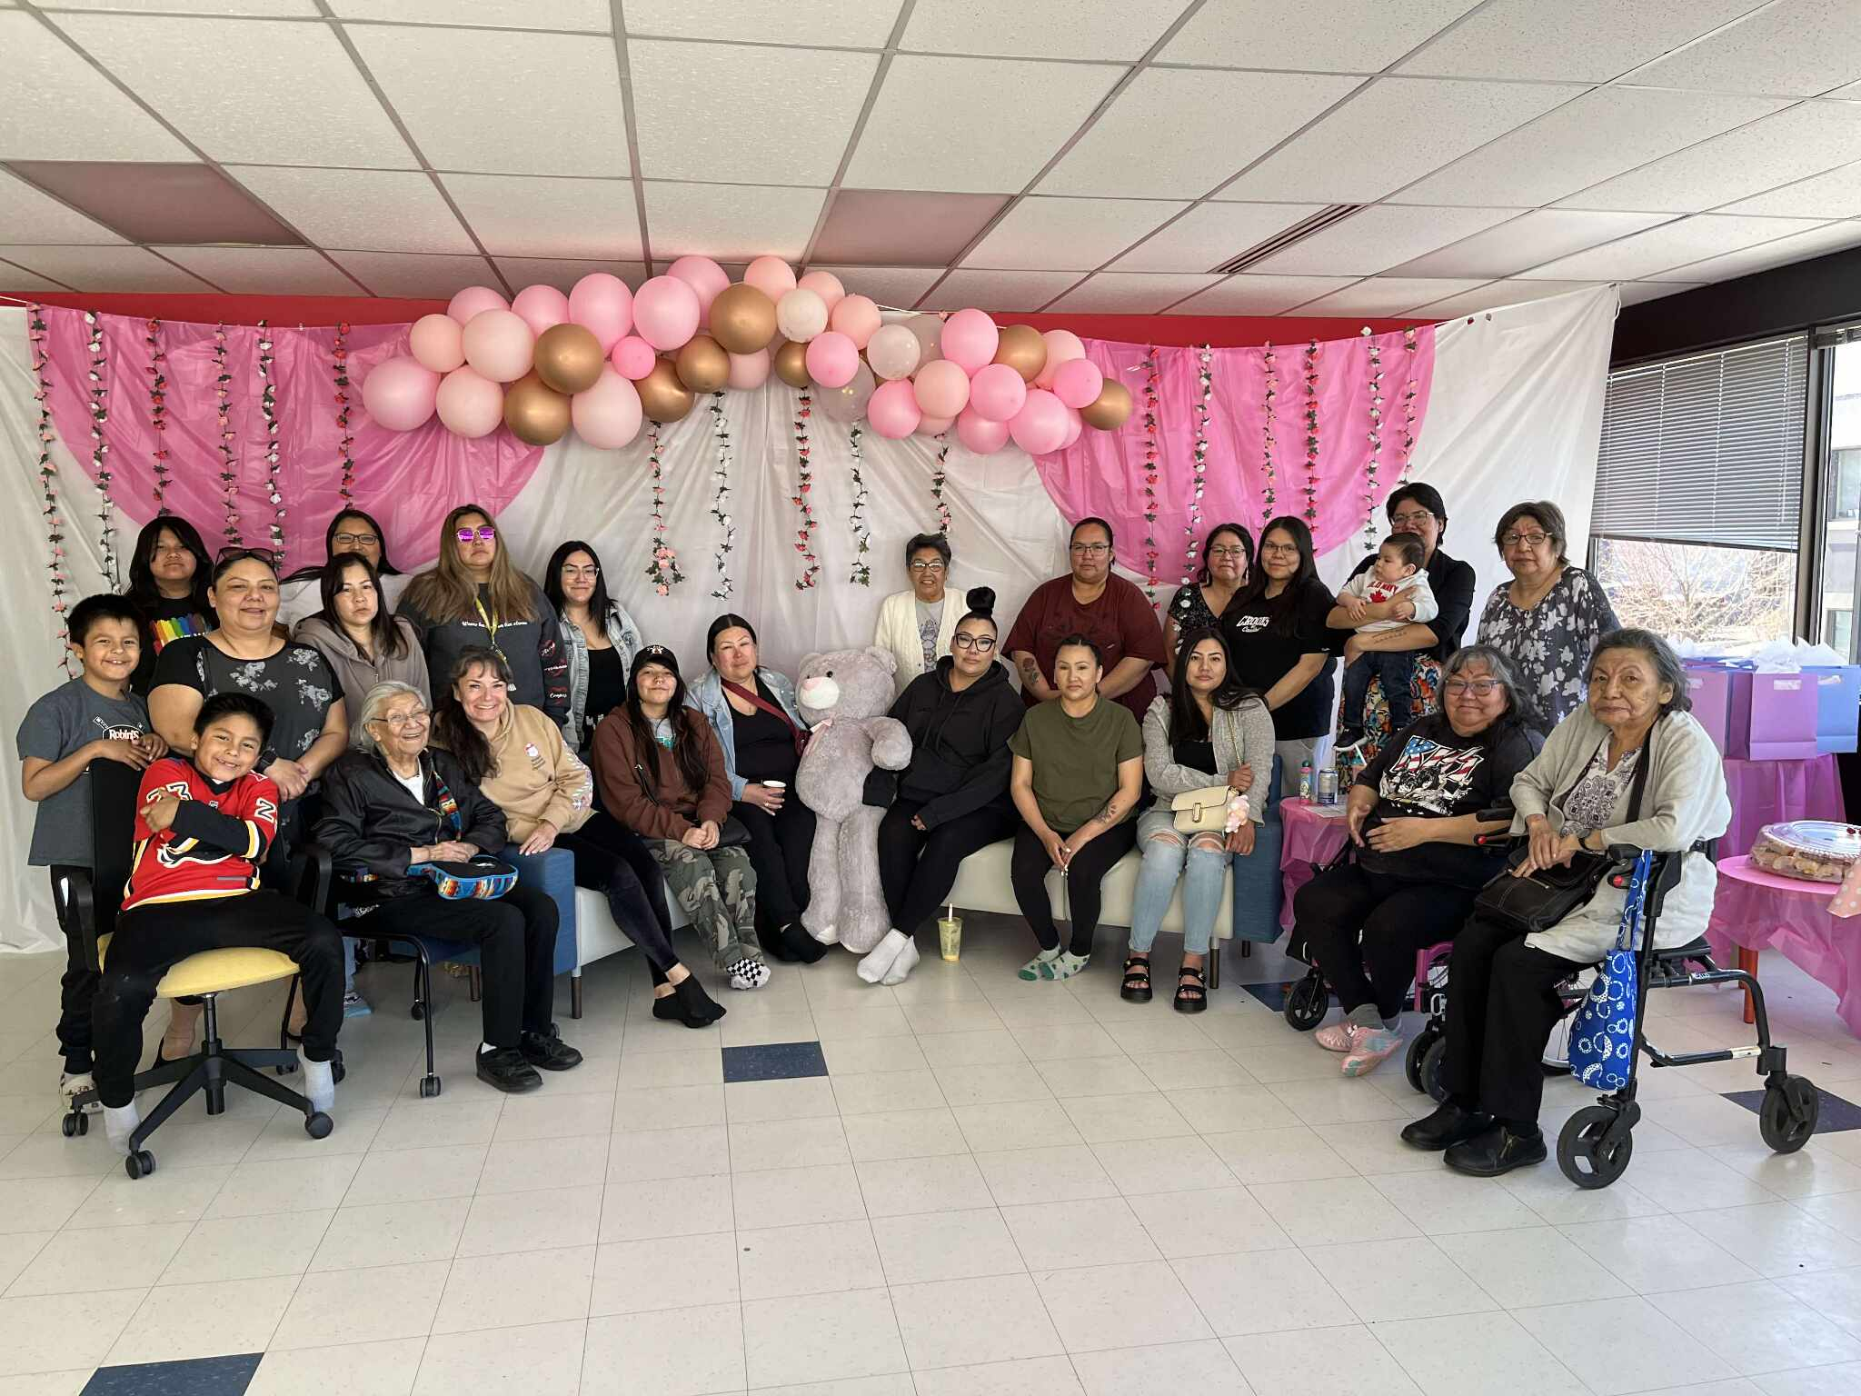
Community Education and Outreach Programs
Awareness & Healthy Habits
Wellness Within Program
This program is Weekly with Monthly Segments on various life skills development.
Mens Night,Womans Night
,Youth and Elders, Family Day activities
These Programs consist of activities involving supports and learning different skills and entertainment that don’t involve alcohol and drugs
These are held monthly
Bens Workout Days
We have workout days for our community members with a trainer 3 times a week. Goal is to teach about physical health and prevent diabetes and other health problems.
Notes:
Community education programs play a critical role in spreading awareness about the risks of addiction and promoting healthy behaviors. These programs often involve workshops, informational campaigns, and collaboration with local organizations. Research shows communities with sustained outreach initiatives report lower rates of substance abuse, by as much as 15-20% compared to areas without such efforts. Education campaigns tailored to cultural and demographic characteristics of the community tend to have higher engagement and impact. Image source: AI-generated

Slide 11
Effective Aftercare Approaches for Addiction Recovery

Slide 12
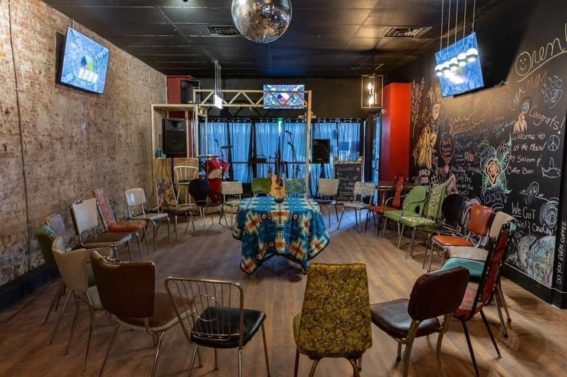
Support Groups and Peer Networks
Social Connectivity
Meetings Daily , Weekly , Monthly for AA , NA healing circles.
Staff Support
Staff supporting clients with going for coffee rides to talk and have a listening ear
Support Mechanisms
Transportation to meetings that they may need to get to for additional support
Notes:
Peer support groups like Alcoholics Anonymous and SMART Recovery provide social connectivity and shared experience, which foster sustained recovery. Meta-analyses confirm that participation in peer networks improves abstinence rates by 20-30% at 12 months post-treatment. These groups offer emotional support, accountability, and practical advice beneficial to recovery maintenance. Online peer support is expanding access, with digital platforms engaging diverse populations. Image source: AI-generated

Slide 13
Social Service Strategies to Support Family Dynamics
Social Service Strategies to Support Family Dynamics

Slide 14
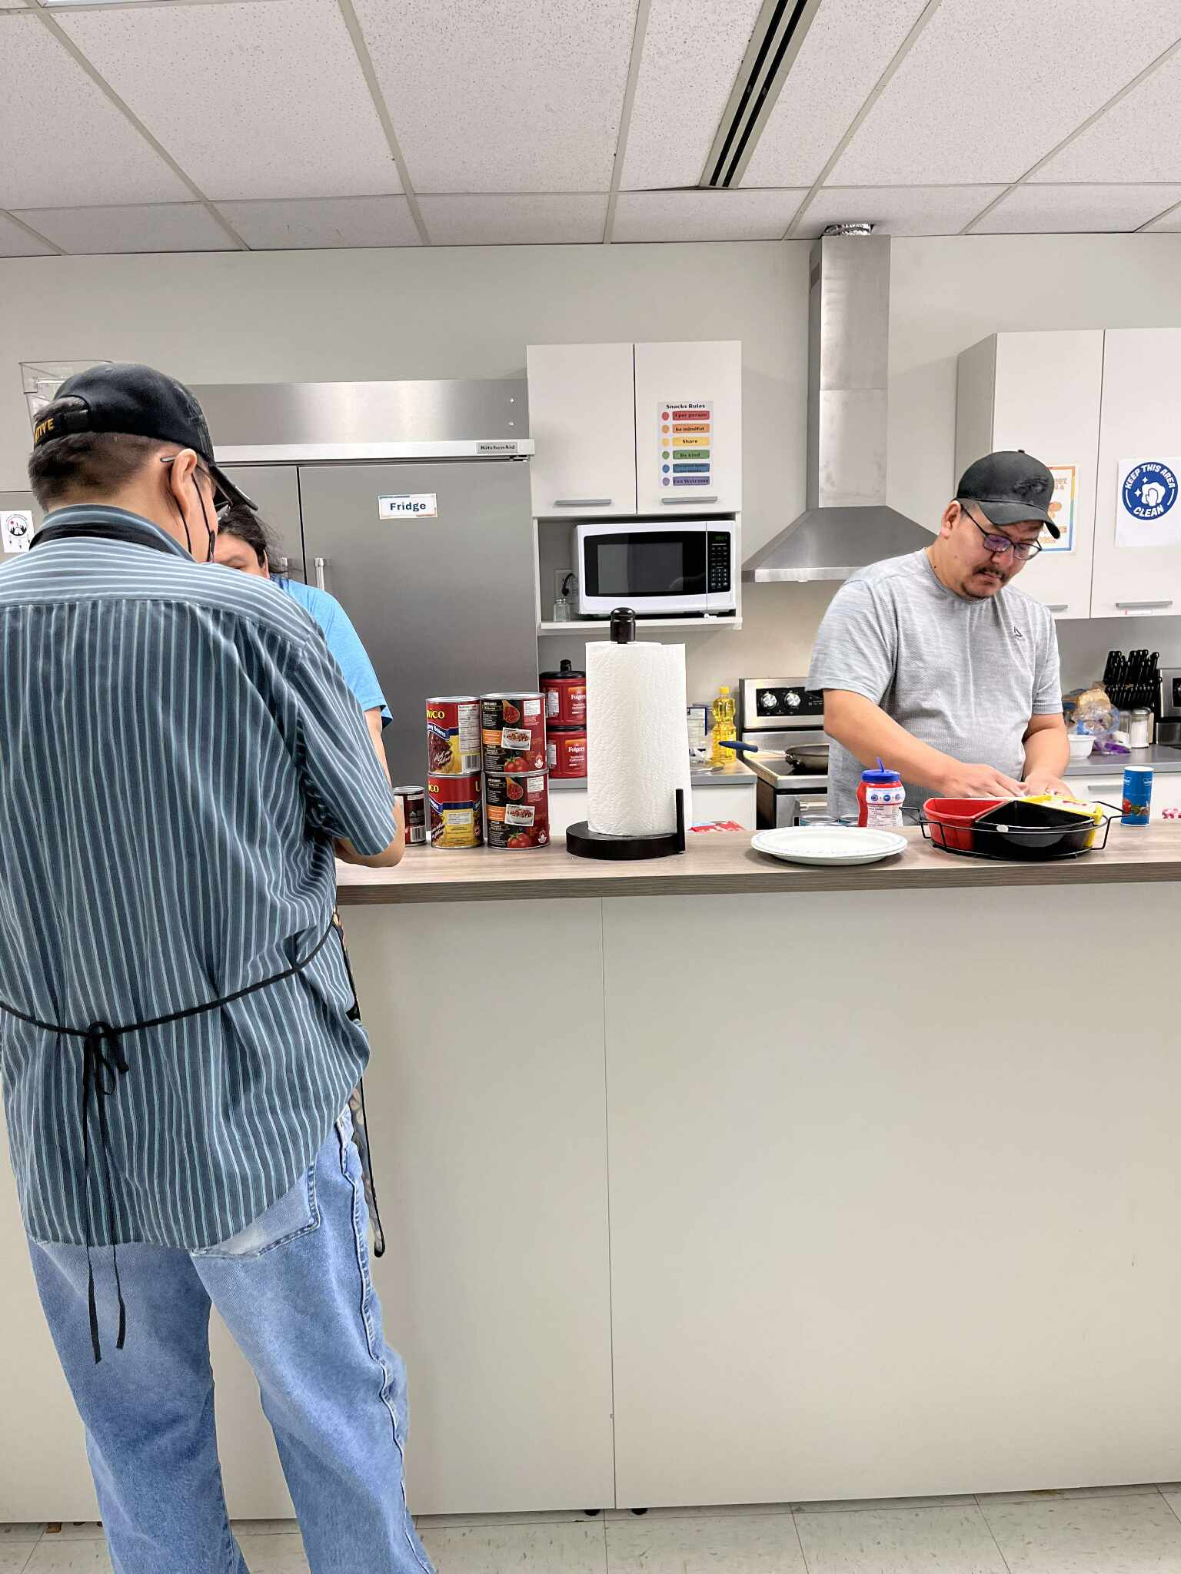
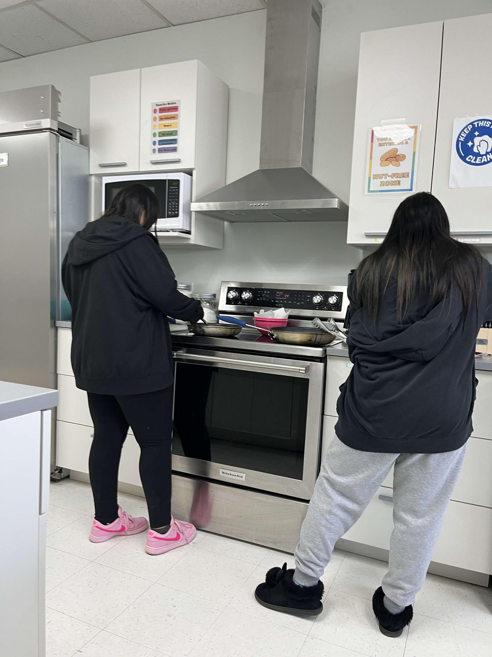
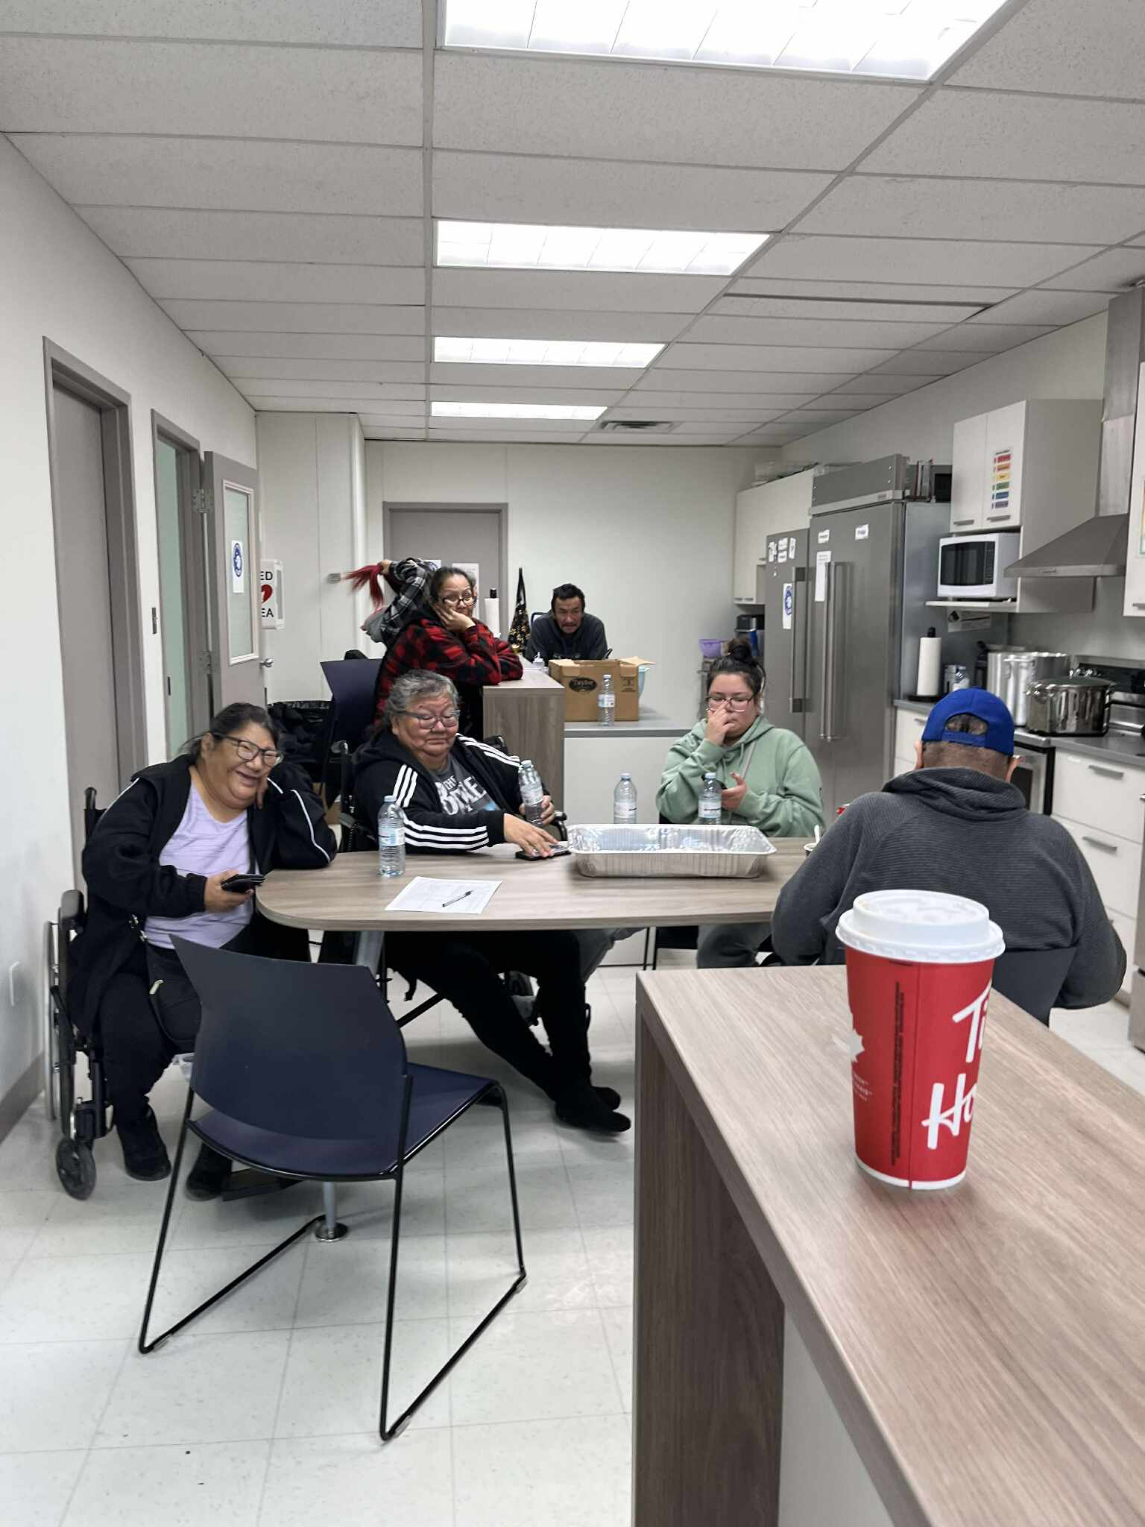
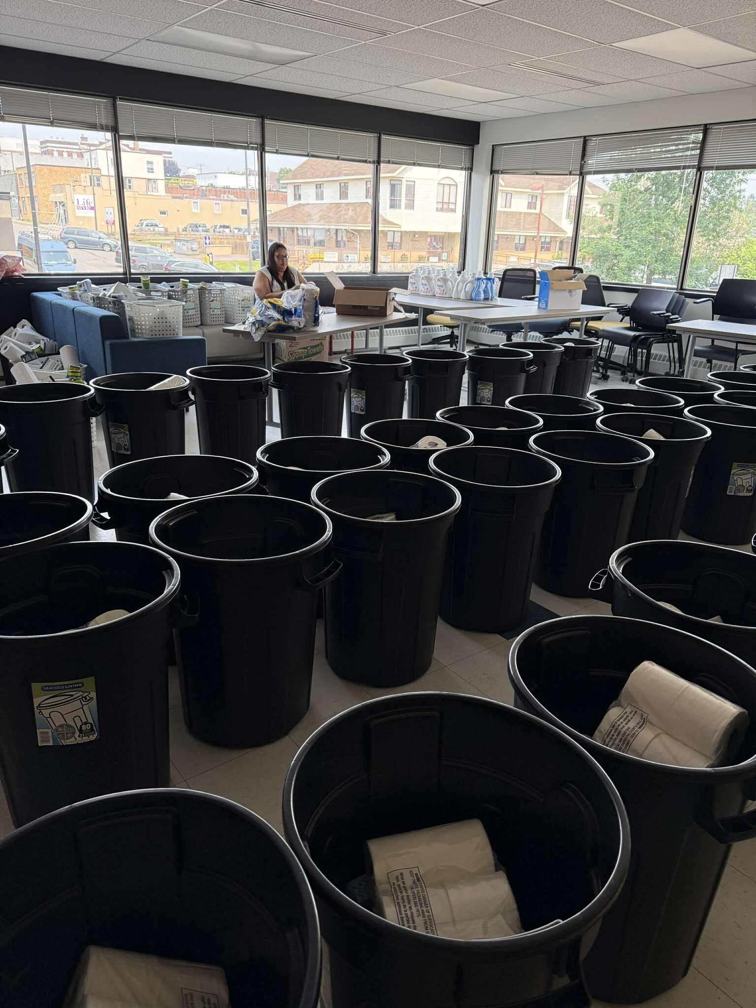
Kookums Pantry Program Support
Monthly Food Hampers
The program provides monthly food hampers to support families and ensure everyone has access to nutritious meals.
Community Kitchen Activities
The kitchen hosts daily hot lunches, cooking classes, feasts, and memorials, strengthening community bonds and unity.
Cleaning and House Maintenance Support
Support includes weekly garbage pick-up, large item disposal, cleaning hampers, and seasonal yard care for community members.
Notes:
Kookums Pantry Program helps families by providing monthly food hampers for community members. The community kitchen is used daily for hot lunches, cooking classes, feasts, and memorials, fostering unity. Additionally, the program offers cleaning and house maintenance support, including weekly garbage pick-up, quarterly large item disposal, cleaning hampers, and seasonal yard care.

Slide 15
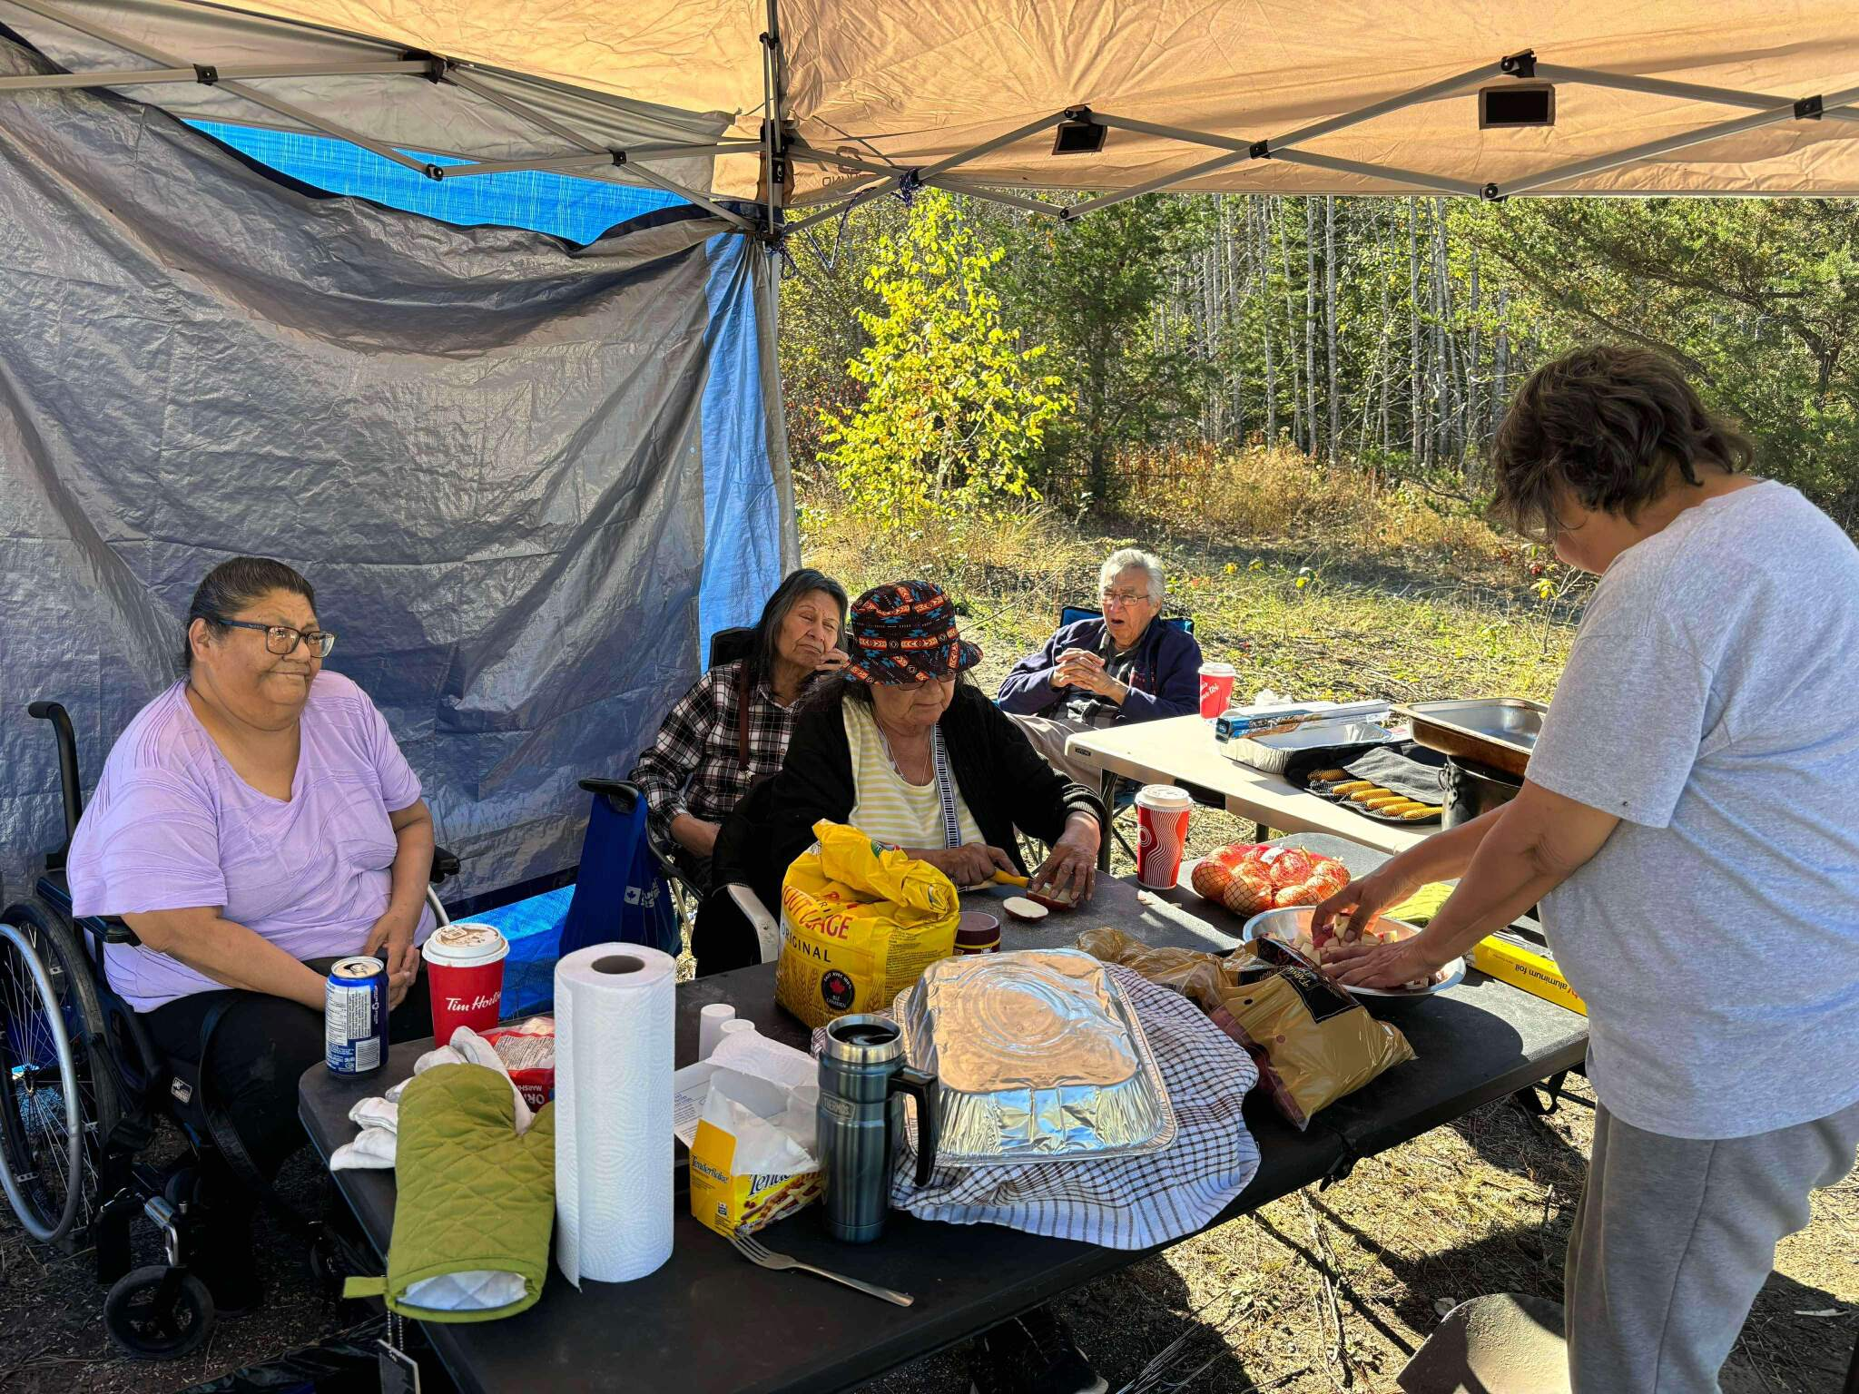
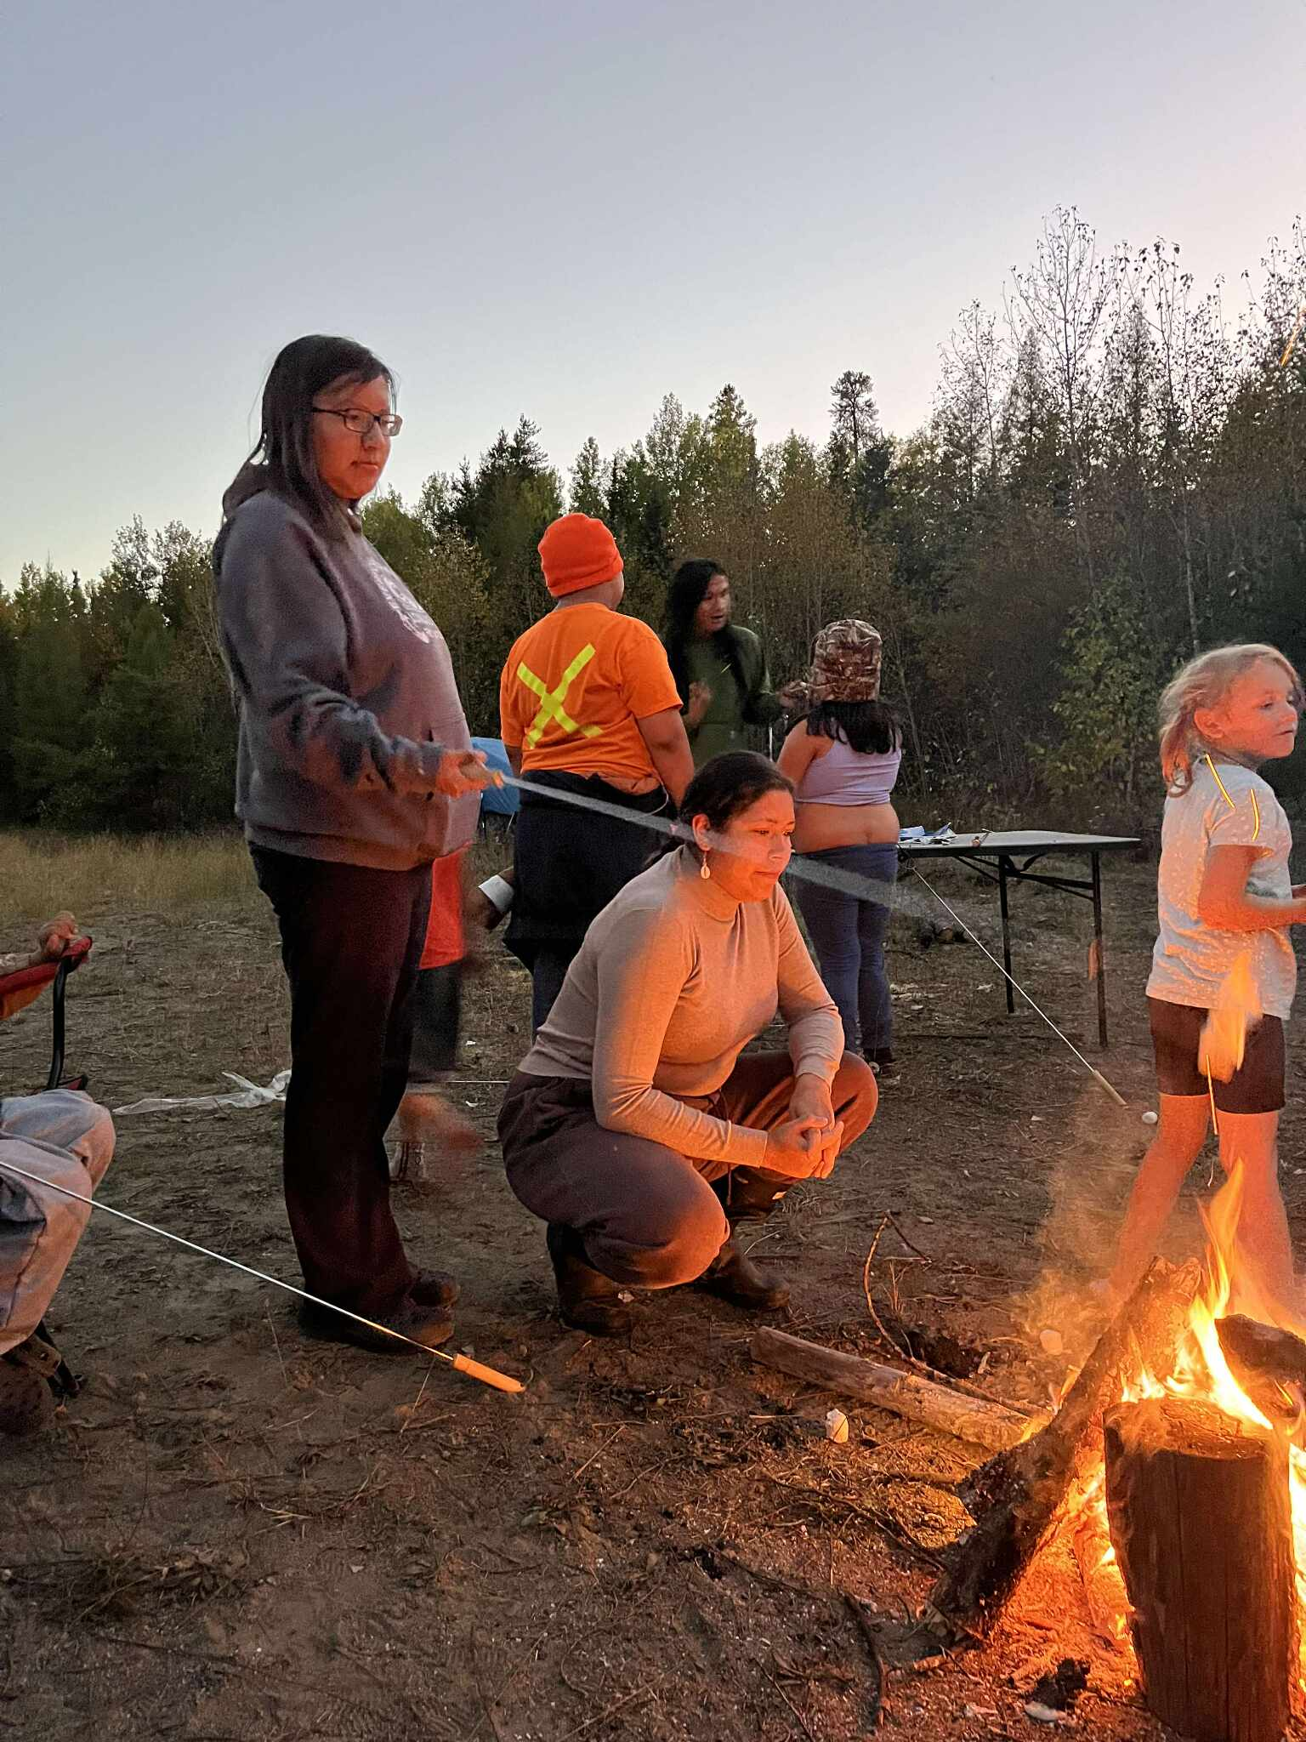
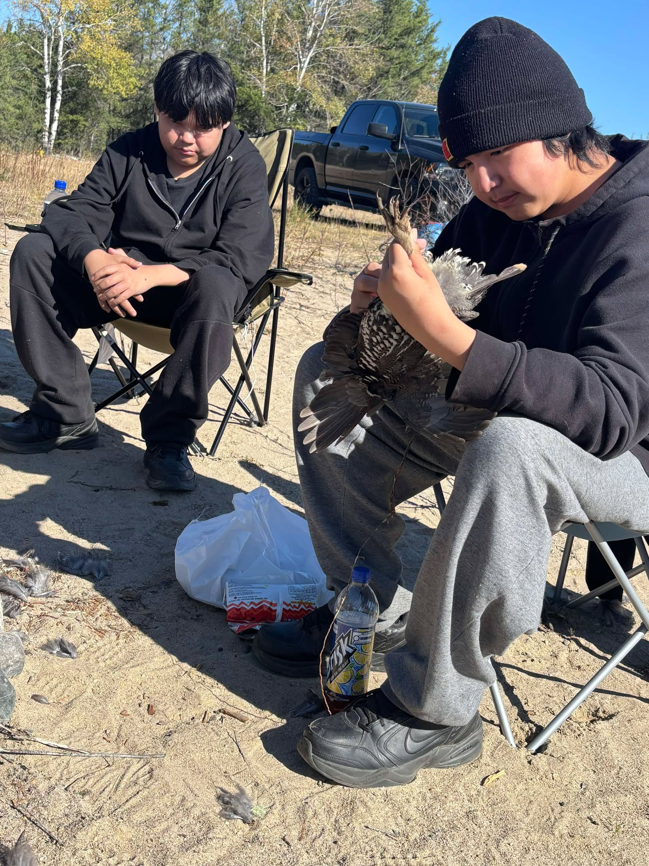
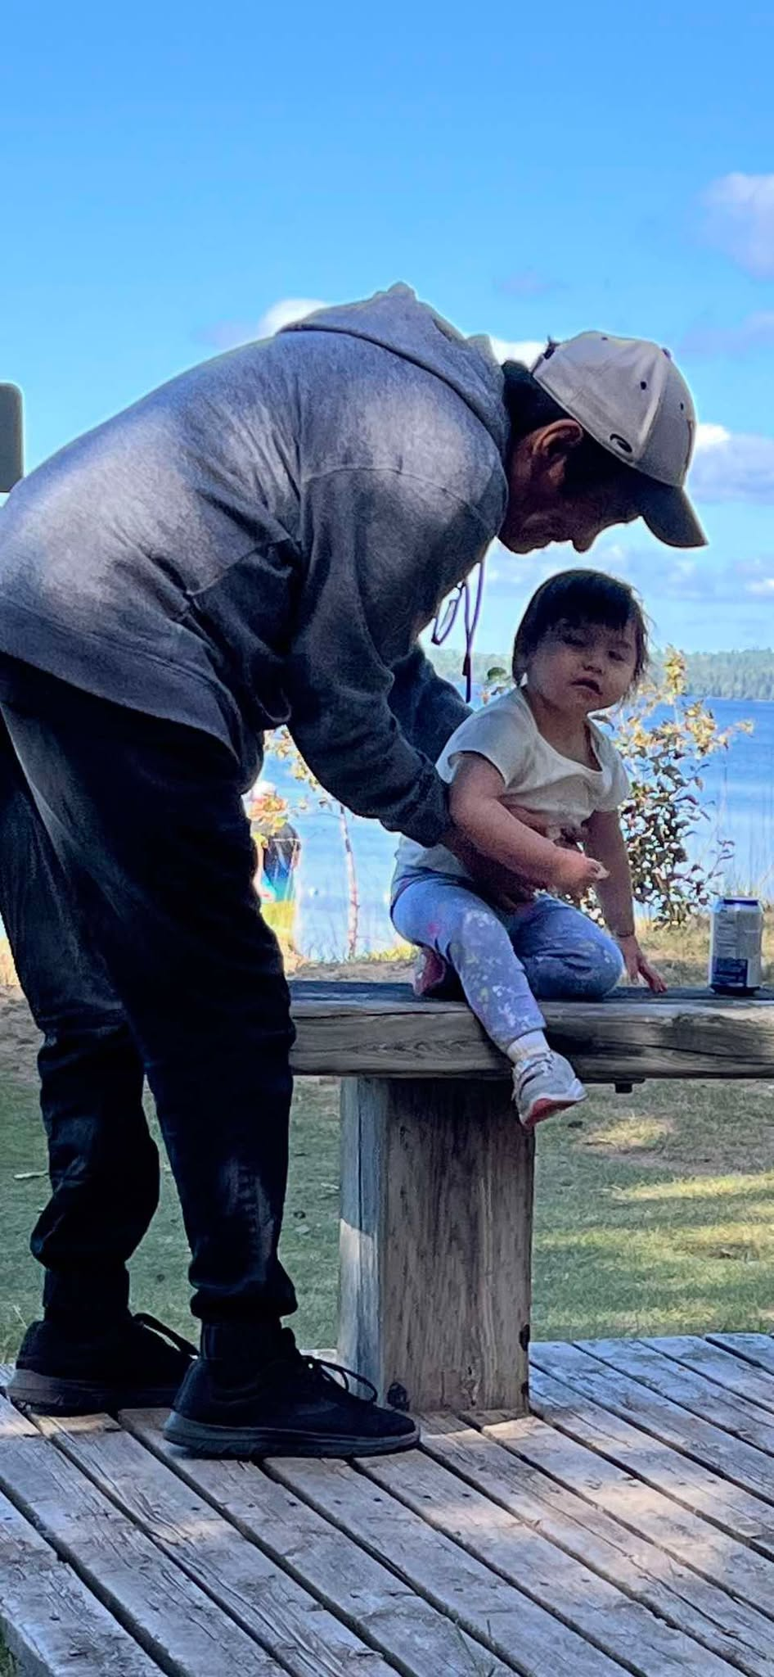
Traditional Parenting, Cultural Practices and Community Support
Takes a community to raise a child
Skills that build resilience
Caregivers learn techniques that strengthen coping and adaptability in children. Learning their roles in the family dynamics in our traditional ways. Fire and Water teachings
Clear boundaries and monitoring
Structured expectations reduce initiation risk and improve family routines. Giving supports when needed to resolve conflicts within the family. Such as sharing circles, counselling sessions, team building activities and learning to listen to each other.
Early recognition of substance use
Parents identify early signs and intervene promptly with support. They enter detox and go to treatment for addictions and family treatment to Aurora Treatment Centre.
Notes:
Parenting programs equip caregivers with skills to foster resilience, set clear boundaries, and recognize early signs of substance use in children. Effective parenting education correlates with a 25-35% decrease in adolescent substance initiation and better family functioning. Such programs often include training on stress management and positive discipline techniques that strengthen parental capacity. Image source: AI-generated

Slide 16
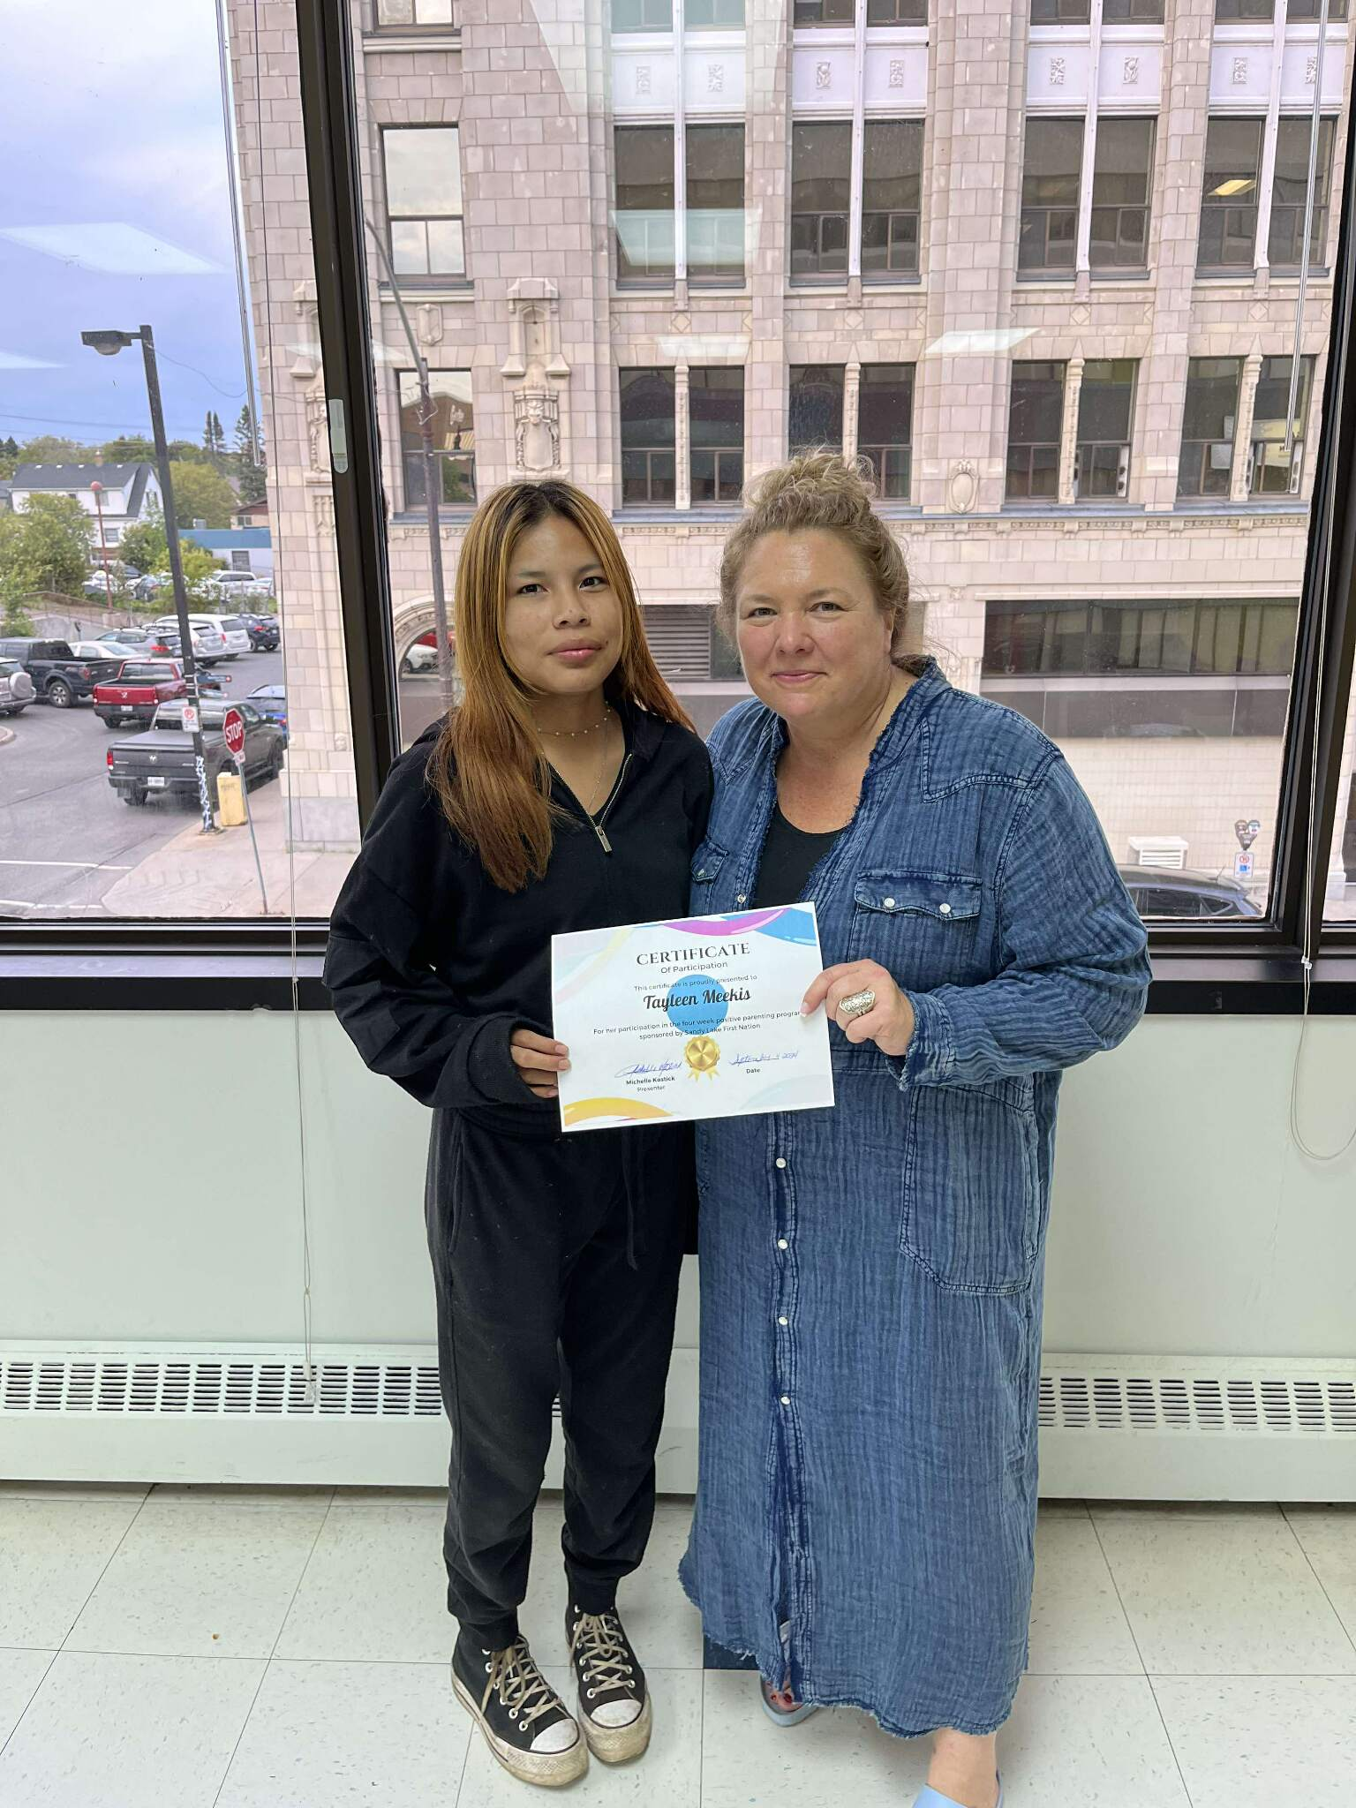
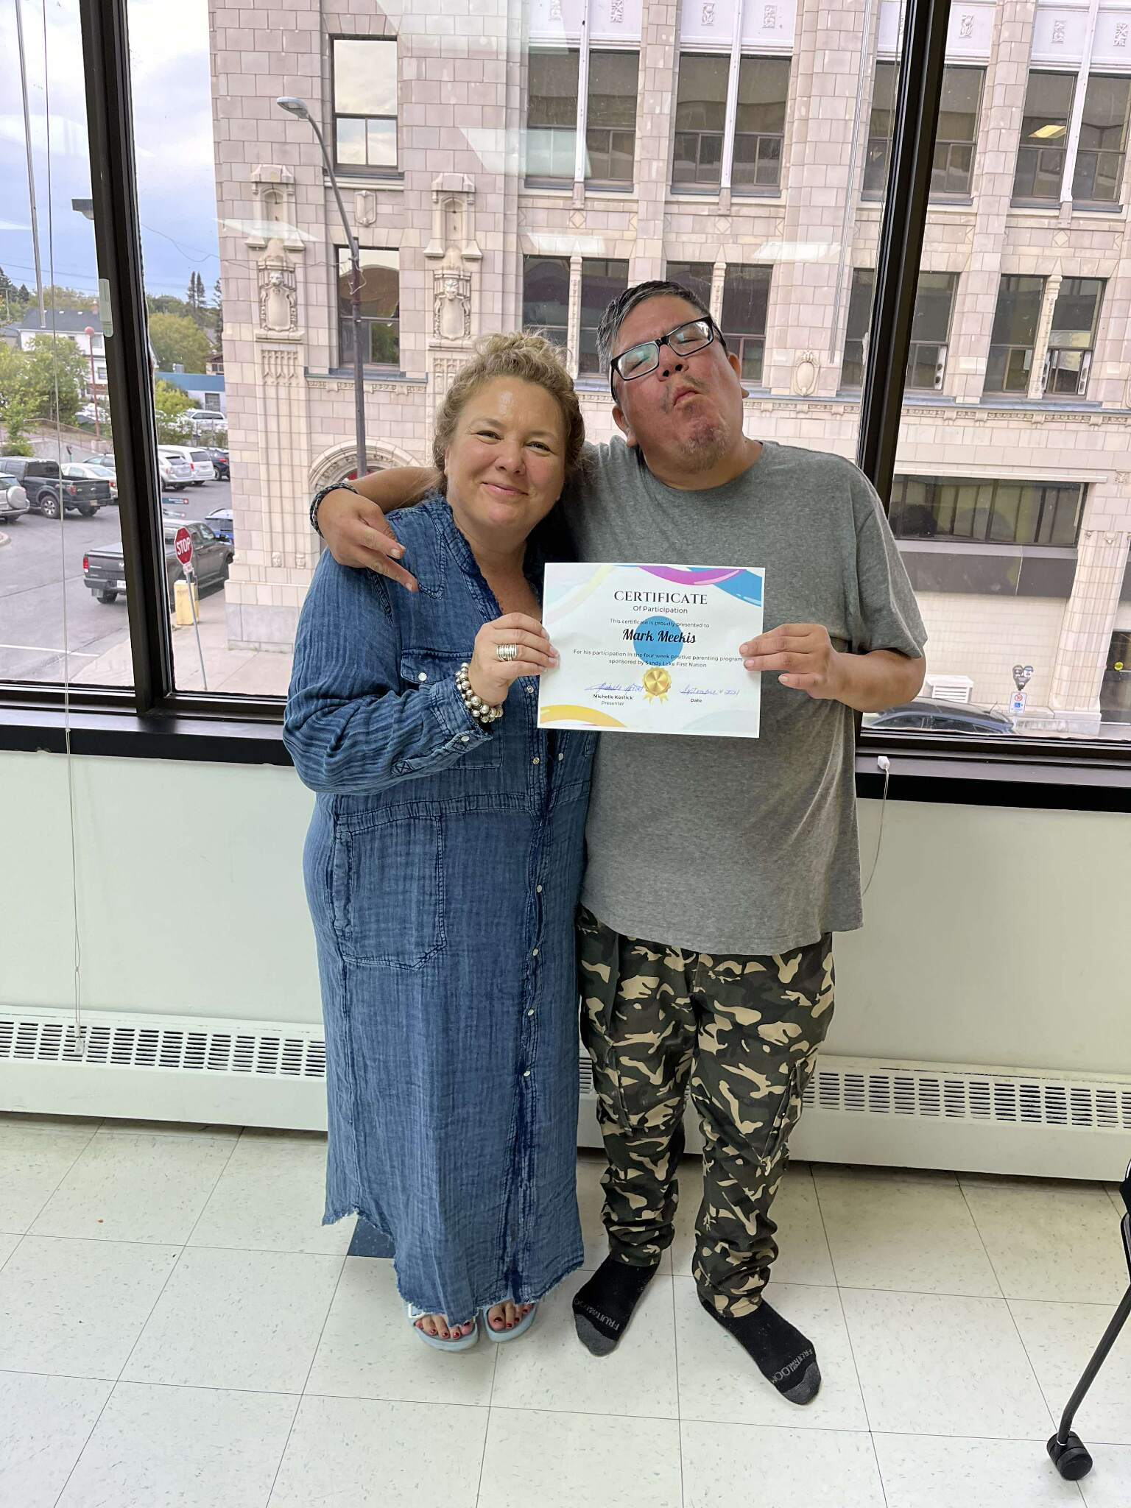
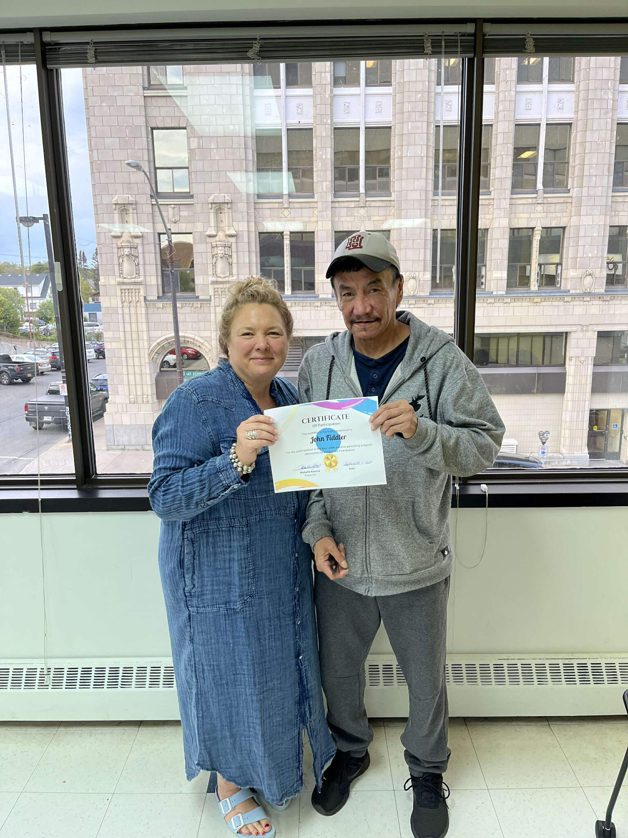
Family Counseling & Mediation Parenting Programs ,Circle of Security
Resolve Conflicts ​
Mediation de-escalates disputes to restore safety and respect. ​
Improve Communication ​
Guided skills build clarity, empathy, and collaborative problem-solving. ​
Strengthen Trust ​
Shared commitments and accountability rebuild connection at home. ​
Family Reunifications ​
Families learning to rely and trust each other when they are reunified and having support to continue becoming a family unit.

Slide 17
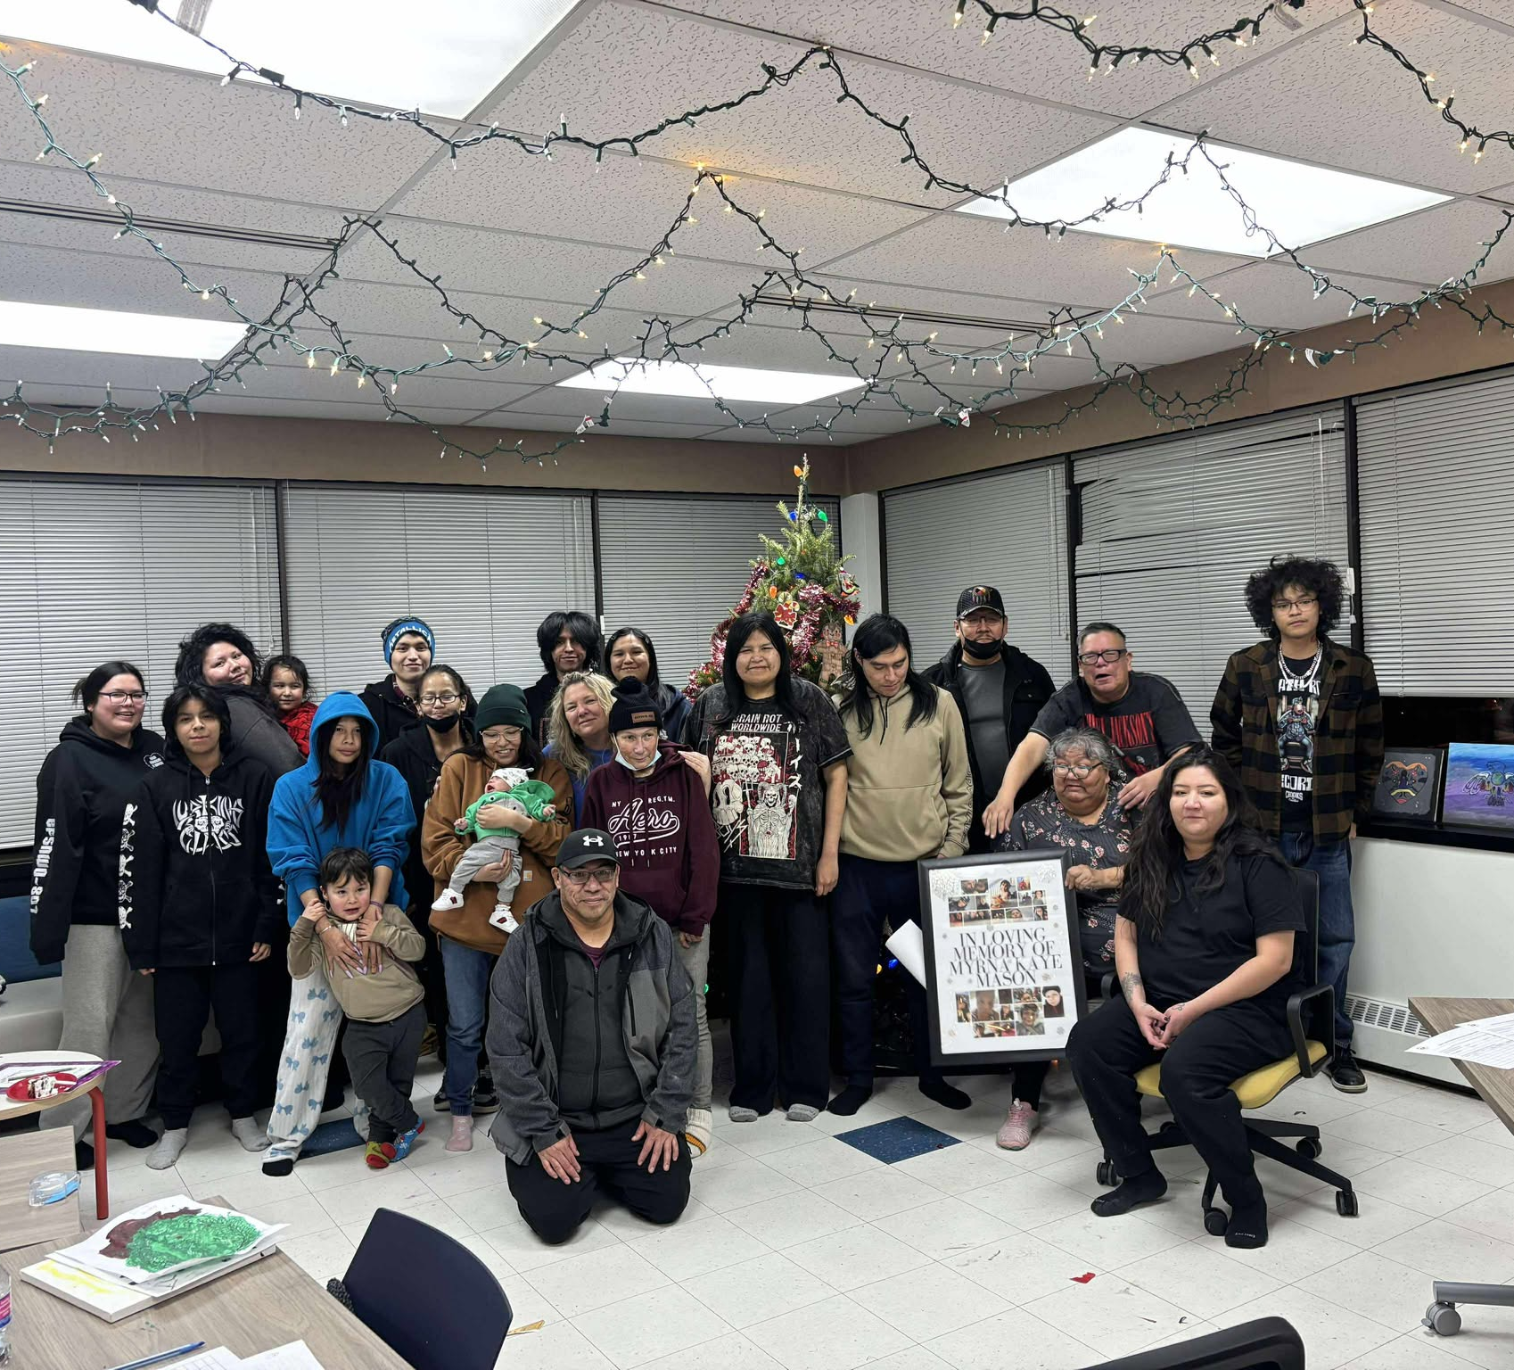
Wellness Within - Empowering Through Workshops
Supporting Family Well-Being
Workshops such as parenting classes and the Circle of Security help families grow stronger and healthier together.
Building Personal Skills
Sessions on grief, coping, self-care, and housing maintenance give individuals tools for daily challenges and personal growth.
Education on Addictions and Trauma
Informative workshops on addictions and trauma empower participants to make healthy, informed choices for their lives.
Notes:
Image source: Microsoft 365 content library Participating in workshops like parenting classes and the Circle of Security supports personal growth and family well-being. Attendees gain valuable skills in grief and coping, self-care, and housing maintenance. Education on addictions and trauma further enables individuals to make informed decisions and foster healthier, more resilient lives.

Slide 18
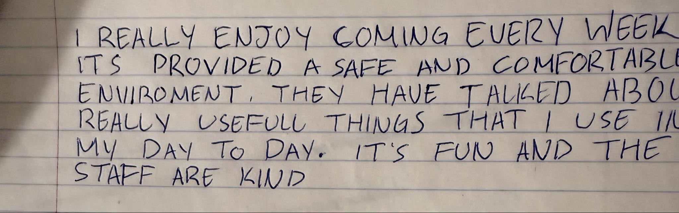
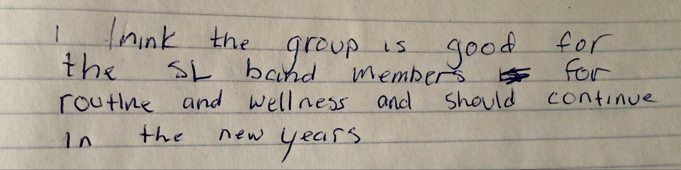
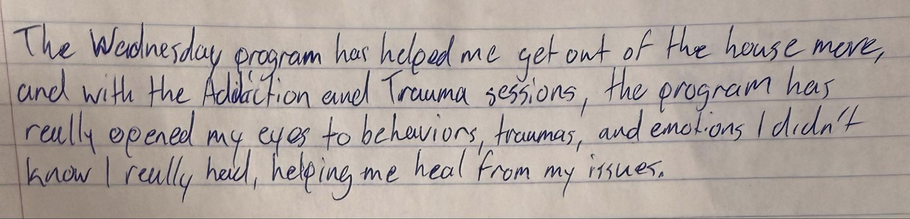
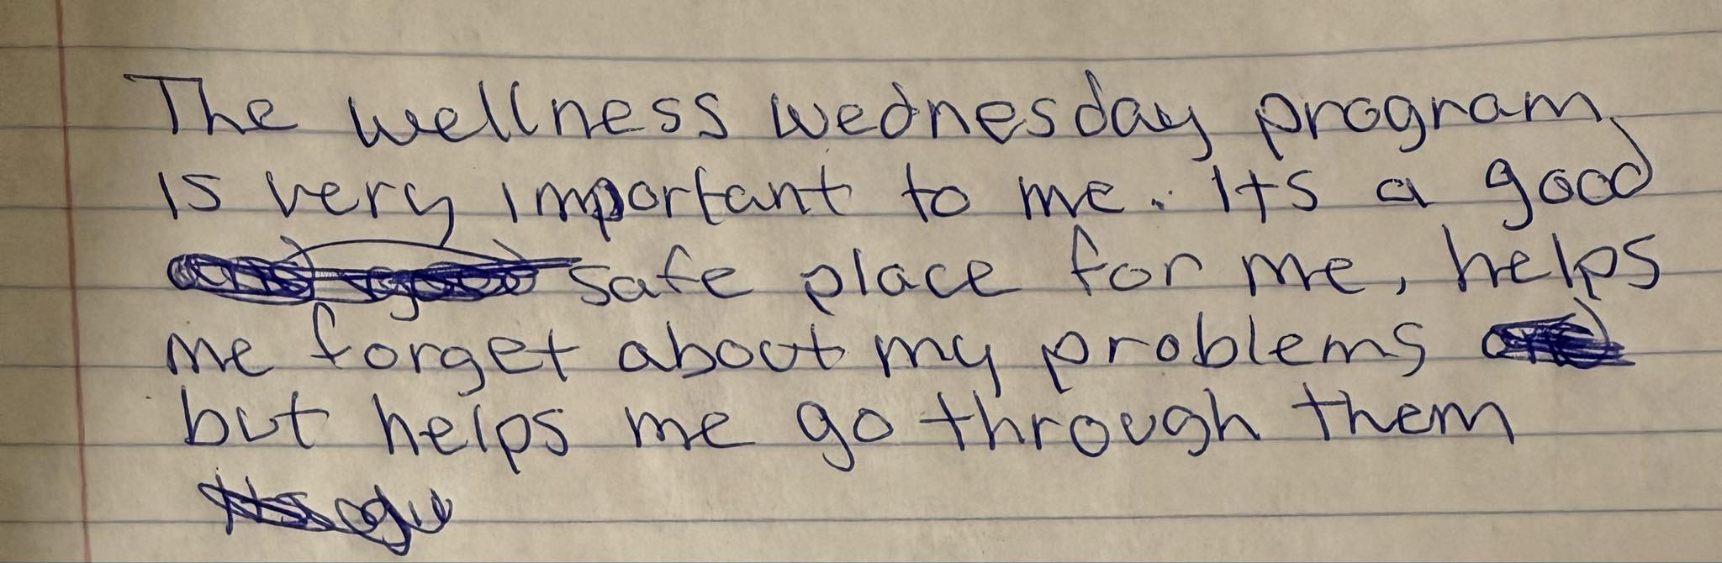
The Power of Feedback
Growth Through Insights
Feedback reveals strengths and improvement areas, supporting personal and professional development for everyone involved.
Building Team Collaboration
Constructive feedback strengthens communication and promotes effective teamwork, leading to better collaboration within groups.
Boosting Performance and Motivation
When feedback is delivered well, it enhances motivation, improves performance, and inspires continuous growth in both individuals and organizations.
Notes:
Image source: Microsoft 365 content library Feedback is essential for personal and professional growth, providing insights into strengths and areas for improvement. Constructive feedback fosters better communication and collaboration within teams. When delivered effectively, it boosts motivation, enhances performance, and drives continuous development in both individuals and organizations.

Slide 19
How it all connects together Prevention Aftercare Healthy Family

Slide 20
Integrated Prevention, Recovery After care, and Family Support
Comprehensive Approach
Blend prevention, aftercare, and family services to address addiction holistically culturally and traditionally.
Stronger Families & Communities
Build resilience, improve family dynamics, and foster healthier communities.
Coordinated Partnerships
Align community programs, child protection, and families for consistent support.
Sustained Aftercare
Maintain recovery momentum with accessible, long-term follow-up services. Continued support of clients and families in all aspects

Slide 21
What is Post Majority Care and who is eligible
Post majority care assists youth aging out of care and young adults that were formerly in care, from 18 years old to 26 years old.
We assist our youth with the pillars of support to help transition them into adulthood. While advocating and mentoring our youth to become independent and self-sufficient.

Slide 22
Pillars of Support
The pillars of support is designed to help our young adults thrive within the community and develop necessary life-skills.
It ensures safety , security and stability for youth that have left care.
We are here to support in each youth in every step in their transition in becoming an adult.
Include
Learning, educational and professional development opportunities.
Reconnection with land, culture, community, and language.
Physical, mental, and social wellbeing.
Financial support, safe and stable housing.
Advocacy and transition to adulthood.

Slide 23
Individualized Plans
We create an individualized plan that is specific for each youth, the youth will work with the post majority worker to create their own transition plan that aligns with their own goals.
Individualized plans may include, supports/assistance with but not limited to;
Cultural programing, and community involvement ( Land-based activities, teaching youth about traditional food-how to prep and cook-learning about the language, flying back to Sandy Lake First Nation for community activities and holidays)
Assistance obtaining identification. (Learning about how and where to apply)
Educational and learning opportunities (Applying for school, assistance with school supplies, transportation, and application fees)
Finding safe and stable housing (Being their advocate to find suitable housing and teaching them resources on where to turn to)
Food security (Kookum's pantry, providing financial assistance with special diet needs)
Life-skills (Income tax, healthy living, meal prep, money management)
Support/advocate (Applying for a family doctor, dentist, optometrist, social assistance, housing)
Financial support (Application fees, transportation fees, medical cost that insurance or NIHB does not cover, driving school)

Slide 24
One-on-One Support
Youth are provided one-on-one support with an assigned post majority care worker. One-on-one provides our youth with;
Mentorship
Builds trust and relationships
Creates communication
Creates a support system
Creates a safe space

Slide 25
Community Involvement
Post Majority youth have been displaced and assimilated into society. They need a place to feel safe, grow and have a sense of community.
Mamow Weechiwaywin creates that space for Sandy Lake youth and young adults. It is breaking the cycle of inherited trauma and builds a healthier, resilient, and stronger generation.
We are stopping intergenerational trauma as a community.

Slide 26
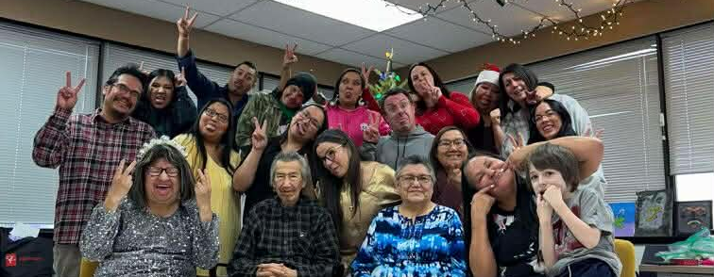
Miigwetch

