Slide 1

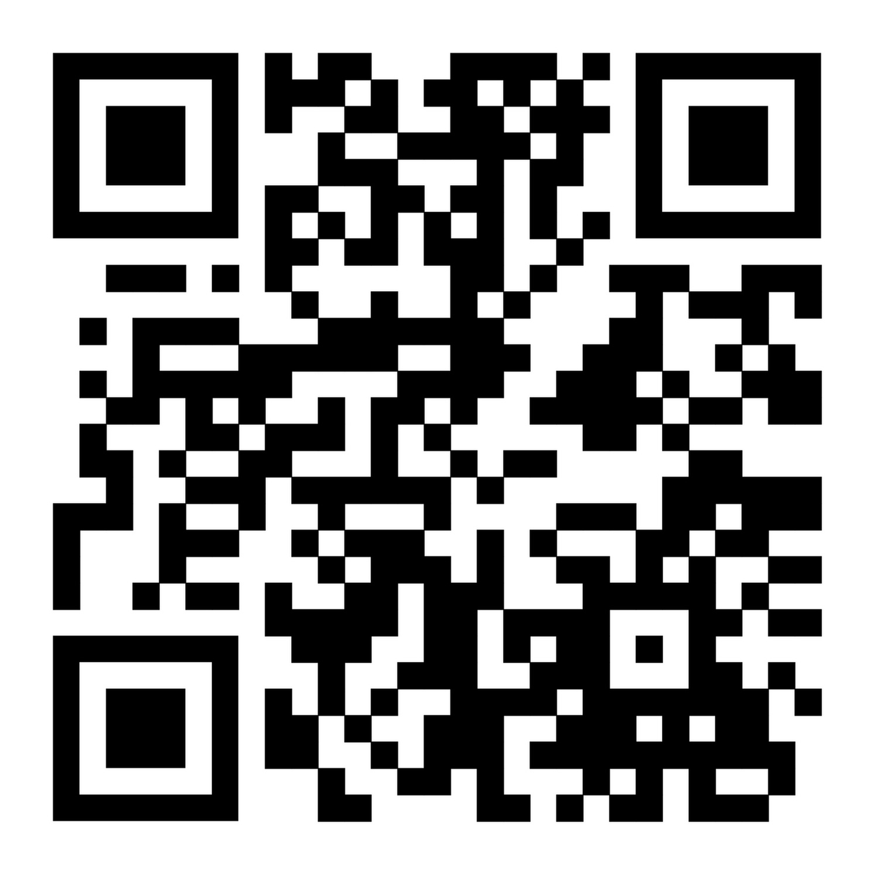
Scan to download this presentation
Updated Procedures for Birth Certificate Applications
Presented by: Lorraine Mashongoane
Date: January 2026

Slide 2


Access to services (ex. Canada Child Benefit, Canada Pension, NIHB after age 2, OHIP, education, banking, employment, housing etc.)
  Status card
  Health card
  Photo card or license
Birth registration
Birth certificate

Slide 3
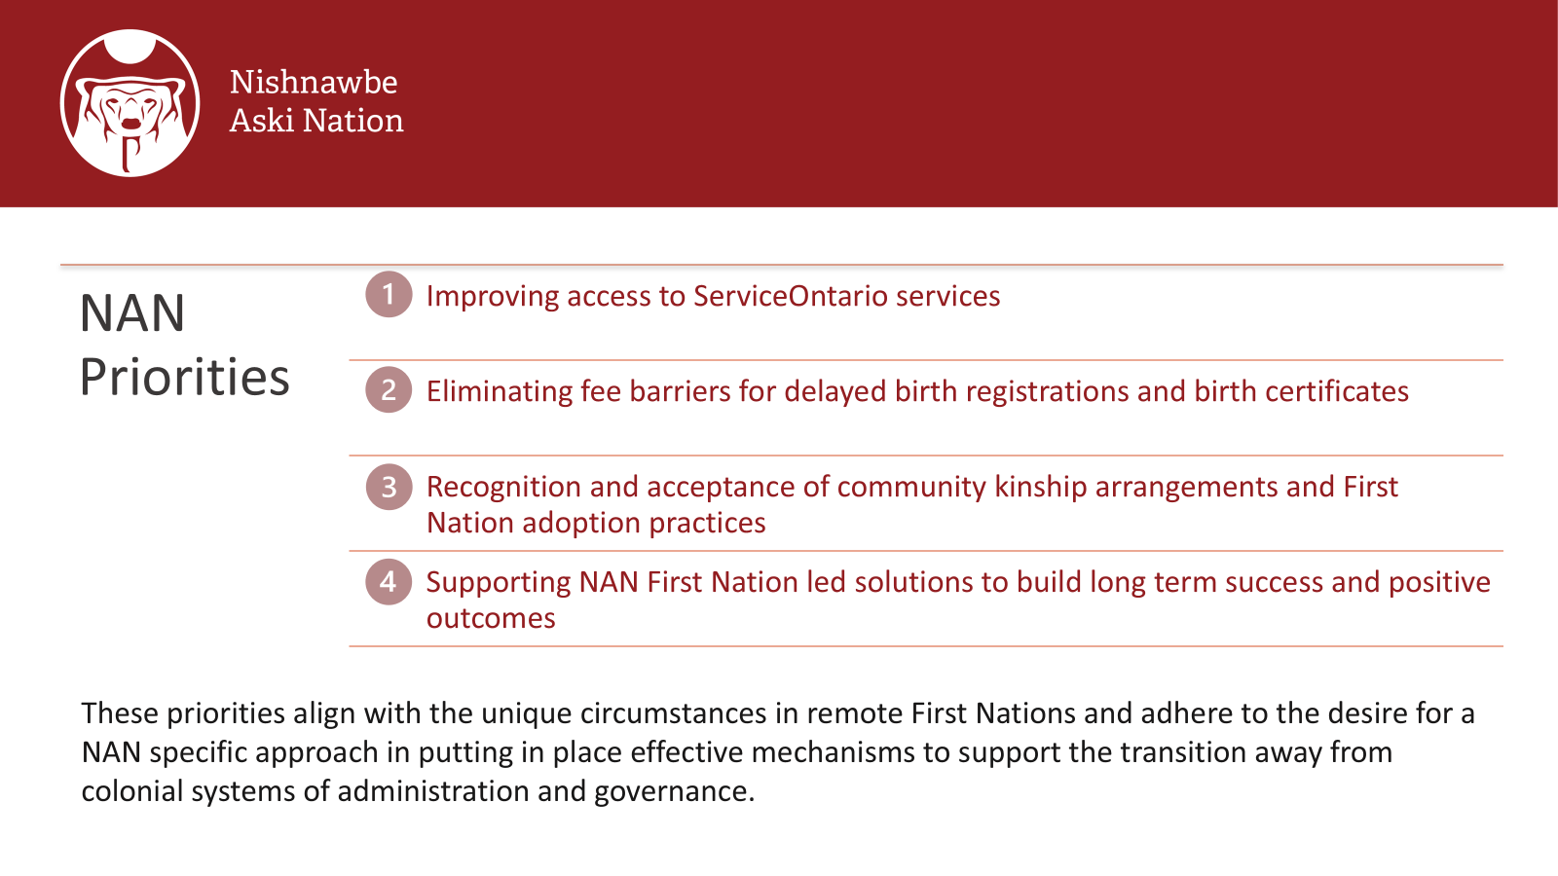

Slide 4
Timeline of Commitments and Work to Date
2019
2020
2022
2023-24
NAN urged former Minister –MGCS to act on systemic barriers resulting in a high # of NAN children without ID
Commitment from Minister to work with NAN to find long term and sustainable solutions
Multi-table was formed w leads from KOSS, MECC, MGCS, IAO, MCCSS, MTO, MOH, Service Canada, ISC, NAN depts
Information Sharing and Review of successful service models in FN’s
Jurisdictional scan on processes across Canada
Data analysis to better determine population data
Work began on draft Priorities and Action Plan for Ministerial review
IAO committed funding to support ID clinics as part of a First Nation led process
Vital Statistic provided training and support
KOBE, Matawa and NAN hosted clinics in 7 NAN communities
Finalized NAN Barriers to ID: Priorities and Proposed Action Plan and Pilot ID Clinics Report
Meeting with IAO and MPBSD DM’s to present action plan
1 year funding provided
Ontario Ombudsman

Slide 5




Service Ontario’s Office of the Registrar General (ORG) is responsible for registering vital events (births, deaths, marriages, still-births, changes of name, adoptions) that occur in Ontario and issues certificates and certified copies of registered vital events
Register vital events & validate birth registration information
Process applications, print, and distribute certificates

Slide 6

ORG Amendments to Operation Policy
The amendments apply only when the parent(s) or person(s) with lawful custody or decision-making responsibility of the child is/are not available
-
The amendments will:
Remove the need for a third-party authorization form signed by the parent(s) or person(s) with lawful custody/decision-making responsibility, and
Add the ability for custom adoptive parents and First Nation Child and Family Services to apply for birth certificates for children in their care.
+

Slide 7
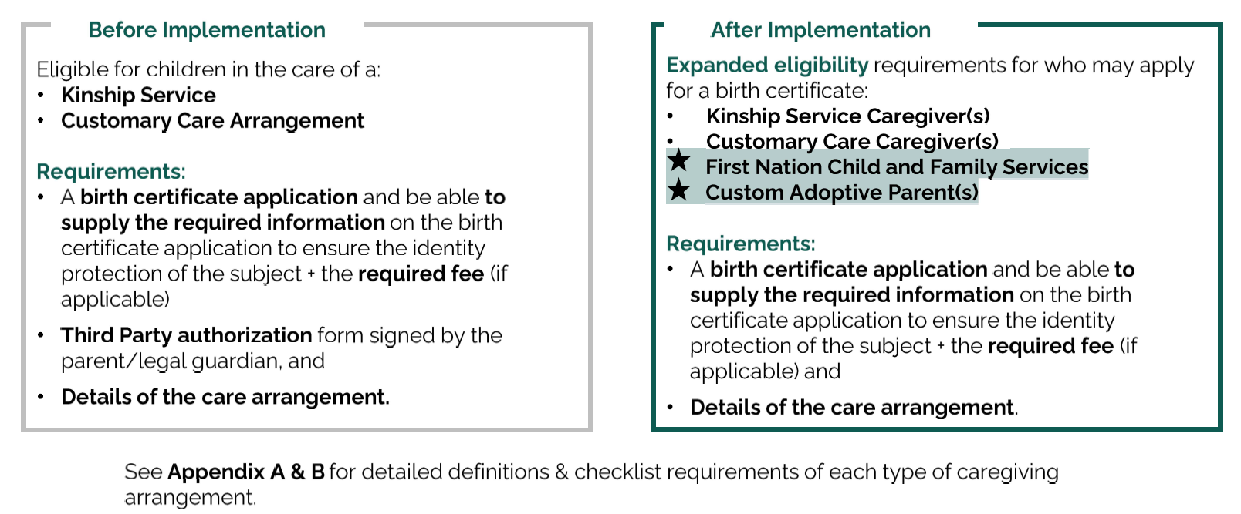

Slide 8
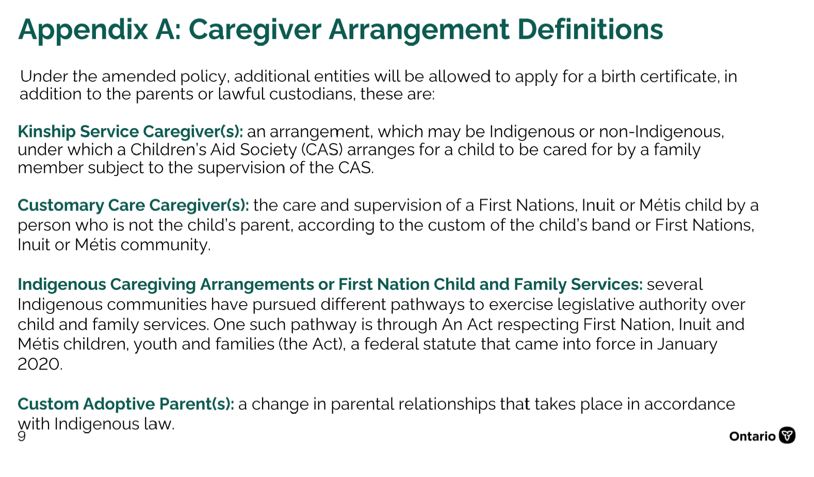
Appendix A: Caregiver Arrangement Definitions

Slide 9
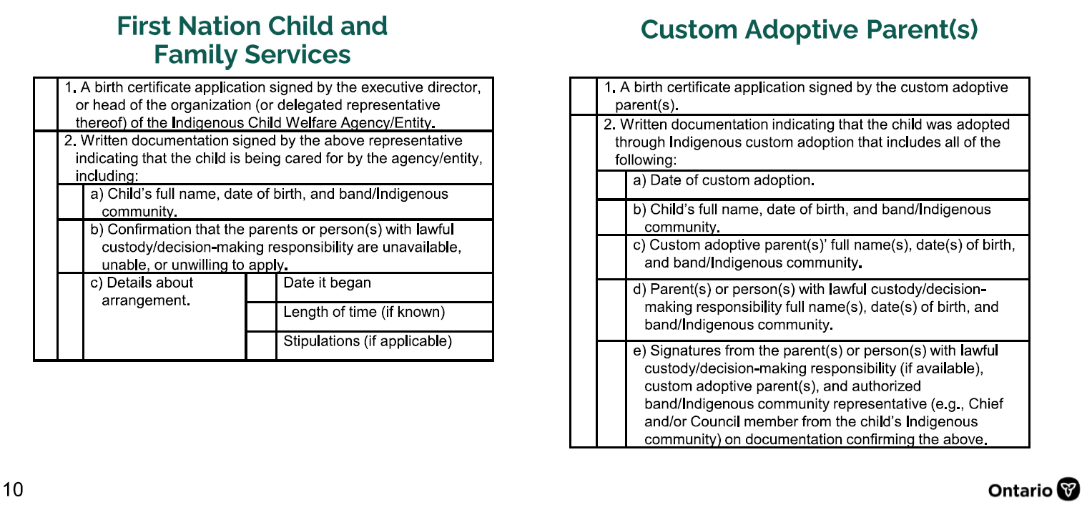
Appendix B: Caregiver Arrangement Application Checklists

Slide 10
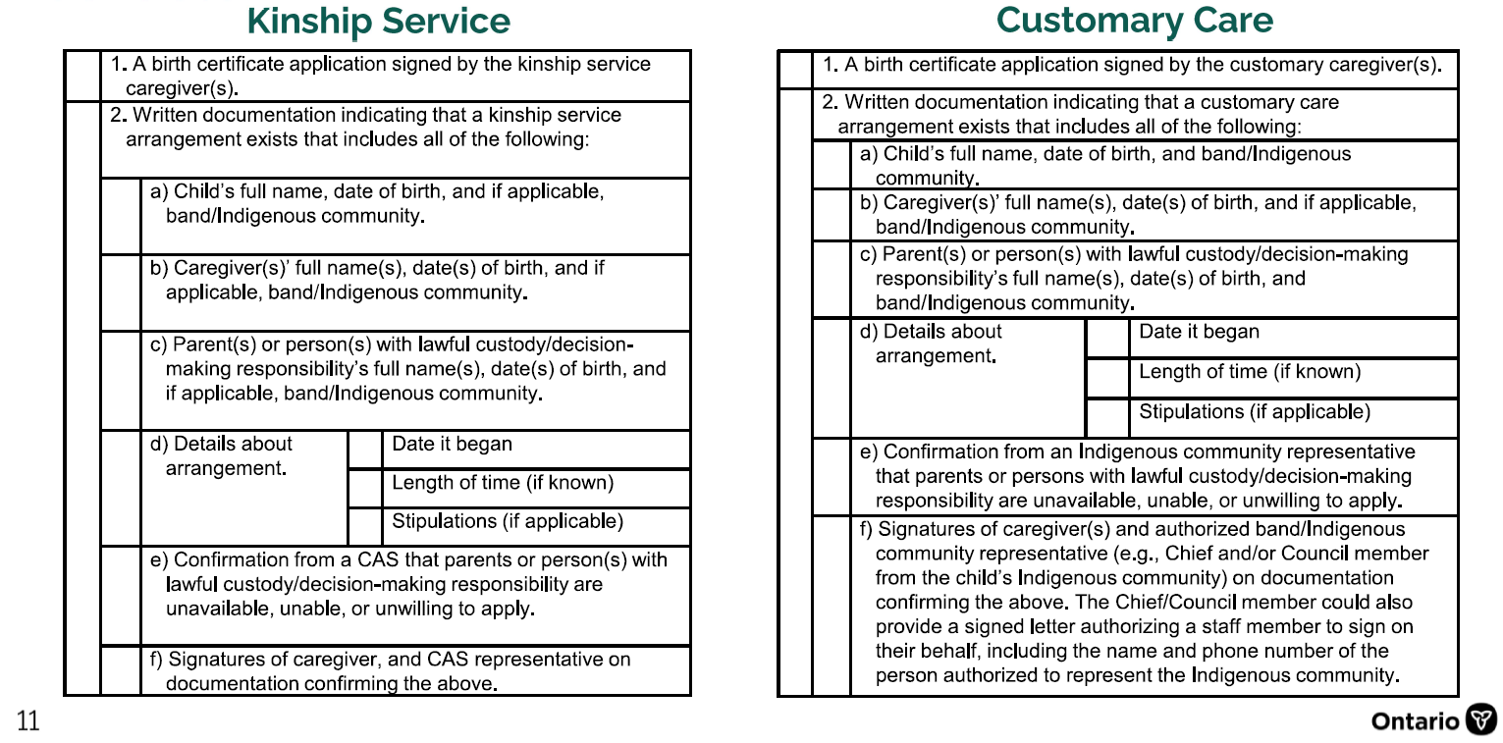
Appendix B: Caregiver Arrangement Application Checklists

Slide 11
Scan to download a copy of this presentation
Or request a copy of this presentation via email please contact
lmashongoane@nan.ca

