Slide 1
Ontario Works, ODSP and ACSD Overview
Presentation for NAN

Slide 2
Who is ONWAA?
We have been supporting Ontario Works Administrators and Homemakers Coordinators and their offices since 1972. We provide culturally appropriate training and tools to these offices.

Slide 3
Ontario Works Application and Process
You will be requested to set up an appointment if living on-reserve, off-reserve the client can start the process online.
They will be required to bring in the following pieces of information:
*Birth certificate, *status card, *social insurance number, health card;
verifications of shelter expenses (rental agreement, mortgage, hydro/utility bills, fire insurance policy);
income tax return;
verification of income from any source for self, spouse and dependents. (Included but not limited to: EI/OAS/WSIB/Pension/rental income/Income from Roomers/Boarders/Income from Employment)
Verification of assets owned; (vehicles, inheritance, life insurance policy, etc.)
copy of up-to-date bank book or a statement

Slide 4
ODSP Application and Process
Applying to ODSP thru the Ontario Works Office, if a client is a person with a disability or becomes a person with a disability while on Ontario Works they can apply to ODSP thru the Ontario Works office, a package will be given to them and then it will go to the Disability Adjudication Unit and they will review (this process takes a long time for adjudication.) You will have to supply medical information for the DAU to review, and you may have to appeal if denied.
You can also apply to this program online.

Slide 5
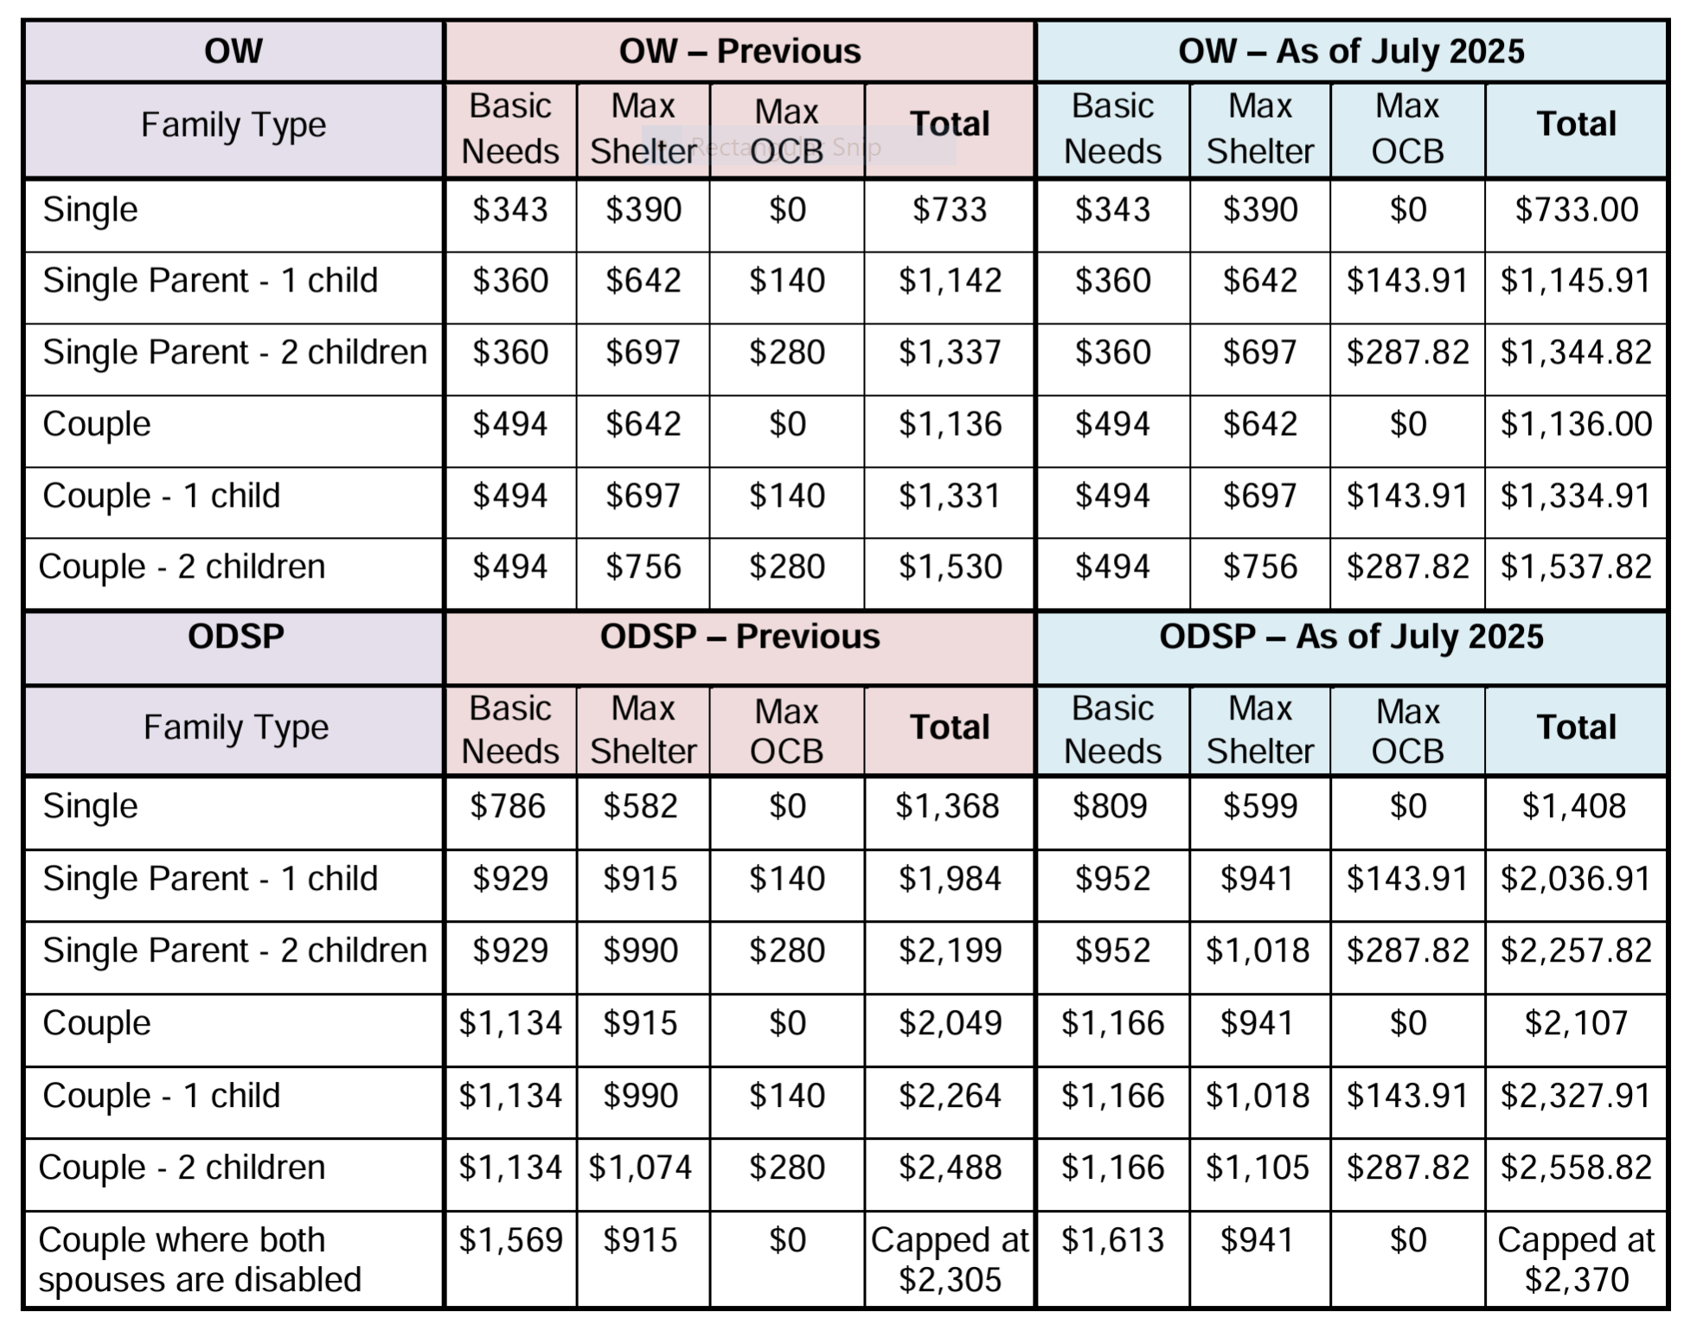
OW and ODSP rates

Slide 6
ACSD – Assistance for Children with Severe Disabilities
If you are a person who is caring for for a child with a severe disability you may be eligible for financial support thru ACSD. Eligible parents and guardians can receive between $25 and $655 a month to help with disability related costs. If the child qualifies for ACSD, they may also qualify for other programs such as Special Services at Home or the Enhanced Respite Program
The application process is available online thru Ontario or you can download a paper copy and mail it to MCCSS.
Annual increases to the program are tied to inflation.

Slide 7
ACSD Continued
Income eligibility
You may be eligible if your total household income is $76,920 or less. You must also meet other factors of eligibility.
Other factors for eligibility
Along with your household income, your eligibility and the amount you receive from the program is based on the:
size of your family
severity of your child’s disability
extraordinary costs related to your child’s disability
What does the ACSD program provide for?
travel to doctors’ appointments, hospitals and other appointments related to the child’s disability
special shoes and clothes
parental relief such as respite
In addition to getting monthly financial support the ACSD program, children may also receive coverage for:
Assistive Devices
Batteries and repairs for mobility devices
Prescription drugs through OHIP +
Dental care thru healthy smiles
Hearing aids and vision care, including eyeglasses
Once granted for ACSD as a child, when you age out of the program, if the youth is still disabled the application process for ODSP is fast tracked.
ODSP has rapid reinstatement where the client on ODSP wants to work or their illness is episodic. So instead of having to apply for ODSP thru OW all of the time and waiting the client can become eligible again for ODSP

Slide 8
Questions?

