Slide 1




CHILD AND COMMUNITY WELL-BEING PLAN (CCWP)
January 13, 2026

Slide 2

PREVENTION / TRANSITION TEAM
CONTACT INFORMATION
KRISTIN MURRAY
EXECUTIVE DIRECTOR
  KRISTIN.MURRAY@KUNUWANIMANO.COM
ANGELA DELCOL
PROJECT MANAGER
  ANGELA.DELCOL@KUNUWANIMANO.COM
MARLENE KAPASHESIT
DIRECTOR OF PREVENTION
MARLENE.KAPASHESIT@KUNUWANIMANO.COM
KRISTINE ARTHUR
PROJECT MANAGER
  KRISTINE.ARTHUR@KUNUWANIMANO.COM
CHARLENE MOORE
DIRECTOR OF SERVICE
  CHARLENE.MOORE@KUNUWANIMANO.COM
TAYLOR CLAVEAU
PROJECT COORDINATOR
  TAYLOR.CLAVEAU@KUNUWANIMANO.COM

Slide 3
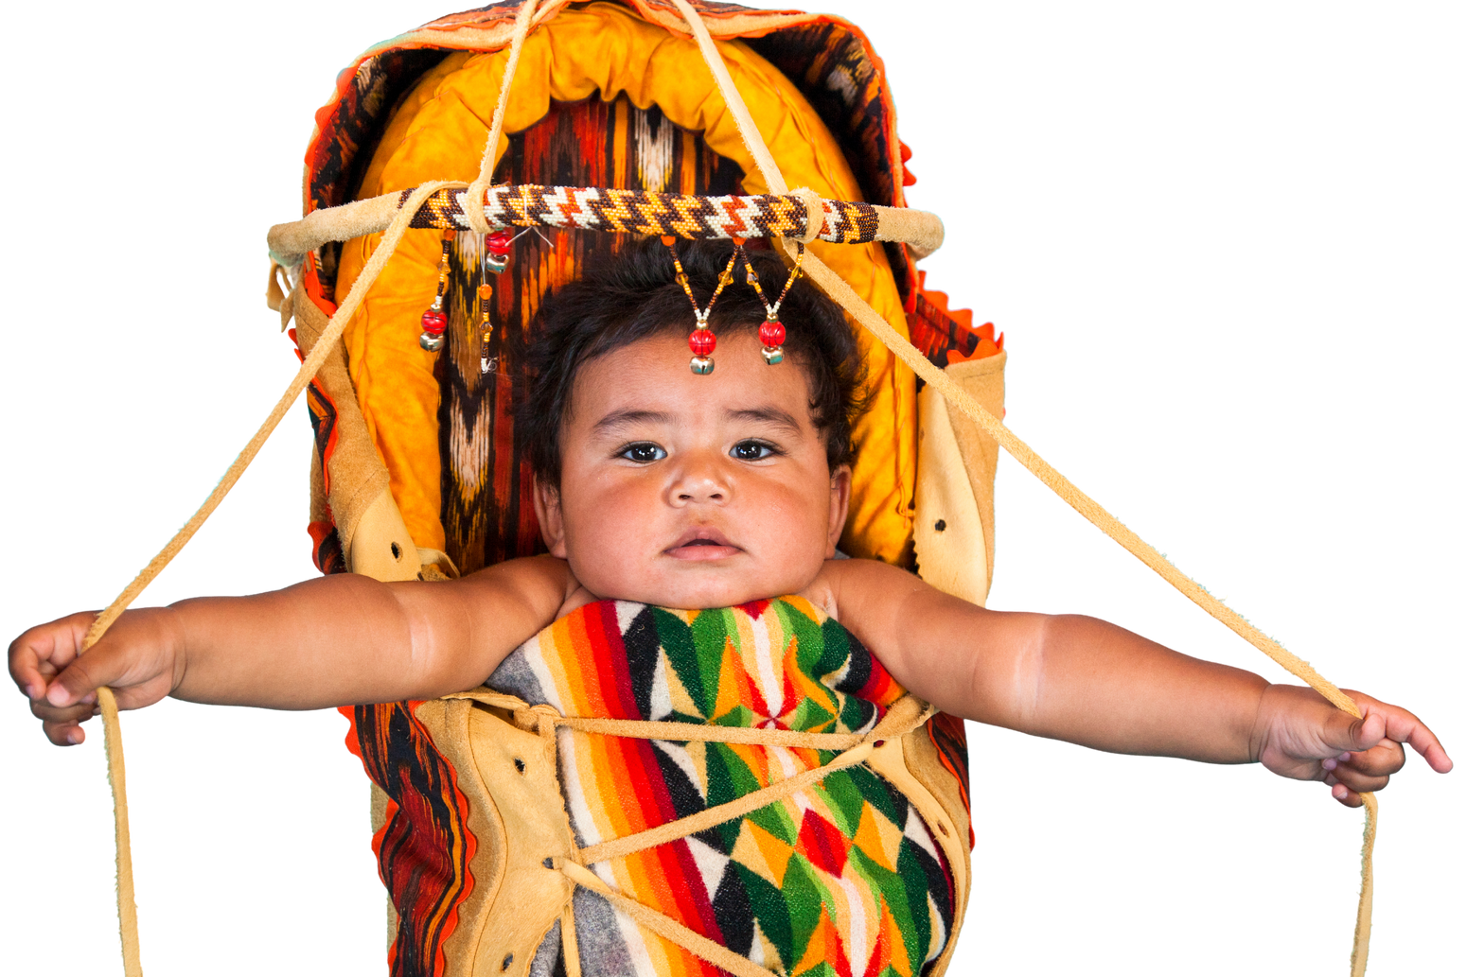
OUR VISION
OUR MISSION
To hold children in the center of all decisions, honour the integrity of our ancestral ways of life, and strive to keep the family healthy and safe.
Unifying First Nations with Kunuwanimano to develop a strong foundation of shared responsibilities in our work with children and families.

Slide 4
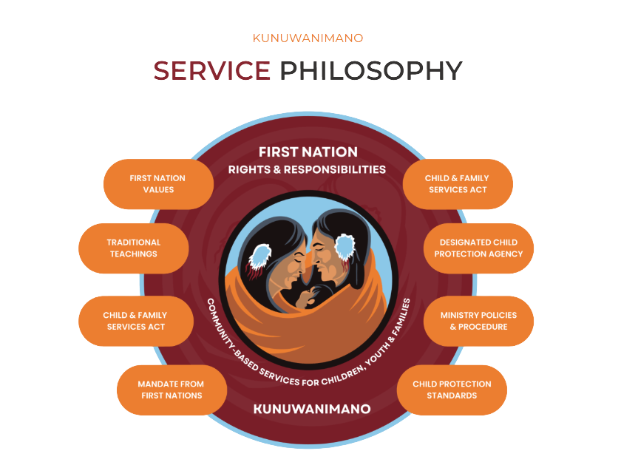

Slide 5

COLLABORATION

Slide 6

ROLES AND RESPONSIBILITIES
TRANSITION PLANNING
PREVENTION SERVICE DELIVERY APPROACH - SUPPORTIVE ROLES
INFORMATION SHARING AND REPORTING MECHANISMS
CONSULTATION AND COLLABORATION
BUILDING OUR CHILD AND COMMUNITY WELL-BEING PLAN TOGETHER

Slide 7


ADVANCED PREPERATION AND PLANNING
  Environmental Scan
  Engagement Action Plan
  Internal transition planning - restructure of service post OFA
  PMSS transition planning
  Updated internal prevention policy and procedure
  Assignment of Project Coordinator

Slide 8
ACCOUNTABILITY

Slide 9

Current Status:
  24 open Post Majority files
  Portfolio to transfer to community post OFA implementation
  All Youth informed of upcoming changes and transition planning (Information session held December 10th, 2025)
  Support being provided/offered by the Youth Services team to First Nations as part of transition planning
POST MAJORITY SUPPORT SERVICES

Slide 10
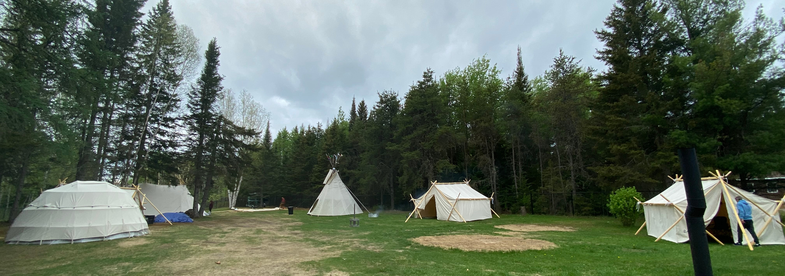

CURRENT PREVENTION SERVICES
  Family Support Workers (7)
  Child and Youth Workers (5)
  Indigenous Program Developer (1)
  Youth Services Workers (5)
  Indigenous Cultural Worker (6)

Slide 11
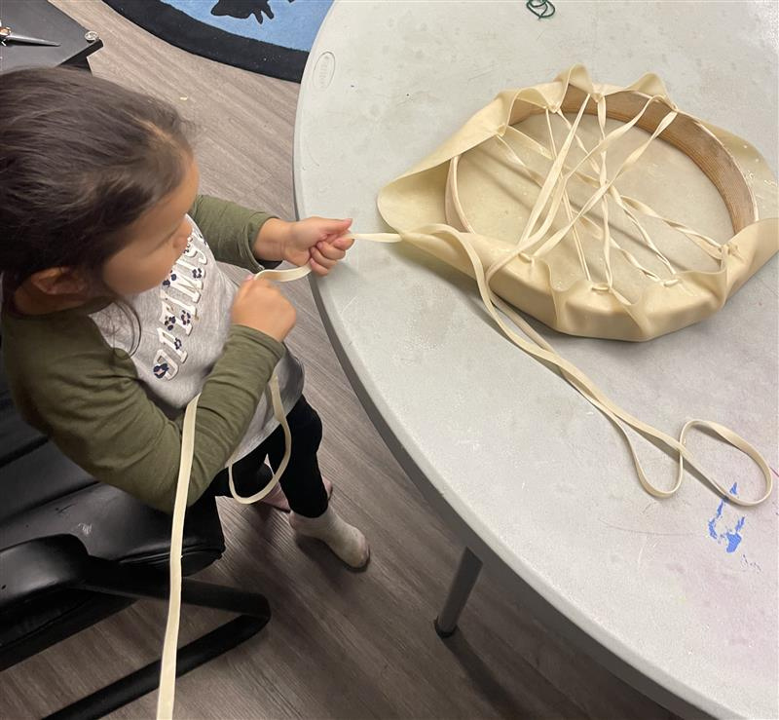






Culturally Grounded, Thoughtfully Delivered
Community Supports / Staff Training and Awareness
  Family hand drumming
  Traditional sewing and crafts
  Beading
  Feast kits
  Traditional teachings
  Traditional cooking
  Medicine wheel and vision boards (youth)
  Land based opportunities/experiences
  Cultural Awareness training for Caregivers
  Monthly Tea and Bannock - open opportunity to learn and ask questions (staff)
Children
&
Families
Staff
Local
Partnerships
Community

Slide 12
REPORTING

Slide 13





REPORTING AND INFORMATION SHARING
  Transition from Frontline to RedMane (Summer, 2026)
  Quality Assurance / Legal team support
  Policy and Procedure Collaboration
Youth Supports
17 Post Majority Support Service Applications
6 Balsam Program Participants (Independent Living)
351 individual connections made with Youth Services Workers
Connections - Program Attendance
225 Parents and Caregivers
403 Children and Youth
VYSA / RSG
25 Voluntary Youth Services Agreements
79 Ready Set Go Arrangements
April 1, 2024 - March 31, 2025

Slide 14



