Slide 1
Collaborating On A Plan for the OFA
Jan 14, 2026

Slide 2
Agenda for Day 2 - TODAY
About OFA
Overview of Tikinagan’s Approach to CCWP
BREAK
Regional Environmental Scan
Identifying Priorities – Breakout Session 2 of 4!
BACK TO MAIN SESSION

Slide 3
Agenda for Day 3 - TOMORROW
Tomorrow, MORNING
Breakout session 3 and 4
Tomorrow, AFTERNOON
Parking Lot Questions & Comments
Recap of Day 2/3
Identifying next steps

Slide 4
Reminders!
DO NOT share any confidential, private information related to the safety of children in your community.
Our conversations are solution-driven for the region; avoid sharing examples or stories from specific cases.
With a large in-person + online group, please allow others an equal opportunity to share.
Have a thought or a question but don’t want to share aloud? Put it in our Parking Lot via sticky note, or send to communications@tikinagan.org.

Slide 5
General info about our sessions
We will be engaging you on a series of questions, asking you to collaborate with us in several ways:
QR-code cellphone participation
Small, rotating group discussions
Large group room discussions
You can also type into the chat (online only)
Parking Lot
You can also visit our Booth and have a conversation/ask Qs!

Slide 6
Goals for Today
Provide updates on Prevention, Post-Majority
Introduce our phased-approach to the OFA’s CCWP
Identify strengths and challenges for:
Community Wellbeing
Child Wellbeing
Tikinagan Services
Identify initial priorities for Tikinagan in co-developing the CCWP with First Nations
Identify ways your community, Tikinagan can work together to provide the best care to families

Slide 7
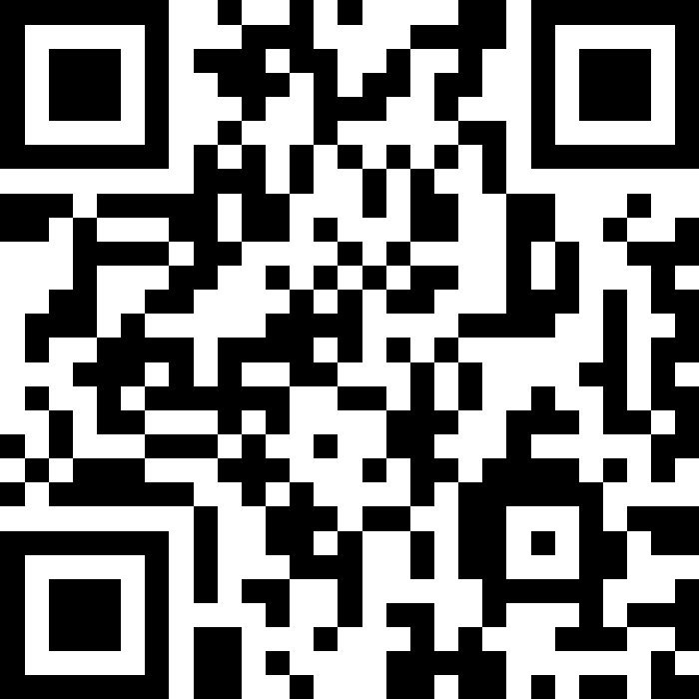
Scan the QR Code
When prompted, use your cellphone and the camera app to scan the QR code on the screen.
All answers submitted are completely anonymous!

Slide 8



Do not edit How to change the design
Today, I am feeling...
The Slido app must be installed on every computer you’re presenting from

Slide 9

Do not edit How to change the design
I am...
The Slido app must be installed on every computer you’re presenting from

Slide 10
Do not edit How to change the design
How would you rate your understanding of Tikinagan and its services?
The Slido app must be installed on every computer you’re presenting from

Slide 11
Do not edit How to change the design
How would you rate your understanding of Mamow Obiki-ahwahsoowin, Tikinagan’s service model?
The Slido app must be installed on every computer you’re presenting from

Slide 12

Do not edit How to change the design
What words, thoughts, feelings, or ideas come to mind when you think about the OFA?
The Slido app must be installed on every computer you’re presenting from

Slide 13
Do not edit How to change the design
How would you rate your understanding of the OFA and its requirements?
The Slido app must be installed on every computer you’re presenting from

Slide 14
Do not edit How to change the design
How would you rate your First Nation’s readiness to fulfil the responsibilities required in the OFA?
The Slido app must be installed on every computer you’re presenting from

Slide 15
Scan the QR Code
When prompted, use your cellphone and the camera app to scan the QR code on the screen.
All answers submitted are completely anonymous!

Slide 16
ᐃᐍ ᐱᑯ OFA Iiwe Biko OFA About OFA

Slide 17
About the OFA, Requirements
Approved by COO, NAN in Feb 2025 – but waiting for approval at CHRT
Nine-year agreement
We welcome our Chiefs’ decision in securing this agreement and appreciate the collaboration that will start to bring transformational change.

Slide 18
First Nations must submit their own plans to ISC (see Appendix 4 in OFA)
Tikinagan must collaborate, co-develop with First Nations on:
Environmental Scan
Agency Summary
CCWP - in collaboration with First Nations
All three must be approved by First Nations (See Appendix 5 in OFA)

Slide 19
Tikinagan, First Nations have six months after the “effective date” to submit their plans
Tikinagan has no additional funding for this work – our current focus remains on child protection.

Slide 20
Under the OFA, First Nations will receive more funding with more responsibility
Prevention
Post-Majority
Tikinagan will receive less funding; has been preparing for the change over the last year
Tikinagan strongly encourages our First Nations to develop and implement prevention and post-majority programming for their community.
Tikinagan supports this transfer of funding and responsibility to First Nations because we believe the answers lie in the community.

Slide 21
Updates on Post-Majority, Prevention

Slide 22
Post-Majority
Since 2022, Tikinagan has been providing post-majority supports through its Neegaan Inabin program for former youth in care up 25 (day of their 26th birthday).
When the OFA is implemented, Tikinagan will lose access to federal Post-Majority funding covering actual expenses and First Nations will receive an allocation to provide these services.

Slide 23
Tikinagan will provide provincially funded financial support through the Ready, Set, Go (RSG) program for 18- to 22-year-olds who were in care on their 18th birthday. RSG provides a monthly allowance that decreases annually.
Support for existing Neegaan Inabin clients will be reduced to align with what is available provincially under RSG.

Slide 24
Without access for reimbursement for actuals, we can no longer continue delivery of this federal program and can provide the provincial RSG support to our Neegaan Inabin clients.
Under the OFA, Tikinagan Post-Majority supports will:
Provide services up to 22 (day of 23rd birthday)
Support young adults who were in care before turning 18
Reduced monthly allowance

Slide 25
Under the OFA, First Nations can:
Develop their own post-majority supports
Provide an allocation for services up age 26 and a former youth in care at any age
Work with Tikinagan to discuss development of your own service
Access tools such as job descriptions, form templates, rates, etc from Tikinagan
Niigaanshkaawin Post-Majority Toolkit, Coming Spring 2026

Slide 26
First Nations Post-Majority Requirements:
Ages 18-25
Taken into care on reserve
Living on reserve or making efforts to live on reserve

Slide 27
Tikinagan will continue to advocate for Neegaan Inabin clients by:
Connecting young adults their First Nation if they are interested in receiving federal Post Majority supports
Transitioning provision of federal Post-Majority service to interested First Nations
Continuing to provide data on the number of Post-Majority clients from your community and would be willing to discuss this transition regarding individual clients.

Slide 28
Do not edit How to change the design
My community is...
The Slido app must be installed on every computer you’re presenting from

Slide 29

Do not edit How to change the design
What strengths and supports can be built upon to implement your Post-Majority program?
The Slido app must be installed on every computer you’re presenting from

Slide 30
Prevention
Indigenous Services Canada (ISC) has been providing a per-person on-reserve prevention allocation which in Ontario has been shared between First Nations and agencies.
Tikinagan’s portion has been reduced over the last three years and is now under 5% of the total allocation for First Nations in Tikinagan’s service area.

Slide 31
Changes to Prevention
Continue:
Maintain community-based prevention staff that can be financially supported
Changes to Service:
Significant reduction of primary/secondary prevention service to our First Nations
Support for First Prevention/partner programs; staff time only.
No financial contributions to programs, events, activities
No distribution of purchased prevention program materials (i.e fire and water safety equipment, sports, etc)
Elimination of urban prevention worker positions

Slide 32
Tikinagan strongly encourages our First Nations to take all of the prevention funding allocated to their First Nation.
First Nations are better positioned to develop and implement prevention programming for their community.
Tikinagan supports this transfer of funding and responsibility to First Nations because we believe the answers lie in the community.
Many of our First Nations have notified ISC of their intentions.

Slide 33
Do not edit How to change the design
My community is...
The Slido app must be installed on every computer you’re presenting from

Slide 34
Do not edit How to change the design
What strengths and supports can be built upon to implement or enhance your Prevention program?
The Slido app must be installed on every computer you’re presenting from

Slide 35
ᐊᓄᐦᑭᐏᐱᒧᒋᑫᐏᓂᐠ ᐅᓇᐦᒋᑫᐏᐣ ANOHKIIWIBIMOJIKEWINIG ONAHCHIKEWIN PROJECT PLAN

Slide 36
ᐃᐍ ᐱᑯ ᐊᓄᐦᑭᐏᐱᒧᒋᑫᐏᓂᐠ ᐅᓇᐦᒋᑫᐏᐣ Iiwe Biko Anohkiiwibimojikewinig Onahchikewin About the Project Plan
The collaboration work builds on Mamow Obiki-ahwahsoowin, Tikinagan-First Nations working together
The OFA will strengthen Tikinagan’s services, enhance supports in our First Nations
Tikinagan will strive to meet with all 29 First Nations – relying heavily on virtual meetings.
We also want to inform, engage the communities as well

Slide 37
ᐃᐍ ᐱᑯ ᐊᓄᐦᑭᐏᐱᒧᒋᑫᐏᓂᐠ ᐅᓇᐦᒋᑫᐏᐣ Iiwe Biko Anohkiiwibimojikewinig Onahchikewin About the Project Plan
Short timeframe – six months after “effective date”
This work is new to both Tikinagan and First Nations
Final Plan requires the signed approval of First Nations
Approaching the plan in four collaborative phases:
MAJIJIKEWIN – Initiation to collaboration
ONAHCHIKEWIN – Planning for collaboration
MAADANOHKAADE – Executing the collaborated plan
KIBAHIIKAADE – Closing/finishing the planning, ongoing collaboration

Slide 38
Some of the steps we are taking in the initiation phase of this work include:
ᒪᒋᒋᑫᐏᐣ | MAJIJIKEWIN
Meet with NAN, ISC, COO to identify and determine requirements
Continue Niigaanshkaawin Working Group
Draft Communications Plan, Project Plan
Gather data/information for Environmental Scan
Agency Summary (internal work)
Today’s event – initiating the work of collaboration

Slide 39
ᐅᓇᐦᒋᑫᐏᐣ | ONAHCHIKEWIN
Some of the steps we are taking in the planning phase of this work include:
Working Group meetings, review of priorities
Conduct a community survey
Host information sessions to share working group findings with First Nations and communities
Engage community-based and urban staff, seeking feedback
Communicate to communities using a variety of mediums, including Wawatay Radio, Radio Scripts for staff to read, Social Media, and Niigaanshkaawin website
Draft the Scan, CCWP, and Action Plan based on engagements

Slide 40
ᒪᑕᓄᐦᑲᑌ | MAADANOHKAADE
Some of the steps we are taking in the execution phase of this work include:
Seek Approval from First Nations prior to/at Annual Chiefs Assembly on Environmental Scan, CCWP
Submit plan before the end of the six months after “effective date”
Begin to initiate plans and activities

Slide 41
ᑭᐸᐦᐃᑲᑌ | KIBAHIIKAADE
Share performance annually at Chiefs Assembly
Some of the steps we are taking in the closing/final phase of this work include:

Slide 42
Do not edit How to change the design
If Tikinagan wants to collaborate with my First Nations on the OFA-CCWP, they should...
The Slido app must be installed on every computer you’re presenting from

Slide 43
Do not edit How to change the design
How would you prefer Tikinagan collaborate / communicate with your First Nation on the OFA? (Check all that apply)
The Slido app must be installed on every computer you’re presenting from

Slide 44
Do not edit How to change the design
In order for this to be true collaboration, Tikinagan should...
The Slido app must be installed on every computer you’re presenting from

Slide 45
Environmental Scan

Slide 46
A Regional Scan
One of the requirements of the OFA is an environmental scan. Today, we’ll focus on a regional scan – highlighting key strengths and issues in our communities.
Your contributions to the discussion will add to our regional results -- many communities are represented here today.

Slide 47
At-A-Glance: Our Region
Our communities are:
Growing
Connected to the land, culture
Healing
Wanting to take care of their own, deliver services (i.e Band Rep, Post Majority, Prevention)

Slide 48
Do not edit How to change the design
What other strengths can you identify in your community?
The Slido app must be installed on every computer you’re presenting from

Slide 49
At-A-Glance: Our Region
Our communities experience:
Barriers in accessing services & supports – such as lack of access, affordability, privacy, and systematic/racism issues
Mental health, substance abuse, addiction issues, as a result of Grief & Loss and intergenerational trauma
Poverty and other inequities
Water boil advisories

Slide 50
At-A-Glance: Our Region
Our families face their own set of challenges, such as:
High cost of living/food, including a higher cost for healthy diets
Living in overcrowded homes, and/or homes that need repair
Poor indoor air quality
Loss of the language
Single-parent homes
Teen pregnancy

Slide 51
Do not edit How to change the design
What other issues/challenges can you identify in your community?
The Slido app must be installed on every computer you’re presenting from

Slide 52
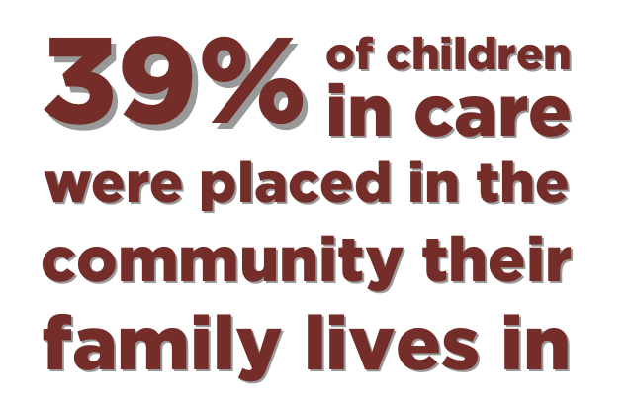
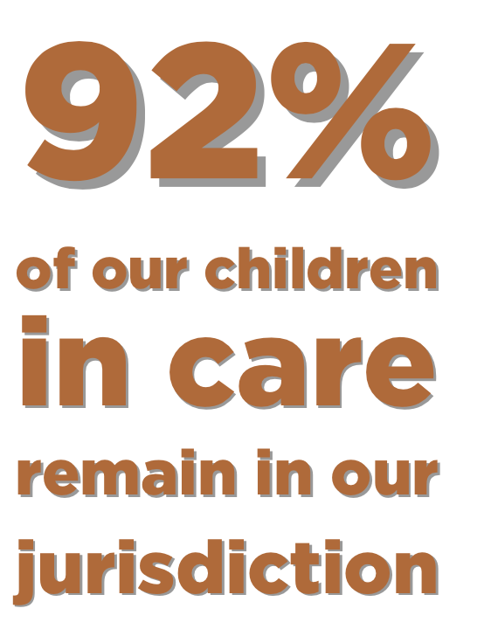
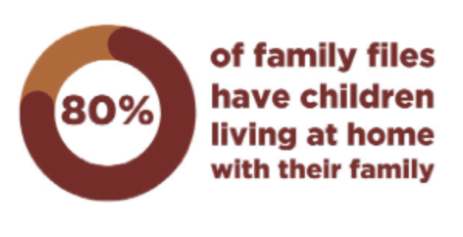
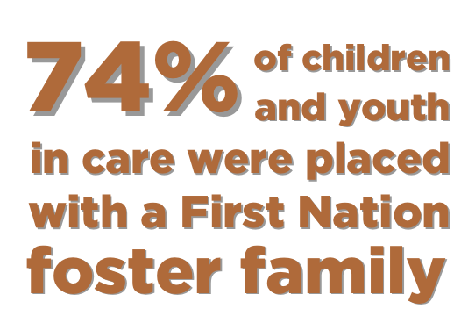
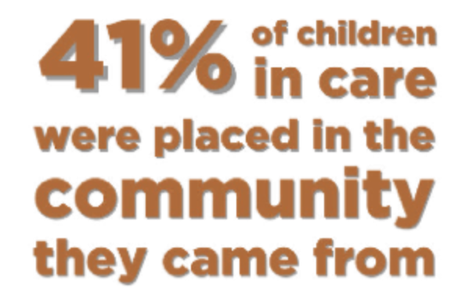
Tikinagan - Strengths

Slide 53
Do not edit How to change the design
What other strengths can you identify with Tikinagan and its services?
The Slido app must be installed on every computer you’re presenting from

Slide 54
Do not edit How to change the design
What suggestions do you have for Tikinagan to improve upon, or enhance its existing services?
The Slido app must be installed on every computer you’re presenting from

Slide 55
Improving Outcomes
Based on what other have submitted as strengths and challenges in our communities, we want to move toward community-based solutions.
We want to hear your priorities because we believe the answers lie within the community!

Slide 56
Breakout Time!
In the true spirit of Mamow Obiki-ahwahsoowin (“Everyone working together to raise our children”), we will break out into four groups:
3 in the room – 1 group will be in the language; 2 in English
1 online, English
Note: English groups encouraged to speak in language but no formal translation present.

Slide 57
Instructions
Divide yourselves into three corners of the room.
Remember our Reminders: confidentiality, no specifics, and equal sharing time.
Start with sticky note questions – then discuss!
New Question when announced!
Groups have 45 minutes to discuss each topic.
Summary / Findings to be shared after lunch Day 3 ☺

Slide 58
Floor plan
Insert floor plan

Slide 59
Four Key Themes
TODAY:
Collaboration, Working Together
Priorities for Tikinagan
TOMORROW:
Accountability
The Best Outcomes for Children, Families

Slide 60
Youth Notetakers
Tikinagan would like to welcome members of the Noodawishinaam Oshkiniigiwag (Hear Us Youth) team who will be taking notes.
We are honoured to have them involved in these discussions.

Slide 61
What does “working together” look like in your community? Give examples of how this works in your community.

Slide 62
Reminder – Parking lot is still open!
Weebudge!

Slide 63
What priorities should guide Tikinagan to ensure children remain in their communities and with their families?

Slide 64
Reminder – Parking lot is still open!
Welcome Back!

Slide 65
Key Themes
TODAY:
Any thoughts from yesterday? / Accountability
The Best Outcomes for Children, Families

Slide 66
Reminders!
DO NOT share any confidential, private information related to the safety of children in your community.
Our conversations are solution-driven for the region; avoid sharing examples or stories from specific cases.
With a large in-person + online group, please allow others an equal opportunity to share.
Have a thought or a question but don’t want to share aloud? Put it in our Parking Lot via sticky note, or send to communications@tikinagan.org.

Slide 67
What additional data or reporting would strengthen shared decision-making between your First Nation and Tikinagan? What kind of information do you need?

Slide 68
How can your community work with Tikinagan to create the best outcomes for families?

Slide 69
Summary from Day 2 & Day 3
Jan 15, 2026

Slide 70
Agenda for Day 3 - AFTERNOON
Parking Lot Questions & Comments
Recap of Day 2
Identifying next steps

Slide 71
Parking Lot

Slide 72
Recap from Day 2 & 3

Slide 73
The Room
# of participants
# of Chief
# of community members
etc

Slide 74
Understanding of Tikinagan, Services
Insert score

Slide 75
Understanding of Mamow Obiki-ahwahsoowin
Insert score

Slide 76
OFA Readiness
Insert score

Slide 77
Prevention & Post-Majority
Insert scores, findings

Slide 78
Collaboration
Slido scores + groupthink summary

Slide 79
Priorities
Slido scores for strengths & challenges + groupthink summary for priorities

Slide 80
Best Care
Group think summary

Slide 81
Accountability
Group think summary

Slide 82
Next Steps
Working with our Niigaanshkaawin Working Group
Preparing more information for a future information session for Chiefs
Moving toward:
Community Survey (online)
Community Engagements (online / in-person)
Draft Environmental Scan, Agency Summary

Slide 83
Do not edit How to change the design
These three days helped me understand my First Nation's role in the OFA.
The Slido app must be installed on every computer you’re presenting from

Slide 84
Do not edit How to change the design
These three days helped me understand Tikinagan's role in the OFA.
The Slido app must be installed on every computer you’re presenting from

Slide 85
Do not edit How to change the design
What key word(s) sum up your thoughts, feelings, or ideas about the OFA?
The Slido app must be installed on every computer you’re presenting from

Slide 86
Do not edit How to change the design
When I return to my community, I intend to share this information with…(Check all that apply)
The Slido app must be installed on every computer you’re presenting from

