Slide 1
Indigenous Early Learning and Child Care
Education Directors Forum – Dagwaagin – 2025
Jaime Dumont, Indigenous Services Canada, Ontario Region
Diane Bjorn, Indigenous Services Canada, Ontario Region
Thunder Bay, Ontario
December 11, 2025

Slide 2
Welcome
Introductions
Today’s topics
  Indigenous Services Canada IELCC
  2025-2026 IELCC Funding Update
  IELCC Workplan & Terms and Conditions of the IELCC Program
  IELCC Reporting
  Q&A

Slide 3
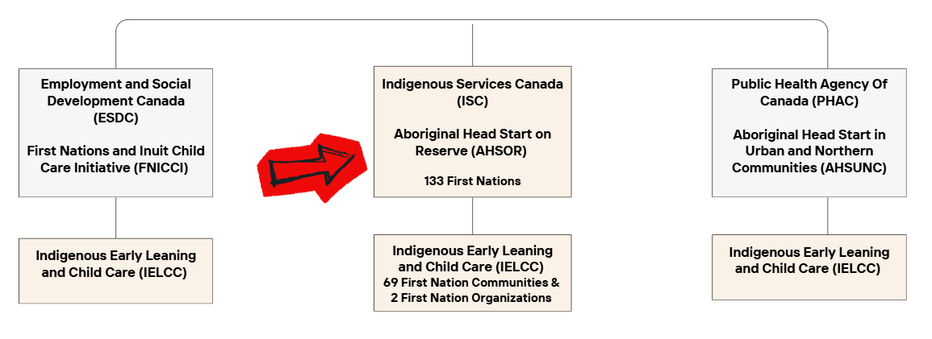
Federal Early Learning Programs

Slide 4
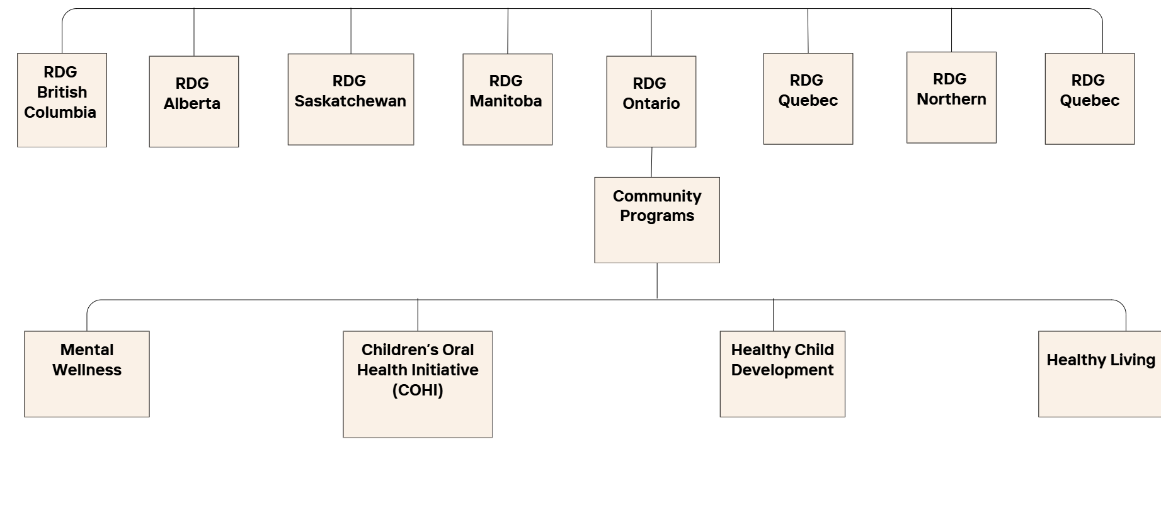
Regional Delivery Sector

Slide 5
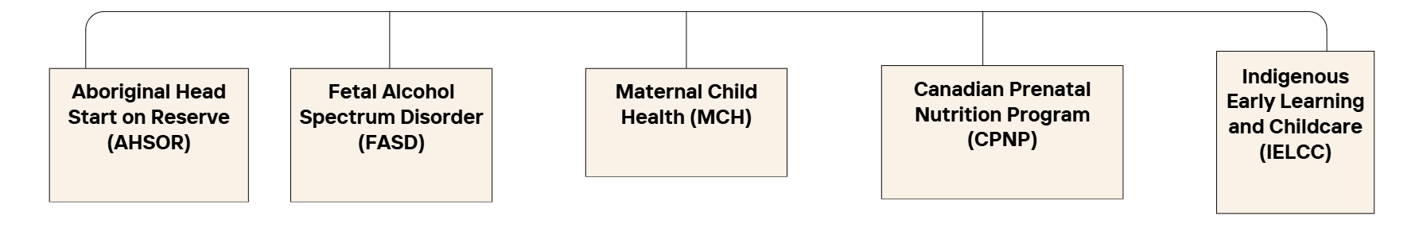
Healthy Child Development
2025-2026 Indigenous Service IELCC Allocations
25-26 ISC ON
IELCC Total
$53,649,850

Slide 6
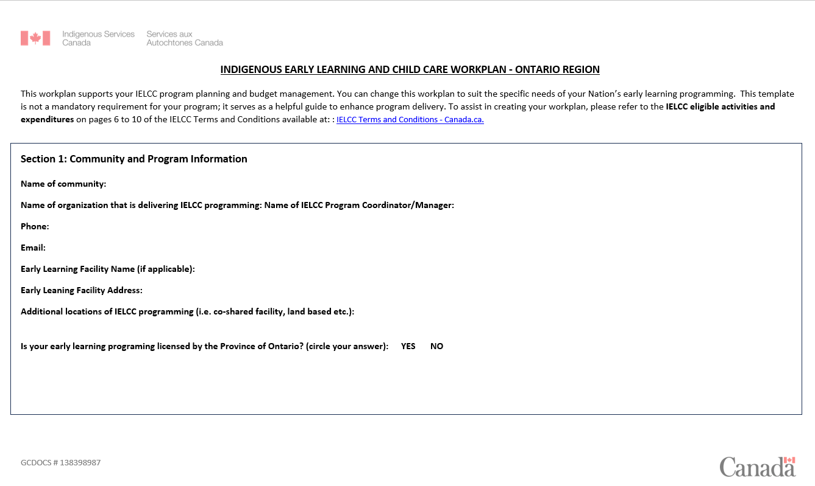
2025-2026 IELCC Workplan Exercise

Slide 7
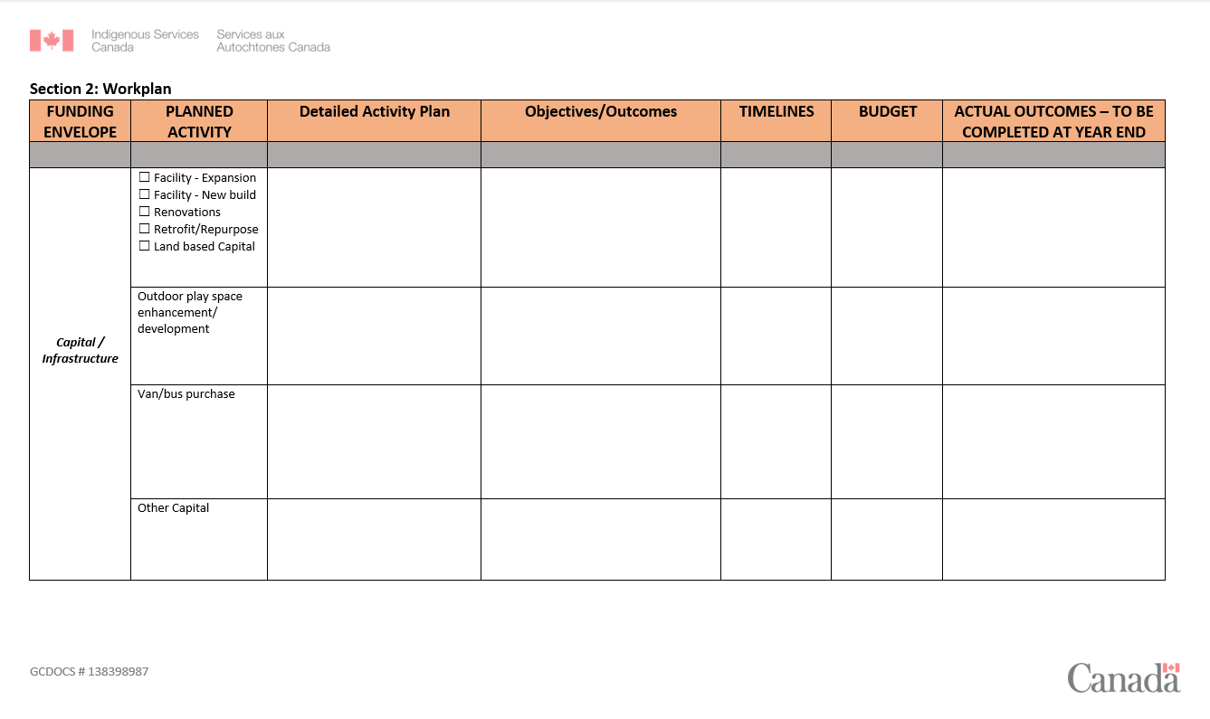
2025-2026 IELCC Workplan Exercise

Slide 8
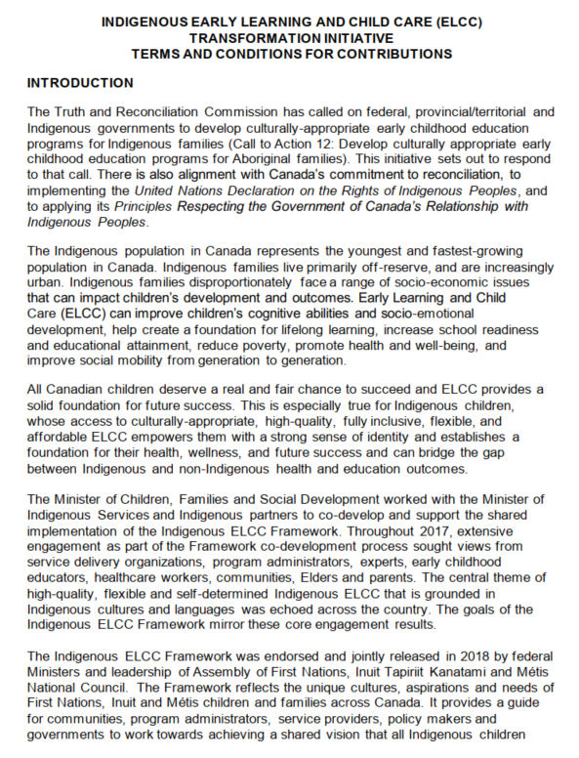
IELCC Terms and Conditions

Slide 9
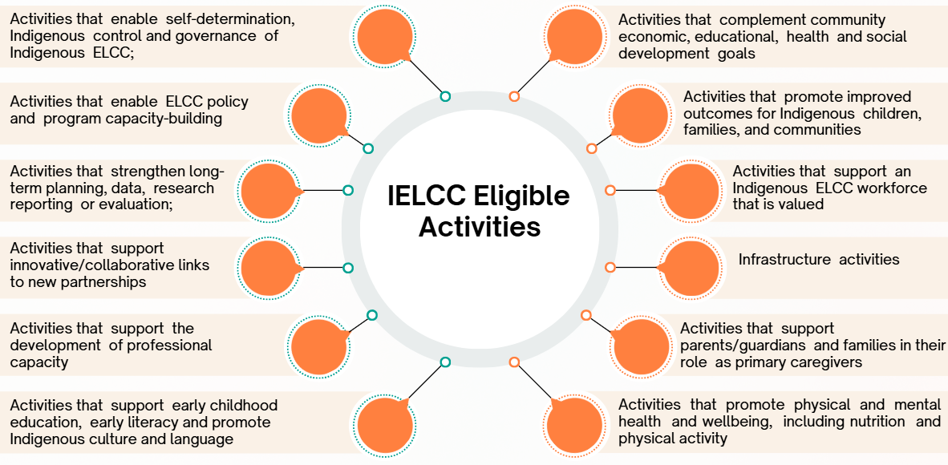
IELCC Eligible Activities

Slide 10
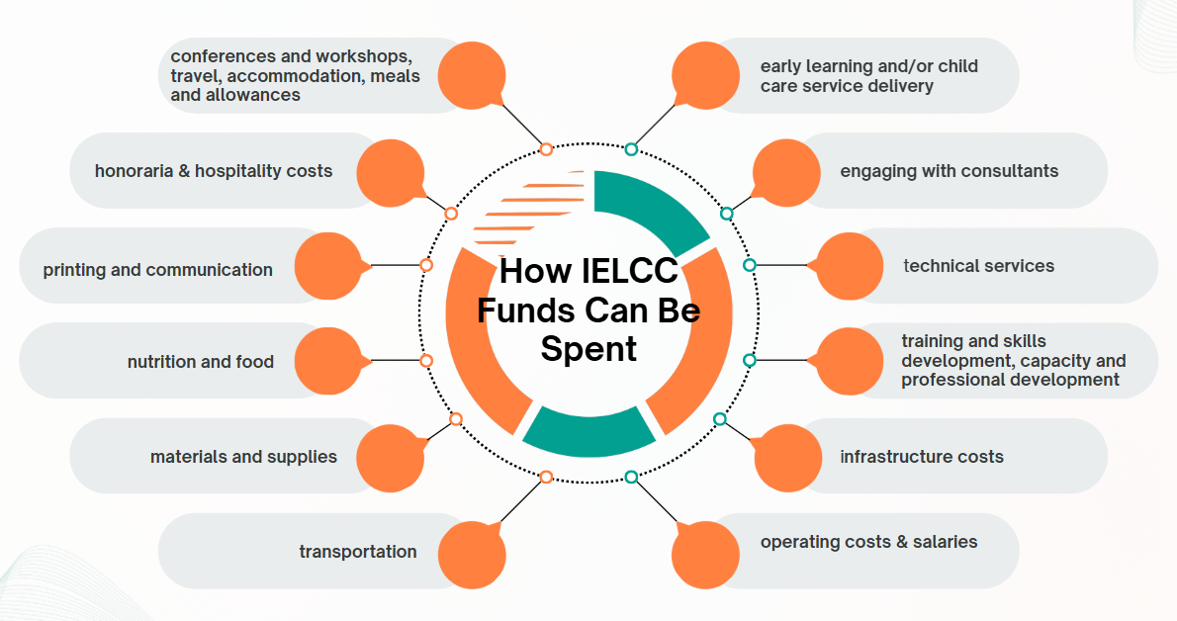
IELCC Eligible Expenditures

Slide 11
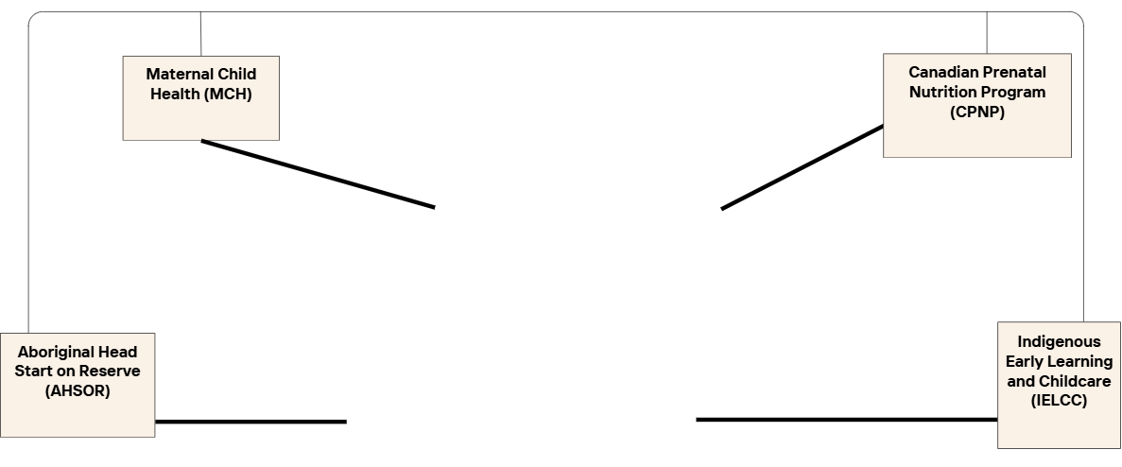
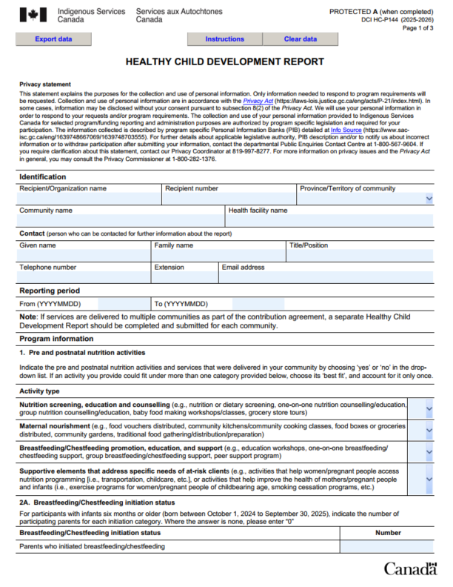
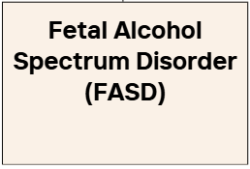
IELCC Reporting – HC-P144 – Healthy Child Development Report

Slide 12
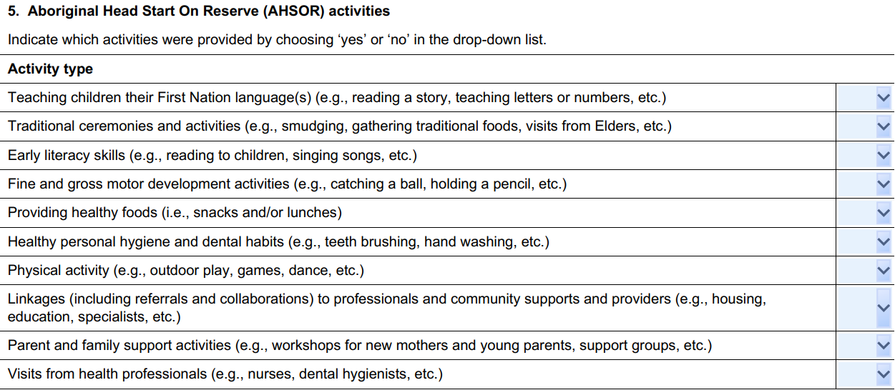
The HC-P144 – Healthy Child Development Report

Slide 13
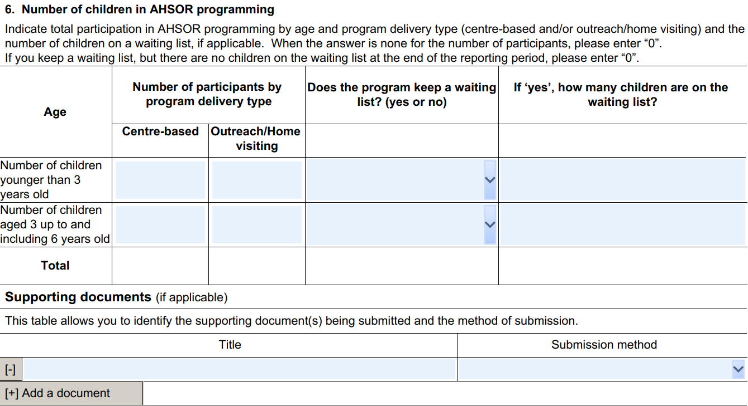
The HC-P144 – Healthy Child Development Report

Slide 14
IELCC Frequently Asked Questions Related to Reporting
Where can I get a reporting template for the HC-P144 – Healthy Child Development Report (or others)
The PDF is not working on my device, what can I do?
Where can I submit a completed report?
Future changes to the HC-P144 – Healthy Child Development Report
Any other type of sessions

Slide 15
Q&A Period
Jaime.dumont@sac-isc.gc.ca
Diane.bjorn@sac-isc.gc.ca
Cayla.Chenier@sac-isc.gc.ca
icd-dci@sac-isc.gc.ca
Reportsontario@sac-isc.gc.ca
communityprograms-programmescommunautaires@sac-isc.gc.ca

