Slide 1
Nishnawbe Aski Nation (NAN) Autism Forum
Presented by: Polly Francis; Early Years Manager
May 21, 2026

Slide 2
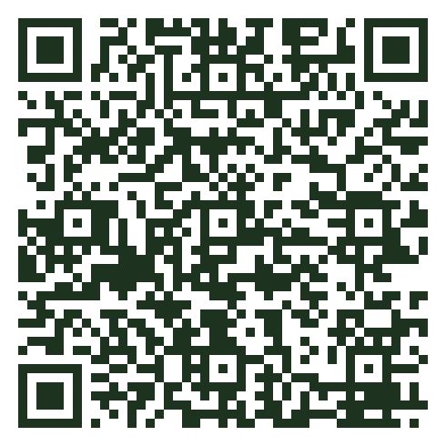
Framework for Autism in Canada
Scan to read
the full framework

Slide 3
DAY 1
Economic Inclusion
Framework Priority Area 2 · Education, training, employment & long-term stability

Slide 4





Five Priority Areas
01
02
03
Screening, Diagnosis & Services
Economic Inclusion
Data & Research
Improving data collection, public health surveillance, and understanding of adult needs.
Improving timely, equitable access to care.
Enhancing employment opportunities and support for autistic individuals.
04
05
Public Awareness
Tools & Resources
Fostering acceptance and understanding.
Providing accessible information.

Slide 5
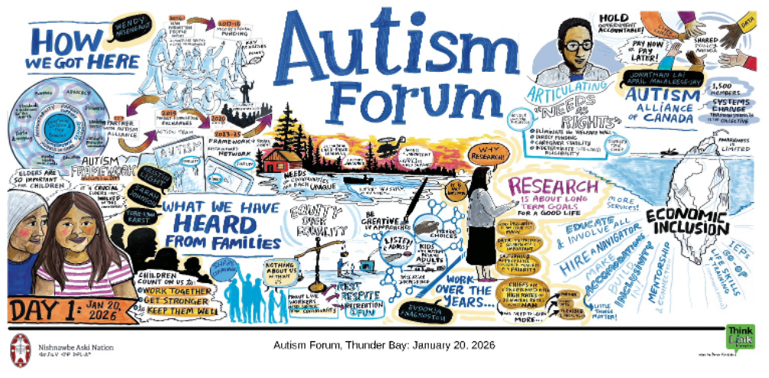
DAY 1 - Economic Inclusion

Slide 6
Key Insights
Support must reflect the realities of remote communities and First Nation contexts, ensuring programs should be culturally relevant, locally accessible, and delivered by people who understand community history and lived experience
Strengthen local capacity and community-based support across the lifespan, including: Early intervention, Inclusive education, Workforce training, and Meaningful employment pathways
Achieving this requires coordinated efforts across health, education, and community sectors, alongside strong partnerships and locally driven solutions.
Families must be supported not only financially, but also socially and culturally.
Systems must be responsive to the diverse strengths, needs, and aspirations of individuals living with autism.

Slide 7
DAY 2
Awareness, Culture,
and Digital Access
Framework Priority Areas 4 & 5 · Public awareness, acceptance, tools and digital resources

Slide 8
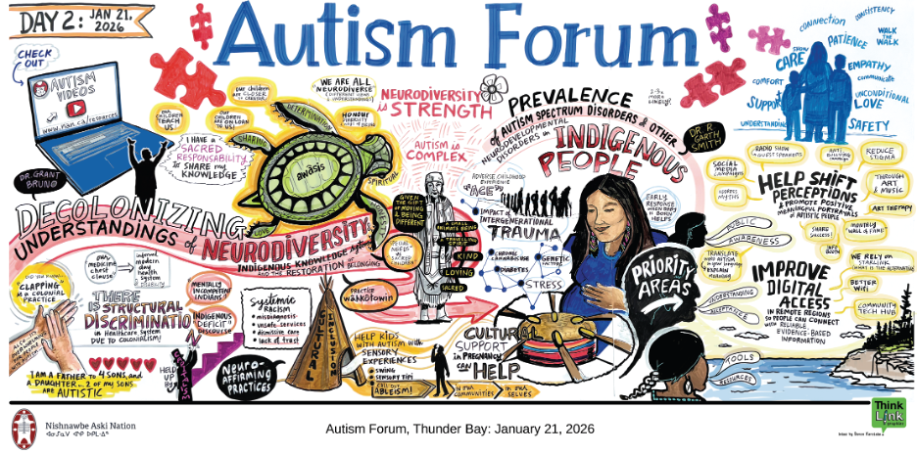
DAY 2 - Awareness, Culture, and Digital Access

Slide 9
Key Insights
Meaningful change in perceptions and access to support must be grounded in community strengths, cultural knowledge, and locally driven solutions.
Storytelling, art, and the guidance of Elders were identified as powerful tools for reframing autism through a strengths-based lens.
A strengths-based lens recognizes the gifts, identities, and contributions of individuals living with autism.
Improving access to information and services requires addressing systemic barriers such as limited connectivity, lack of infrastructure, and digital inequities in remote communities.
Flexible, multi-format approaches to knowledge sharing should combine digital innovation with trusted, in-person relationships.

Slide 10
DAY 3
Screening, Diagnosis
& Services
Framework Priority Area 1 · Navigation, cultural safety, and lived experience

Slide 11
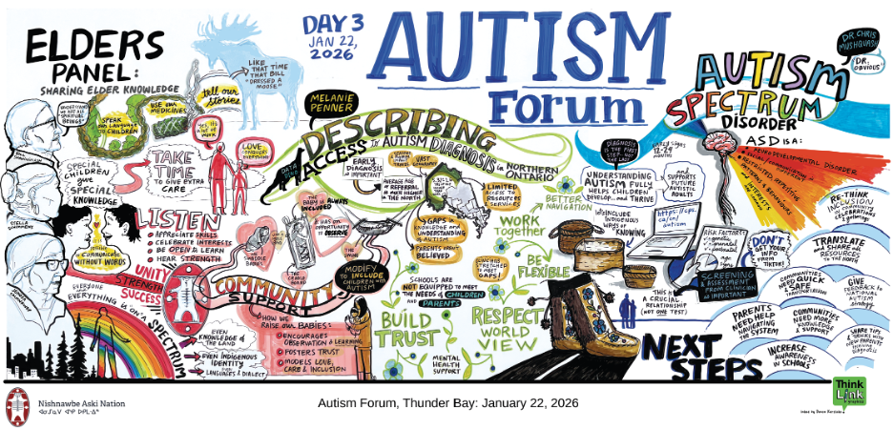
DAY 3 - Screening, Diagnosis & Services

Slide 12
Key Insights
Service access for autism in remote First Nation communities is currently fragmented and difficult to navigate, requiring a shift toward coordinated, community-based systems with trusted service navigators to reduce barriers and improve timely support.
First Nations need culturally safe, relationship-based approaches—grounded in trust, lived experience, and community involvement—are essential to designing effective screening, diagnosis, and service pathways.
Improving access requires bringing services closer to communities through local hubs, enhanced communication tools, cross-sector collaboration, and increased local capacity, while addressing transportation and infrastructure challenges.

Slide 13
Action Mapping

Slide 14
Economic Inclusion
Theme / Area | First Nation Level Actions | NAN Advocacy Actions
Early Identification & Diagnosis | Develop local screening programs; train early years staff; increase awareness of early signs | Advocate for mobile diagnostic teams; fund in-community diagnosis models
Education Supports | Create smaller classrooms; sensory-friendly spaces; strengthen IEPs; integrate life skills | Advocate for inclusive education funding and flexible models
Training & Workforce | Train local educators and workers; support local certification pathways | Advocate for funding First Nation workforce development
Family & Caregiver Supports | Create parent support groups; peer networks; local training | Advocate for expand caregiver supports and mental health funding
Respite Services | Train local respite workers; use trusted community members | Advocate for increase flexible respite funding programs
Employment & Skills | Develop local training, mentorship, and land-based employment | Advocate for inclusive employment policies and incentives

Slide 15
Economic Inclusion
Theme / Area | First Nation Level Actions | NAN Advocacy Actions
Employer Awareness | Educate local employers; create inclusive workplaces | Develop NAN-wide awareness campaigns
Community Programs | Build hubs, social programs, cultural and land-based activities | Advocate for funding community-based programming
Housing & Independent Living | Develop transitional housing and supported living options | Advocate for housing investments and policy reform
Financial Supports | Help families access funding; raise awareness of supports | Reform OW/ODSP; create flexible and stable funding models
Travel Costs | Coordinate local travel supports | Advocate for travel funding and national travel credits
Long-Term Planning | Support families with care planning and transitions | Develop NAN-wide tools for financial and future planning

Slide 16
Awareness, Culture, and Digital Access
Theme / Area | First Nation Level Actions | NAN Advocacy Actions
Storytelling & Awareness | Host storytelling events; share lived experiences; community radio and social media | NAN-wide awareness campaigns
Role of Elders | Engage Elders in mentorship, teachings, and awareness | Support Elder engagement in policy and program design
Art & Expression | Create art programs, workshops, and showcases | Advocate for funding arts-based autism initiatives
Cultural & Land-Based Learning | Integrate language, ceremony, and land-based activities | Advocate for culturally grounded program funding
Inclusive Community Events | Create sensory-friendly spaces; adapt community events | Develop accessibility standards and funding supports
Anti-Stigma Education | Deliver school programs and anti-bullying initiatives | Advocate for curriculum inclusion and awareness strategies

Slide 17
Awareness, Culture, and Digital Access
Theme / Area | First Nation Level Actions | NAN Advocacy Actions
Community Recognition | Celebrate strengths through events and storytelling | Promote strength-based NAN-wide messaging
Digital Infrastructure | Create community tech spaces; support device access | Advocate for broadband and infrastructure investment
Offline Access | Provide USBs, printed materials, DVDs | Develop multi-format NAN-wide resources
Digital Literacy | Train community members and Elders in tech use | Coordinate digital literacy programs
Hybrid Service Models | Combine in-person care with virtual follow-ups | Promote hybrid service policies
Digital Content | Develop culturally relevant, plain-language materials | Support translation and First Nation-led content creation

Slide 18
Awareness, Culture, and Digital Access
Theme / Area | First Nation Level Actions | NAN Advocacy Actions
Knowledge Sharing Platforms | Create local or regional platforms for sharing resources | Build NAN-wide portals and knowledge hubs
Telehealth Access | Use virtual care for follow-ups and consultations | Expand telehealth systems and funding

Slide 19
Screening, Diagnosis & Services
Theme / Area | First Nation Level Actions | NAN Advocacy Actions
Service Navigation | Train local navigators; provide case management | Advocate to fund navigator roles; streamline systems
Community Service Hubs | Establish central hubs for services and supports | Advocate to fund infrastructure development
Local Service Delivery | Train local health staff; host visiting specialists | Expand mobile service models and workforce funding
Accommodation for Providers | Develop local lodging solutions | Advocate to fund accommodation infrastructure for remote service delivery
Communication & Information | Create local information kits and websites | Standardize service information systems
System Coordination | Coordinate health, education, and social services locally | Advocate for cross-sector integration and funding alignment

Slide 20
Screening, Diagnosis & Services
Theme / Area | First Nation Level Actions | NAN Advocacy Actions
Training for Providers | Provide local training in autism and cultural safety | Advocate to fund professional development and certification programs
Relationship-Based Care | Host circles, gatherings, and community meetings | Promote relational service models in policy
Transportation | Organize community transport supports | Advocate for transportation funding programs
Lived Experience Inclusion | Create advisory groups; peer networks | Embed lived experience in governance and policy
Safe Participation Spaces | Develop sensory-friendly meeting spaces | Advocate to fund inclusive infrastructure standards
Cultural Communication | Use First Nation languages and storytelling | Support culturally relevant communication strategies

Slide 21
Screening, Diagnosis & Services
Theme / Area | First Nation Level Actions | NAN Advocacy Actions
Trust Building | Engage families and communities consistently | Promote long-term funding and workforce stability
Diversity of Needs | Tailor services to individuals | Advocate for flexible service models
Cultural Safety | Integrate Elders and local knowledge into services | Require cultural safety standards and training
Community Awareness | Host local education sessions | Participate in awareness initiatives
Data Sovereignty | Collect and manage community data; build local capacity | Advocate to fund First Nation data governance systems

Slide 22
Meegwetch
Early Years Contacts:
Polly Francis
Early Years Manager
pfrancis@nan.ca
Tara Pedersen
Early Years Office Coordinator
tpedersen@nan.ca

