Slide 1
Community Engagement Initiatives
Jacob Osadec – Territorial Coordinator
May 2026

Slide 2
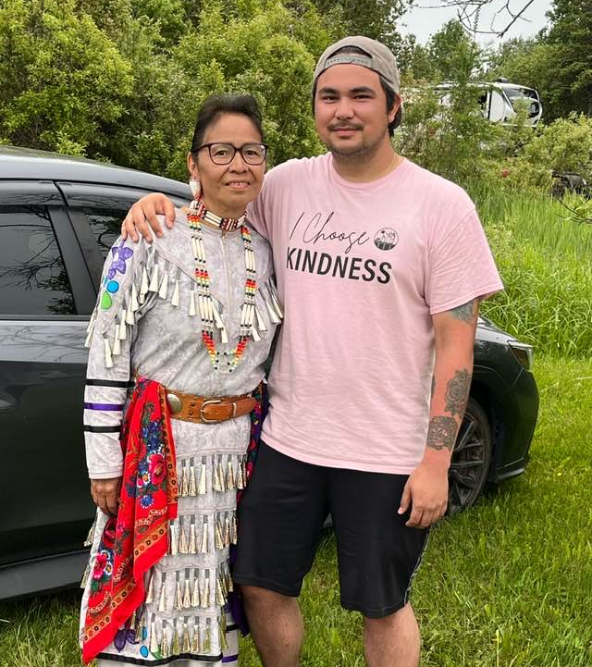
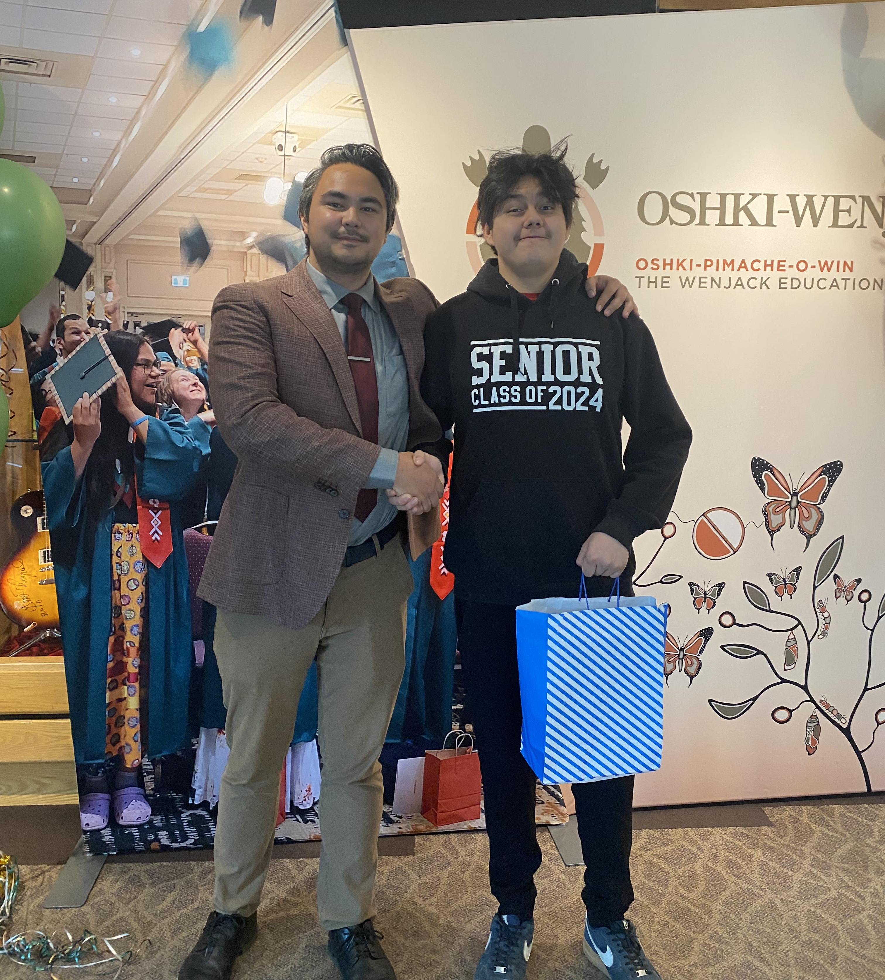
Introduction

Slide 3

Community Engagement
This year, we focused on the effectiveness of our engagement. We identified practical ways our team could strengthen our approach, and ensure our work truly reflects and incorporates the community.

Slide 4
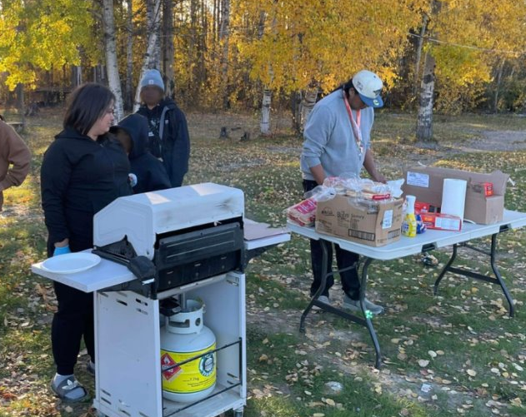
Community Engagement
While our current approach to community engagement worked, there is always room to improve. We realized how we engage matters.
Wunnumin Lake, September 2025

Slide 5

Community Engagement
Some of the ways we have improved our engagement include:
Multi-day/Purpose visits
Collaboration with organizations affiliated
with NAN communities
Working with community members
(Elders, Cooks, Youth)
Incentives for participation

Slide 6

Multi-Day/Purpose Visits
We extended the length of our visits and try incorporating our visits with events already happening in the community. Our goal is to be more present in the community and build trust before asking for input or feedback. Having community members know who we are also allows for more meaningful dialogue.

Slide 7
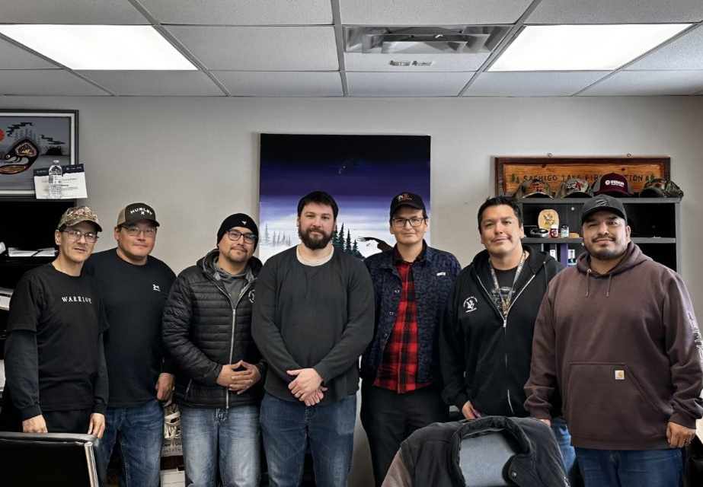
Collaboration
In addition to collaborating with other departments within NAN, we have also collaborated with Chiefs of Ontario with our engagement to help save costs. This collaboration was well received, and we plan to work with Chiefs of Ontario more in the future.
Sachigo Lake, February 2026

Slide 8


Working With Community Members
We have started working with communities more with our engagement. For example, we always ask the community if they would like to provide:
Youth Helpers
Community Cooks
Elder Support
Translators

Slide 9
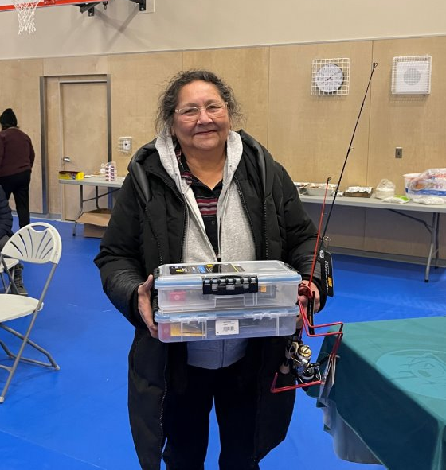
Incentives for Participation
Before each visit, we take time to learn about the community’s interests, activities, and day-to-day experiences so we can provide activities and gifts that are meaningful, relevant, and reflective of community values.
North Caribou Lake, January 2026

Slide 10
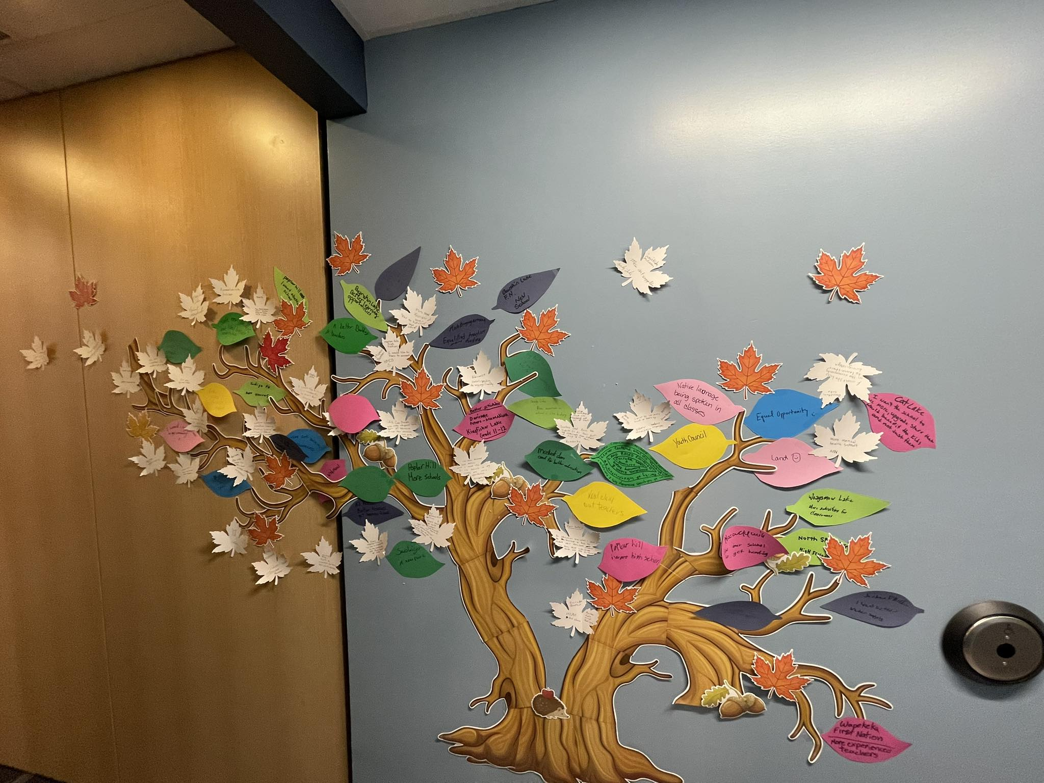
Year in review
8 Community Visits (27 days)
4 Regional Sessions
20+ new data-sharing agreements signed
3 Off-reserve school engagement sessions
NAN-Carleton Youth Leadership program
NAN Youth Voices

Slide 11
Community Based Coordinator Program Overview

Slide 12

Community Based Coordinator (CBC) Program
The Community Based Coordinator (CBC) Program is designed to help First Nations communities understand, discuss, and prepare for taking control of their own education system.
Valerie Wabasse, Assistant Education Director
Nibinamik First Nation CBC

Slide 13

Goals of the CBC Program
The goals of the CBC program are:
  Inform community members about education self-governance
  Gather feedback and concerns from the community
  Prepare the community to make informed decisions before ratification
  Help each First Nation create its own Local Education Code

Slide 14

What is a Community Based Coordinator?
A CBC is a local person hired by the community, or an existing staff with added duties, who:
  Shares information about the education agreement
  Organizes meetings and events
  Listens to community feedback
  Communicates community input back to the NAN Education Jurisdiction team

Slide 15

Community Expectations
Upon signing, communities are expected to:
  Hire or assign a coordinator
  Sign a Data-Sharing Agreement
  Create a simple workplan outlining how they will engage with the community
  Start community engagement activities

Slide 16

What kind of activities are allowed?
Communities can use the funding for activities such as, but not limited to:
  Community information sessions or feasts
  Council or leadership dinner meetings
  School or board meetings with sponsored meals
  Flyers, radio announcements, or other communications

Slide 17
Miigwetch!
For more information, please contact
josadec@NAN.ca

