Slide 1
Community Led Land Based Curriculum Development for Early Learning and Child Care
Presented by: Laura Baxter & Victor Chapais
Date: Thursday April 30, 2026

Slide 2
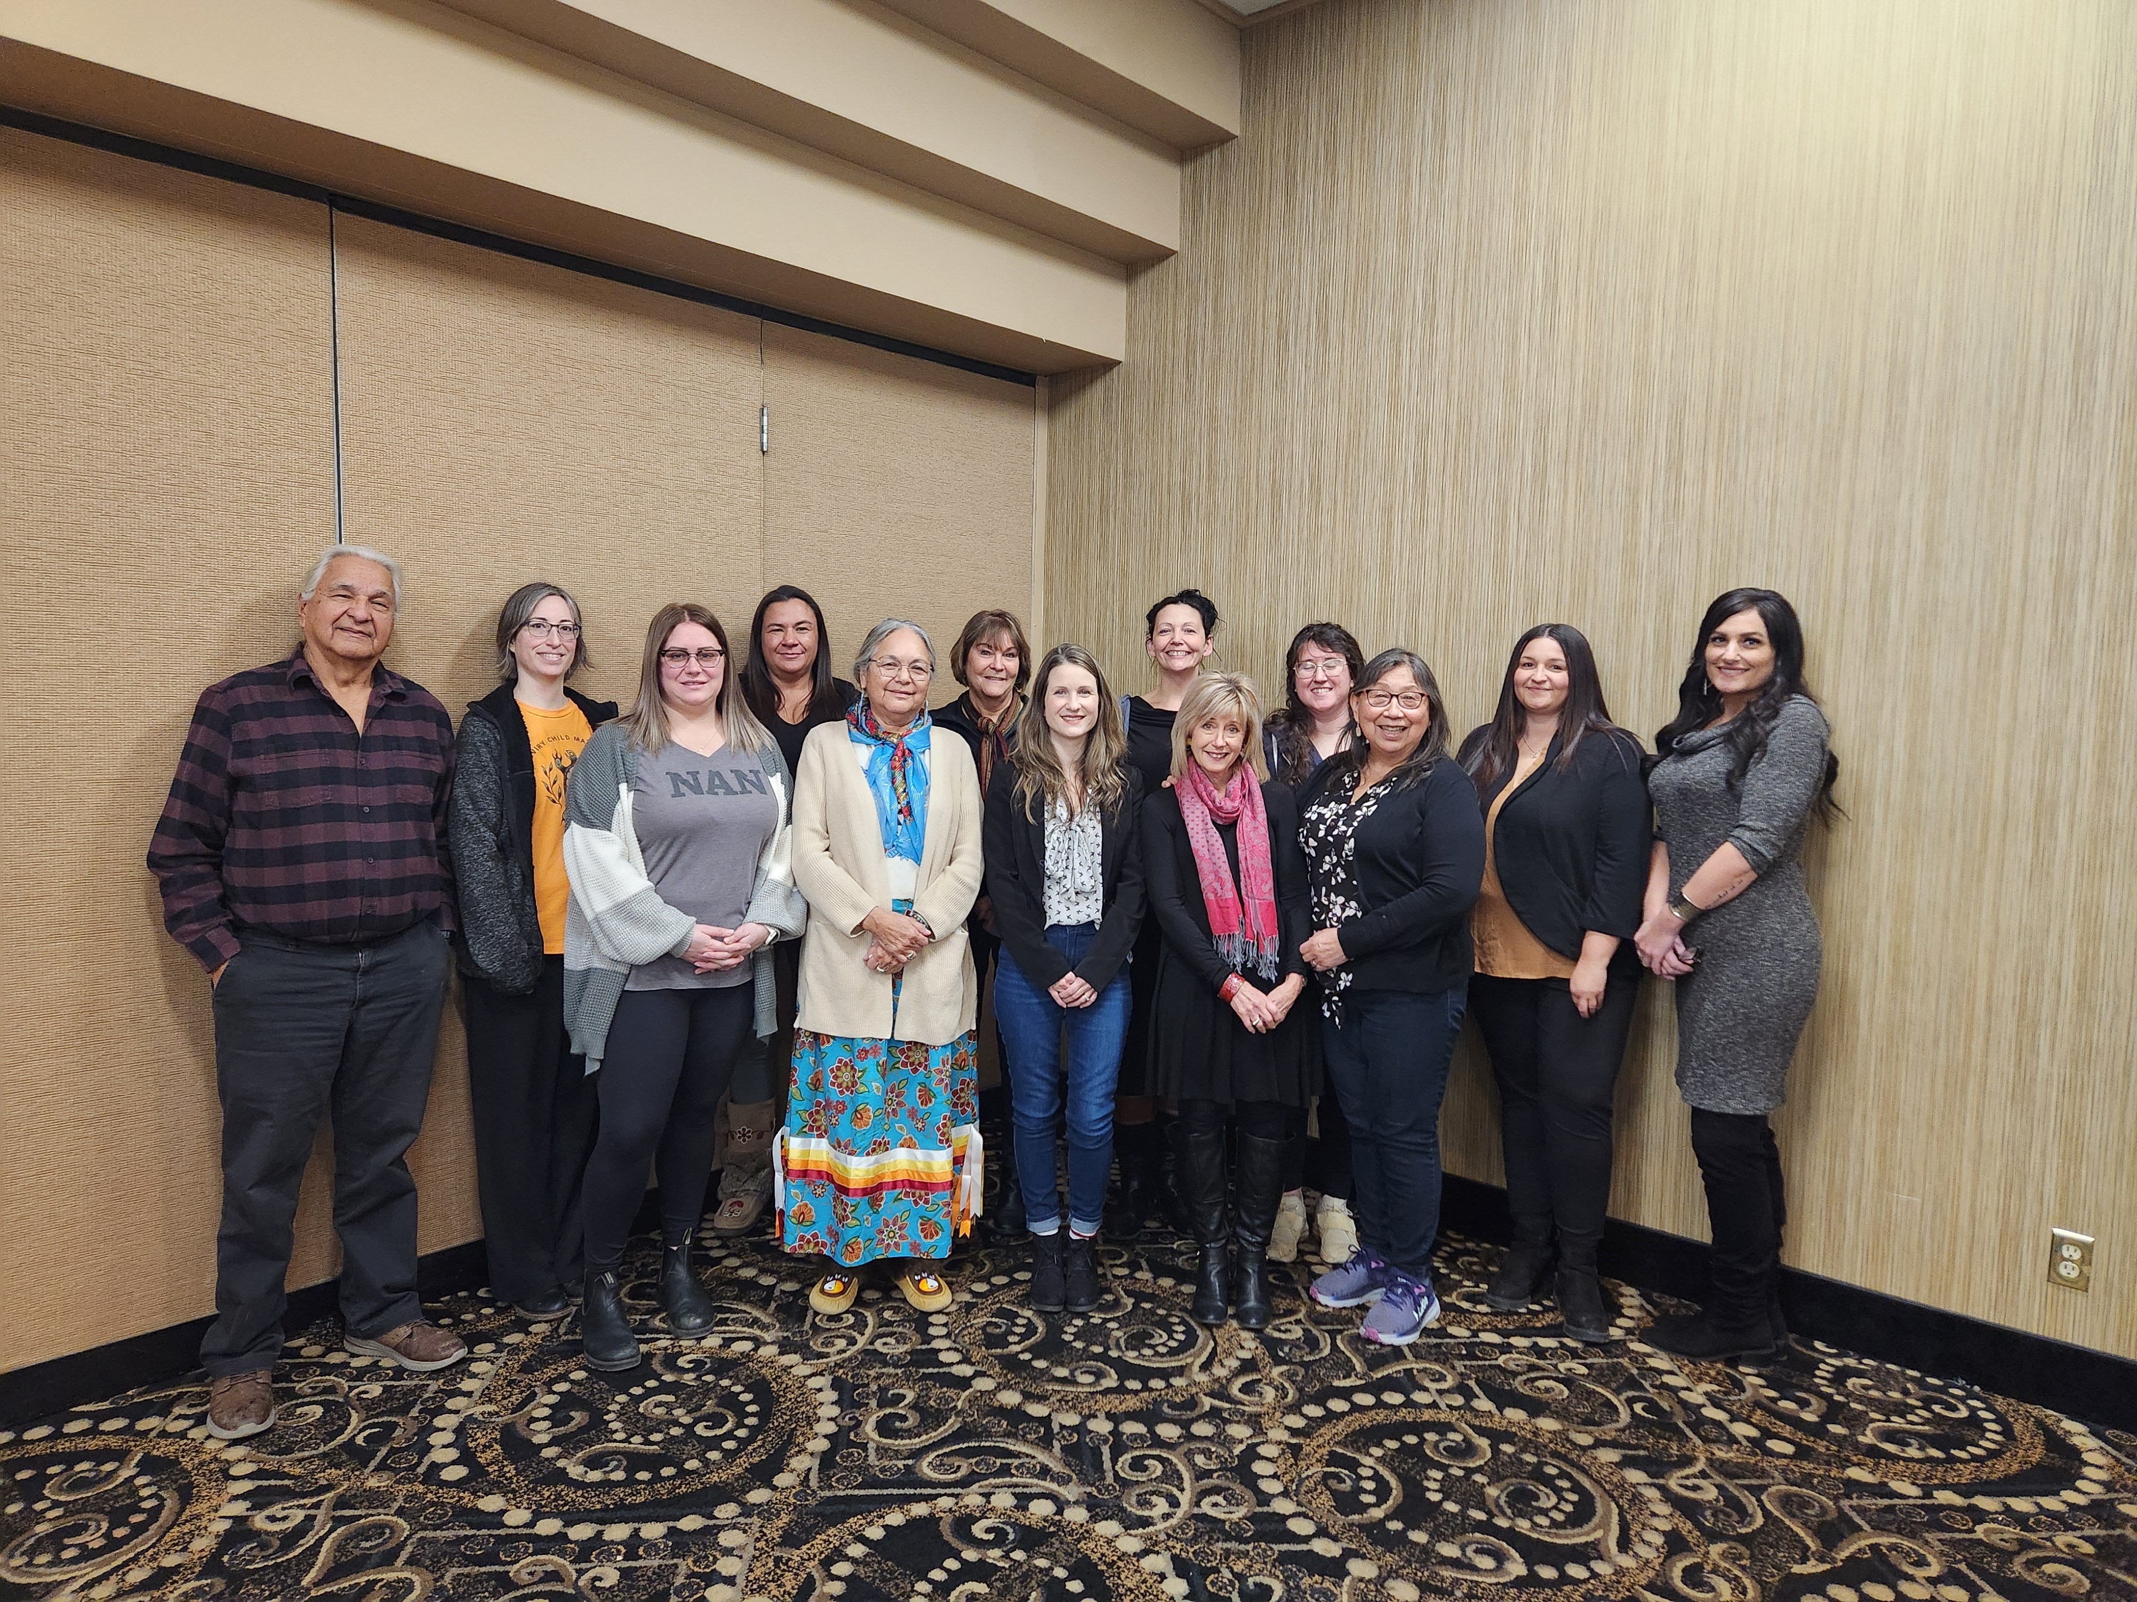
Wiichi-Bimosemik Awaashishag
Working under Quality Improvement Project,
funded by Employment and Social Development Canada
Members consists of NAN Staff, Elders,
Ginoogaming Aboriginal Head Start staff,
Oshki-Wenjack Staff, Confederation College Staff,
Early Years Consultants, and Curriculum Writers
Together we are working to create a college level,
generative land-based curriculum for Early Childhood
Educators
Notes:
Employment and Social Development Canada

Slide 3
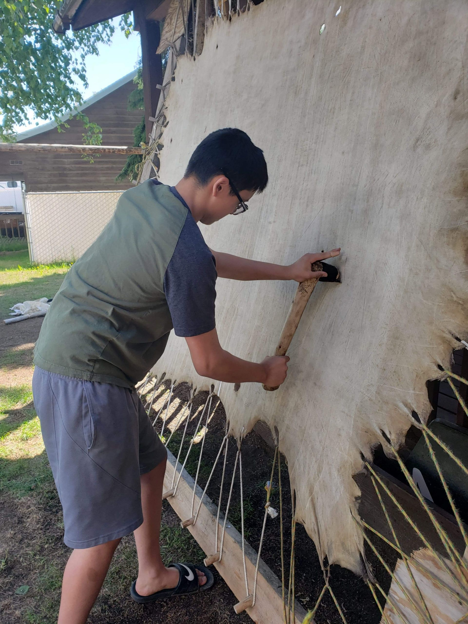
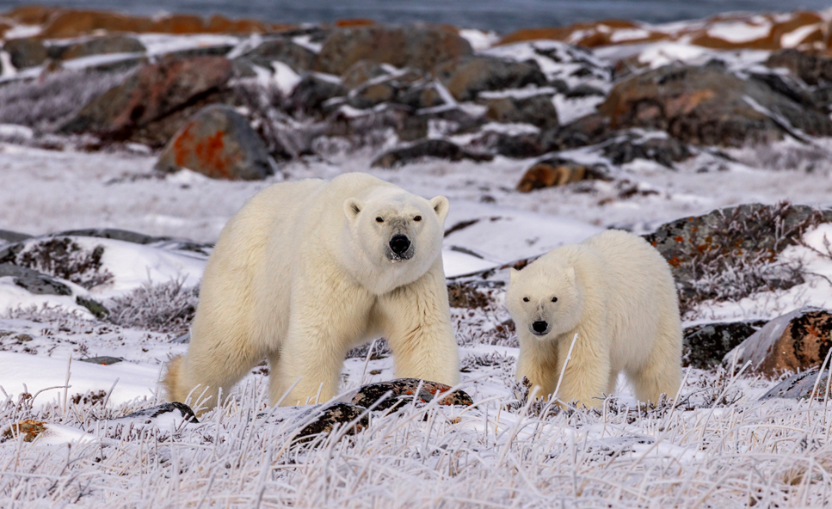
What is a Generative Curriculum?
It is an educational approach that integrates Indigenous knowledge and perspectives into the learning process.
The content of the curriculum will be community based. Each learner will learn from their own individual community Elders, Knowledge Keepers and Community Campions.

Slide 4
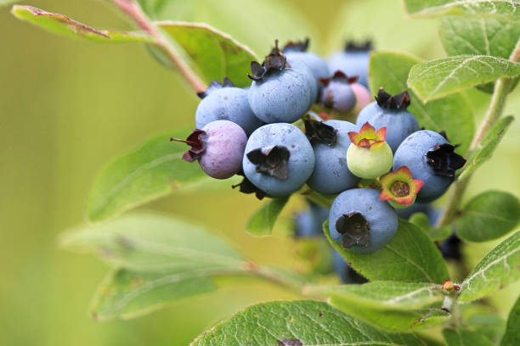
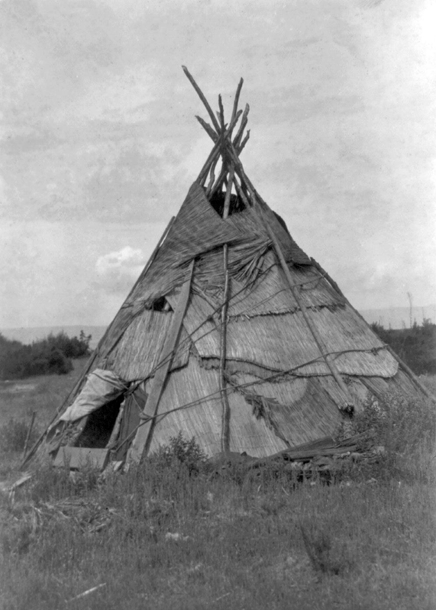
What is a Generative Curriculum?
It involves the co-creation learning through dialogue, hands on experience, and ongoing reflections rooted in Indigenous ways of knowing, then transferring those skills to an early learning environment.
It allows the learner to pick and choose the topics that best suit their interests. Assessments will be completed as the learner sees fit, such as essays, blogs, visual arts, reports, videos and so on.

Slide 5
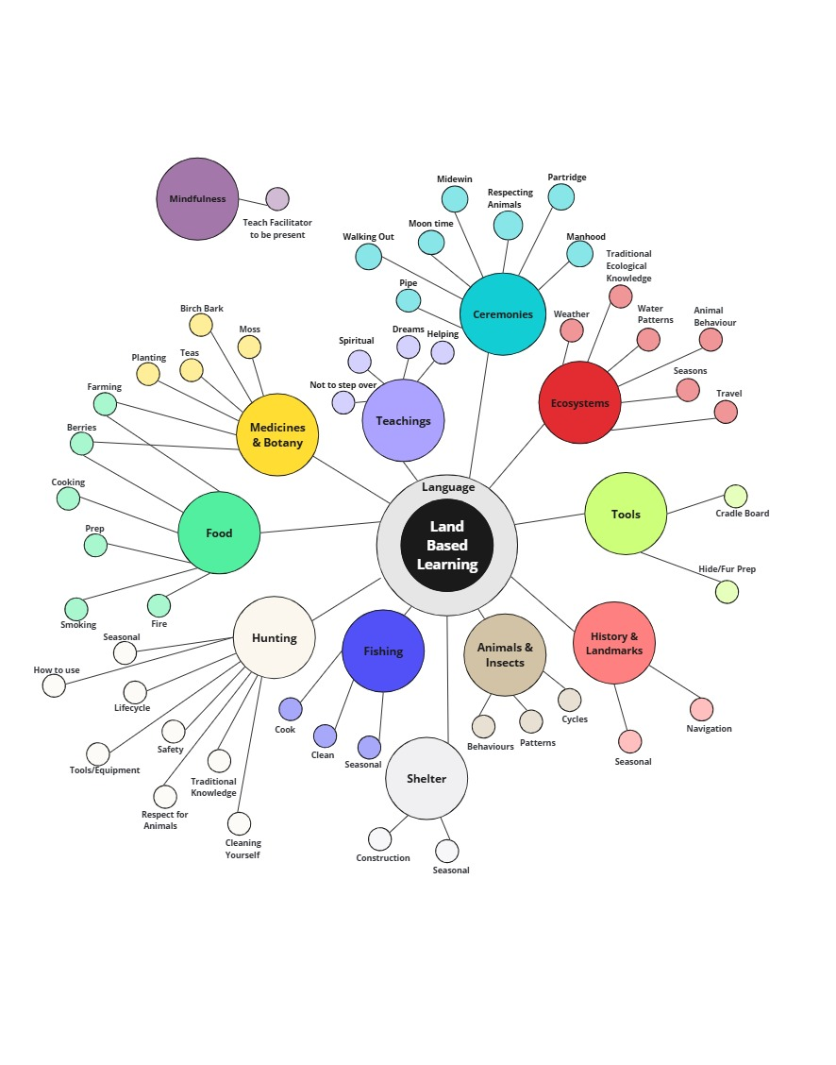
Land Based Learning Mind Map
Guided by the Elders of Wiichi-
Bimosemik Awaashishag, we developed
this mind map to help determine the key
points on which to focus the curriculum.
During our meetings we also discusses
learning styles, assessments, learning
outcomes, Elder protocol, and child safety.

Slide 6
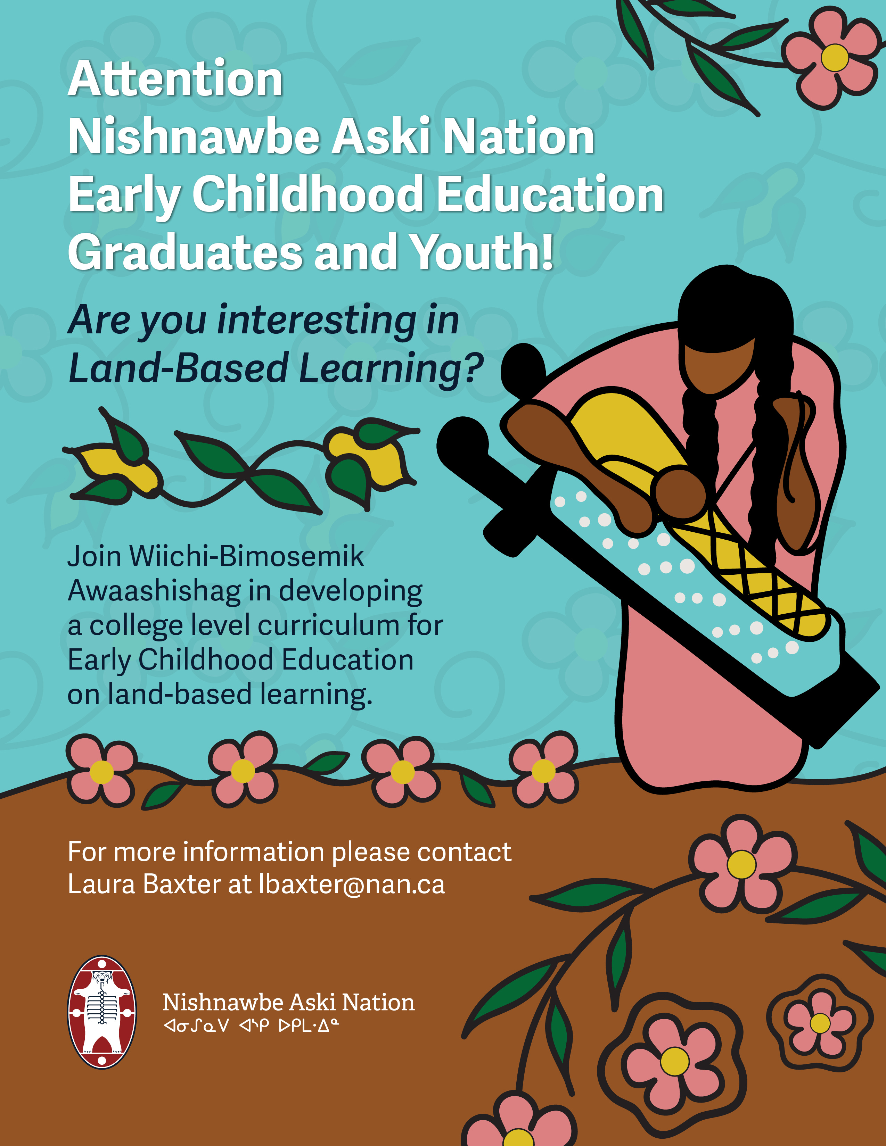

Slide 7
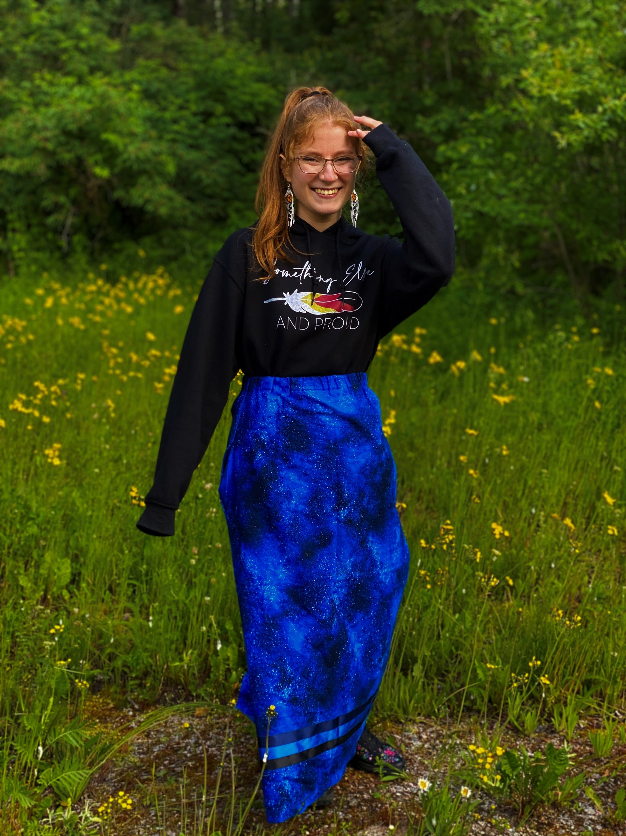
Curriculum Writers
Mackenzie Angeconeb is an Anishnaabekwe artist and educator from Lac Seul First Nation. She had worked within the early years sector for the past 6 years and has a passion for bringing the culture back to our communities and children.
In 2025, Mackenzie had her dream of being an author become a reality. Her debut, The Fragments that Remain, is a heart wrenching YA novel about siblings battling cultural disconnection, addiction, and sexuality discovery. A poetry collection called Each Stitch to Build a Heart, Part 1, was released later that year and Part 2 is releasing in June 2026.
Between writing, beading, and painting, Mackenzie spends as much time as she can in nature and her community. She lives in Sioux Lookout, ON with her husband and daughter.
Available for author talks regarding healing through writing and the traditional publication process. Visit mackenzieangeconeb.com for inquires.

Slide 8
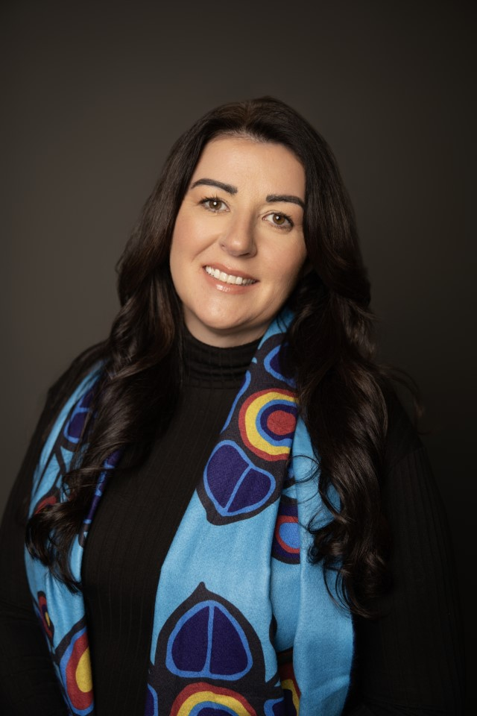
Curriculum Writers
Lori Huston is a Métis scholar and doctoral candidate
in Curriculum Studies at the University of British
Columbia. Her research centers on Indigenous early
childhood education, exploring how local First Nation
knowledge and teaching practices can guide a heart-
centered approach to education that helps reclaim
cultural knowledge and strengthen Indigenous
sovereignty.

Slide 9
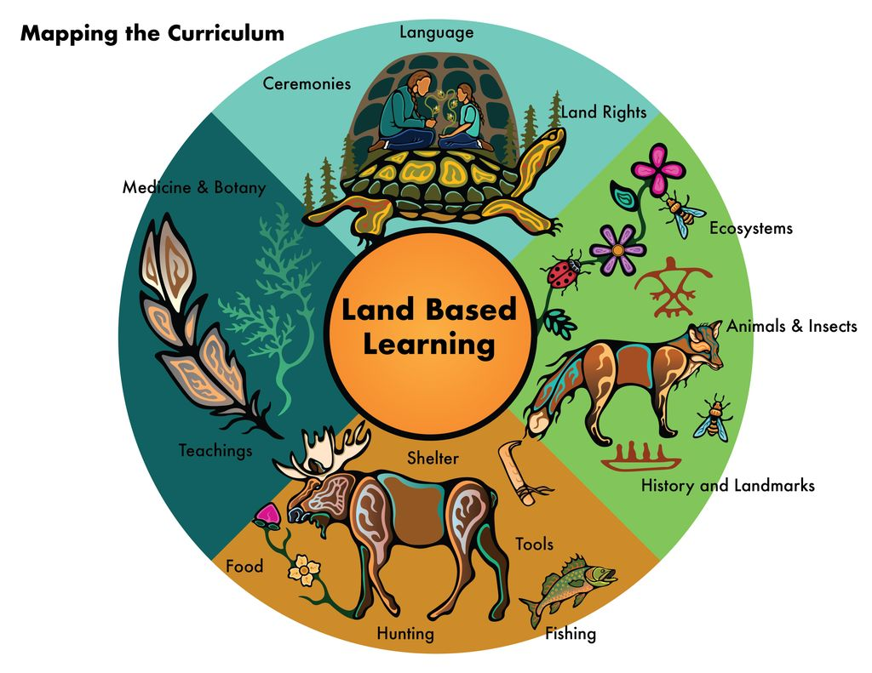
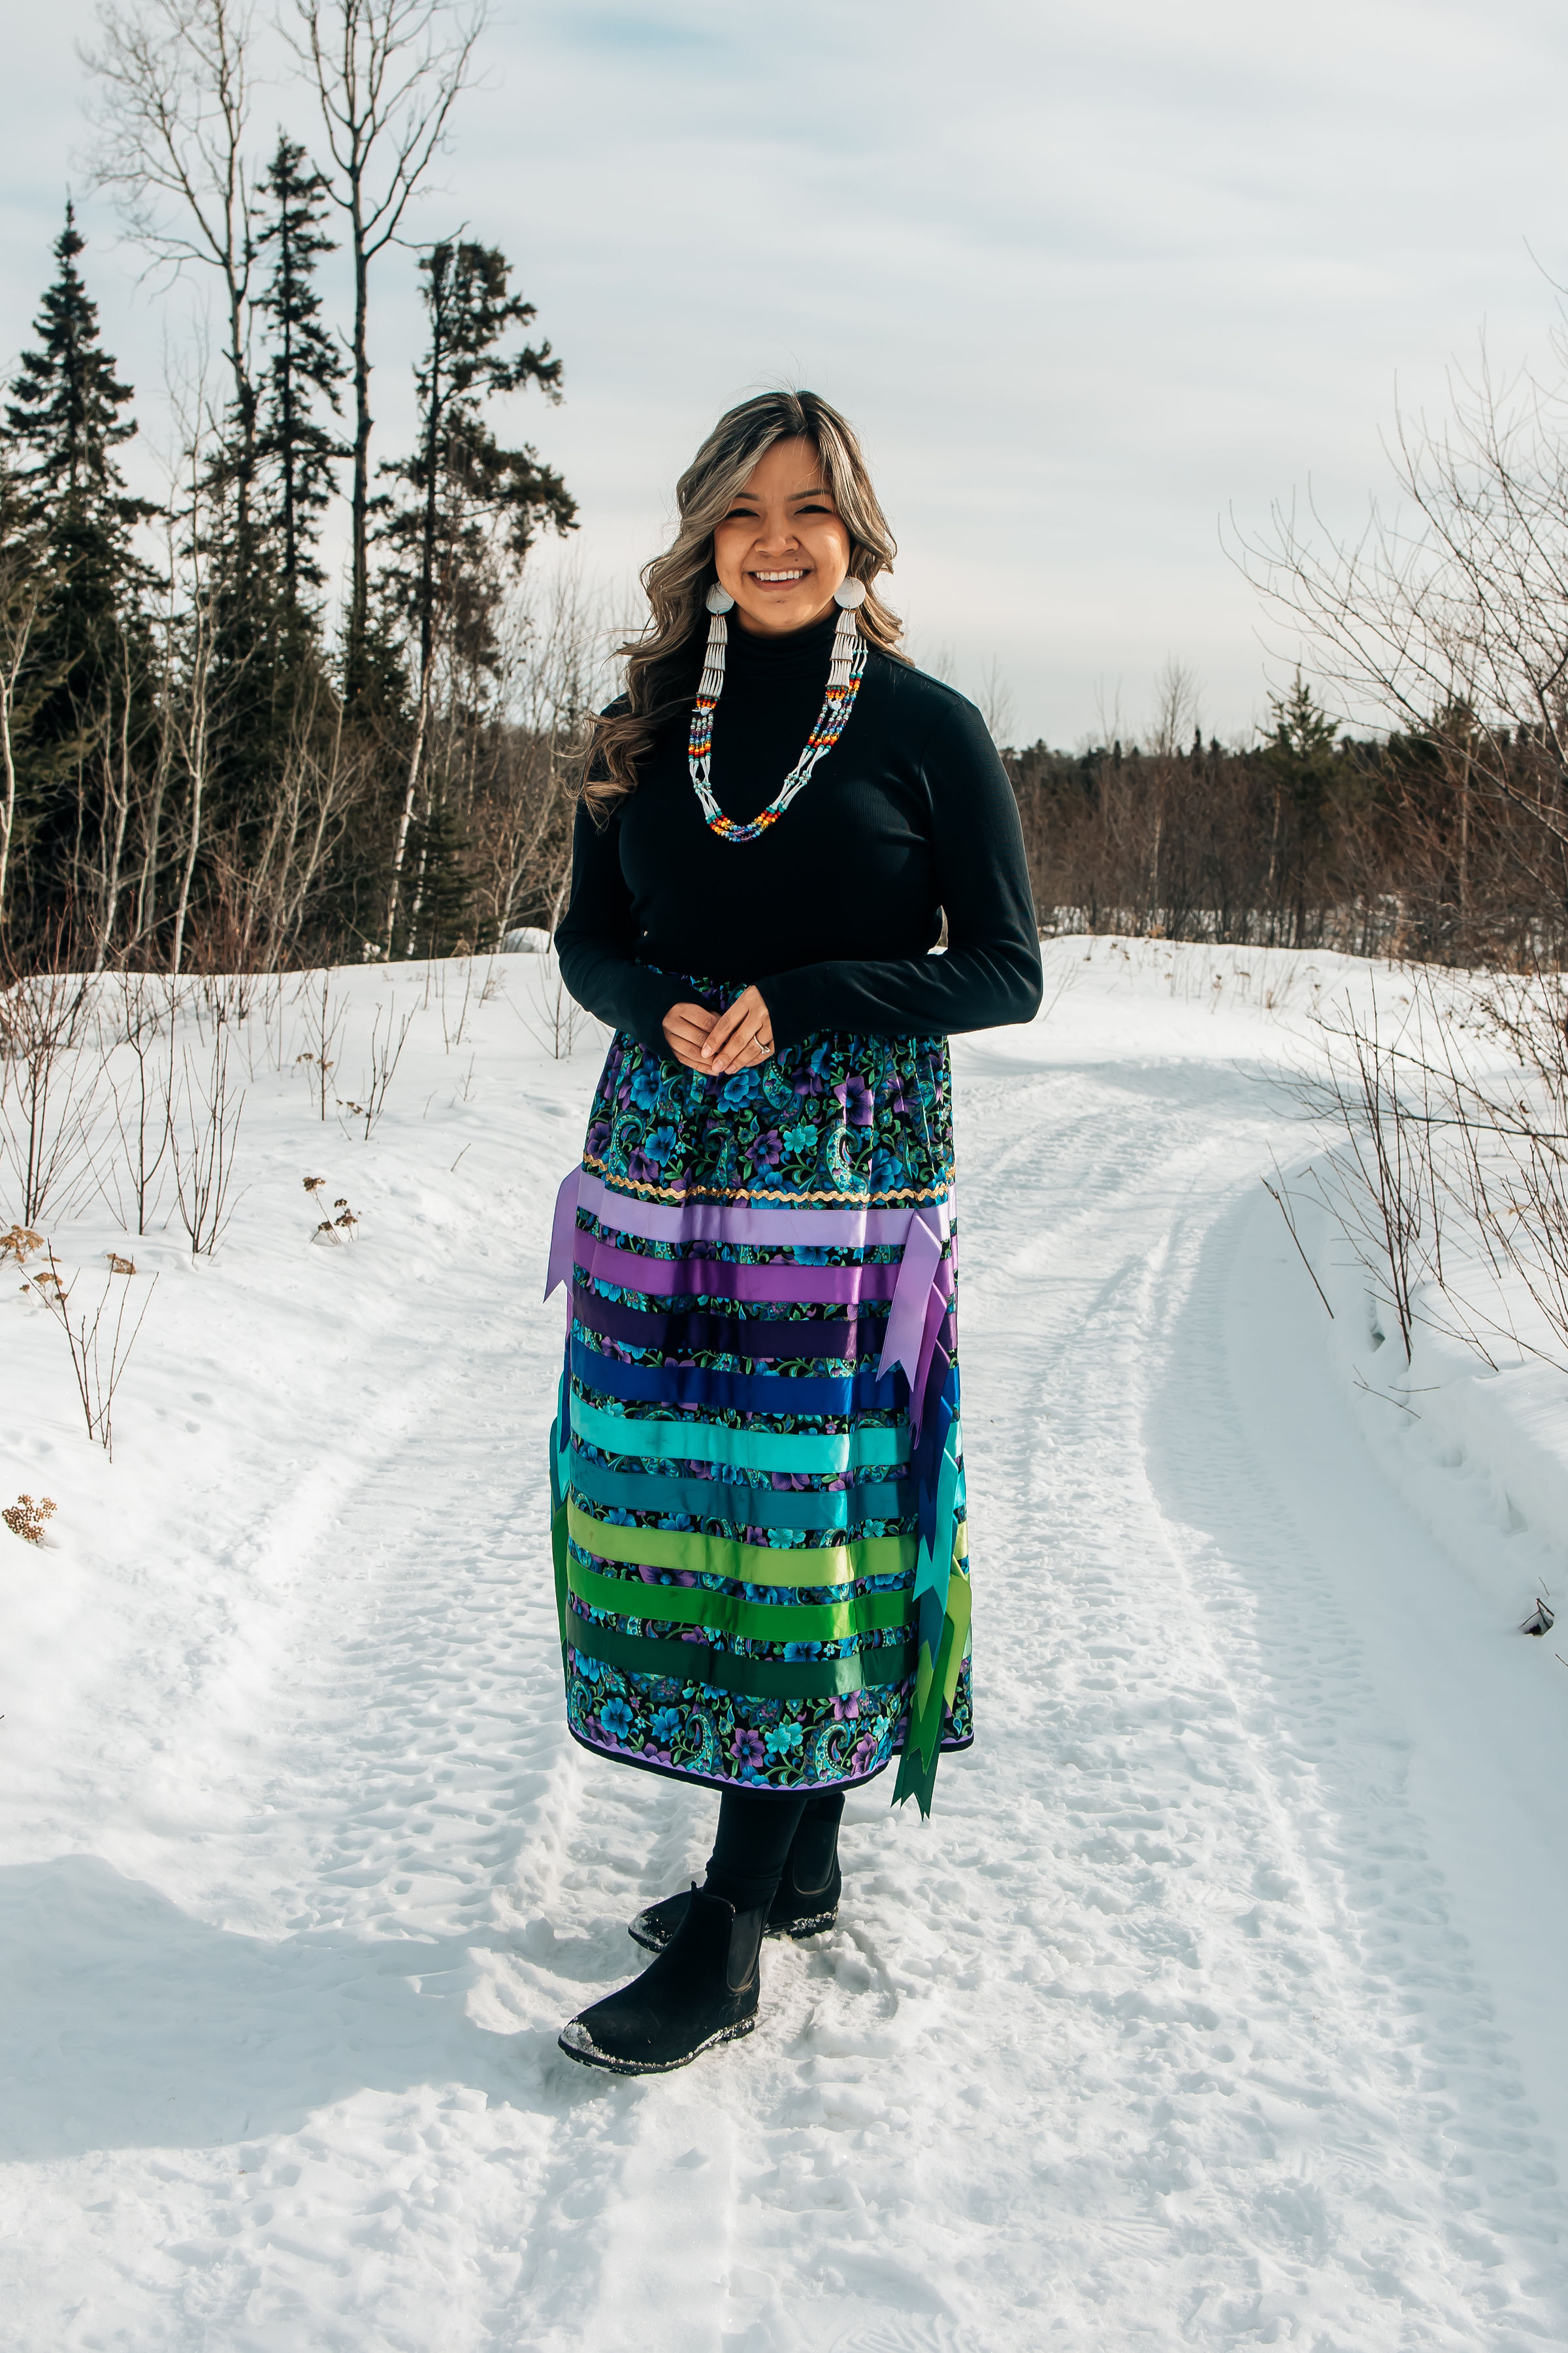
Storm Angeconeb is an Ojibwe
artist, proud member of Lac Seul
First Nation, Treaty Three
Territory, born and raised in
Winnipeg, Manitoba. Currently
based in Red Lake, Ontario.
Many of her works include the
knowledge and teachings passed
down to her. Carrying those
teachings with respect and
incorporating them into her work.
Storm continues to practice her
art through painting, digital art and
practicing beadwork.
Art by Storm Angeconeb,
Lake Seul First Nation

Slide 10
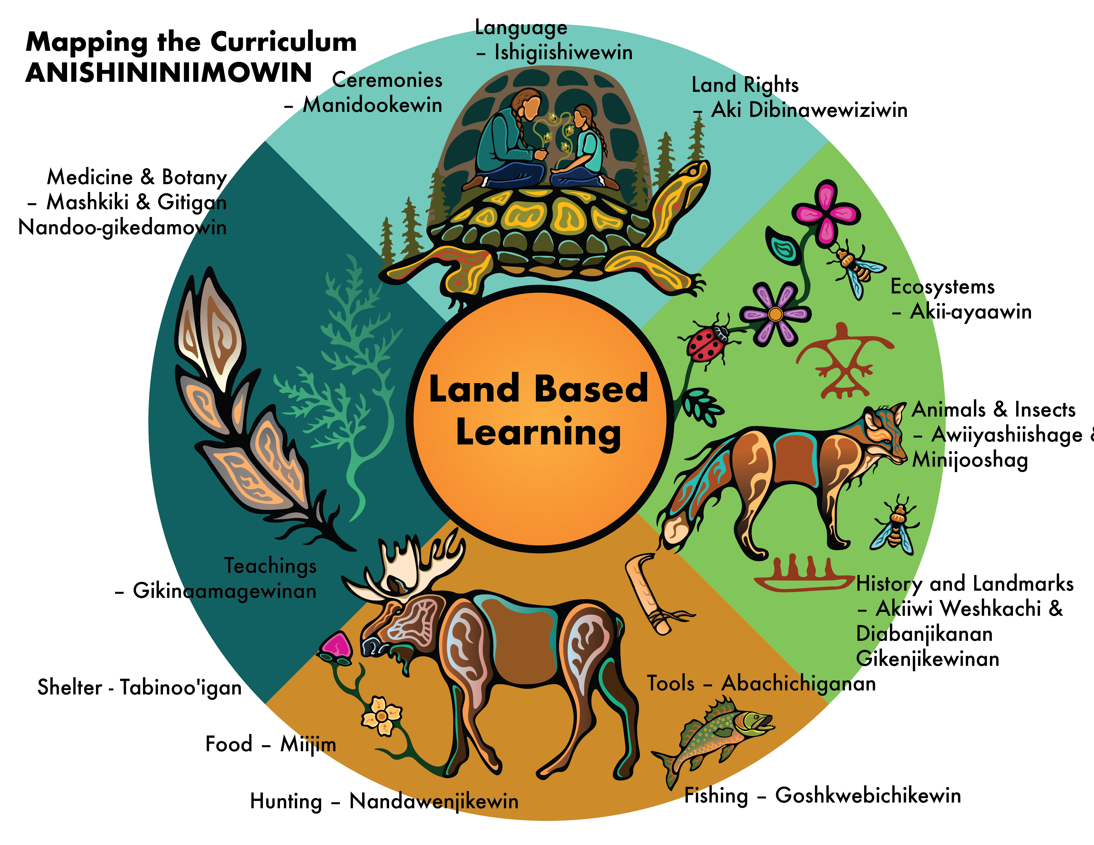
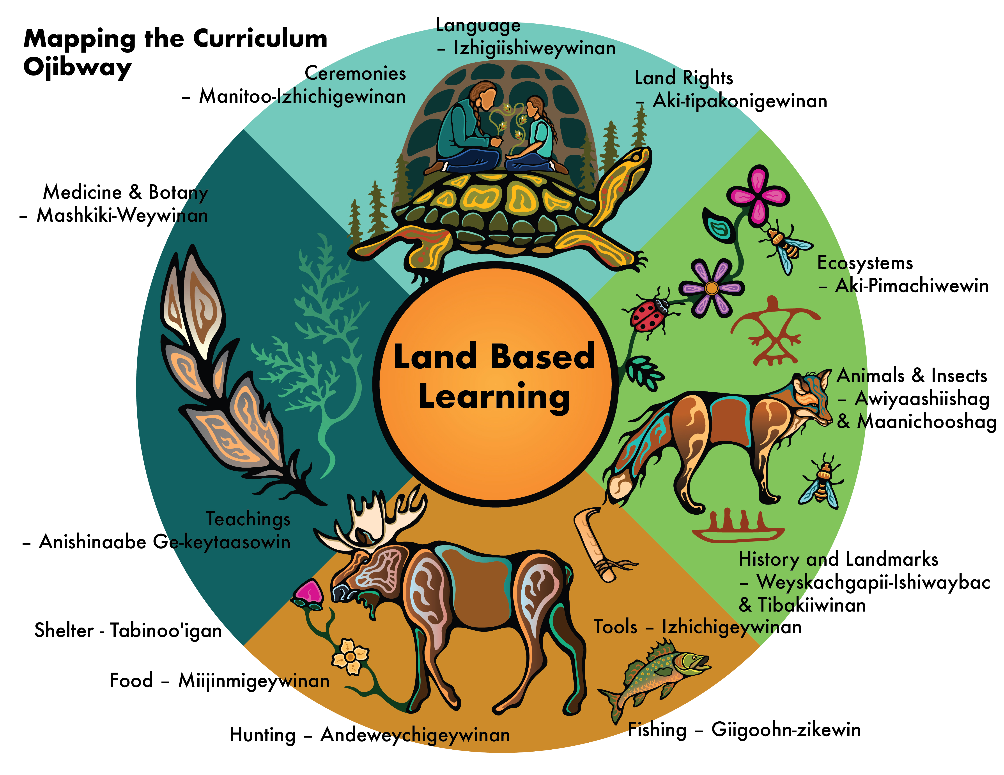
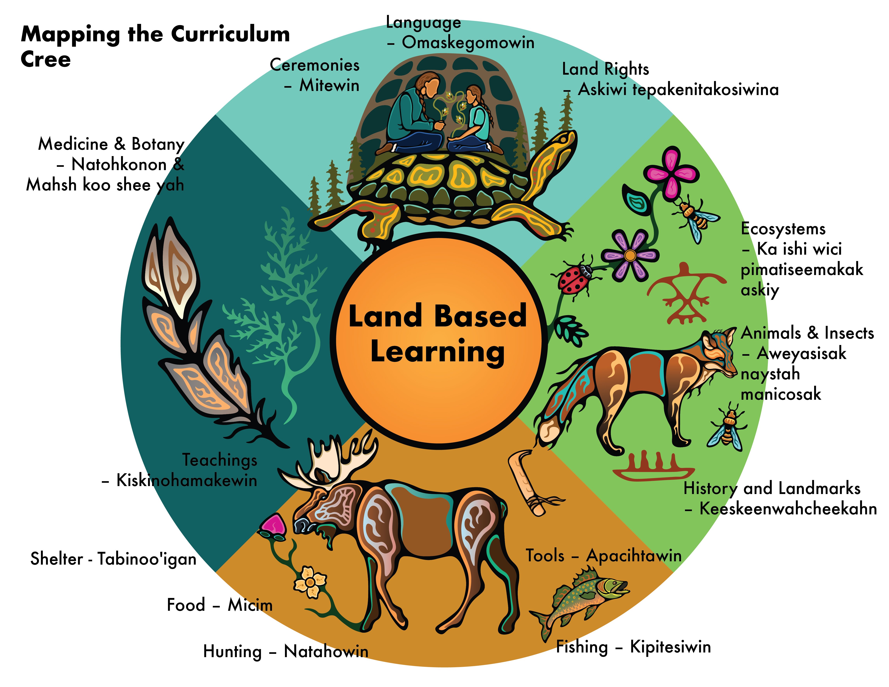

Slide 11
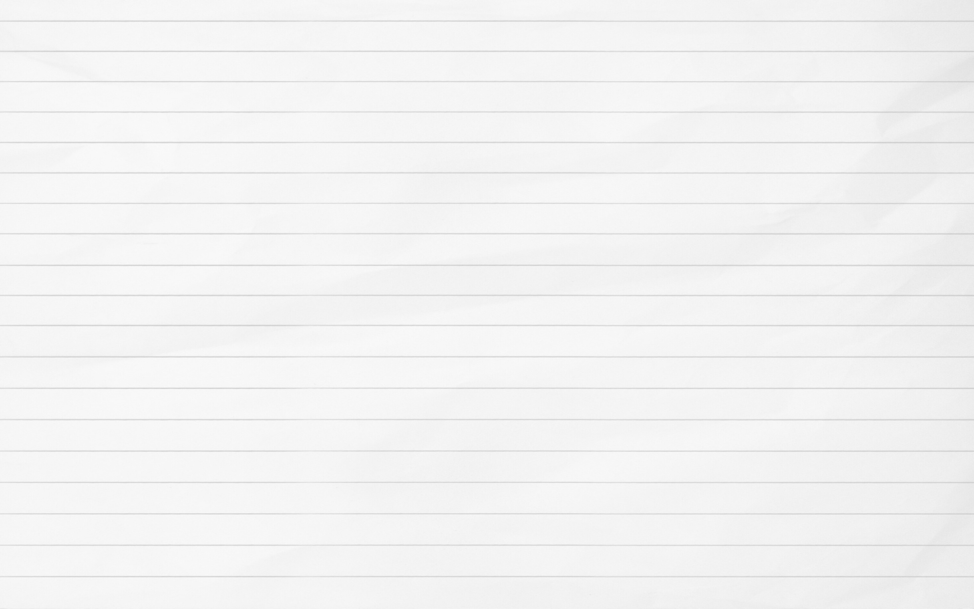
MICRO-CREDENTIALS ARE
Short
Concentrated
Flexible
Self Paced
Tailored
Stackable

Slide 12
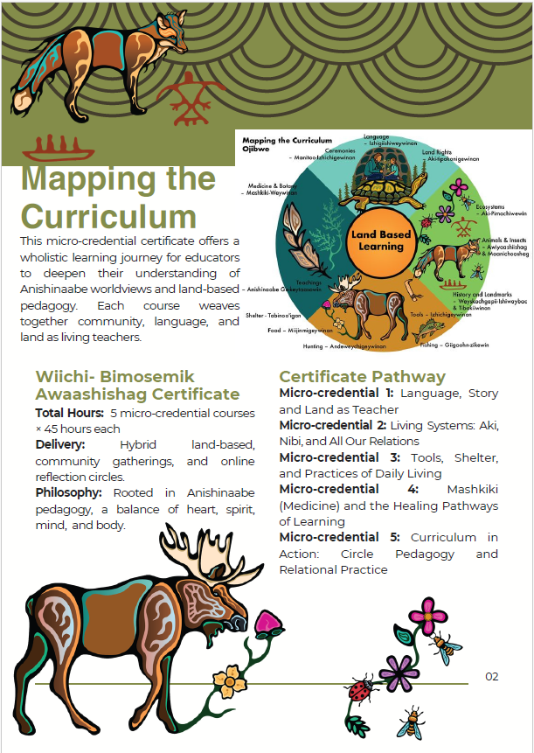

Slide 13
Miigwetch
Laura Baxter – lbaxter@nan.ca

