Slide 1

Keeping Our Children Safe
DRAFT Presentation
Kelly Massaro-Joblin & Shelley Franceschini

Slide 2
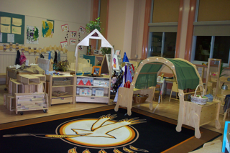
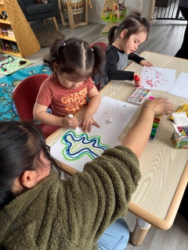
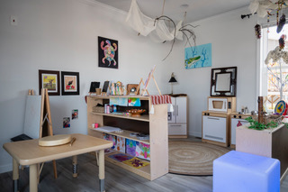
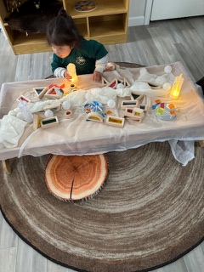
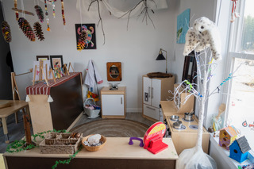
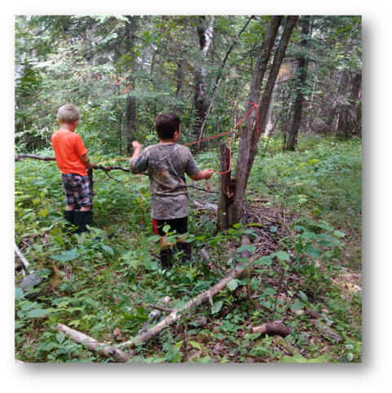
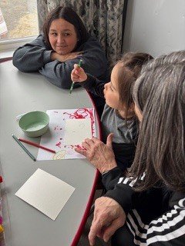


Slide 3

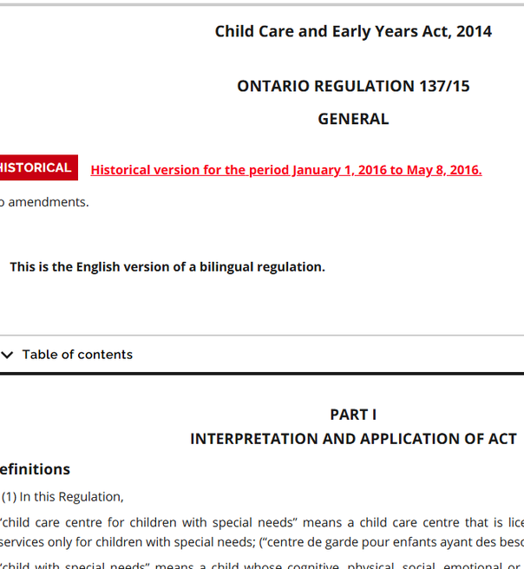


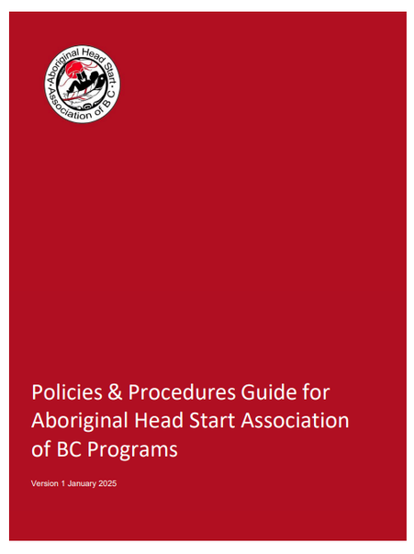
Frameworks & Resources
Policies & Procedures Guide for Aboriginal Head Start Association of BC Programs
Ontario Ministry of Education Child Care and Early Years Act
Health Canada First Nations Head Start Standards Guide
Saskatechwan First Nations Child Care Policies and Regulations

Slide 4
How They Differ
•Ensures minimum legal standards are met
•Focus on rules, policies, and oversight
•Designed for consistency across systems
•Ensures children are deeply well and protected through shared responsibility
•Focus on relationships, care and community responsibility
•Rooted in connection,
trust, and collective care

Slide 5
How Health & Safety Are Defined
•Emphasis on physical
safety and risk prevention
•Defined through
legislation and policy
•Safety is documented and inspected
•Safety is created and maintained by caregivers and the community every day
•Emphasis on physical,
emotional,
mental,
and spiritual well-being
•Defined through
relationships,
shared responsibility
and lived experience

Slide 6
View of the Child
•Child as an individual
receiving care
•Needs grouped by age
and category
•Focus on supervision
and protection
•Child as a whole being connected to family, community, and land
•Needs understood through observation, relationship, and readiness
•Focus on belonging, dignity, and identity

Slide 7
Age Grouping & Development
•Fixed age categories
•Mixed-age allowed only in limited ways
•Development is standardized
•Flexible, Support that follows each child’s pace
•Mixed-age learning is
natural and beneficial
•Development is individual
and relational

Slide 8
Responsibility for Safety
•Responsibility assigned to
staff and licensee
•Accountability to authorities
•Responsibility shown through compliance
•Relational shared among caregivers, families, and community
•Accountability to children, families, and future
generations
•Responsibility shown through attentive, consistent care

Slide 9
Supervision & Staffing
•Staff-to-child ratios
define supervision
•Supervision measured by number
•Qualifications are set
by policy
•Supervision defined by attentive presence and knowing each child
•Supervision measured by responsiveness and relational awareness
•Knowledge, experience and lived experience

Slide 10
Environment & Play
•Controlled and inspected play spaces
•Risks are minimized
•Safety is engineered
•Environment and land are teachers; safety is nurtured through guidance
•Risks are balanced with learning and confidence-building
•Safety is supported by attentive caregiving and community vigilance

Slide 11
Caring For Infants
•Infant care guided by procedures
•Emphasis on equipment and rules
•Safety ensured through consistency
•Infant care guided by care, trust, and relationships
•Emphasis on nurturing presence and responsive care
•Safety ensured through relationships and shared responsibility

Slide 12
Understanding Accountability/Documentation
•Documentation and inspections
•Documentation and inspections
•Proof of compliance
•Watching over and supporting children as part of daily life
•Accountability to children, families, and community
•Demonstrated impact on
child well-being

Slide 13
What Safe Looks Like
•Environment meets
standards
•Risks are controlled
•Rules are followed
•Children feel secure, valued, and supported
•Environment is welcoming, calm, and respectful
•Children grow confident and capable through guidance

Slide 14
Summary of Key Differences
•Compliance-driven
•System-focused
•Relationship-driven and
community-shared
•Child- and community-focused
•Minimum standards
•Safety as obligation
•Whole-child well-being
•Safety as responsibility and care

Slide 15
Bringing It All Together
•Regulations protect children and guide practice
•Relational & wholistic perspectives deepen care and connection
•Children are safest when:
  Minimum standards are met and
  Relationships, attentiveness, and community responsibility are strong

Slide 16
IMPORTANT TO NOTE: These guidelines were collaboratively developed to serve as a guide for communities to use or adapt, if they choose. These guidelines explore the community conversations necessary to deliver safe, high quality culturally based care to NAN First Nation children and families.

Slide 17

Section 5 – Inclusive and Culturally Safe Programming
5.1 Principles of Inclusion
5.2 Language, Knowledge, and Land-Based Learning
5.3 Respecting Family and Cultural Practices
Section 6 – Staff Qualifications and Responsibilities
6.1 Supervisor / Coordinator Roles
6.2 Child Care Staff Roles
6.3 Health Assessments and Immunizations
6.4 Professional Development and Training
6.5 Standard First Aid Certification
6.6 Staff Screening and Police Record Checks
Section 7 – Emergency Preparedness and Safety Protocols
7.1 Emergency Communications and Telephone Services
7.2 Fire Safety and Evacuation Procedures
7.3 Power or Utility Outages
7.4 Emergency Contact Information
7.5 Children’s Records and Attendance
7.6 Security, Intruder Safety, and Online Safety
Section 8 – Environmental Health
8.1 Water Safety and Quality
8.2 Pest Control and Chemical Use
8.3 Smoking, Vaping, and Traditional Tobacco Use
Section 9 – Administrative Policies
9.1 Insurance and Liability (TBD)
9.2 Documentation and Record Keeping
9.3 Review and Updating of Guiding Principles
Section 1 Purpose and Guiding Practices
1.2 Roles and Responsibilities in Early Years Programs
1.3 Employer / Leadership Responsibilities
1.4 Wholistic Early Learning and Care Approach
1.5 Cultural Protocols and Ways of Knowing
Section 2 – Program Standards
2.1 Ratios, Group Size, and Supervision
2.2 Transportation Safety
2.3 Guidance and Treatment of Children
2.4 Child Wellbeing and Safety
2.5 Mental Health and Crisis Response
Section 3 – Environment and Safety
3.1 Building, Equipment, and Playground Requirements
3.2 Play Activity Space
3.3 Play Materials and Equipment
3.4 Furnishings and Safe Sleep Practices
3.5 Outdoor Play Space and Land-Based Learning
3.6 Playground Safety and Environmental Risks
Section 4 – Health and Well-Being
4.1 Health and Medical Supervision
4.2 Signs of Illness and Communicable Disease
4.3 Accident and Serious Occurrence Reporting
4.4 Anaphylaxis and Medical Needs
4.5 Administration of Medication
4.6 Sleep and Rest Practices
4.7 Nutrition and Safe Food Handling
DRAFT

Slide 18
Ratio, Group Size and Supervision
To ensure safety and individualized care, the supervisor or manager will ensure that children are actively supervised by qualified (“qualified” as deemed by community) employees in sufficient numbers to meet each child’s needs:
• One adult must be present with 5 or fewer children (excluding infants) while on the premises.
• Two adults are required for groups of 6 or more children.
• Two staff are recommended to accompany any group of children when leaving the premises.
• 1:1 supervision is recommended for children with safety needs during outings.
Children must be supervised by more then one adult (18+) at all times off the premises, including community walks, outings, and transportation. It is suggested that children are supervised by more then one adult at all times off the premises.
These ratios support relational care, where children thrive in smaller groups with familiar, nurturing adults.
Elders teach that safety comes from connection and mutual respect—values that should underpin all supervision practices.
DRAFT

Slide 19

Guidance and Treatment of Children
We are committed to creating a safe, respectful, and nurturing environment here every child is respected, valued and supported.
Behaviour Guidance
Guidance must be age-appropriate, culturally sensitive, and focused on teaching and relationship-building. A written behaviour guidance approach is shared with staff and families.
Prohibited Actions
Children must never be subjected to:
Physical harm (e.g., hitting, shaking,).
Harsh, belittling, or humiliating treatment.
Corporal punishment (e.g., spanking).
Unsupervised isolation (confinement)
Withholding food, rest, or toilet use as punishment.
*Review new Health and Safety Ministry document
Protection from Harm
Children are sacred and must be protected from any inappropriate behaviour such as emotional, physical, sexual, and spiritual harms. It is our shared responsibility to ensure that every child is surrounded by love, grounded in culture, and supported as they grow in their own time, in their own way. We uphold relational care where every child’s spirit, safety, and well-being come first.
T
DRAFT

Slide 20
Child Wellbeing and Safety
Every Child Care and Early Years Program carries a sacred responsibility to protect
and nurture the wellbeing of all children in its care. When there is concern that a child may
be experiencing harm or neglect, the facility shall respond with care, respect, and urgency.
This response should include collaboration with the child’s family, community supports,
and the designated Child and Family Services Authority, following both community and
legislative protocols.
The Child Abuse Protocol shall be kept on file and shared in a way that supports
understanding from a cultural perspective. It should be reviewed during staff orientation,
along with teachings about cultural approaches to child wellbeing, kinship responsibilities,
and trauma-informed, culturally grounded care.
If an allegation of harm is made involving a staff member, the Child Care or Early Years
Program shall notify the Child and Family Services Authority to investigate and follow up in
a way that upholds fairness, cultural safety, and community trust. Whenever possible, guidance
from Elders or Knowledge Keepers should be included to support accountability, healing,
and the continued safety of all children.
Staff Responses to Child Wellbeing and Safety (recommendation)
• Have a trauma-informed approach for children experiencing emotional distress.
• Staff should receive training on recognizing and responding to mental health concerns.
• Staff should receive Ireferral information for mental health and traditional healing supports.
DRAFT
Page 2 0f 2

Slide 21
Guiding Questions
Review the Policy Together
Identify:
What works well in this policy?
What might be challenging?
What language or wording could change?
What supports programs may need?
Record: Strengths, Concerns, Suggestions

Slide 22
KEEPING CHILDREN SAFE
Final Thoughts, Questions & Reflections
“We are trusted with their spirits, and their lives.”
Elder Sam Achneepineskum

