Slide 1
PIRA
Pediatric Indigenous Rehabilitation Aide/Assistant
Hilairy Walters
NAN-Early Years Advisor
hwalters@nan.ca
January 2026

Slide 2
Introduction to PIRA:
Together, Nishnawbe Aski Nation (NAN) and Oshki-Wenjack are co-creating the Pediatric Indigenous Rehabilitation Assistant (PIRA) program to support First Nation communities. This initiative is being shaped with the support of a wide range of community partners, service providers, and dedicated community supporters, all working collaboratively to address the unique rehabilitation needs of First Nation children and families.
As of January 2026, NAN and Oshki-Wenjack have worked closely to establish the program’s course learning outcomes and have initiated curriculum development for the two-year Rehabilitation Assistant Diploma. This milestone reflects a strong and ongoing commitment to culturally grounded, community-driven education.
The PIRA Advisory Committee has been instrumental in advancing this work. Their dedication and guidance have helped move the program from its initial vision—first imagined in 2021—into a meaningful and tangible reality. Their continued commitment ensures that the program remains rooted in community priorities and positioned for long-term success.

Slide 3
Pediatric Indigenous Rehabilitation Assistant (PIRA)
A Pediatric Indigenous Rehabilitation Assistant (PIRA) is a trained frontline professional who supports children, families, and service providers by improving access to early identification, developmental screening, and rehabilitative care within First Nations communities.
Guided by First Nation knowledge, relational accountability, and community-led priorities, PIRAs enhance continuity of care and help bridge gaps between local supports, health systems, and external specialists.
Grounded in cultural safety, trauma-informed practice, and the strengths of local language and community relationships, PIRAs play a vital role in strengthening developmental wellness pathways for children from infancy through adolescence.

Slide 4
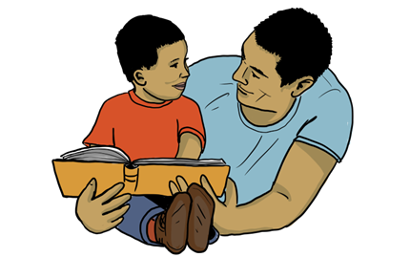
How PIRAs Support Children
PIRAs provide culturally safe, child-centered support that helps children thrive across
physical, social, emotional, and developmental domains.
They may:
• Assist in delivering therapy-informed activities designed by Children's Treatment Centre clinicians (OT, PT, SLP).
• Support developmental play, motor skills, sensory regulation, communication goals, and adaptive functioning.
• Provide consistent day-to-day practice opportunities between therapy visits.
• Observe and document developmental progress to inform therapists and families.
• Build trusting relationships that help children feel safe, understood, and supported.

Slide 5
How PIRAs Support Families
Families benefit from accessible, culturally grounded support close to home.
PIRAs help to:
• Offer guidance on routines, developmental milestones, and strategies that fit the family’s culture and environment.
• Support parents/caregivers with tools for co-regulation, emotional literacy, and attachment-building.
• Provide advocacy and navigation support when accessing external services such as Jordan's Principle, health services, schools, or specialist referrals.
• Strengthen family voice and choice in all rehabilitation planning.
• Build trusting relationships rooted in respect, reciprocity, and community values

Slide 6
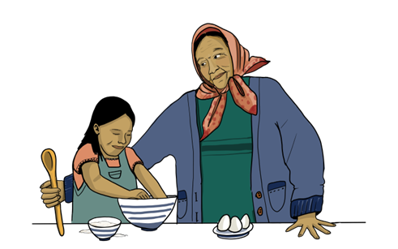
How PIRAs Support Community Wellness
PIRAs strengthen community-based systems of care by:
• Increasing local capacity to deliver early intervention and rehabilitation supports.
• Reducing reliance on fly-in services and decreasing wait times.
• Supporting community programming (land-based learning, wellness groups,
school activities, prevention initiatives).
• Helping streamline communication between families, schools, health services, and visiting clinicians.
• Promoting local language, cultural teachings, and community traditions within developmental programming.

Slide 7
How PIRAs Support Service Providers
PIRAs make clinical services more effective, more coordinated, and more culturally relevant.
They may:
• Prepare children/families for therapy visits and support follow-through after appointments.
• Implement therapy plans designed by occupational therapists, physiotherapists, and speech-language pathologists.
• Provide accurate observation notes and progress updates to clinicians.
• Assist with equipment use, home programming, environmental modifications, and safety practices

Slide 8
How PIRAs Build Capacity & Strengthen Systems of Care
PIRAs serve as a bridge between families, community systems, and external partners.
This results in:
Stronger early identification pathways
More children are identified earlier in life, leading to more timely supports.
Improved developmental monitoring
Consistent in-community presence means concerns are addressed before they escalate.
Smoother transitions across home, daycare, school, and health systems.
Culturally grounded rehabilitation practices, weaving Indigenous worldviews, traditional knowledge, and land-based wellness into modern rehabilitation.

Slide 9
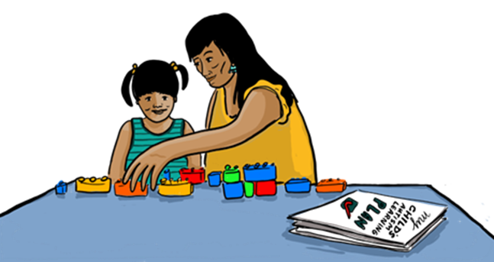
How PIRAs Build Capacity & Strengthen Systems of Care
Sustainable local workforce development
Communities gain skilled members who contribute long-term to children’s well-being, reducing dependency on outside systems.
• Expanded wrap-around care
PIRA roles integrate with programs such as Indigenous Healthy Babies Healthy Children,
education, nursing stations, early childhood educators, and mental health teams.

Slide 10
Pediatric Indigenous Rehabilitation Aide vs. Assistant
Shared Purpose, Different Depth of Skills
Both the Pediatric Indigenous Rehabilitation Aide (Certificate – 1 year) and the Pediatric Indigenous Rehabilitation Assistant (Diploma – 2 year) support children, families, and communities by strengthening developmental pathways rooted in First Nations knowledge and community wellness.
They differ in level of training, scope, and complexity of responsibilities.

Slide 11
Pediatric Indigenous Rehabilitation Aide (PIRA – Aide)
Certificate-Level | Foundational Skills | Community Support Role
Role Overview
The Aide provides front-line, entry-level support to children, families, and rehabilitation providers.
Their focus is on daily implementation, hands-on assistance, and reinforcing therapy-informed activities in homes, schools, and community spaces.
Core Responsibilities
• Carry out basic therapy exercises and developmental activities as instructed by OT/PT/SLP or other clinicians.
• Support children’s participation in routines, play, self-help skills, and school/daycare environments.
• Document basic observations related to the child’s engagement, behaviour, and progress.
• Help prepare materials, activity spaces, and equipment for sessions.
• Assist families with understanding routines, follow-up activities, and home-based strategies.
• Promote cultural safety, kindness, and emotional literacy through one-on-one interactions.
• Support group programs, land-based activities, and community events for children and families.
• Act as a positive, consistent presence that families trust.

Slide 12
Skills & Abilities (Aide Level)
• Foundational knowledge of child development and developmental milestones.
• Ability to follow structured therapy plans with guidance from clinicians or an Assistant.
• Basic observational and documentation skills.
• Strong relationship-building and communication with families.
• Understanding of cultural safety, trauma-informed approaches, and community values.
• Ability to support emotional regulation and co-regulation in children using simple strategies.
• Reliability and consistency in daily routines and support tasks.
Scope
Aides do not create therapy plans, conduct assessments, or make clinical decisions.
They work under direct supervision and focus on hands-on, day-to-day support.

Slide 13
Pediatric Indigenous Rehabilitation Assistant (PIRA – Assistant)
Diploma-Level | Advanced Skills | Coordinated Rehabilitation Support
Role Overview
The Assistant has enhanced training that allows them to take on more complex tasks, coordinate with multiple service providers, and work more independently. Assistants serve as connectors between families, schools, health services, and specialized therapists.
Core Responsibilities
(Includes all Aide duties plus enhanced responsibilities.)
• Implement more complex therapy programs designed by clinicians with greater independence.
• Support clinicians during assessments by preparing the environment, organizing equipment, and recording detailed observations.
• Conduct structured developmental screenings under supervision (if permitted by policy).
• Develop session materials and modify activities to fit the child’s needs, culture, and environment.

Slide 14
Pediatric Indigenous Rehabilitation Assistant (PIRA – Assistant)
Diploma-Level | Advanced Skills | Coordinated Rehabilitation Support
• Provide detailed reporting and progress monitoring for therapists, educators, and health teams.
• Coordinate communication between families, CTCs, schools, and community service providers.
• Participate in case conferences, care planning meetings, and interprofessional teams.
• Assist families with system navigation (e.g., Jordan’s Principle, referral pathways, transitions).
• Offer stronger emotional literacy support, including strategies for trauma-responsive care, self-regulation, behaviour supports, and safety planning.

Slide 15
Skills & Abilities (Assistant Level)
• Deeper understanding of child development, disability, rehabilitation practices, and Indigenous wellness frameworks.
• Proficient communication and ability to collaborate across health, education, and community systems.
• Intermediate documentation, data collection, and progress reporting skills.
• Ability to adapt therapeutic activities within the scope of a clinician’s plan.
• Strong skills in relational practice, advocacy, and cultural grounding.
• Knowledge of safety protocols, emergency response, infection control, and environmental modifications.
• Greater independence with minimal supervision.
Scope
Assistants work with greater autonomy, contribute to care coordination, and handle more advanced therapy support tasks. They support system navigation and interprofessional communication but still do not diagnose, assess, or prescribe treatment.

Slide 16
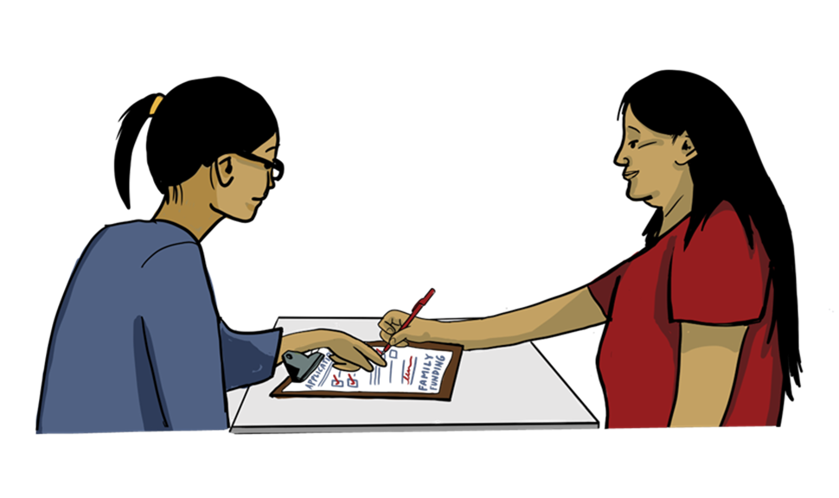
Community Impact: Aide vs. Assistant
Both Roles Strengthen Community Systems by:
• Increasing access to developmental supports.
• Building trusted relationships with families.
• Supporting local language, culture, and identity.
• Enhancing early identification and developmental monitoring.
• Reducing wait times and dependency on fly-in services

Slide 17
Differences in Impact: Aide vs. Assistant
Area | Aide | Assistant
Level of Responsibility | Entry-level | Intermediate
Independence | Works mainly under direct supervision | Works with moderate independence
Clinical Support | Basic implementation | Complex implementation & monitoring
System Navigation | Minimal | Strong role in bridging systems
Documentation | Basic observations | Detailed progress reports
Family Support | Day-to-day support | Advocacy, planning, coordination
Community Programs | Supports delivery | Supports design & coordination

Slide 18
Summary
Aides strengthen daily routines and hands-on child development support.
Assistants enhance system navigation, advanced therapeutic implementation, and interprofessional collaboration.
Together, these roles create a sustainable, culturally grounded model of community-based pediatric rehabilitation, empowering First Nations communities to support their children in ways that honour language, identity, and traditional knowledge.

Slide 19
Anticipated timeline for program launch:
Over the spring/summer months (2026) , we aim to complete the program application and all corresponding documents, including course descriptions, course outlines, and course learning outcomes for both the Aide and Assistant streams.
This will also include the development of the one-year certificate curriculum, placement handbook, and a draft outline for the second year (Assistant) program. Once finalized, the application will be submitted to the Indigenous Advanced Education and Skills Council (IAESC) for initial review and consideration.
The goal is to launch the program for enrolment in the new year of 2027, with students beginning their studies in the fall of 2027.
Although there is still work to be completed and potential revisions to be made within the application, the goal remains clear. The PIRA program is committed to preparing competent, capable, and confident Rehabilitation Assistants who will support children and families in First Nation communities. Through this work, PIRA aims to strengthen community-based care and contribute to improved outcomes for First Nation children and their families.

Slide 20
Meegwech/ Thank you

