Slide 1

STRENGTHENING OUR NATIONS: GOVERNANCE & LAW-MAKING
Skylene Metatawabin – Strategic Advancement Capacity Coordinator
807.625.4641 | smetatawabin@nan.ca
Nishnawbe Aski Nation
Office 807.623.8228 Fax 807.623.7730
100 Back Street Rd., Unit 200
Thunder Bay, ON P7J 1L2
www.nan.ca
Notes:
Today I want to talk about Education Jurisdiction and law-making, and what this means for our Nations.
This work is really about self-determination, reclaiming decision-making, and creating education systems that reflect who we are.
My role is to support communities in understanding the process and the development of local education codes..

Slide 2
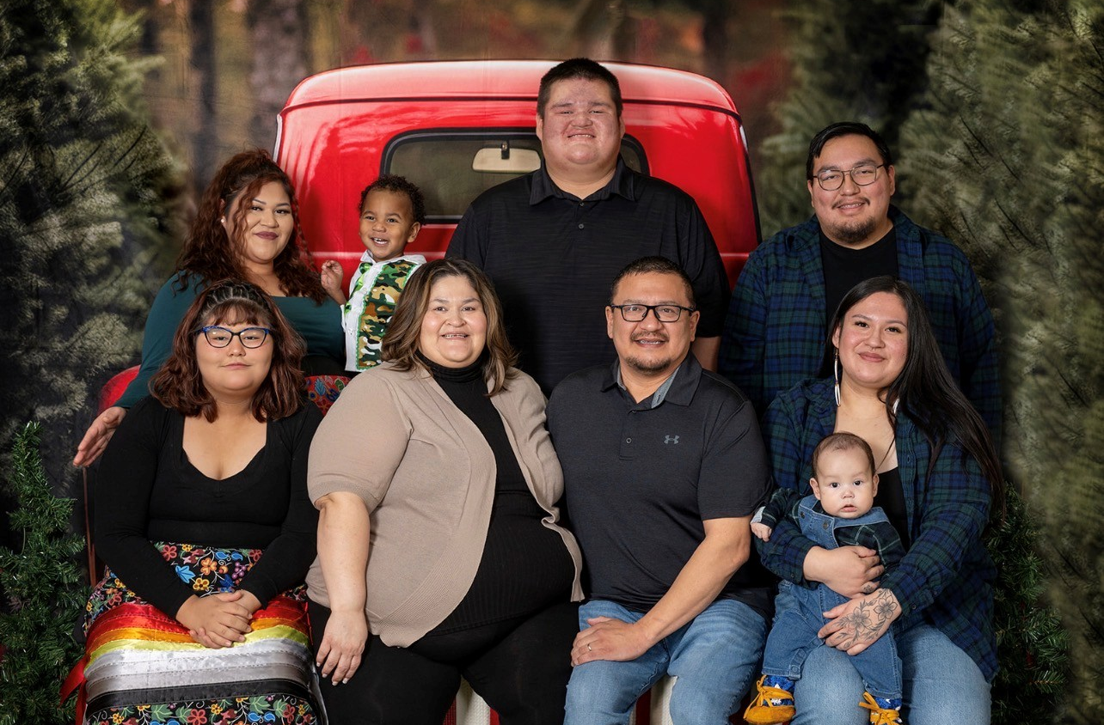

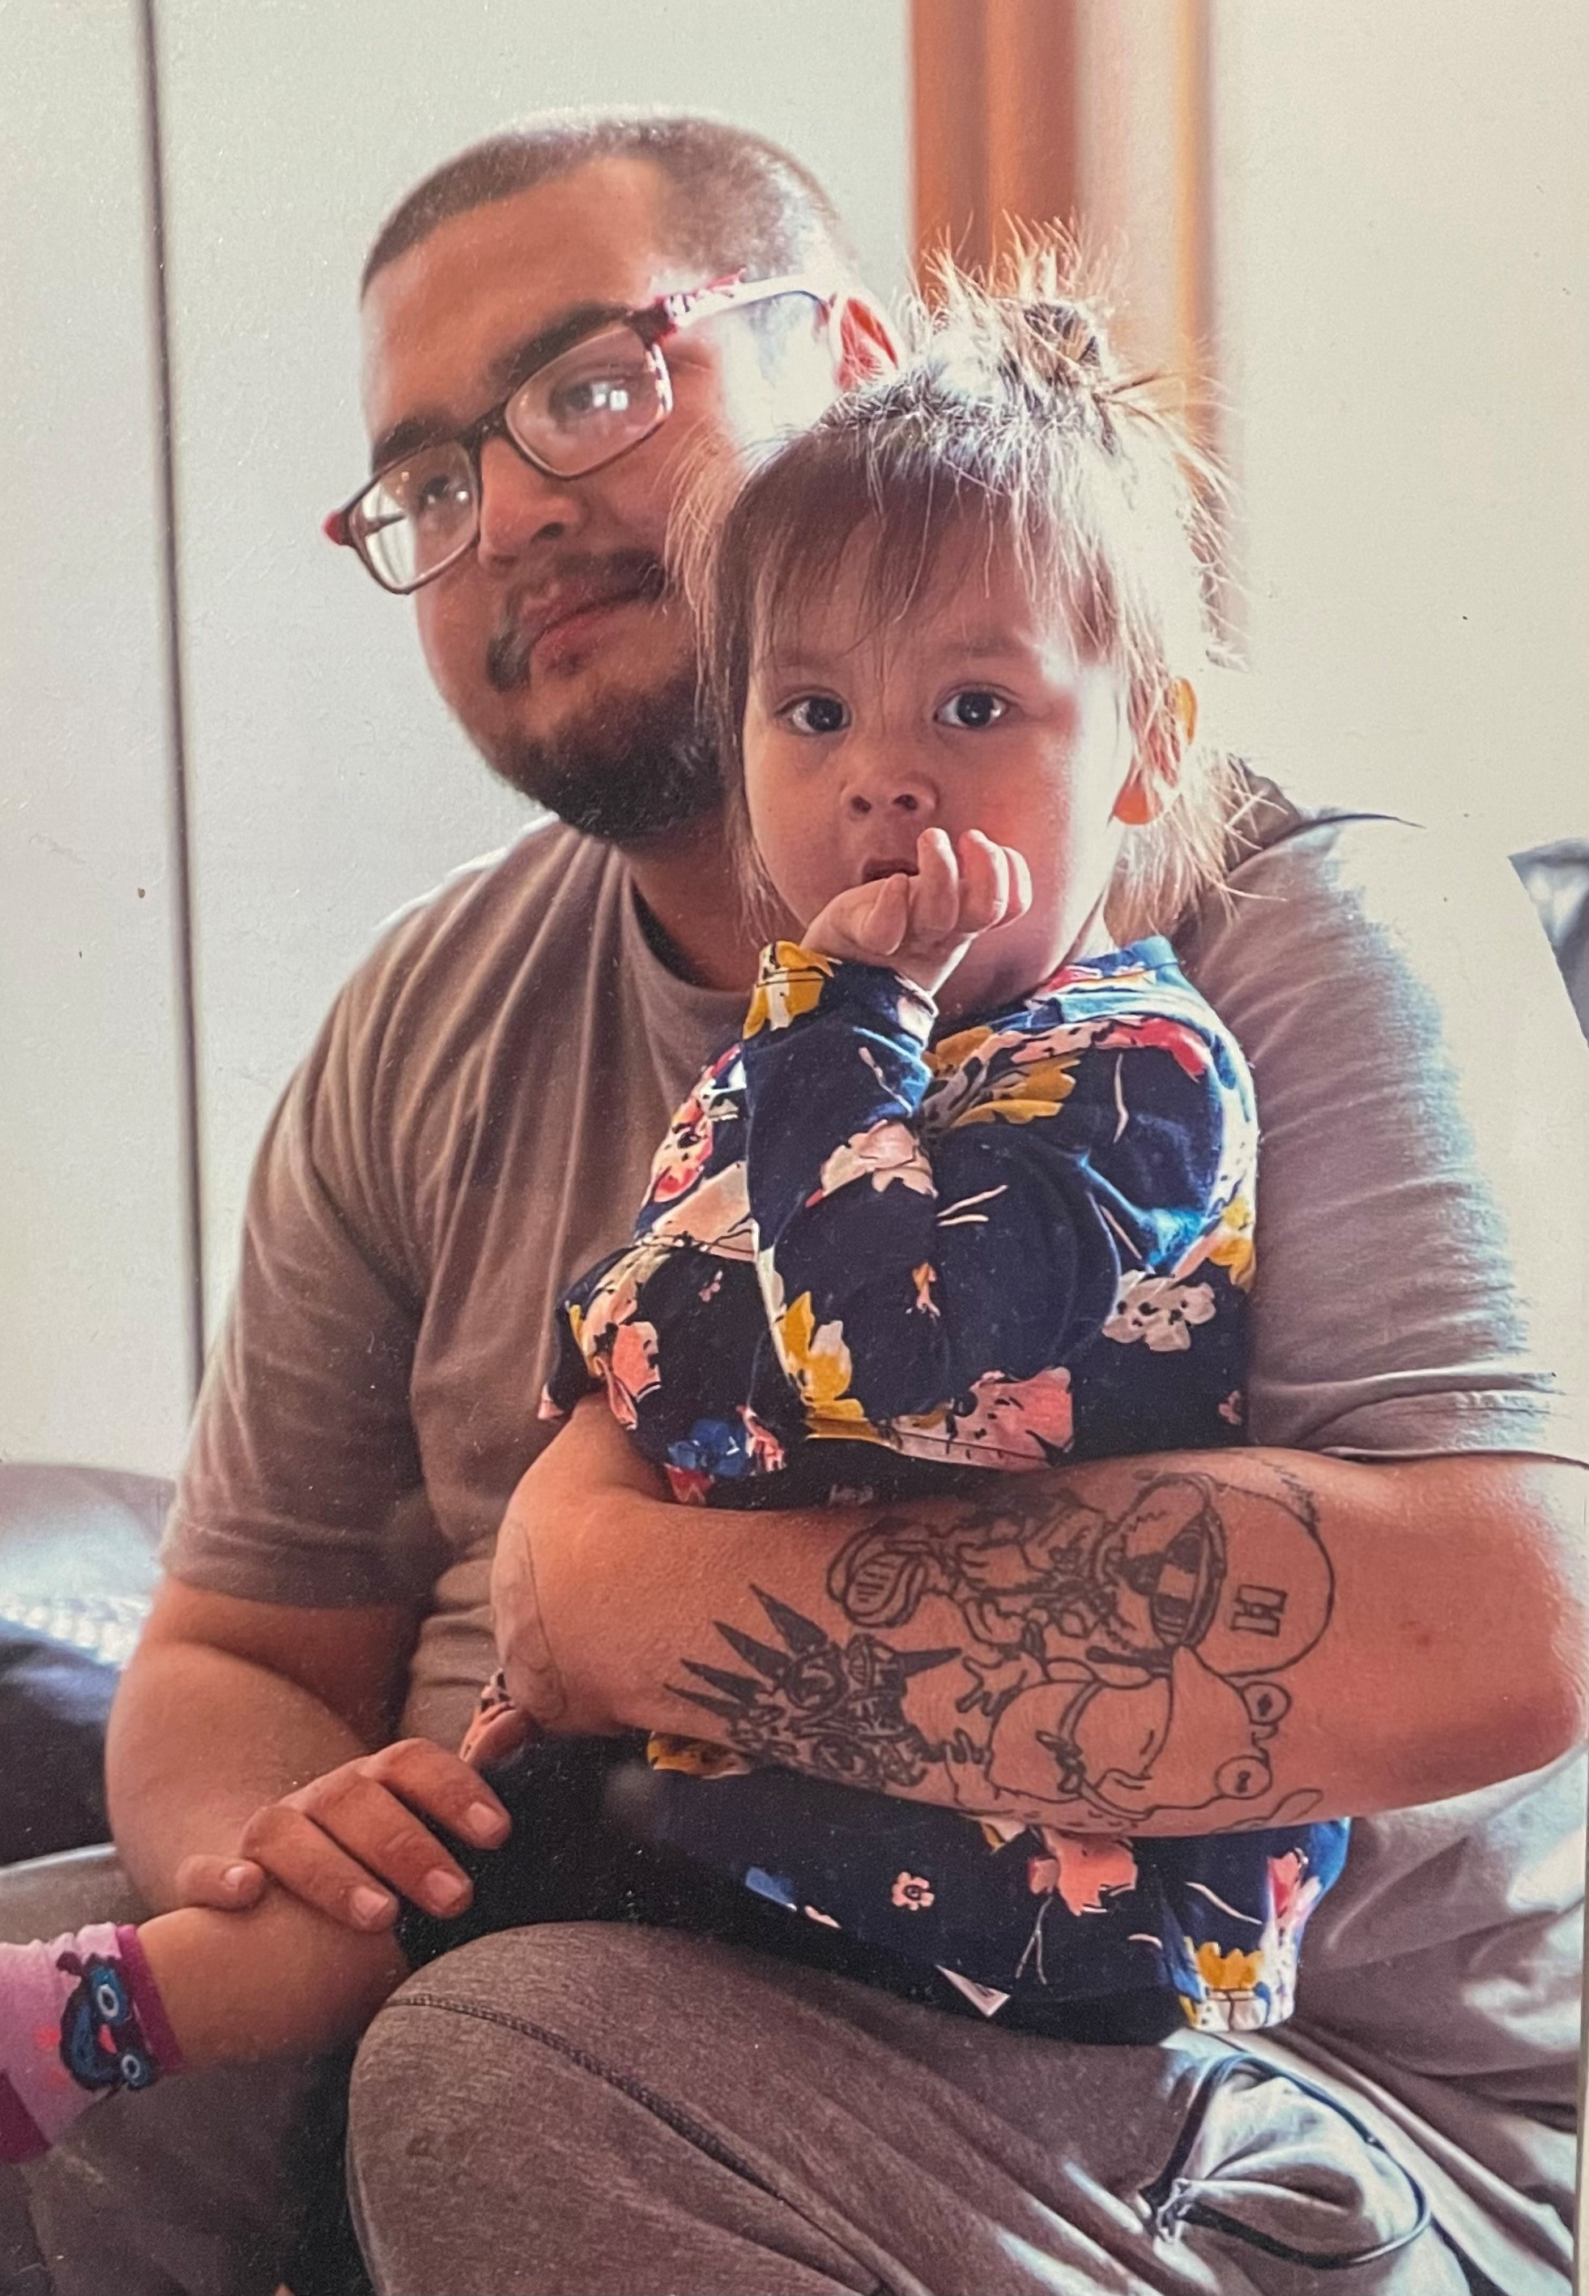
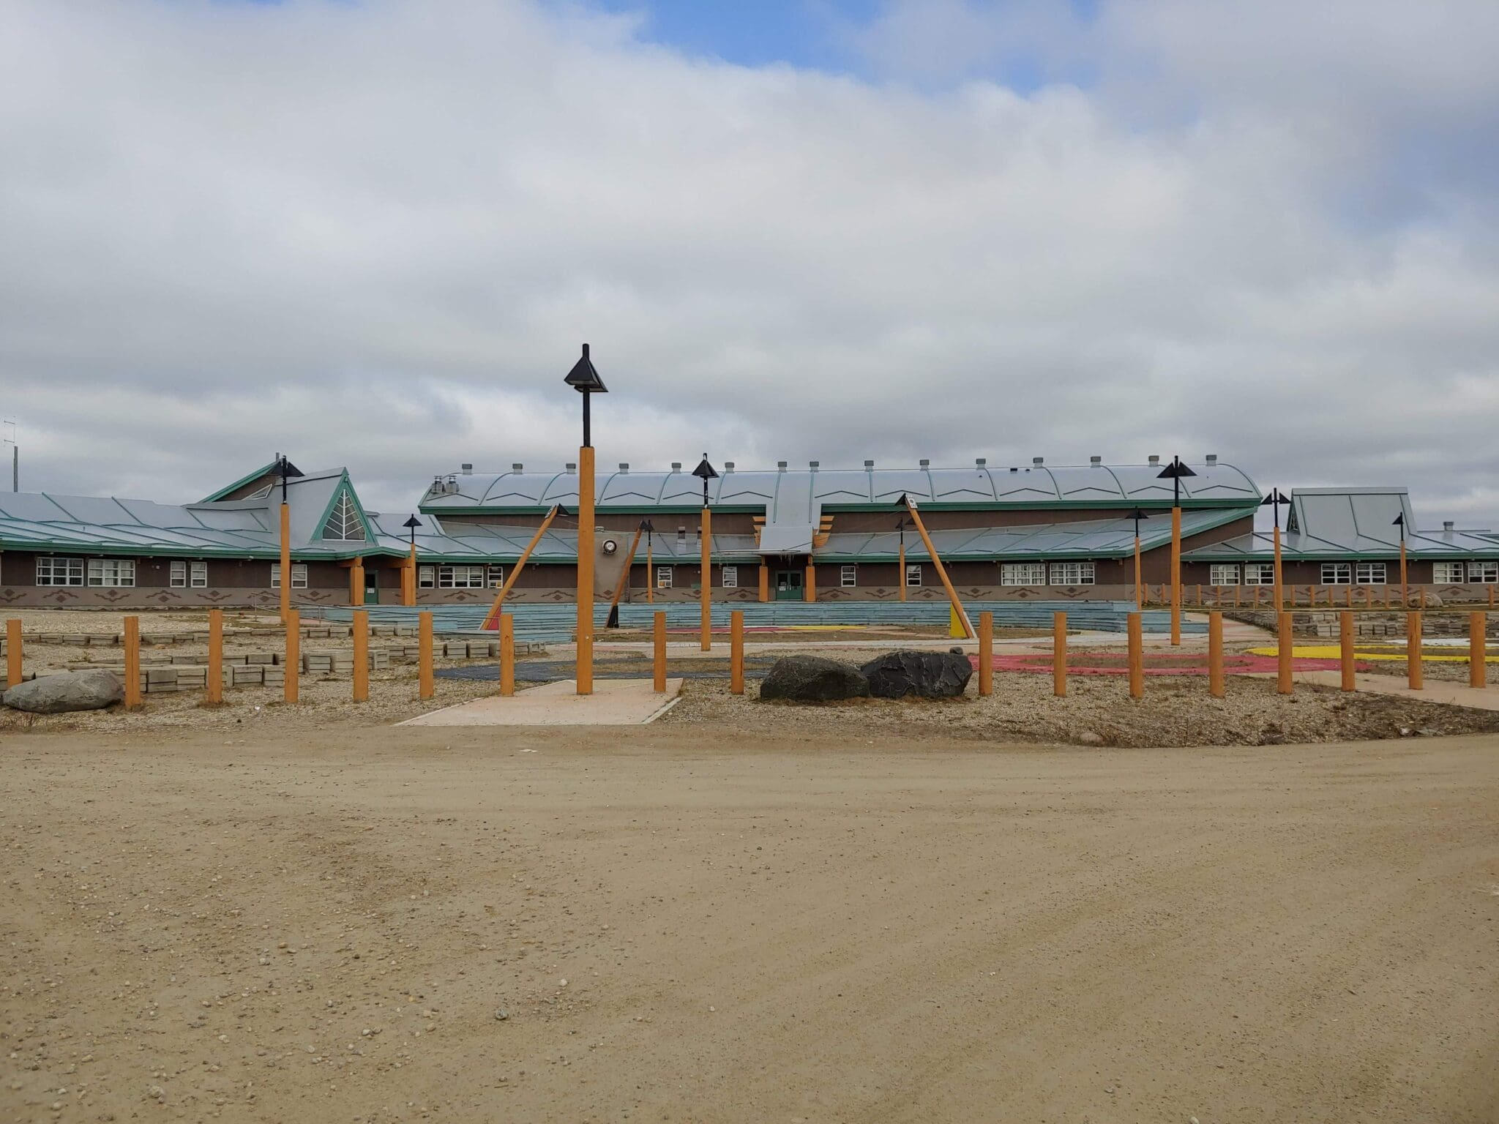
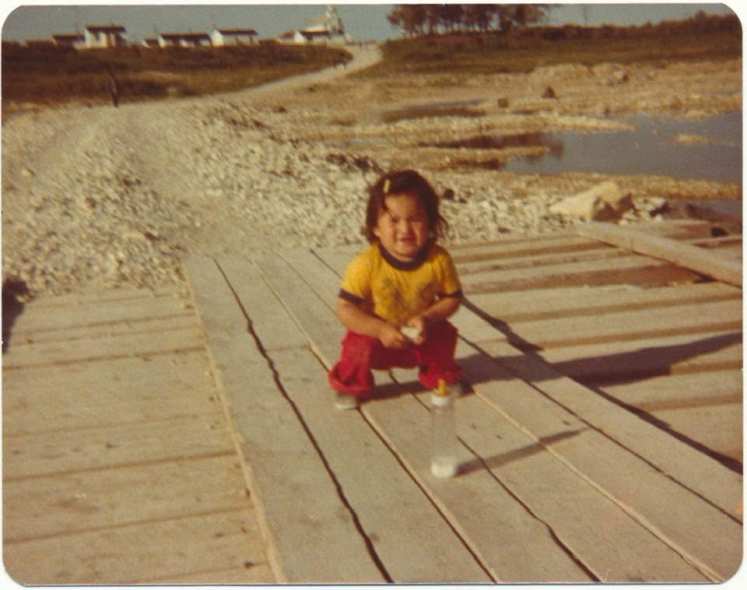
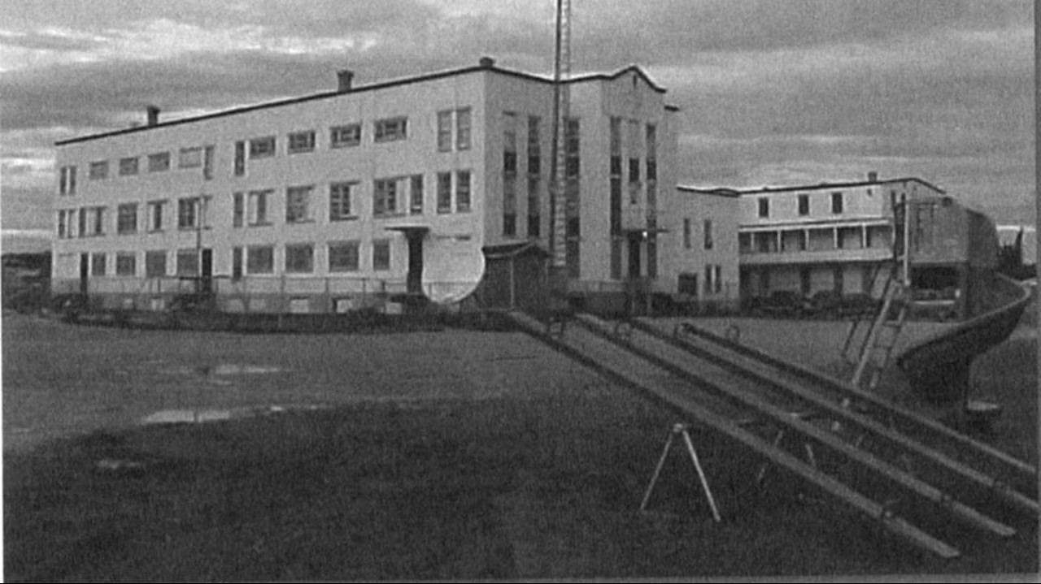
Notes:
Fort Albany FN member
Married and been with husband for 26yrs /18yrs
Mother of 4 and a glammie to 9
Intergeneration survivor
Mom attended residential school and I Attended Day school and actually started my career in Education when I was 19yrs /29yrs as a TA
New school 2001 – TA to Head Start Coordinator to Certified Kindergarten teacher
I do this work for my grandkids, and for the little girl I promised I would make a difference for someday. I do not always know what that looks like, but I believe my journey continues to guide me to where I am needed.

Slide 3
Overview
Education Jurisdiction
Why it matters
Regional Education Agreements
Our Pathway to Education Jurisdiction
Important
Territory Wide Education System (TWES) Framework
Comparing other First Nation education systems
A Pathway to Law-Making
Voices in Action Activity

Slide 4
Do not edit
How to change the design
When you hear the words Education Jurisdiction, what is the first word that comes to mind?
The Slido app must be installed on every computer you’re presenting from

Slide 5
Education Jurisdiction restores First Nations authority to create and manage their own K-12 education laws. This shifts decision-making from federal/provincial systems to community-driven governance.
What This means for Education Directors:
Greater control over curriculum, staffing, standards, and school operations
Ability to embed language, land-based learning, and cultural knowledge
Clear governance structures and accountability mechanisms
A shift away from Indian Act sections 114-122
System Level Shifts for Participating First Nations:
Local Education Codes replace federal rules
First Nations join the Territory Wide Education System (TWES)
Notes:
It’s about moving away from one-size-fits-all education.
And as First Nations we see treaties as sacred, relationship‑based agreements. Canada treats treaties as legal, land‑focused policy and often ignores their original spirit.
So Why EJ Matters: First Nations gain recognized law‑making authority over education. The final agreement becomes law through Royal Assent (bill → House of Commons vote → Governor General approval).

Slide 6
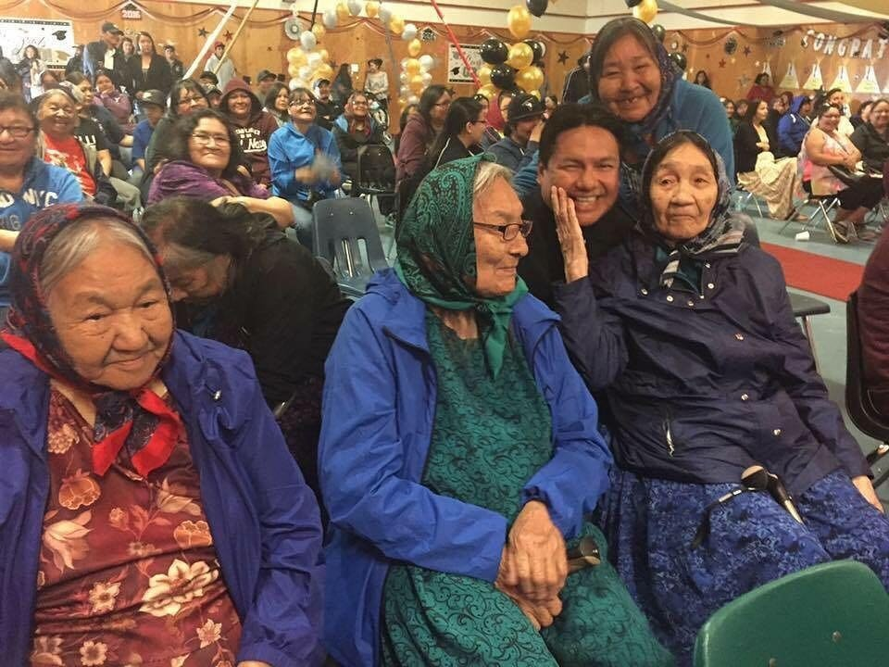
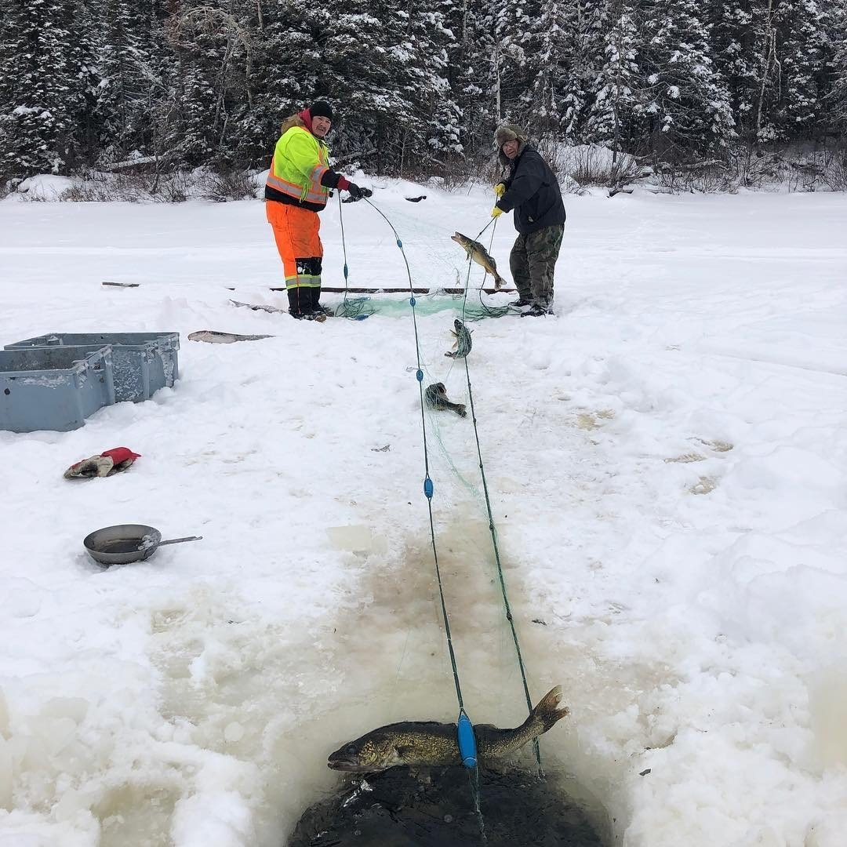

Why it matters
Education Jurisdiction helps communities decide what works best for their youth.
It ensures schools teach who we are, not just provincial content.
It’s about self-determination and pride in learning.
Notes:
Bullet 2: The province doesn’t run First Nations schools, but it does control the rules for credits and graduation. That means First Nations students still have to fit into a provincial system that wasn’t built for them—especially in high school. This is why EJ matters. It is about deciding who defines success, whose standards count, and how our students move forward without having to constantly adapt to someone else’s system.

Slide 7
Do not edit
How to change the design
Rank the most important priorities for a Territory wide education system
The Slido app must be installed on every computer you’re presenting from

Slide 8
A Regional Education Agreement (REA) allows multiple First Nations in a region to collaborate on shared education priorities. Each Nation keeps its own local authority while working together on planning, shared services, and capacity building.
Although Canada allows individual communities to pursue agreements on their own, it prefers regional participation to create stronger, more coordinated agreements.
Funding Considerations
  Develop needs-based funding plans
  Conduct a thorough review of annual funding requirements
  Work with the federal government to establish a regional funding agreement
Currently, only 4 REAs in Canada have been approved and funded. REA funding is tied to government programs, which may change or end. Communities should be aware that no additional funding is guaranteed.
EDUCATION PARTNERSHIPS PROGRAM (EPP) Improves service delivery through collaboration between First Nations, education authorities, and partners
↓ supported by
STRUCTURAL READINESS (SR) Builds governance, policies, and organizational capacity so systems can function effectively
↓ leads to
REGIONAL EDUCATION AGREEMENT (REA) DEVELOPMENT Supports long-term education system transformation and First Nations control of education
↓ results in
IMPROVED STUDENT OUTCOMES Better services, stronger systems, and community-driven education
Notes:
What we are also noticing is that there is confusion around REA’s and how the EPP funding mechanism is run.

Slide 9
Our Path to Education Jurisdiction
Notes:
NAN continues to negotiations with Canada while supporting communities in readiness. Team focuses on building awareness and understanding by engaging communities

Slide 10
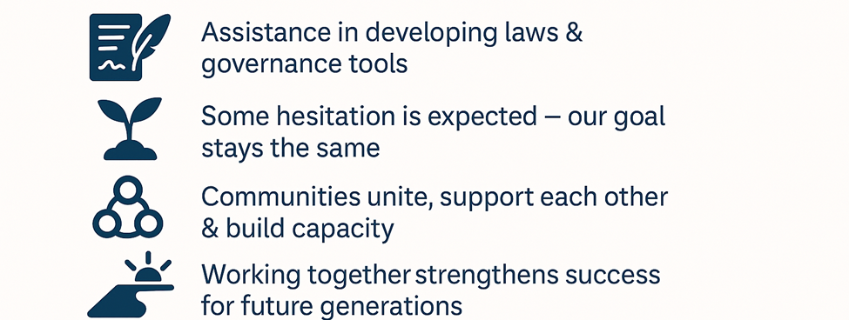
While NAN and Canada continue negotiations, the NAN Education Jurisdiction team will work with communities to prepare for the transition to the Territory Wide Education System (TWES).
Important: NAN will have no authority or control over TWES. NAN’s role is limited to supporting pre-Implementation and ratification stage.
Although some uncertainty remains, our shared goal is unchanged — to strengthen and improve the quality of education for our children.

Slide 11

Introducing the Territory Wide Education System (TWES) Framework
All levels will work together to deliver an entire education system
This Photo by Unknown Author is licensed under CC BY

Slide 12
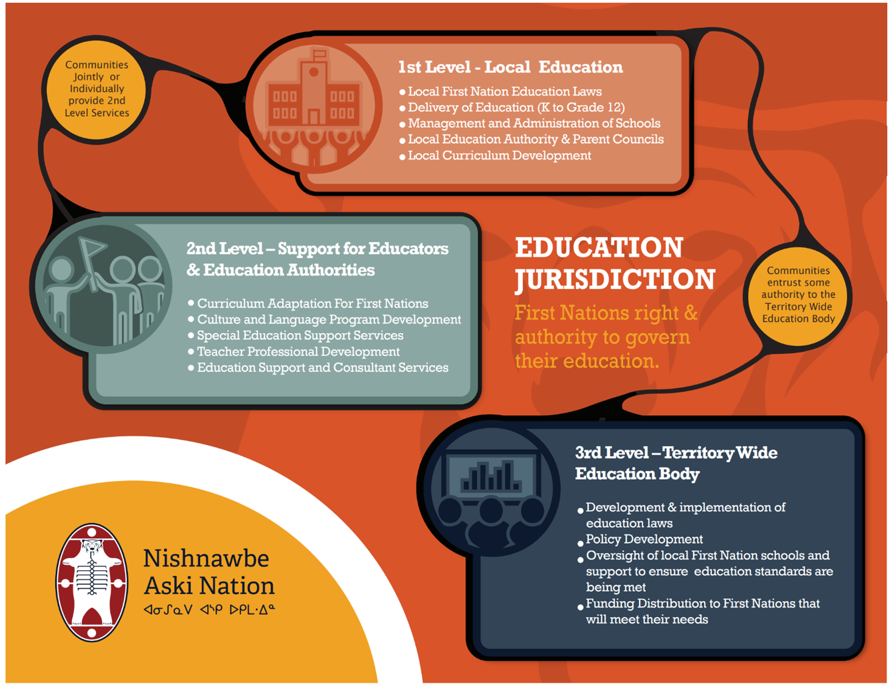
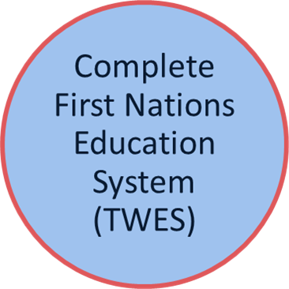

Slide 13
Do not edit
How to change the design
What concerns or challenges do you think communities may face during transition to TWES?
The Slido app must be installed on every computer you’re presenting from

Slide 14



Notes:
Examples of First Nations education systems

Slide 15
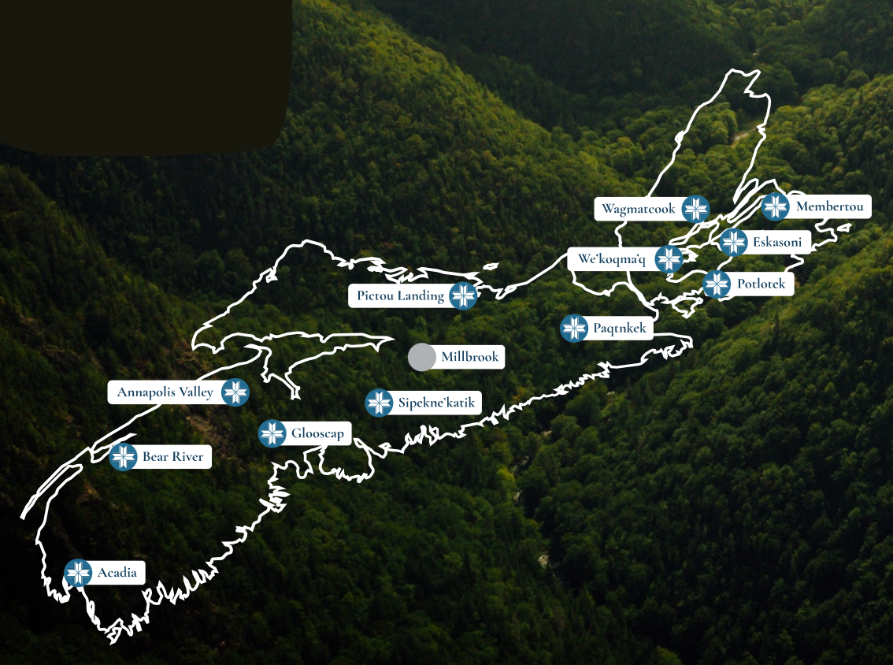
Mi’kmaw Kina’matnewey
In 1999 the Mi’kmaq Education Act was established, a federal law known as the Final Agreement.
Mi’kmaw Kina’matnewey serves 12 out of the 13 Mi'kmaq communities found within the Nova Scotian Mi'kma'ki territory
Vision is a successful holistic life-long journey rooted in Mi’kmaw language and culture.
Board of Directors are comprised of their Chiefs & appointed council members
Notes:
We would strongly recommend if you can visit Mi’kmaw – take your Board (take me) and see firsthand the amazing work they are doing for their schools.

Slide 16
Anishinabek Education System launched in 2018 is comprised of the 24 Participating First Nations (PFNs), Local Education Authorities, Regional Education Councils (RECs), and the Kinoomaadziwin Education Body (KEB).
Local Education Authorities:
Each PFN has law-making power and authority over education from JK to Grade 12 on-reserve and may set up a Local Education Authority (education board or committee) to support and manage education programs and services at the community level.
Regional Education Councils (4 RECs with 14 members):
The REC provides opportunities for networking, and for determining local and regional education priorities. The RECs are also responsible for electing and voting for candidates that will sit on the Kinoomaadziwin Education Body Board of Directors.
Kinoomaadziwin Education Body:
The KEB will take direction from and support First Nations in their delivery of education programs and services and liaise with the Province of Ontario on education matters.
Notes:
For over 20 years, the Anishinabek Nation and its communities have been building the Anishinabek Education System (AES), grounded in their inherent right to control on‑reserve education. Through the Agreement with Canada, the AES receives stable funding to operate its own education system—parallel to federal and provincial systems—and to make its own decisions about how education funding is used.

Slide 17


Founded in 1978 and the Cree Education Act 1988. The Cree School Board provides education for nine communities in the James Bay Territory. It oversees programs from preschool to adult education and vocational training.
Each community elects a representative to the regional Council of Commissioners.
  The Council of Commissioners includes nine community representatives, a regionally elected Chairperson, and 2 non-voting observers from the regional government.
  They also have subcommittees:
    Executive Committee – its functions include approval of capital projects, personnel plans, and labour relations settlements
    Governance Committee – supports the Council in its governance process
    Audit Committee – assists the Council in carrying out its monitoring responsibility
https://files.cscree.qc.ca/video/www/gov/Governance-Structure-of-CSB-web.mp4

Slide 18
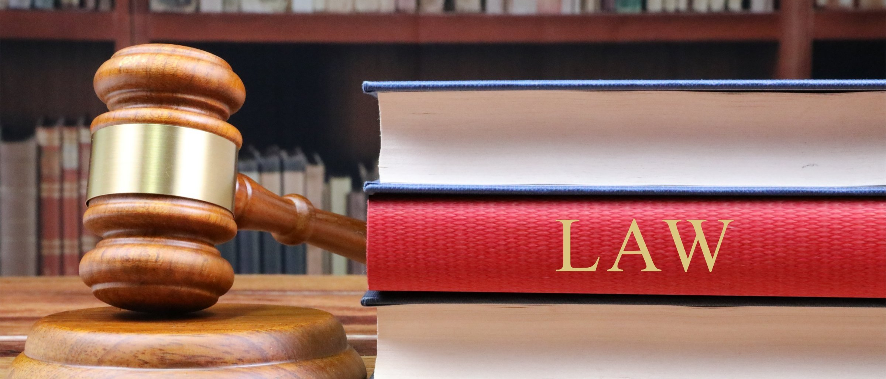
OUR PATHWAY TO LAW-MAKING
This Photo by Unknown Author is licensed under CC BY-SA

Slide 19
What is Law-Making?
A First Nation has the authority to create its own laws (codes) for how education will run in their community.
What is a Local Education Code?
A Local Education Code is your community’s law for education.
It covers:
    How teachers are hired
    What is taught
    How schools are managed
Each First Nation creates their own.
Who makes the Law?
Chief and Council approve the laws.
Community members, including youth, share ideas.
Everyone has a voice!
Notes:
We can build on Communities existing policies to develop a template for all FN’s but ensuring we still meet your FN’s specific needs

Slide 20


Law-Making Procedures
Accountability to Members
Political and Financial Accountability
Amendment Process
Delegation of Jurisdiction
Structures for Education Governance
Promotion of Language and Culture
Appeal Mechanisms
Conflict Resolution Rules
  Key Elements the Code Must Include
This will provide each First Nation with a legally binding, transparent, and culturally respectful framework for managing education, supported by clear governance, accountability, and dispute resolution processes.
This Photo by Unknown Author is licensed under CC BY-NC-ND

Slide 21
Local Education Code - Workplan
Phase 1
Readiness Intake
Collaborate with LEA’s to map current systems
Phase 5
Ratification Readiness
Phase 4
Review & Finalize
Phase 2
Engagement
Phase 3
Draft LEC V1
Establish a Working Group
Build awareness & Understanding
Develop engagement plans
Community engagement
“What we heard” Report
Code Framework Approval
Drafting the Education Code
Validation & Stress Testing
Community Review Period
Final Code Revision
Ratification Readiness Package
Final Leadership Review / Sign-off
Notes:
Snapshot on how we plan to prepare those communities who are committed through data sharing & have a CBC’s - for ratification by ensuring LEC readiness through community-led engagement.
We will work closely with CBC’s as they will be leading this work. In collaborations with Leadership + Education Directors + LEA’s
And this is where we will need your guidance in empowering the CBC’s
Lead local readiness planning
Support community engagement
Prepare for transition to Local Education Codes
Identify capacity needs (staffing, governance, data systems)

Slide 22
Do not edit
How to change the design
What is one action communities can begin now to prepare for Education Jurisdiction?
The Slido app must be installed on every computer you’re presenting from

Slide 23
Voices in Action (Law-making) Group Activity
  Dream It! – Name and draw or describe your ideal education system
  Make It Fair – Create 3-5 education system rules or laws
  Include All – Who should help make decisions?
  Ratify It! – Sign and present your “Education Code Poster”
  Wrap-Up: Review each groups posters and display posters for a mini “Education Gallery Walk”

Slide 24

Chi-Miigwetch
Together, we’re building the future of education for our Nations.
Skylene Metatawabin – Strategic Advancement Capacity Coordinator
807.625.4641 | smetatawabin@nan.ca
Nishnawbe Aski Nation
Office 807.623.8228 Fax 807.623.7730
100 Back Street Rd., Unit 200
Thunder Bay, ON P7J 1L2
www.nan.ca
?
Notes:
final thoughts:
Education Jurisdiction is not about creating more work for Education directors. It is about clarity, cultural alignment, and community voice.
Education Directors become partners in a Nation-led education system.
Education Jurisdiction is about reclaiming responsibility for our children’s future.
This work takes time, care, and strong community involvement.
Together, we are building education systems rooted in who we are.
Thank you for your time, your questions, and your leadership.

